Slide 1
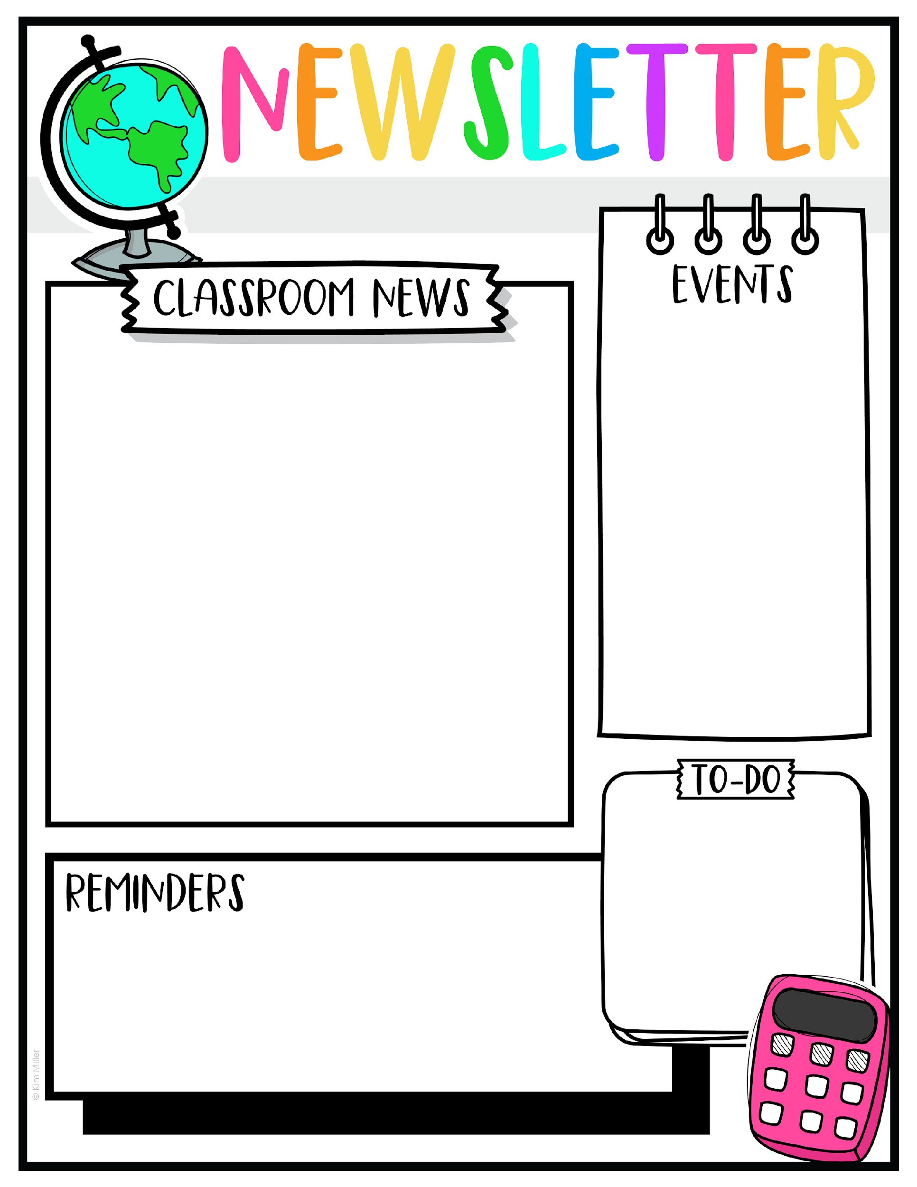
Week of September 22
Reading Comprehension test on Thursday.
Spelling Test on Friday.
Topics they will be learning this week:
Math:
Counting strategies to add and subtract
English
Read story “I Can, Too!”
Phonics: Connecting sentences to images.
Science
Plants and Light
S. Studies
passage on “How Can We Get Along With Each Other?”
Spelling Words
pin
win
hit
sit
bit
bill
hill
will
come
are
Hot lunch is Monday-Wednesday only. It is $5
They still have to bring a snack everyday, even hot lunch days. Snack and lunch are 2 different timings.

