Slide 1
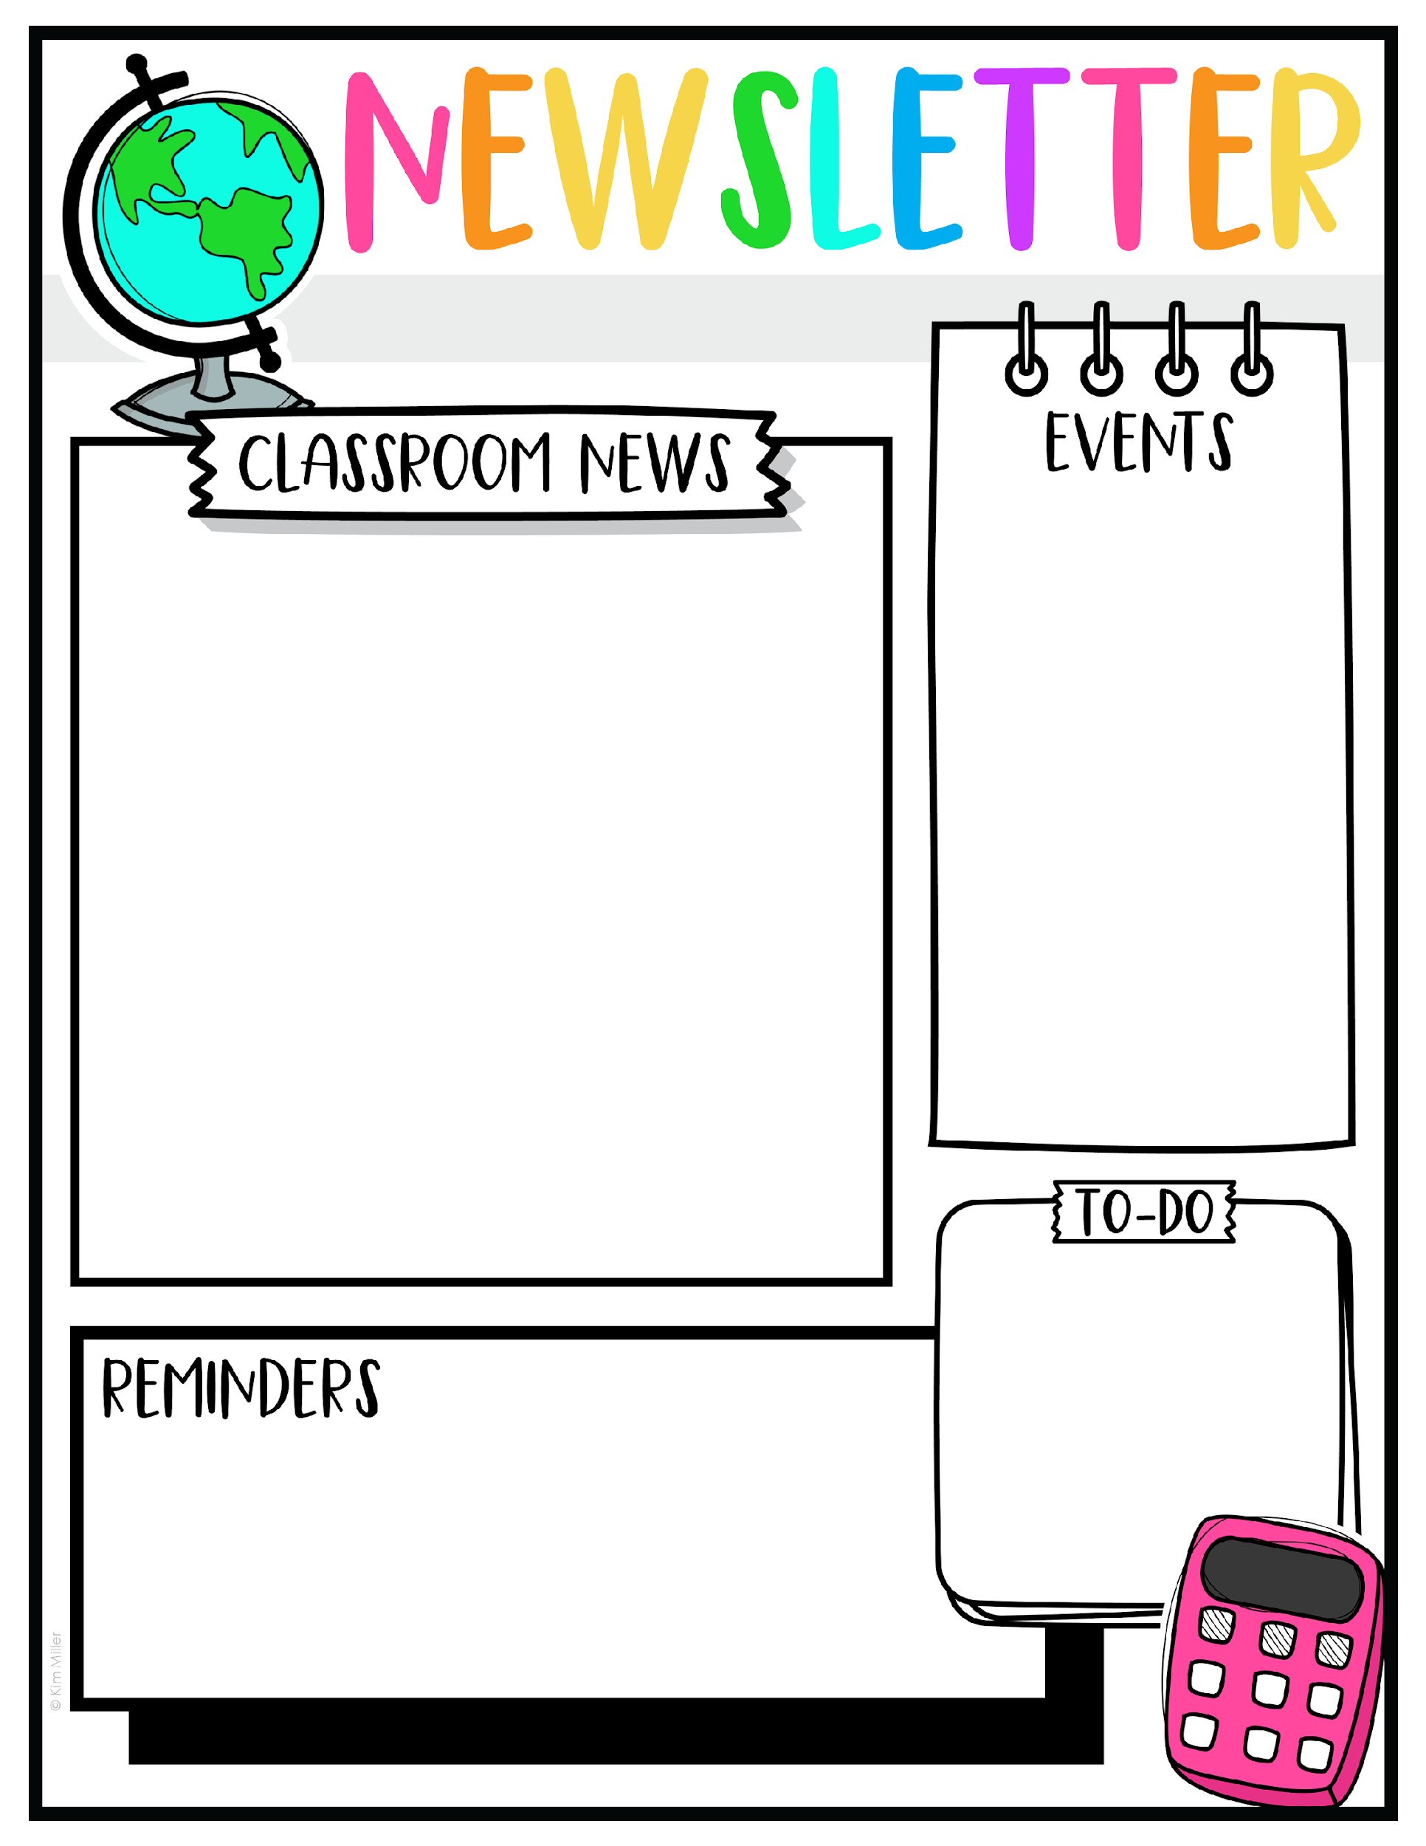
Week of October 13
No tests this week due to Quran Competition.
Spelling test on these words will be on Thrursday, October 23rd.
Reading Comprehnsion Test on How You Grew will be on Wednesday, October 22.
Topics they will be learning this week:
Math:
Addition/Subtraction Within 20
Adding questions under 10 (teen answers)
English
Reading: How You Grew
Capitalization
Science
Young Plants look like their parents
S. Studies
Why Do We Vote?
Spelling Words
Dog
log
box
fox
mom
cost
lost
rock
lock
block
No school on Monday, October 13th

