Slide 1
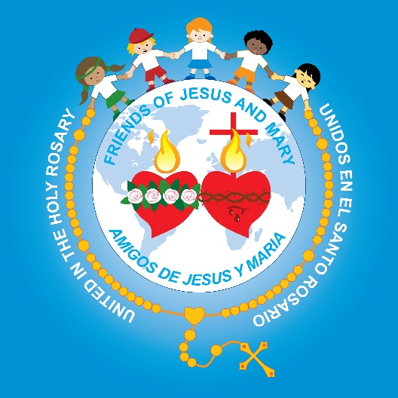
Friends of Jesus and Mary
The Sacrament of Reconciliation

Slide 2
The Birth of John the Baptist https://youtu.be/490SDWdIG3U
Luke 1: 76-79 Words of Zechariah:
And you, child, will be called prophet of the Most High,
for you will go before the Lord to prepare his ways, to give his people knowledge of salvation through the forgiveness of their sins, because of the tender mercy of our God by which the daybreak from on high will visit us to shine on those who sit in darkness and death’s shadow, to guide our feet into the path of peace.”

Slide 3
Jesus gives the Apostles the power to forgive sins. (John 20: 19-23) https://youtu.be/b2szkCm0ulY
On the evening of that first day of the week, when the doors were locked, where the disciples were, for fear of the Jews, Jesus came and stood in their midst and said to them, “Peace be with you.”
When he had said this, he showed them his hands and his side. The disciples rejoiced when they saw the Lord.
[Jesus] said to them again, “Peace be with you. As the Father has sent me, so I send you.”
And when he had said this, he breathed on them and said to them, “Receive the holy Spirit. Whose sins you forgive are forgiven them, and whose sins you retain are retained.”
THE GOSPEL OF THE LORD. PRAISE TO YOU LORD JESUS CHRIST.

Slide 4
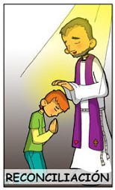
Reconciliation is a Healing Sacrament https://youtu.be/dgEhqvydsK0
Reconciliation

Slide 5


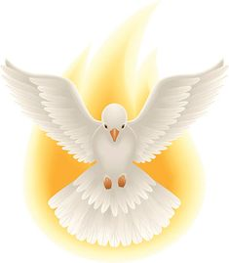

Original Sin is the sin of Adam and Eve.
God erases the stain of Original Sin, in the Sacrament of Baptism.

Slide 6
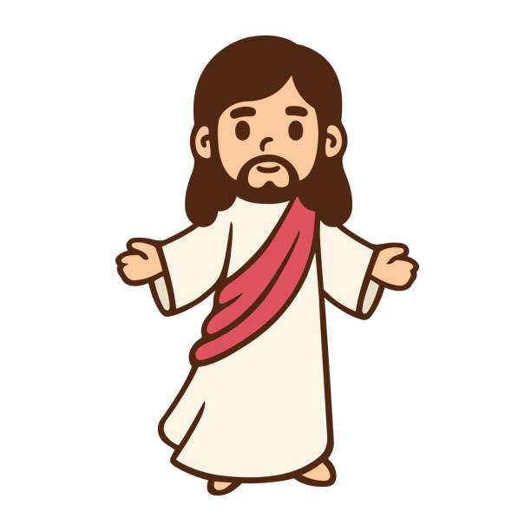
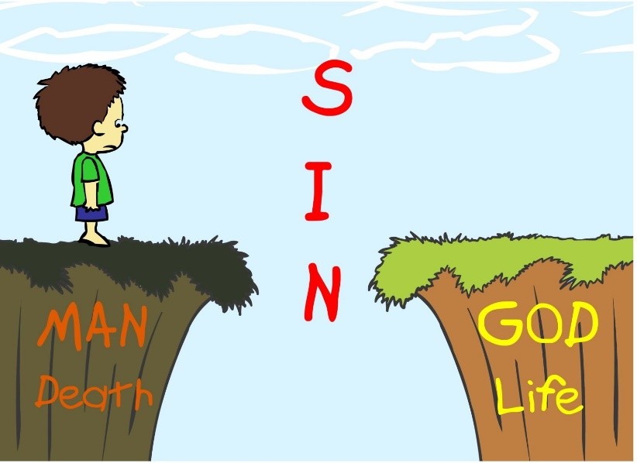
Personal Sin is the sin we choose to commit.
There are 2 kinds of Personal Sin.
When we totally reject God, we commit a Mortal Sin. We put ourselves at risk of facing God’s judgement after death.
Venial Sins are less serious, but they still hurt our relationship with God and others.

Slide 7
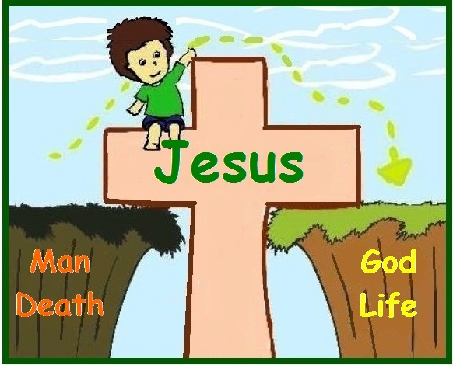
Because of Jesus’ sacrifice for us, our sins are forgiven in the Sacrament of Reconciliation.

Slide 8
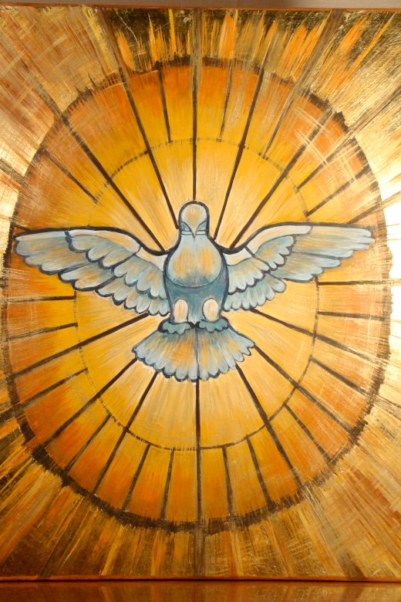
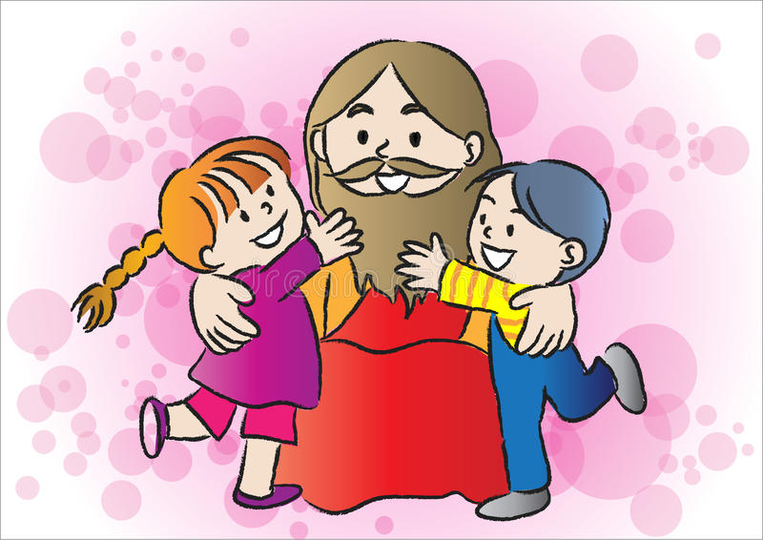
When we sin, the Holy Spirit leads us back to God. God, in his grace, wants all his children to live with him in heaven. Guided by the Holy Spirit, we confess our sins in the Sacrament of Reconciliation.

Slide 9
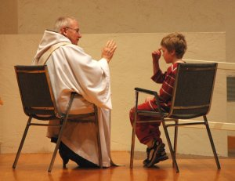
The priest gives us a penance to make up for what we have said or done, and we receive the gift of God’s forgiveness.
Then we know we are at peace with God, and so at peace with ourselves and others.

Slide 10
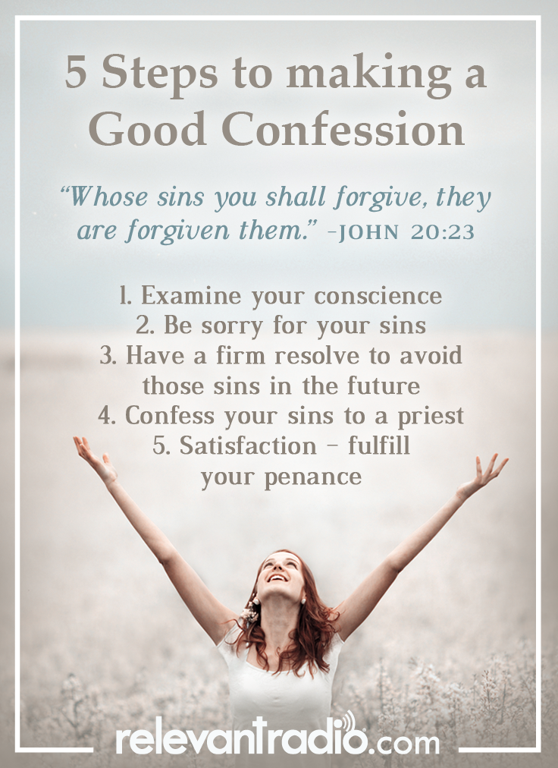

Slide 11
7 Steps of the Sacrament of Reconciliation https://youtu.be/gy0xSo1JnWs

