Slide 1


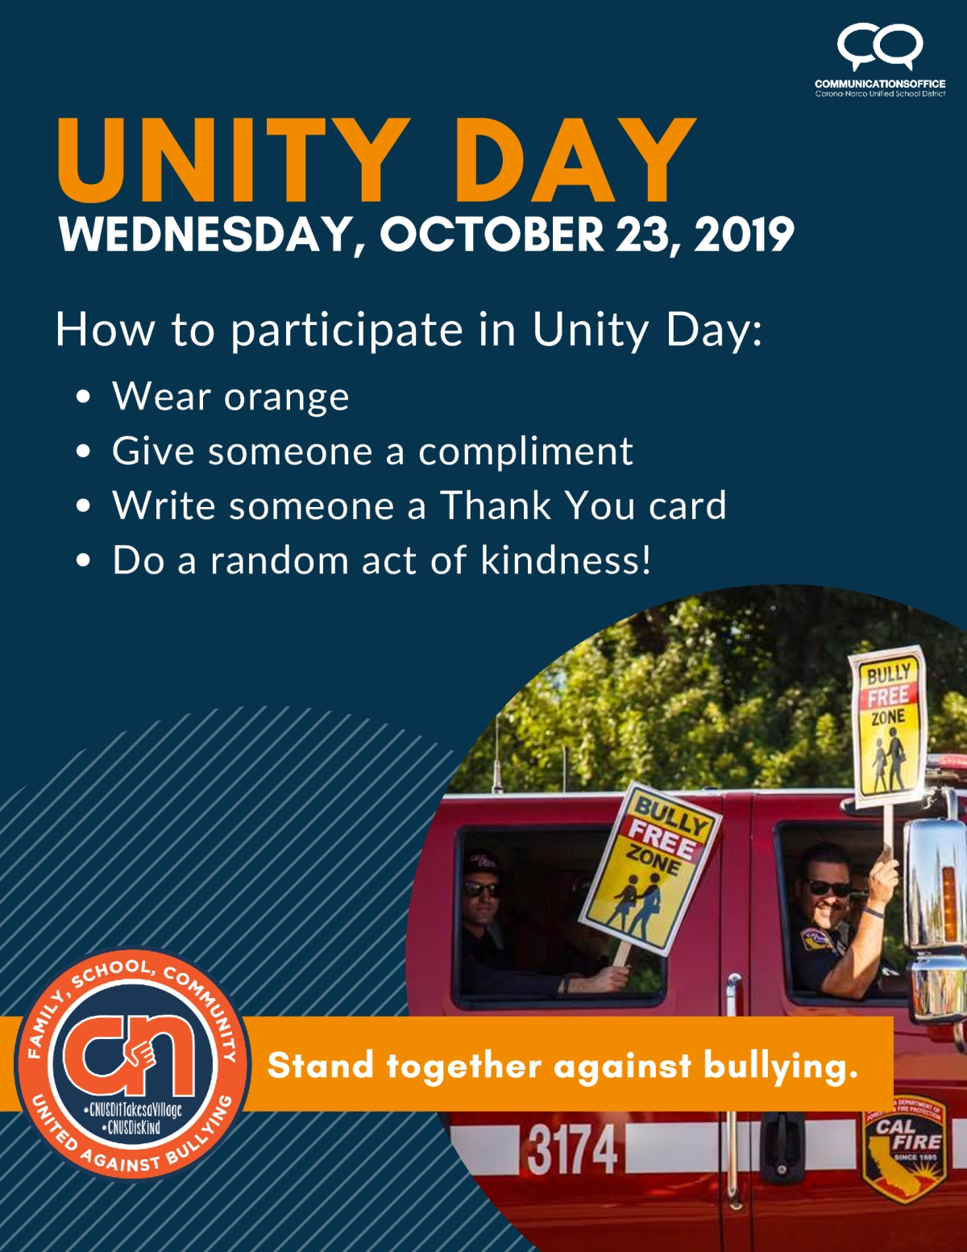

Corona/Norco Council of PTAs:
Operation Advocacy:
October 2019 Mission Brief Page 1 of 6
October 14th, 2019
Dates to Remember:
October 16^{th:}College and Career Fair, Santiago High School
October 17th: Great California Shake Out
October 23rd-Unity Day
October 23rd-31st: Red Ribbon Week, Theme: Send a Message, Stay Drug Free
October 27th: Red Ribbon Family Fun Festival
November 6th: Advocacy Think Tank, 8am-10am, Parent Center
November 12th: Reflections Entries due at Council Meeting
November 14th: National Block it Out Day (Block out negativity and bullying)
October Mission: National Bullying Prevention Month
Unity Day-October 23rd
Come together in one giant ORANGE message of hope and support, WEAR AND SHARE ORANGE to color our nation, and even the world, visibly showing that our society believes that no child should ever experience bullying.
Ask your Admin team if they would make the 11th school day of the month/of every month a “K” Day (Kindness Day).
  What does that mean at your school?
  How can you as a PTA leader help?
Classroom Poster: We Pledge to Choose Kind.
  Print these out for your teachers! Ask them to have their class sign the Pledge and post it up in their classroom.
    https://wonderthebook.com/assets/downloadables/Wonder_EduKit14_Poster_WEB.PDF
There is a Certified KIND Classroom Challenge that your teachers can participate in.
  http://choosekind.tumblr.com/certified-kind-classroom-challenge
  If possible, offer to your teachers to supply the jar and/or the marbles for the kindness challenge?
Mission: Create a Kindness Mission Statement
Mission Levels:
  Level 1- Create a Kindness/Bullying Prevention Mission Statement
  At your October Unit Board meeting, put some time on your agenda to create/determine your unit’s mission statement.
    Examples: Kindness is Contagious, Choose Kindness & Erase Meanness
    Include Mission Statement in monthly report
  Level 2-Create at least one sign with your Mission Statement AND post the sign prominently at your school.
  Take picture of PTA Board in front of sign.
    Include pictures in your monthly report
  Level 3-Include Mission Statement on all/every communication with parents, students, teachers, and staff.
    Update unit FB page with your Mission Statement
    Example: any flyers that you create for Red Ribbon Week, figure out how to include your Kindness Mission Statement

Slide 2

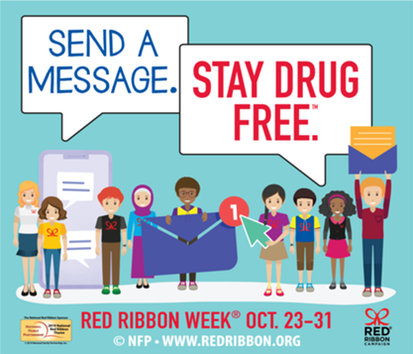

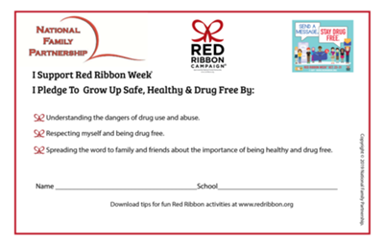
Corona/Norco Council of PTAs:
Operation Advocacy:
October 2019 Mission Brief Page 2 of 6
October 14th , 2019
From the planning guide
IT TAKES A COMMUNITY TO TEACH PREVENTION
How will you celebrate Red Ribbon Week®?
Schools
• Incorporate drug prevention curriculum throughout your week.
For ideas check out redribbon.org/curriculum
• Plan essay and poster contests about drug prevention
• Create theme days and coordinate fun and impactful prevention activities
• Decorate the interior and exterior of your school
• Decorate your homeroom door
• Invite parents and families to a special health fair or education program
• Organize a Red Ribbon Rally
• Organize a Miles of Quarters Campaign
• Screen Natural High videos www.naturalhigh.org
Red Ribbon Campaign Family and School Planning Guide
http://redribbon.org/downloads/RR_Guide_2019.pdf
The Red Ribbon Campaign® is the oldest and largest drug prevention program in the nation, reaching millions of young people during Red Ribbon Week® , October 23rd - October 31st each year.
What Is Red Ribbon Week? It is an ideal way for people and communities to unite and take a visible stand against drugs. Show your personal commitment to a drug-free lifestyle through the symbol of the Red Ribbon, October 23 - 31st.
Why? The Red Ribbon Campaign® was started when drug traffickers in Mexico City murdered DEA agent Kiki Camarena in 1985. This began the continuing tradition of displaying Red Ribbons as a symbol of intolerance towards the use of drugs. The mission of the Red Ribbon Campaign® is to present a unified and visible commitment towards the creation of a DRUG - FREE AMERICA.
Recommendation:
If you are having a family event in October, create a pledge and have your students and family members sign it!
http://redribbon.org/downloads/RR_Youth_Pledge.pdf
http://redribbon.org/downloads/RR_Adult_Pledge.pdf
(Spanish available as well http://redribbon.org/downloads/Downloadswithlinks/)
Resources from the DEA-
Drug Enforcement Agency
https://www.getsmartaboutdrugs.gov/
And the American Heart Association
https://www.heart.org/en/healthy-living/healthy-lifestyle/quit-smoking-tobacco/how-to-keep-kids-and-teens-from-smoking-and-vaping

Slide 3


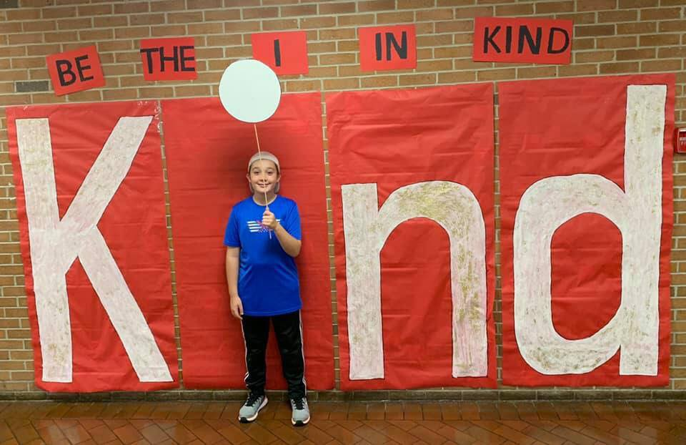




Corona/Norco Council of PTAs:
Operation Advocacy:
October 2019 Mission Brief page 3 of 6
October 14th, 2019
Life Lessons from Sesame Street:
Article on www.nbcnews.com
Yellow-haired Muppet Karli helps 'Sesame Street' tackle addiction
The newest "Sesame Street" Muppet will explain why she's in foster care: Her mom "was away for a while because she had a grown-up problem.“ Children can relate to Karli and use her as a way to open up dialogue about the drug crisis in America, 'Sesame Street' says.
https://youtu.be/GYHidecGy2U
Available in Sesame Street in Communities
https://sesamestreetincommunities.org/
Supporting a Kindness Campaign/Bullying Prevention
Share these songs/videos with your own boards, associations, families, and teachers-and ask them to share it with their students. (as appropriate)
  K-3rd: Universal Kids: Kindness is a Muscle (song)
  https://youtu.be/tP4gLX8FBDA
  3rd-8th: Random House Kids: R.J. Palacio, author of Wonder (video)
  https://youtu.be/olmM_9r-6l8
  All grades
  Life Vest Inside: Kindness Boomerang (song & video)
  Count the acts of kindness!
  https://youtu.be/nwAYpLVyeFU
  6th-9th
  Life Vest Inside: Dance for Kindness (song & video)
  https://youtu.be/s12-0E_O_V4
  Burger King: Bullying Jr.
  https://youtu.be/mnKPEsbTo9s
Books about Kindness- Are Are these in the library at your school?
  We are all Wonders by R. J. Palacio
  365 Days of Wonder by R. J. Palacio
  The Jelly Donut Difference by Maria Dismondy
  Kindness Counts by Bryan Smith
Be the I in KIND!
Create this sign for your school-tie it into your Red Ribbon Week activities and have it as a photo opp at your next family night.

Slide 4

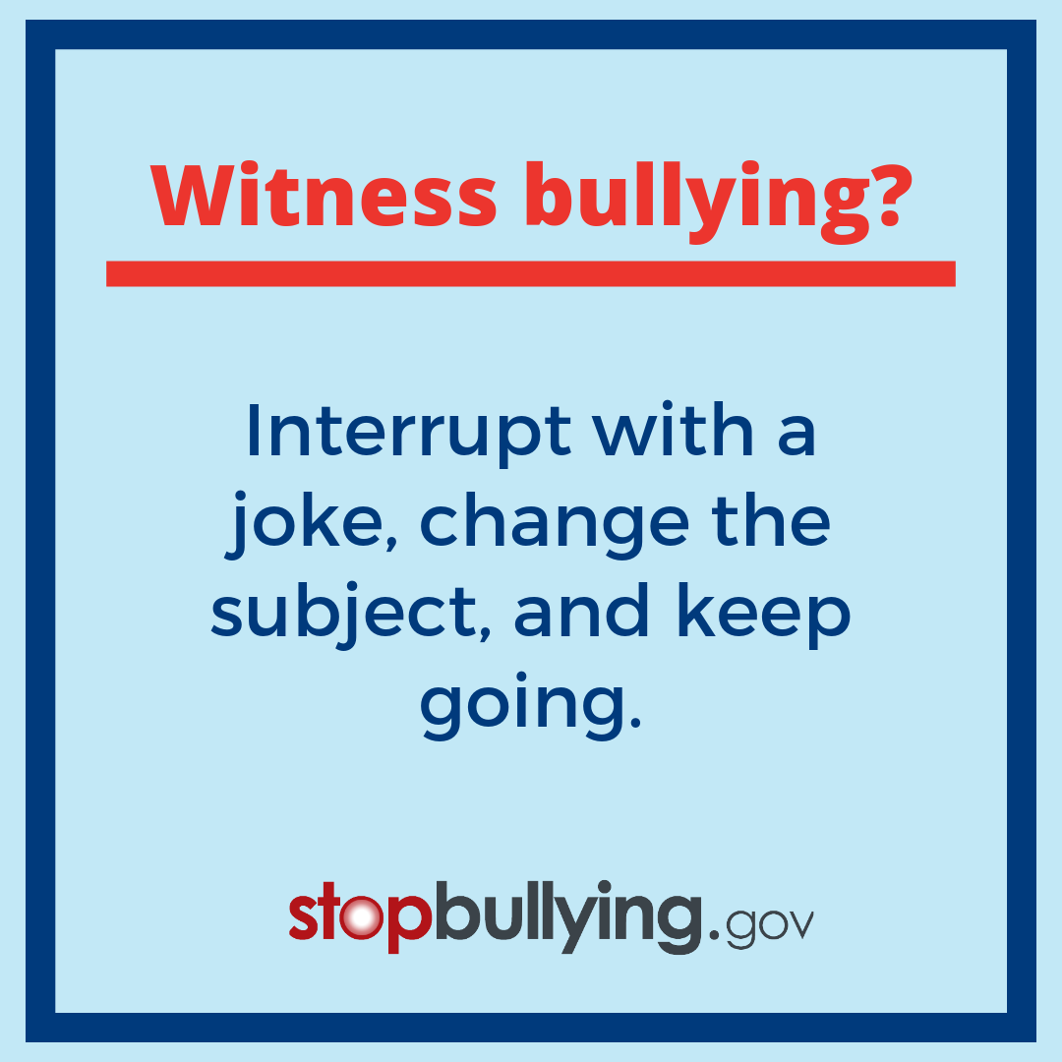

Corona/Norco Council of PTAs:
Operation Advocacy:
October 2019 Mission Brief page 4 of 6
October 14th, 2019
Supporting a Kindness Campaign/Bullying Prevention
  Additional Resources-
    share with your teachers, parents, and students-including sending out via email, remind, or posting to your FB page…
  16 Books That Model Empathy and Compassion for Young Readers
  https://www.readbrightly.com/books-that-model-empathy-compassion-young-readers/
  5 ways animals can teach kids kindness
  https://www.nationalgeographic.com/family/5-ways-kids-learn-kindness-from-animals/
  10 Ways to Make a Difference
  https://corona.macaronikid.com/articles/5d82507fa1e7b244ffee3477/10-ways-to-make-a-difference-macaroni-kid-act-of-kindness-week
  PBIS-Positive Behavioral Interventions and Supports
    Drill down deeper into something we all have heard about
  https://www.pbis.org/
  www.Stopbullying.gov
    Is an official site of the United States government with great information and ideas. Bullying defined by the CDC.
  Engaging Parents and Youth and How parents and youth can contribute
  https://www.stopbullying.gov/prevention/at-school/engage-parents/index.html#
  Also has a FREE online Bullying Prevention Training Program-
  Presidents-maybe you and your Board could take the training.

Slide 5


Corona/Norco Council of PTAs:
Operation Advocacy:
October 2019 Mission Brief page 5 of 6
October 14th, 2019
  Supporting a Kindness Campaign
    Suggestions:
    Wear Tshirts with Positive Message, Do random acts of kindness
    Ask your school librarian what books/stories are in the library on kindness.
      Could your librarian put the Kindness books on display?
    Develop campus campaign to encourage JUST ONE random act of kindness per month-
      IF EVERY STUDENT IN CNUSD DID ONE RANDOM ACT OF KINDNESS BE MONTH THAT WOULD BE OVER 54,000 ACTS OF KINDESS EACH MONTH…WHAT A WONDERFUL WORLD THAT WOULD BE.
Ongoing Mission: United Against Bullying
Share the CNUSD Bullying Prevention and Safety information with your Board, Parents, Teachers, and Association.
  https://www.cnusd.k12.ca.us/cms/One.aspx?portalId=211960&pageId=1953218
Look for the “Be a Buddy, Not a Bully” posters at your school.
Share this with your board and teachers
  PBS Org 9 Tips for Teaching Kindness in the classroom
  https://www.pbs.org/education/blog/9-tips-for-teaching-kindness-in-the-classroom?utm_campaign=school_2019&utm_content=1566866400&utm_medium=social&utm_source=facebook&fbclid=IwAR33tQdxhAKdbIjzXB0R4m54HvCZ7C67RS7S8TvlJvmTWsSLhra8t4sq45M
Ask your Principal, Assistant Principal, and School Counselor how you and the PTA can help
  Supporting Bullying Prevention
    Suggestions:
    For Elementary Schools
      Have each class create a “United Against Bullying” poster, all students and teacher sign it, to display prominently at school, take class pictures
      Host door decorating contest using “Be a Buddy, Not a Bully” theme
    For Middle and High Schools
      Have each group/club/team create a “United Against Bullying” poster, take group pictures
      Host contest for students to develop “Be a Buddy, Not a Bully” song, jingle, commercial, skit
Mission: Create a Visual Representation
Mission Levels:
  Level 1- Create a large poster of the Yellow and Blue “United Against Bullying” logo and display it prominently at your school.
    Have PTA Board members, teachers, parents, and students sign the poster-committing to being UNITED AGAINST BOULLYING
  Level 2-Create a large poster (as noted above) AND meet with your Admin team to discuss how PTA can help with Bullying Prevention on at your school.
    Include your plan in your monthly report
  Level 3-Create a large poster (as noted above) AND meet with Admin Team AND roll plan out to your PTA Board as to how PTA will be involved in the Bullying Prevention Campaign at your school.
    Include your plan in your monthly report

Slide 6

Corona/Norco Council of PTAs:
Operation Advocacy:
October 2019 Mission Brief Page 6 of 6
October 14th , 2019
From TODAY.com:
“Being kind is good for your health: How to practice kindness every day”-author A. Pawlowski is a TODAY contributing editor focusing on health news and features.
https://www.today.com/series/one-small-thing/being-kind-good-your-health-how-practice-kindness-every-day-t163335
Share with your PTA Boards and your family:
Interesting article with science and research to support being kind plus videos to illustrate and demonstrate the benefits of being kind.
Advocacy in Action:
From CAPTA…
In 2011, Governor Jerry Brown signed AB 1156 (Eng). This legislation, sponsored by California State PTA, helps protect students from bullying and harassment.
The bill requires training of school-site personnel in the prevention of bullying, and it gives victims of bullying priority for transferring out of a school, if requested.
Inaction can have dire consequences. Students who experience bullying are at increased risk for poor school adjustment, sleep difficulties, anxiety, depression, and negative health effects such as headaches and stomachaches. The depression and anxiety caused by being bullied can lead students to think about and attempt suicide, and have behavior problems and difficulty learning.
Bullying is prevalent on school campuses. According to the National Center for Educational Statistics, 2016, more than one out of every five (20.8%) students report being bullied.
Advocacy Think Tank!
This is an idea share, for brain storming, discussion, understanding, and for not reinventing the wheel.
Come to one, come to all, come for some, come for all-whatever works for you.
Meetings to be held at the CNUSD Parent Center at 152 East 6th Street.
Wednesday, November 6th, 8am-10am
Wednesday, December 4th, 8am-10am
Please RSVP to cnptaadvocacy@outlook.com
Did you know that National PTA adopted a Bullying Prevention Resolution in June 2005? Follow the link for details. https://www.pta.org/docs/default-source/files/advocacy/resolutions/bullying-r.pdf

