Slide 1
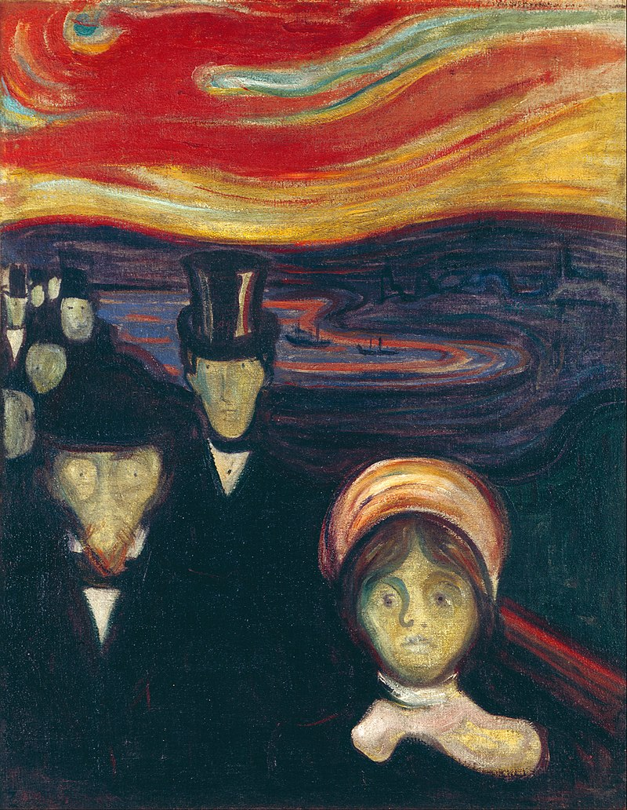
The Moderns: Men without God? _________________________ “Anxiety.” Edvard Munch, 1894. (Images/Wikimedia Commons)
"Rite of Spring“ - Stravinsky, 1913

Slide 2
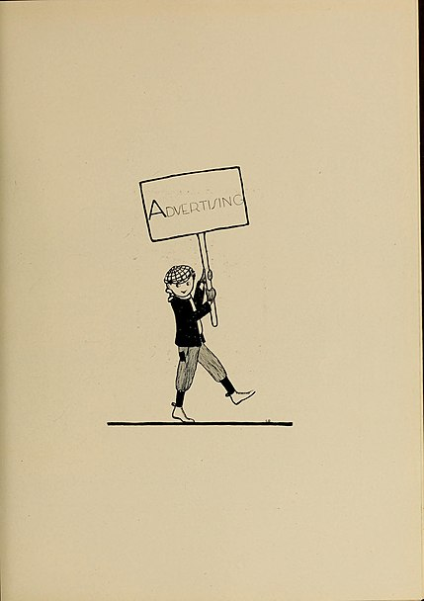
Mass Culture
Mass literacy
Mass media tech
Mass audiences
Mass genres:
Newspaper
Magazines
“Pulp fiction”
Cinema

Slide 3
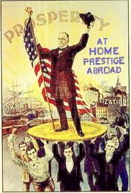
Mass Politics
Small, elite political clubs give way to mass political parties of today; mass communication attracts voters
Traditional elite doesn’t control who gets to be a politician, or how they behave

Slide 4
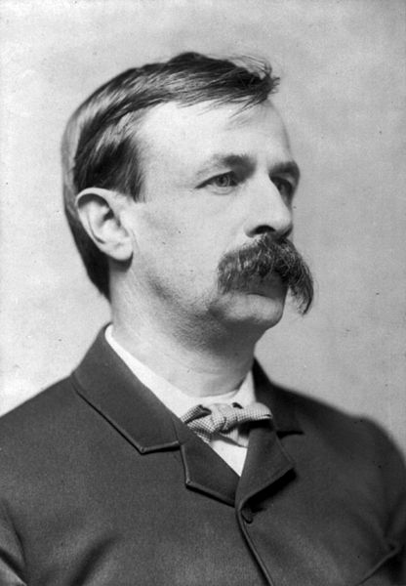
Looking Backward
Edward Bellamy (1850-1898) of Chicopee, Massachusetts writes 1887 novel Looking Backward his for entertainment.
He will die young
Tuberculosis
Premise: The world will be a socialist utopia in the year 2000
One of the greatest bestsellers in history
“Bellamy Clubs” formed nationwide to discuss ways of making his fantasy a reality
On right: Portrait (Image/Library of Congress

Slide 5
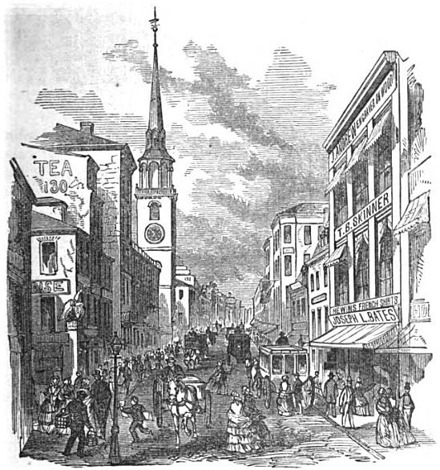
Protagonist Julian West falls asleep in Boston, 1887…
On right: Boston State House, ca. 1865. No attribution. (Image/Wikimedia Commons)

Slide 6
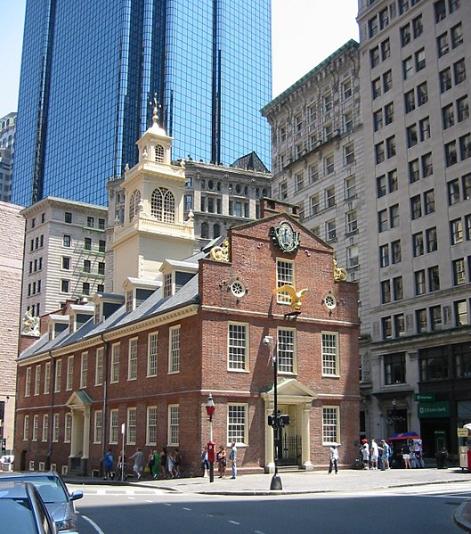
… and wakes 113 years later; tours a perfect new world, guided by a doctor
Image: Boston Old State House & New Sky Scrapers. 2008. Art Anderson.

Slide 7
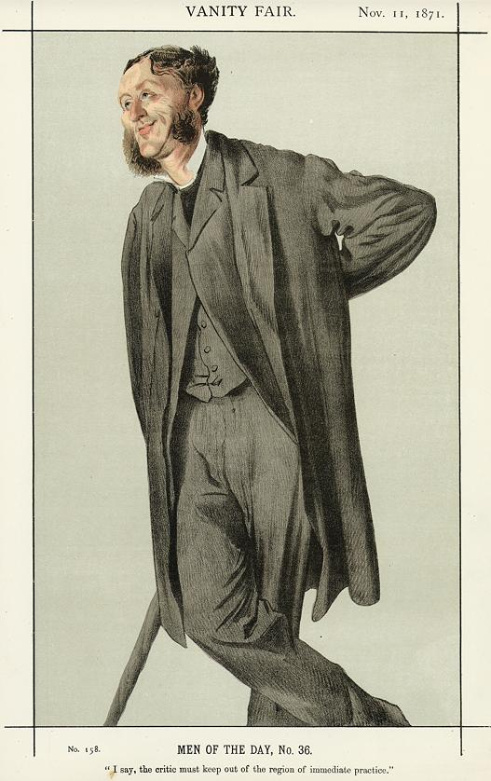
Bridging the Romantics and the Moderns
Matthew Arnold
(1822-1888)
Victorian poet, cultural critic
Half Modern, half Romantic:
“The Sea of Faith Was once, too, at the full, and round earth’s shore Lay like the folds of a bright girdle furled. But now I only hear Its melancholy, long, withdrawing roar, Retreating, to the breath Of the night-wind, down the vast edges drear And naked shingles of the world.” – Dover Beach
Notes:
Public domain photograph of Matthew Arnold
Dover Castle fromhttp://volokh.com/sasha/dover.html
Nietzsche by Edvard Munch 1906
fromhttp://www.durham21.co.uk/2010/02/god-is-dead/

Slide 8
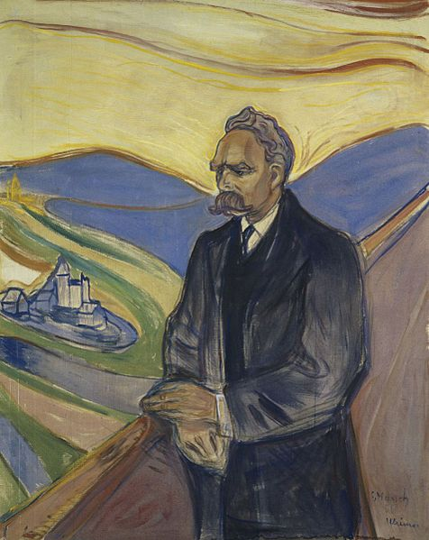
Friedrich Nietzsche
(1844-1900)
Son of a Lutheran pastor
Philologist
Develops interest in European intellectual history
Loses faith in God
Failed romance with Lou Salome, later muse of Sigmund Freud
Dies in family’s care after mental breakdown
Portrait. Munch, 1906. (Image/Wikimedia Commons)

Slide 9
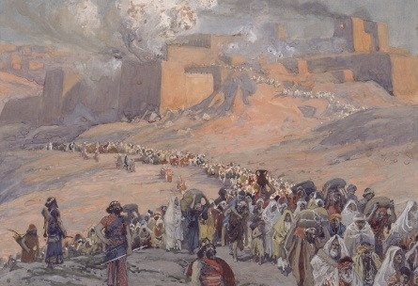
History (According to Nietzsche)
Jewish culture, a product of oppressed people, reflects their compromise, failure, weakness
Judeo-Christian values of love and humility are not really virtues, just the guilt-tripping that pathetic people use against their oppressors
“The Flight of the Prisoners.” Tissot, ca. 1896-1902.

Slide 10
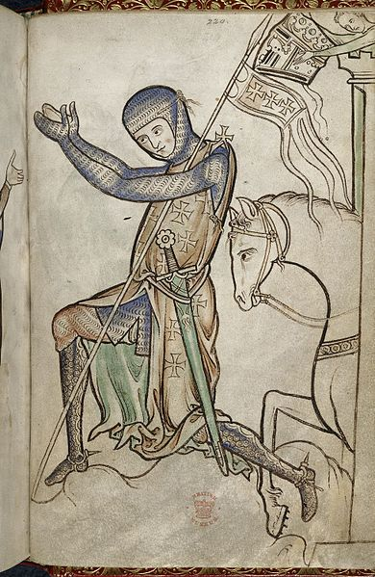
Cont’d.
Christian weakness causes the fall of Rome to Germanic barbarians
Germanic barbarians convert to the Roman religion, wrongly thinking it will help them to imitate Roman civilization
Like the Romans, they abandon their pagan nobility and pride for Judeo-Christian “peace” and “love”
Thus, Western Civilization is a massive mistake
Illumination. Westminster Psalter, 1200s.

Slide 11
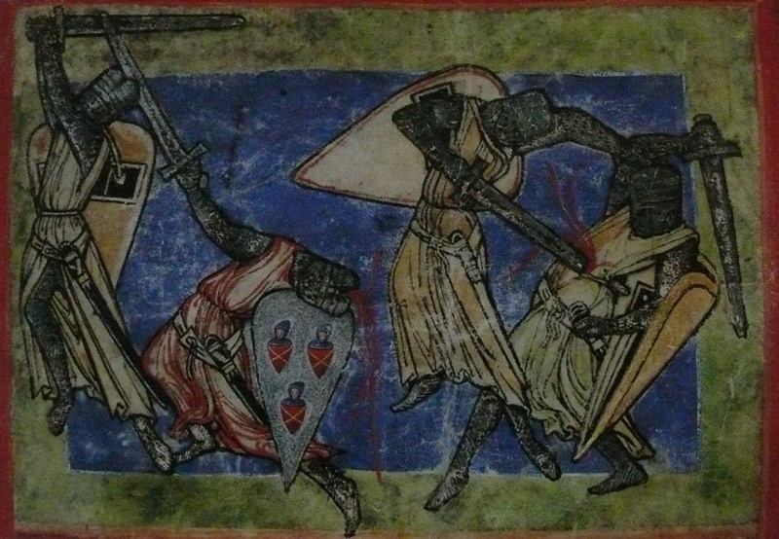
History (According to Nietzsche)
If Germanic peoples give up Christianity’s pathetic virtues coping methods, they can return to greatness and build a better civilization
Illumination: Allegory of Combat Between Virtues and
Vices. Ca. 1200. (Image/Wikimedia Commons)

Slide 12
Cont’d
Video
Nietzsche is a realist, wishes to improve the world
Hates anti-Semites; disagrees with what he views as elements of Jewish culture
Later interpreters ignore his advice that anti-Semites should “be shot”
Condemns mass culture
Encourages “life-affirmation,” which involves an honest questioning of even basic moral principles, resulting in…

Slide 13
“Death of God”
“God is dead. God remains dead. And we have killed him. How shall we comfort ourselves, the murderers of all murderers?... Is not the greatness of this deed too great for us? Must we ourselves not become gods simply to appear worthy of it?”
In light of what we have discussed, what does Nietzsche mean by this?

Slide 14
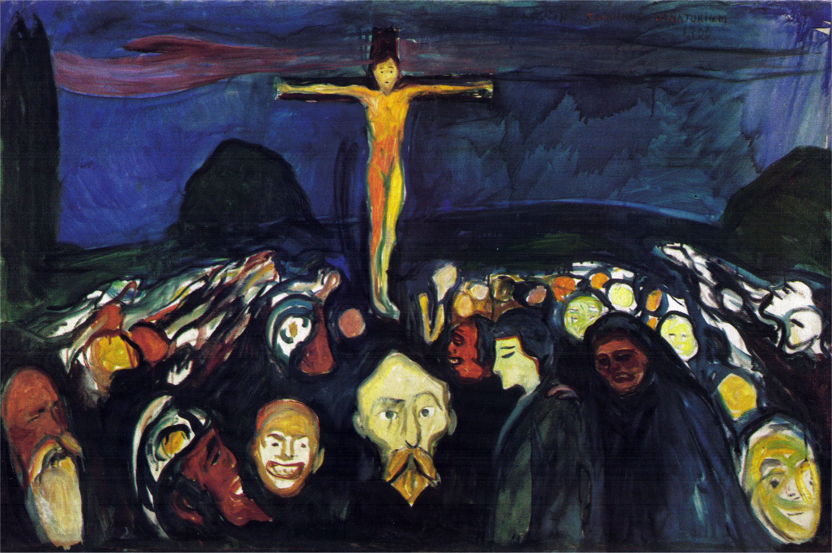
“Golgotha.” Munch, 1900.

