Slide 1
How to deal with Procrastination
By Shyam Gupta and Aarohi Rorane
Psychologist, Emotion Of Life

Slide 2
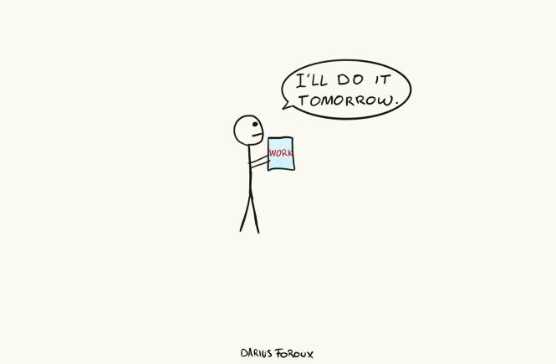

Slide 3
What is Procrastination?
The word procrastination comes from the Latin pro, which means "forward," and crastinate, which means "tomorrow.
Procrastination is often confused with laziness, but they are very different.
Procrastination is an active process – you choose to do something else instead of the task that you know you should be doing. In contrast, laziness suggests apathy, inactivity and an unwillingness to act.
Procrastination usually involves ignoring an unpleasant, but likely more important task, in favor of one that is more enjoyable or easier.
But giving in to this impulse can have serious consequences. For example, even minor episodes of procrastination can make us feel guilty or ashamed. It can lead to reduced productivity and cause us to miss out on achieving our goals.
Some researchers define procrastination as a “form of self-regulation failure characterized by the irrational delay of tasks despite potentially negative consequences.”

Slide 4
Types of procrastinators
Some researchers classify procrastination in two main types: passive and active procrastinators.
Passive procrastinators: Delay the task because they have trouble making decisions and acting on them
Active procrastinators: Delay the task purposefully because working under pressure allows them to "feel challenged and motivated"
Others define the types of procrastinators based on different behavioral styles of procrastination, including:
Perfectionist: Puts off tasks out of the fear of not being able to complete a task perfectly
Dreamer: Puts off tasks because they are not good at paying attention to detail
Defier: Doesn't believe someone should dictate their time schedule
Worrier: Puts off tasks out of fear of change or leaving the comfort of "the known"
Crisis-maker: Puts off tasks because they like working under pressure
Over-doer: Takes on too much and struggles with finding time to start and complete task

Slide 5
Procrastination can be a case of pure avoidance.
But most often, procrastination minimally involves a two-stage process. The first part involves an impulse to delay. That impulse can be triggered by a negative mood, a threat, discomfort, anticipated tedium, or some other real or imagined negative condition. The second stage almost immediately blends with the first. You reassure yourself that later is better, such as when you delay by telling yourself that you just need to warm up, and then you'll get control of the situation. Then you wait to warm up. In this two-stage process, procrastination has both an active and a passive phase. The active phase of procrastination involves engaging in avoidance activities such as napping or daydreaming instead of finishing a pressing report. The passive process involves excuse making and false justifications, such as deciding that tomorrow is a better time to start, coming up with excuses like “time just ran out”

Slide 6
Procrastination and Mental Health
In psychology, it has long been believed that people who procrastinate have a faulty sense of time—that they think they will have more time to get something done than they actually do. While that may be true for some, more recent research suggests procrastination is linked to difficulty managing distress. Specifically, it seems that task aversion is to blame—that is, when people view a task in an unpleasant manner (“It will be tough, boring, painful...”), they are more likely to put it off.
While procrastinators may be trying to avoid distress, this approach can ironically cause more distress in the long run. Procrastination can lead to increased stress, health problems, and poorer performance. Procrastinators tend to have more sleep issues and experience greater stressful regret than non-procrastinators. What’s more, procrastination can also hinder your self-esteem with the guilt, shame, or self-critical thoughts that can result from putting off tasks.

Slide 7
Depression
Procrastination can also be a result of Depression. Feelings of hopelessness, helplessness, and a lack of energy can make it difficult to start (and finish) the simplest task. Depression can also lead to self-doubt. When you can't figure out how to tackle a project or feel insecure about your abilities, you might find it easier to put it off and working on other tasks.
Obsessive-Compulsive Disorder (OCD)
Procrastination is also pretty common in people with obsessive-compulsive disorder. One reason is that OCD is often linked with maladaptive, unhealthy perfectionism, which causes fears about making new mistakes, doubts about whether you are doing something correctly, and worry over others' expectations of you.
People with OCD also often have a propensity toward indecision, causing them to procrastinate rather than make a decision.
ADHD
Many adults with attention-deficit/hyperactivity disorder (ADHD) struggle with procrastination. When you're so distracted by outside stimuli, as well as internal thoughts, it can be hard to get started on a task, especially if that task is difficult or not interesting to you.
Anxiety
Those who experience anxiety may tend to become preoccupied by fear of failure. Lack of confidence in one’s ability to complete a task can lead to procrastination in order to avoid failure in the short-term.

Slide 8
Reasons for procrastination
The main psychological mechanism behind our procrastination is as follows:
When we need to get something done, we rely primarily on our self-control in order to bring ourself to do it.
Our self-control often receives support from our motivation, which helps us get things done in a timely manner.
In some cases, we experience certain demotivating factors, such as anxiety or fear of failure, which have an opposite effect than our motivation.
In addition, we sometimes experience certain hindering factors, such as exhaustion or rewards that are far in the future, which interfere with our self-control and motivation.
When demotivating and hindering factors outweigh our self-control and motivation, we end up procrastinating, either indefinitely, or until we reach a point in time when the balance between them shifts in our favor.

Slide 9
When it comes to specific reasons why people procrastinate, in terms of demotivating and hindering factors, the following are among the most common:
Abstract goals. ( If not a SMART) specific, measurable, attainable, relevant, time bound,
Feeling overwhelmed.
Anxiety.
Task aversion.
Perfectionism.
Fear of evaluation or negative feedback.
Fear of failure.
Lack of motivation.
Lack of energy.
Sensation seeking.

Slide 10
How to manage procrastination?
Accepting and Recognizing that you procrastinate:
You might be putting off a task because you've had to re-prioritize your workload. If you're briefly delaying an important task for a genuinely good reason, then you aren't necessarily procrastinating. However, if you start to put things off indefinitely, or switch focus because you want to avoid doing something, then you probably are.
You may also be procrastinating if you:
Fill your day with low-priority tasks.
Leave an item on your To-Do list for a long time, even though it's important.
Read emails several times over without making a decision on what to do with them.
Start a high-priority task and then go off to make a coffee.
Fill your time with unimportant tasks that other people ask you to do, instead of getting on with the important tasks already on your list.
Wait to be in "right mood," or wait for the "right time" to tackle a task

Slide 11
Understand the “WHY” behind your procrastination
Most of time we procrastinate because we find a task boring, unpleasant or just too overwhelming, to tackle procrastination it is important that you understand why and when do you procrastinate? Is it nature of the task? Do you think you lack the skills or time to complete to task? Do you fear criticism or think that you’ll be scrutinized and wrongfully judged/evaluated for the task? Such questions for self-reflection can help you understand why do you exactly procrastinate. Maintaining a thought log can help you identify your triggers.
Adopt anti-procrastination strategies
Forgive yourself for procrastinating in the past, often we end up beating ourselves up for procrastinating in the future which may lead us to believe we may never fall out of that pattern. Self-forgiveness is important to build a positive attitude about yourself and it might motivate you to stop procrastinating in future
Promise yourself a reward if you complete a difficult task on time, reward yourself with a treat, such as a slice of cake or a coffee from your favorite coffee shop. And make sure you notice how good it feels to finish things, this can act as a driving force for you to get things done!
Ask someone to check up on you Peer pressure works, This is the principle behind self-help groups. You can also partner up with someone and give tasks to one another for the day. Check up on each other at the end of the day.
Rephrase your inner dialogue the phrases "need to" and "have to," for example, imply that you have no choice in what you do. This can make you feel disempowered and might even result in self-sabotage. However, saying, "I choose to," implies that you own a project, and can make you feel more in control of your workload.
Minimize Distractions and Tidy up turn off your email and social media, and avoid sitting anywhere near a television while you work! Clean and organize your work space to make it more approachable for yousrself.

Slide 12
Making a to-do list:
It is an important aspect when it comes to tackling procrastination. Making a to-do list helps us realize the tasks that we have to get done, however how we make our to do list is also important
Break-down your tasks, using the CBT technique and creating SMART goals can aid in making an efficient to-do list. Remember to have specific, measurable, attainable, realistic/relevant and time based goals. For e.g. your end goal can be “I want to get A grade on my Psychology test on the topic of Intelligence” for that smart goals can be, studying every-day for at least 45 mins. Dividing your syllabus in such a way that you cover at least 10 pages of a chapter everyday. Test yourself by taking mock tests or asking someone else to prepare a quiz for you. Narrowing down a big task into small-relevant tasks can help you achieve your goal and it might not feel that overwhelming. Once you’ve done this you can prioritize the tasks from most to least important and get to work!
Drop the perfectionism.
Perfectionism is an all-or-nothing mentality: Something is either perfect, or it is a failure. People with perfectionistic tendencies tend to wait until things are perfect in order to proceed—so, if it's not perfect, you cannot be finished. Or if it is not the perfect time, you believe you can't start. This all-or-nothing mentality can hold you back from starting or completing tasks.
Instead, focus on being better than perfect. This means to still strive for excellence, creating excellence, or setting yourself up with excellent conditions, but at the same time, you focus on getting the job done.
#DoneIsBetterThanPerfect

Slide 13
Avoidance hierarchy
Avoidance Hierarchy is a CBT worksheet introducing a fear hierarchy or an avoidance hierarchy. Using this worksheet the client can be guided into developing a hierarchy of feared situations ranging from most-feared at the top to least-feared at the bottom. The client is encouraged to give anticipated fear, anxiety, or distress ratings for each item – according to how distressing they feel it would be to encounter that situation. The order of items can be changed to reflect these anticipated fear ratings until a final hierarchy has been constructed. Once completed the avoidance hierarchy can be used to guide a process of graded exposure. Clients can be guided to start by exposing themselves to the least-feared items, building up as more confidence is gained.

Slide 14
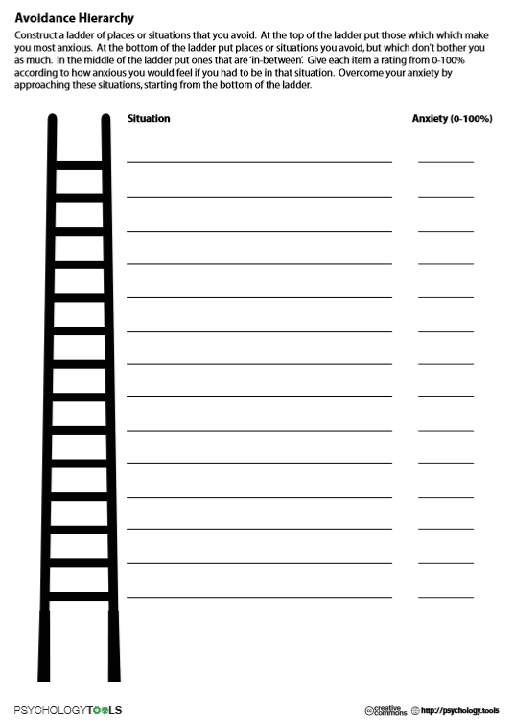

Slide 15
Time management
You can use various time-management techniques in order to make it easier for yourself to get started on your work and to remain focused once you’ve started
For example, you can use the Pomodoro Technique, which is a time-management technique where you use a timer in order to organize your workflow. The Pomodoro Technique entails working on your tasks for a set amount of time (e.g. 25 minutes), and then taking a short break (e.g. 5 minutes), before starting to work again. In addition, as part of the Pomodoro, once you complete a certain number of work cycles (e.g. 4 cycles), you can take a longer break (e.g. 30 minutes), before getting back to work.
You can modify the amount of time according to way that best suits your needs.
Procrastinate consistently, yes you heard it right!
Rather than a character flaw or lack of discipline, one way to look at procrastination is a natural desire for curiosity and variety in our work.
If you can make time on a regular basis to cultivate your many different interests and curiosities in small ways, you’ll be less likely to feel the need to indulge them in big ways via procrastination on a major task.
To do this, allow yourself to procrastinate regularly, but do it intentionally. If you have 3 hours of studying to do today, set up 10 minutes at the end of each hour to indulge your procrastination guilt-free.
Do any task for 10 minutes it is called that Zierganick effect, once you start something your brain is likely to be alert till you finish the task. So once you’ve started the task it is more likely you will continue to do it even after 10 minutes are over

Slide 16
Establish a Routine:
Establishing a consistent daily/weekly/monthly routine can be helpful in getting you to avoid procrastinating.
For example, you can set up a routine of doing creative work early in the morning before checking emails or social media, which is a good way to ensure that you start your day being productive, and by completing your most important tasks while you still have a clear head.
Increase your energy levels:
Increasing your energy levels is one of the best ways to get out of slumps and get yourself to stop procrastinating, since being tired can make you more likely to procrastinate.
Specifically, the following are some of the main things that you can do in order to increase your energy levels:
Get enough sleep. In general, you’re more likely to procrastinate if you’re not getting enough sleep. Simply making sure that you sleep enough will therefore help you be more productive, and will lead to various other improvements in your life, in terms of your physical health, mental health, and general wellbeing.
Eat something (moderately) healthy. If you’re hungry, eat something that will give you some energy. Avoid junk food or snacks that will spike your energy for a short while and then cause you to feel tired.
Take a break and go outside. If you’re stuck inside all day and feel that the walls are closing in on you, take a short break and go outside to breathe some fresh air and clear your head.
Get some exercise. If you haven’t done anything physical in a while, try to get your body moving a bit. You don’t have to do anything major, and even a short walk, a few pushups, or a bit of stretching can help you feel better.
Listen to music. Listening to certain types of music that you like can sometimes give you an energizing motivational boost while you work.

Slide 17
Add a delay before indulging your impulses
One way to help yourself resist the desire to engage in impulsive behaviors such as procrastination is to add a brief delay before you indulge yourself.
For example, if you want to check your phone for notifications or check a website for new posts, you should make yourself count to 10 first. Then, if the urge to engage in that procrastinatory behavior is still there, you can follow through on it. However, if the urge to do it disappears, which it often will while you count, you can choose to get back to work instead.
Use Your Natural Patterns to Your Advantage
If you are more alert in the mornings, schedule more difficult tasks in the mornings. Do you feel more desire to interact with people after lunch? Schedule lunch meetings or phone calls then. Is there a time of day you prefer to be quiet and withdraw into yourself? That may be a good time for organizing your desk or filing system. Chances are if you don’t like doing a particular task at a certain time, you are more likely to put it off.
Work with a therapist or counselor
If there’s a chance a mood issue or mental health concern could be contributing to chronic procrastination, working with a mental health professional could be a key step to overcoming procrastination When procrastination is a symptom of a psychiatric condition, medication and therapy to address the underlying condition can help reduce a person’s tendency to procrastinate.
If procrastination occurs so frequently that it negatively interferes with daily functioning, therapy can help a person identify why and when they procrastinate, replace self-defeating thoughts with more productive thoughts, and learn new behavioral strategies to cope with stress.

Slide 18
Believe in yourself, appreciate your small wins, be consistent and start small.
Procrastinate tomorrow!

Slide 19
Thank you ☺
Questions are welcome
Contact us on:
www.emotionoflife.in
info@emotionoflife
7678694626

