Slide 1
Turning negativity to positivity
Made by :Trannum Gupta
Under the guidance of
Mr. Shyam Gupta

Slide 2
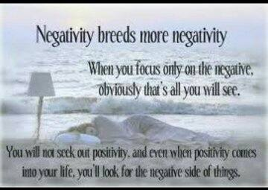
Meaning of negativity
Negativity is the tendency to be downbeat, disagreeable and skeptical. It is a pessimistic attitude that always expects the worst.

Slide 3
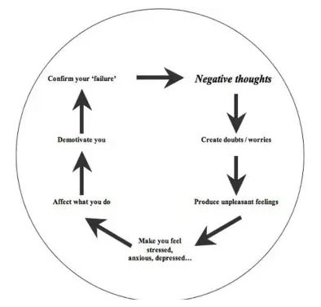
Cycle of negative thinking

Slide 4
Causes of negativity
Negativity is often a product of depression or insecurity.
It can stem from :
  illness, life events, personality problems, and substance abuse..
Frequent criticism, cynical thoughts, and denial can create neural pathways in the brain that encourage sadness

Slide 5
Types of Negativity
1) Cynicism: A general distrust of people and their motives.
2) Hostility: Unfriendliness towards others; unwilling to develop relationships.
3) Filtering: Only noticing the bad in what should be a happy experience or memory.
4) Polarized Thinking: The belief that if something or someone is not perfect, then they must be horrible.

Slide 6
Types of Negativity (2)
5) Jumping to Conclusions: Assuming something bad will happen because of circumstances in the present.
6) Catastrophizing: The belief that disaster is inevitable.
7) Blaming: Blaming others for personal maladies, and feeling that you are a victim to life’s uncontrollable events.

Slide 7
Types of Negativity (3)
8) Emotional Reasoning: Using your emotions to define what is real and what is not.
9) Fallacy of Change: The thinking that if people or circumstances change, you can then be happy.
10) Heaven’s Reward Fallacy: Type of negativity that assumes there will always be a reward for hard work and sacrifice. When the reward does not come, you become bitter and depressed.

Slide 8
Effects of Negativity
Negative thoughts and emotions are a natural response to disaster and heartache. But extended bouts of negativity can result in serious health problems. Negativity sends our body into stress, or ‘fight-or-flight’ mode.
  Our bodies are designed to deal with stressful situations by releasing cortisol into the bloodstream, making you more alert and focused. Though some stress is good for us, too much can be detrimental to your health.

Slide 9
Effects of Negativity (2)
Extended periods of negativity slows digestion, and decreases the immune system’s ability to fight inflammation. This is also why negative people are more likely to get more sick than optimists.
Some of the common effects of negativity include:
  Headache
  Chest pain
  Fatigue
  Drastic changes in metabolism (i.e. overeating or under-eating)
  Hurts mental health leading to smoking or substance abuse as a way of coping.
Upset stomach
Sleep problems
Anxiety
Depression
Social withdrawal

Slide 10
Meaning of positivity
Positivity means thinking in an optimistic way, looking for solutions, expecting good results and success, and focusing and making life happier. It is a happy and worry-free state of mind, which looks at the bright side of life.
The emotions associated with positivity are joy, love and inspiration.
The thoughts associated with positivity are thoughts of courage, self-esteem certainty, and success.

Slide 11
Positivity means a positive frame of mind.
With this frame of mind, you do not take things too personally.
You enjoy the present moment.
You do not worry about the future.
You focus on doing and achieving, not on thinking about the past and about difficulties.
It means a state of being a happy, tolerant and good-natured.

Slide 12
What it is not ?
Being positive does not mean ignoring difficulties and bad experiences. It means acknowledging them, learning from them, doing better, and using the knowledge gained to improve.
With this state of mind, though you might experience negative emotions and go through unpleasant experiences, you will not lose your spirit or give up.
It is important that you strive to experience more positive than negative thoughts and emotions. The ratio should be in favor of positivity, not negativity.

Slide 13
Effects of Positivity
Positive emotions broaden your sense of possibility and open your mind up to more options.
Positive thoughts provide an enhanced ability to build skills and develop resources for use later in life.
Barbara Fredrickson refers to this as the “broaden and build” theory because positive emotions broaden your sense of possibilities and open your mind, which in turn allows you to build new skills and resources that can provide value in other areas of your life.

Slide 14
Achieving Positivity
1. Be Mindful
  Observe your thoughts: Try not to label them as "good" or "bad" or get too invested. Watch them pass like traffic in your mind. Don't try to stop them or intervene.
  Do one thing at a time: When you’re eating, for example, just eat. Don't watch TV or listen to music or work on your computer. Focus on the tastes and textures of the food in your mouth.
  Do nothing: Every day, set aside 5-10 minutes to sit with yourself and just do nothing. No phone, no book, no TV, no music. Only you and your thoughts.

Slide 15
Achieving Positivity (2)
2. Practice Gratitude
  Practicing gratitude is surprisingly simple. Find a time of day that suits you (the last thing at night works best) and write down three things for which you are grateful.
  You may choose something as small as a hot shower or the coffee you drank on your way to work, or as general as support from your friends and family. If you’re unable to get out of bed due to mental or physical illness, be thankful that you have a soft pillow and a comforting space to rest and recover.

Slide 16
Achieving Positivity (3)
3. Journal
  During challenging times , starting a positivity journal could help achieve a happier mindset. Keep gratitude lists here, jot down inspiring quotes and collect images that make you feel good.
  Having a bad day ?
    Just look back at your positivity journal and know that there are things in life to feel good about.

Slide 17
“Celebrate the positives and learn from the negatives”

Slide 18
Turning Negative Thoughts
into Positive Thoughts
1. Accept that life doesn’t always go as planned
  Some people struggle when things don’t go their way and prefer for the entire world to be in balance. If not careful, one negative issue can snowball into a personal crisis.
  Staying aware of their surroundings and staying focused on the big picture can help avoid the negative spiraling.

Slide 19
Continued…
  Others who tend to be very set in their ways may also find it difficult to deal with roadblocks as it doesn’t allow them a lot of flexibility for change, so when change is forced upon them, they tend to resist.
  The key to overcome this is to be open to new and unexpected things, and to attempt to roll with the changes.

Slide 20
Continued…
2. Change your perspective
Life is all about our perception of the things we encounter each and every day.
If your inner voices keep sending negative messages, it’s time to change the channel.
Surround yourself with positive people, read a self-help book or try meditation to calm the negative in your mind. Look for the good in every situation.

Slide 21
Continued ….
3. Learn from your failures
Absolutely everything we experience can fall into one of two categories: a positive or negative experience. If we can train ourselves to enjoy and celebrate the positive things while we learn from the negatives, we put ourselves in a much better position to succeed.
Each time you have a roadblock, think about the knowledge and insight you have gained about a person situation or experience.

Slide 22
Bonus tips
Learn to recognize what is REAL. See both the good and the bad in the world. The more you become a realistic optimist, the more you will be able to focus your energy on the positive.
Live in the moment. Focus on the task at hand, and avoid thinking of past mistakes or future fears. If a negative thought enters your head, respond with at least three positive affirmations immediately. Positive thinkers can control their mind and are aware of which thoughts enter their head.
Be positive. If being positive is a habit, then you need to practice optimism everyday! Participate in activities that cultivate happy thoughts–like hobbies, spending time with loved ones, and meditation. Engage in uplifting media and conversations.

Slide 23
Bonus tips
Turn your negativity into action. Experiencing negative emotions and thoughts is inevitable, but positive thinkers know how to turn those negative statements into action.
For example, a positive thinker may look in the mirror and see that she has gained a bit of weight over the holiday season. Instead of dwelling on her appearance, she uses it as motivation to live a healthier lifestyle.
Spend time with uplifting people. Negativity is contagious. Spend time talking with those who care about you and leave you feeling enlightened and content. Humans are social creatures, and developing a healthy network of family and friends can help you to see the glass half-full.

Slide 24
Thank You

