Slide 1

Behavioural Activation Therapy
Made by :Trannum Gupta
Under the guidance and support of
Mr . Shyam Gupta
(Psychotherapist with TickTalkTo App)

Slide 2
All of this activity has positive feedback effects:
  Doing things we enjoy gives us feelings of pleasure
  Challenging ourselves means that we have a chance to grow and develop, and gives us a sense of mastery
  Having positive relationships with other people makes us feel connected and valued

Slide 3
The relationship between what we do and how we feel
Psychologists have found that there is a close relationship between our activity and our mood. When we are feeling good we spend time with people whose company we enjoy, do activities that make us feel good, and take on new tasks and adventures that challenge us as individuals.

Slide 4
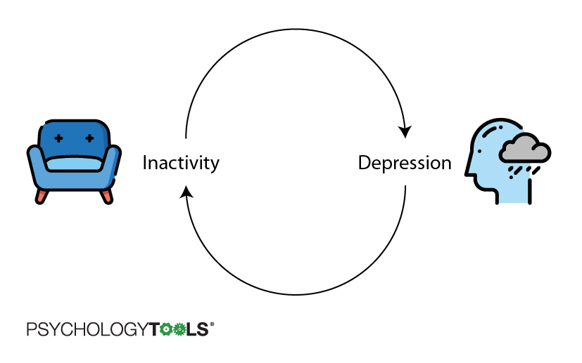
The reverse is true too!!
People who are depressed tend to do less overall and so they have fewer opportunities to feel pleasure, mastery, and connection – the things we need to feel good .It is easy to fall into a trap:
Behavioral Activation (BA) is one way out of this vicious cycle. It is a practical and evidence-based treatment for depression.

Slide 5
What is Behavioral Activation?
Behavioral activation (BA) is one functional analytic psychotherapy which are based on psychological model of behavior change, generally referred to as applied behavior analysis. This area is also a part of what is called Clinical behavior analysis (CBA) .

Slide 6
Behavioural Activation aims at :
increase engagement in adaptive activities (which often are those associated with the experience of pleasure or mastery),
decrease engagement in activities that maintain depression or increase risk for depression, and
solve problems that limit access to reward or that maintain or increase aversive control”

Slide 7
Theory and rationale of behavioral activation
Behavioral activation is a development of activity scheduling, which is a component of cognitive therapy.
It has two primary focuses:
  the use of avoided activities as a guide for activity scheduling and
  functional analysis of cognitive processes that involve avoidance
Behavioural activation is grounded in learning theory and contextual functionalism.
The focus is on the whole event and variables that may influence the occurrence of unhelpful responses – both overt behaviour and cognitive processes.

Slide 8
What it is not ?
It is not about scheduling pleasant or satisfying events (as in the first stage of cognitive therapy).
It does not focus on an internal cause of depression such as thoughts, inner conflicts or serotonergic dysfunction.

Slide 9
It involves following steps:
Assessment and Formulation : Learning about the vicious cycle of inactivity > depression > inactivity and understanding that we need to activate ourselves to feel better again
Monitoring our daily activities to understand the relationships between our activity and our mood
Identifying our values and goals (working out what really matters to us)

Slide 10
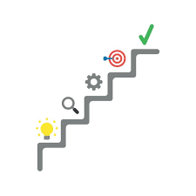
Continued…
Simple activation (scheduling and carrying out meaningful activities to boost our experiences of pleasure and mastery)
Problem-solving any barriers to activation

Slide 11
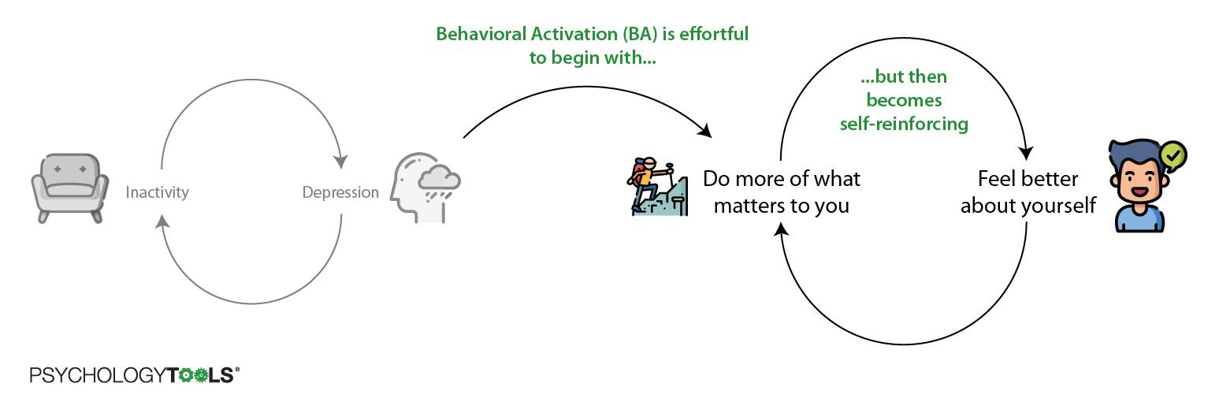
This guide will walk you through all of the essential steps to get you started with behavioral activation.

Slide 12
Assessment and formulation
Assessment : In each session, the therapist tries to determine what contextual factors are involved in the way the individual is thinking and feeling and how that person responds to whatever factors seem to be maintaining their depressed mood.
Formulation : The key issue in the formulation is determining the nature of the avoidance and escape, and using this to guide the planning of alternative ‘approaching’ behaviours.

Slide 13
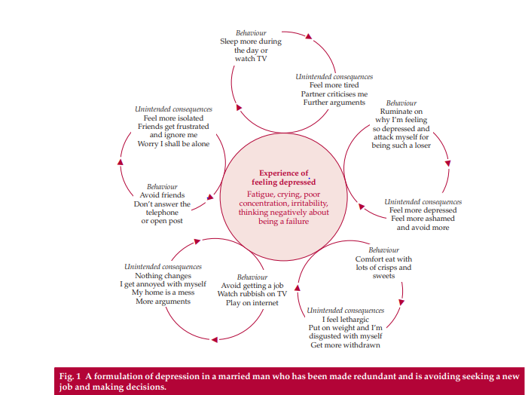
Example of Formulation

Slide 14
Examples of avoidance in depression
Social withdrawal
  Not answering the telephone
  Avoiding friends
Non-social avoidance
  Not taking on challenging tasks
  Sitting around the house
  Spending excessive time in bed
Cognitive avoidance
  Not thinking about relationship problems
  Not making decisions about the future
  Not taking opportunities
  Not being serious about work or education

Slide 15

Continued…
  Ruminating on trying to explain the past or solve insoluble problems
Avoidance by distraction
  Watching rubbish on television
  Playing computer games
  Gambling
  Comfort-eating
  Excessive exercise
Emotional avoidance
  Use of alcohol and other substances

Slide 16
Activity monitoring: recording what you do and how you feel ??
The first step in behavioral activation therapy is to monitor your activity and mood to understand more about how your depression works. This is called Activity Monitoring.
You can use an Activity monitoring worksheet to record what you do each waking hour every day for a week.
We need to find out how the patient’s mood changes as they do different activities, and they may rate their mood for each time slot on a scale of 0 to 10, with 0 representing feeling very depressed and 10 representing feeling very good.

Slide 17
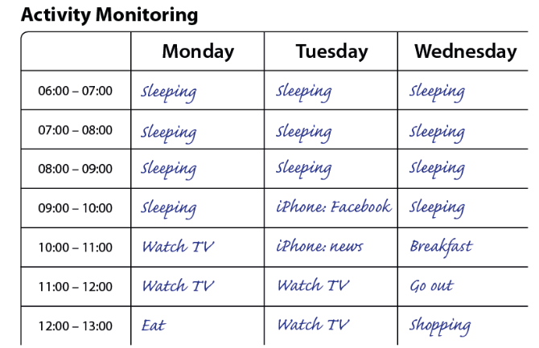

Slide 18
Reviewing your activity monitoring : learning about the association between activity and your mood
Look at your completed behavioral activation worksheet and ask yourself these questions to find out the patterns between your activity and your mood .

Slide 19
The questions can be:
What activities were associated with your highest mood? What were you doing when your mood was highest?
What activities were associated with your lowest mood? What were you doing when your mood was lowest?
What do you notice about the relationship between your mood and how active you were?
Were there any days when you didn’t leave the house? What was your mood like on those days?
What was your mood like on the days when you were most active?

Slide 20
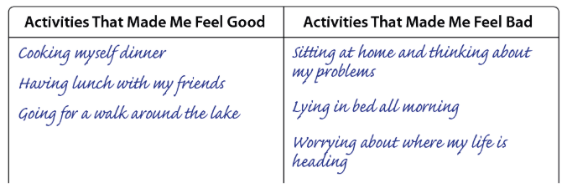
Now the patient is supposed to make a list of activities which helped him/her to feel good or bad. This list is used in the later steps.

Slide 21
Values: thinking about what matters to you deep down
Values are what you care about, deep down, and what you consider to be important.
They reflect how we want to engage with the world, with the people around us, and with ourselves.
Psychologists think that a happy life is one where we are in touch with our values: where we are doing at least some of the things that we think are important.

Slide 22
Values versus Goals
Values (valued directions) are not goals – they are more like a compass and must be lived out by committed action.
Thus, getting married is a goal, but being a good partner is a value: you never reach your destination as there is always something more you can do.
If a valued direction in life is to be a good parent, then the first goal for a depressed patient might be to spend a specified time each day playing, reading or talking with their child.

Slide 23
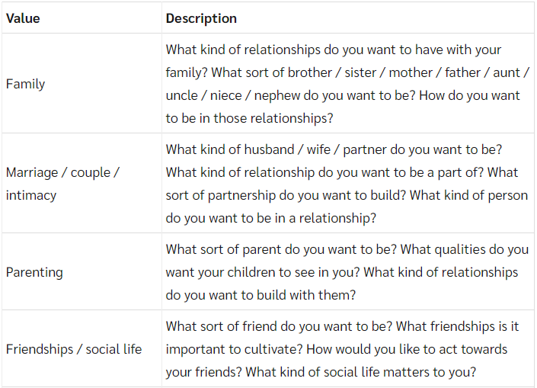
The domains below are valued by some people.

Slide 24
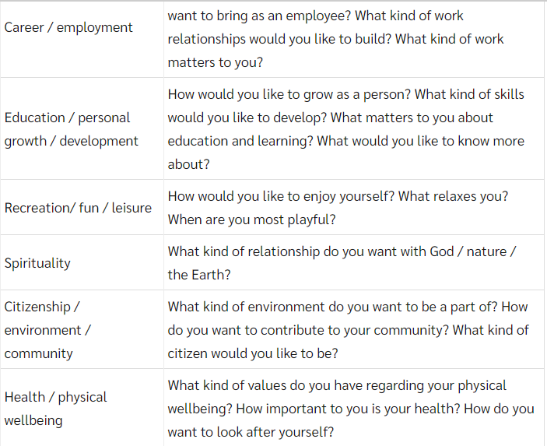

Slide 25
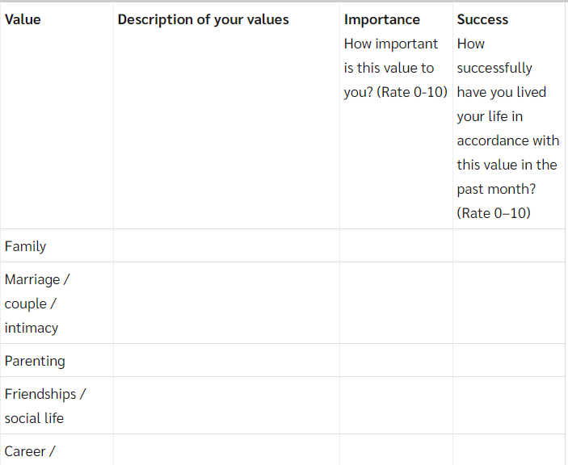
The Valued Living Questionnaire is a useful instrument for helping individuals identify their valued directions like the following :

Slide 26

Goals
All patients should have clearly defined goals in the short, medium and long term that are related to their avoidance and can be incorporated into activity scheduling and regularly monitored.
Sometimes the goals will compete and then only some of them will be met.
Goals should include a return to normal work and social roles as soon as possible.

Slide 27
Structure
A typical behavioral activation session has a structured agenda to review the homework and the progress towards the goals, to discuss feedback on the previous session and to focus on one or two specific issues.
The number of sessions to treat depression would be between 12 and 24.
Sessions are collaborative and the patient is expected to be active and to try to generate solutions.
Homework is more likely to be carried out if the individual is actively engaged in setting it and if there are agreed times or places when it will be carried out.

Slide 28
Continued….
Techniques of functional analytic psychotherapy introduce learning theory into the therapeutic relationship, showing how it can enhance change towards the goals.
It brings the patient’s attention to what they are currently thinking, feeling and doing about the therapist and the therapeutic relationship.

Slide 29
Continued…
The therapist identifies behaviours within the session that are examples of the patient’s problems and uses their own behaviour to decrease these; likewise, the therapist identifies improvements in the patient’s daily life and responds to reinforce these.
The effect of the therapist’s behaviour on the patient would be observed and the reinforcement adjusted as necessary.

Slide 30
Simple activation: planning and engaging in valued activity
The next step of behavioral activation is to get active. It is known by now the importance of increasing the level of activity even if one doesn’t feel like it to begin with.
With behavioral activation for depression we can kick-start the activity by planning it and sticking to the plan.

Slide 31
Good places to get some activation targets for activity plan
Get activation targets from your activity monitoring worksheet: Which activities were best at improving your mood?
Get activation targets from your values assessment worksheet: Which values matter to you the most? What activities could you do that would be in line with your values? For example, if family is something you value perhaps you could plan to spend time with them doing something specific.

Slide 32
Continued….
Make sure that you are doing the basics: Be sure to include targets like washing and brushing your teeth every day, doing laundry every week, cooking meals, shopping for food, and to include some activities that are social and which mean you will have contact with other people.
Use an activity menu: Use a list of activities that have helped other people to pick some that you think might lift your mood.

Slide 33
Activities menu
Do some exercise
Meet a friend for coffee
Cook a meal for someone
Clean the house
Take a bath
Listen to music you like
Do something nice for someone

Slide 34
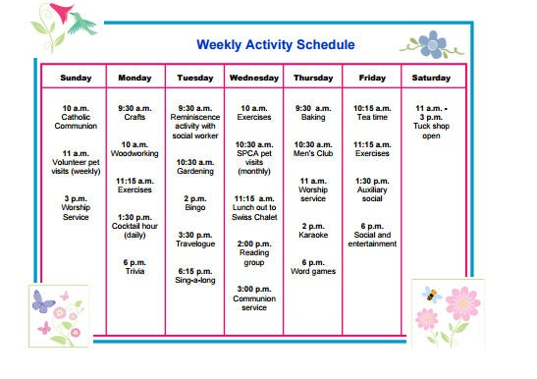
Now it is time to schedule some activities for the next week. Start by choosing some activities with low difficulty .Write down the activities that will be done on an activity monitoring record form. It is important to be specific about:
  What the activity is
  When you plan to do it
  Where you will do it
  Who you might do the activity with

Slide 35
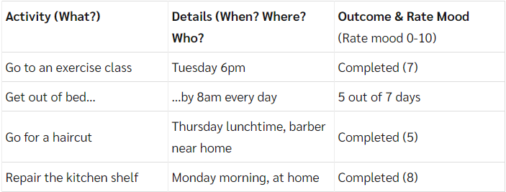
An Example of Activity Scheduling

Slide 36
What does one do with cognitions?
The most common cognitive responses are rumination, fusion and self-attack
Rumination frequently involves trying to answer questions that cannot be answered, constantly seeking reasons for the depression,
fantasizing
  (‘If only I’d found a way to make him different’) or
self-pity
  (‘What have I done to deserve being treated this way?).

Slide 37
Continued…
Both rumination and self-attack serve to avoid aversive situations such as silence or provide escape from thinking about interpersonal problems or feelings.
The therapist encourages the individual to be aware of the context (the antecedents) in which these responses occur and the consequences of engaging in them.
These consequences usually involve some form of avoidance and non-goal-directed activity.
Individuals are helped to turn ‘Why’ or ‘If only’ questions into ‘How’ questions that relate to attaining their goals and following their valued directions and that can be incorporated into their activity schedules.

Slide 38
Cognitive fusion describes the way in which thoughts or images from the past become fused with reality, and information about the world is obtained from this revised internal reality.

Slide 39
Continued…
Patients are taught to become more aware of their surroundings and to see events for what they are, rather than what their mind is telling them.
This process is akin to mindfulness and involves separating the thought of an event from the experiencing of it. Patients are taught to distance themselves from thoughts and no longer to engage with or ‘buy into’ them.

Slide 40
Metaphorical Parking LOT
A metaphor for thoughts and urges that I like is traffic on a road.
Engaging with thoughts is akin to standing in the road and trying to divert the cars (and getting run over) or trying to get one and find a parking space for it.
However, even if one manages to divert or park one car there are always more to be dealt with.

Slide 41
Goal and Aim of Cognitive Fusion
The goal is to acknowledge the thoughts but not to attempt to stop or control or answer back at them.
The aim is to accept fully aversive thoughts and to ‘walk along the side of the road’, engaging with life despite the traffic, which one can quietly ignore.

Slide 42
Obstacles to activity scheduling
The individual’s beliefs about avoidance: people tell themselves that they will engage in a particular activity when they feel motivated or when they ‘feel like it’.
Solution : They should always act according to the plan or activity schedule – not according to how they feel at the time.

Slide 43
Individuals are told that the longer they wait, the greater the likelihood that they will become even less motivated: if necessary, the task should be done now, even in an unmotivated way.
‘Just doing it’ leads to differences in the way the individual thinks and feels, which in turn increases motivation and changes the way others view them.

Slide 44
Other approaches consistent with behavioural activation
Exercise and healthy eating
Problem-solving therapy
Sleep management
Counseling
Family or couple therapy
Compassionate mind training
Acceptance and commitment therapy

Slide 45
Exercise and healthy eating
Becoming fitter is not important in behavioural activation but increasing activity levels is.
A key issue is trying to find an activity that fits the individual’s personality, for example their degree of competitiveness or sociability
People with depression may also eat chaotically, neglect to eat or live off junk food. The function of this may be to numb themselves emotionally.

Slide 46

Tip : Eating healthily can be incorporated into activity scheduling (e.g. growing and buying food, preparing meals, eating at set times and occasionally eating out)

Slide 47
Problem-solving therapy
Problem-solving therapy identifies the problems to be solved and the steps a person might take to try to solve them.
People do not lack problem-solving skills, but they may be avoiding their problems. This is where the therapy becomes integral to behavioural activation.
Warning : Problem-solving should not be used with nonexistent problems or worries of the ‘What if’ type, as it would merely generate further questions and worry.

Slide 48

Sleep management
Sleep management is integral to behavioural activation.
Many individuals with depression have a chaotic sleep pattern or use sleep to avoid activity.
It is important to do a
functional analysis on the
pattern of sleep and,
if necessary, integrate a
sleep routine into an activity schedule

Slide 49
Counseling
Counselling is consistent with behavioural activation provided that it is supportive in helping people to move on in their lives and solve their problems.
Analytical counselling, trying to find reasons in the past for current problems – ‘getting to the bottom of it all’ – may be counterproductive and can encourage rumination and further depression.

Slide 50

Family or couples therapy
Partners and other family members reinforce an individual’s avoidance; they can be overprotective, aggressive or sarcastic; they may minimize the problem or avoid the individual.
Behavioural activation might be used to help the family to be consistent and emotionally supportive, perhaps helping the individual to follow their activity schedule.

Slide 51
Compassionate mind training
Compassionate mind training is a newer development that can be integrated into behavioural activation with individuals who have chronic problems associated with shame, self-criticism or self-attacking.
Like behavioural activation, CMT is based on a functional analysis of the self-directed behaviour and teaches individuals to develop self compassion and soothing behaviours.

Slide 52
Acceptance and commitment therapy
Acceptance and commitment therapy is another newer development within the family of behavioural and cognitive psychotherapies and it has an increasing evidence base.
Its focus is on the way individuals perpetuate their difficulties through the language they use and on how they can learn to act in a valued direction despite their feelings.

Slide 53
The evidence base for behavioural activation
A key evaluation of behavioural activation as a treatment for depression occurred in a randomised controlled trial in which it was compared with standard CBT, an antidepressant (paroxetine) and a drug placebo in 214 out-patients .
Depression, therapist adherence, therapist competence, response and remission were measured. In the participants with more severe depression, behavioural activation was found to be as efficacious as paroxetine and more efficacious than CBT.

Slide 54
Compared with paroxetine, behavioural activation brought a greater percentage of participants to remission and retained a greater percentage in treatment.
Thus, behavioural activation is effective across the low-intensity treatment for mild to moderate depression in the community up to intensive treatment for day patients and in-patients with severe depression and is suitable for use in stepped care.
(Stepped care is a way of using limited resources to greatest effect).
Another potentially fruitful possibility would be computerised behavioural activation with minimal support for mild depression.

Slide 55
Why choose behavioural activation?
It may be easier to train staff in its use .
It may have greater efficacy in severe depression.
Patients may find it more acceptable and it may be more cost-effective in the long term.
NOTE : The priority for research is to determine the cost effectiveness of behavioural activation for both mild to moderate depression with low-intensity workers in stepped care and for severe depression either alone or in combination with antidepressant medication.

Slide 56
References
http://www.veale.co.uk/wp-content/uploads/2010/10/60-BA-for-depression-.pdf
https://www.psychologytools.com/self-help/behavioral-activation/
https://theconversation.com/explainer-what-is-behavioural-activation-for-depression-62910

