Slide 1
Rational Emotive Behaviour Therapy - REBT
Created by:
Ms. Aarohi Raorane
Psychologist
Emotion of life

Slide 2
What is REBT?
Developed by Albert Ellis in early 1950s REBT is a therapeutic approach which focuses on your irrational beliefs and negative thought patterns and tries to change it to Rational Beliefs and thought patterns.
Ellis realized that people experience psychological disturbance not because of the events happening around them but because of how people perceive the events that happen around them.
He emphasized that what we think we also feel and behave
His work was influenced by a lot of Greek and Roman philosophers, Modern Philosophers like Immanuel Kant and Research Philosopher like Popper.
It takes more active-directive approach in a therapeutic setting
REBT takes an integrative approach i.e. it focuses on emotions, behaviors, feelings and operates in this framework
REBT is also has an eclectic approach i.e. it takes elements from various different forms of therapy like:
Unconscious motives and defense systems as Freudian do
Roger’s unconditional positive regard/ acceptance
Adler – encourages clients to change
Skinnerian’s and behaviorist – give Homework assignments, use operant conditioning, employ in vivo desensitization; and so on

Slide 3
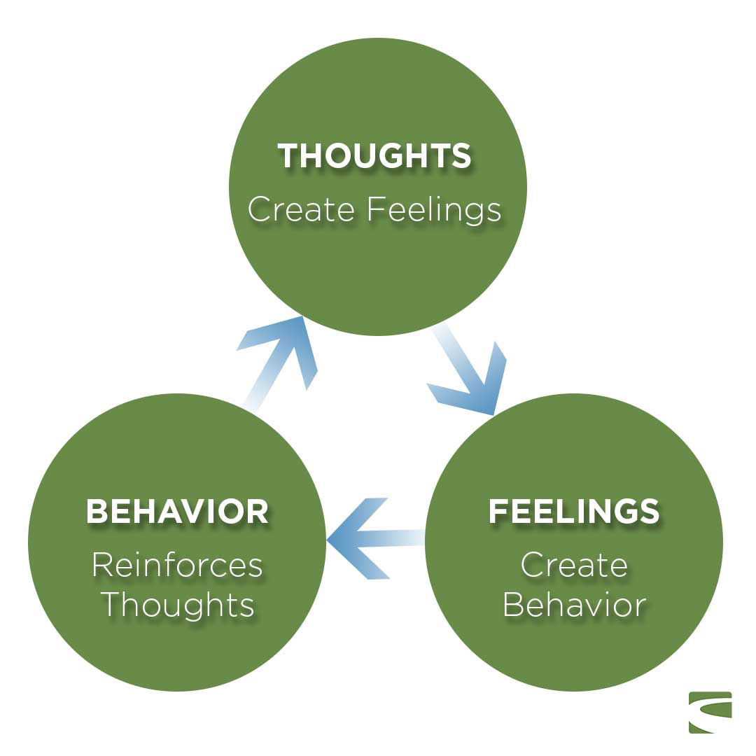
Thought, feelings and Behavior are not independent of each other but rather interconnected, they influence each other

Slide 4
The REBT Model of Emotion
REBT is primarily concerned reliving people of their emotional disturbances, However, it also acknowledges that people are bound to have negative emotions when faced with negative life events.
To accommodate these two positions REBT distinguishes between emotions that are negative in tone and have largely unconstructive consequences and emotions that are negative in tone and have largely constructive consequences. The former are known as unhealthy negative emotions (UNEs) and the latter healthy negative emotions (HNEs).
To simplify it let’s start with unhealthy negative emotions, some examples of these are Anxiety, depression, guilt, unhealthy anger, shame, hurt, unhealthy jealousy, unhealthy envy. These emotions are unhealthy because it hinders our ability to achieve a goal or desire.
Whereas healthy negative emotions are concern, sadness, remorse, disappointment, healthy anger, sorrow, healthy envy; “healthy” negative emotions are those who helps and motivate us in achieving our goals and desires in life.
The REBT model of emotion states that the emotions that we experience are based largely on the beliefs that we hold about ourselves, others and the world. More specifically it states that our unhealthy negative emotions about life’s adversities are based largely on the irrational beliefs that we hold about these adversities and that if we want to experience healthy negative emotions about the adversities in question we need to change our irrational beliefs to rational beliefs.

Slide 5
Unhealthy negative emotions vs Healthy negative emotions
Unhealthy Negative Emotions (UNE) | Healthy Negative Emotions (HNE)
1. Anxiety | 1. Concern
2. Depression | 2. Sadness
3. Guilt | 3. Remorse
4. Shame | 4. Disappointment
5. Unhealthy Anger | 5. Healthy Anger
6. Hurt | 6. Sorrow/Disappointment
7. Unhealthy Envy | 7. Healthy Envy
8. Unhealthy Jealousy | 8. Healthy Jealousy

Slide 6
Themes of UNE and HNE
Anger- we anticipate negative consequences, start avoiding things
Concern- though we are tensed about the event we are more likely to face the event and approach it
Depression- feeling of hopelessness, no meaning in life
Sadness- experience of loss, mourning but hopeful
Guilt- When we break/violate our own moral codes, personal norms, try to punish ourself
Remorse- Upset about violating our norms but there’s no self-punishment
Shame- when we violate social norms, fear criticism from society, most common in Socialized anxiety disorder and Avoidant Personality disorder
Disappointment- we feel displeased because we haven’t met but social norms but we try to improve
Unhealthy Anger- we experience this when other break or don’t follow our rules
Healthy anger- it is more flexible than healthy anger, we try to solve the problem instead of blaming others.

Slide 7
Themes of UNE and HNE
Hurt- this happens when our expectations are unmet
Sorrow/Disappointment- we feel displeased because our expectations aren’t met but we try to resolve the conflict
Unhealthy Envy: More materialistic oriented, we compare ourselves with others on the basis of power, status, materialistic achievement
Healthy Envy: We get inspired and motivated to achieve those things that we don’t have
Unhealthy Jealousy- People oriented, we feel insecure, possessive about our partners or in interpersonal relationships
Healthy Jealousy- this experience leads us to safeguard our relationships, take more efforts to appreciate and express gratitude towards our loved one.

Slide 8
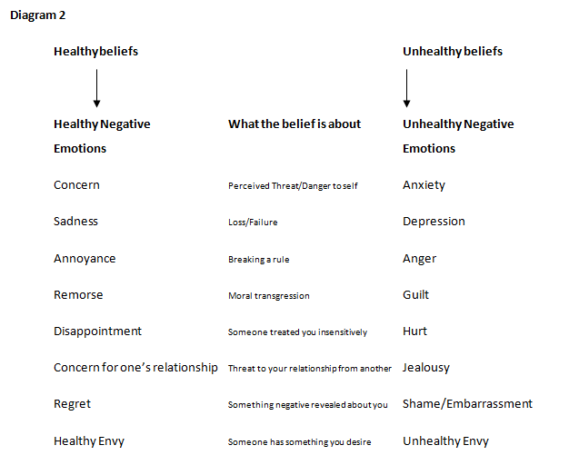

Slide 9
Irrational Beliefs and Rational Beliefs
Irrational in REBT means “that which prevents us from achieving our goals and purposes"
And Rational in REBT means “that which helps people to achieve their basic goals and purposes”
Hence the meaning of rational and irrational isn’t absolute but rather more relative in nature.
Rational Beliefs | Irrational Beliefs
Self-helping | Self- defeating
Flexible, adaptive, productive, consistent with social reality | Rigid, dogmatic, unhealthy, maladaptive, inconsistent with social reality
Helping the group to survive and to achieve its basic goals | Interfering with the group survival and wellbeing
The balance between self and social interests | Unbalance between self and social interests

Slide 10
Irrational Beliefs
There are four types of Irrational Beliefs
Demands: These are the primary Irrational belief. They often feature phrases such as must, absolute shoulds, have to, need and ought. Example: I would love to succeed and therefore I have to!
Awfulising: In REBT awful is defined as anything that is evaluated as being worse than 100% bad. Example: If I don't succeed in my presentation is will be awful!
Low Frustration Tolerance (LFT): Otherwise known as I-can't-stand-it-itis, LFT beliefs feature an acknowledgement of a struggle and an assertion that the struggle is truly unbearable or cannot be stood. Example: If people are rude to me I cannot stand it!
Conditional Self (other, life) Acceptance: Otherwise known as self-downing, this is where we define our self based on one aspect. Example: If I fail at something important to me then I am a failure! It is also called as global evaluation of self, others or world.

Slide 11
Rational Beliefs
There are four types of Rational Beliefs
Preferences - Rather than demanding, preferring is a much more helpful attitude to have about life. Example: I would love to succeed but I don't have to.
Anti-awfulising: Nothing in this world could not be worse, and anti-awfulising beliefs reflect this. Example: If I don't succeed in my presentation, it may be bad but never truly awful!
High Frustration Tolerance (HFT): Usually, we tell ourselves we cannot stand something when in fact we do not like it (and we might dislike it very much indeed). HFT enables us to face difficulty with more courage and resilience. Example: If people are rude to me, I do not like it, but I can stand it and it would be worth the struggle.
Unconditional Self (other, life) Acceptance: We are far to complex to be rated in one aspect or dimension. In fact it is impossible to truly define a human being in any one way. We are better off rating our behaviour, not ourselves. Example: If I fail at something then I will have failed at an important thing to me, but that would never make me a failure I would be a fallible human being.

Slide 12
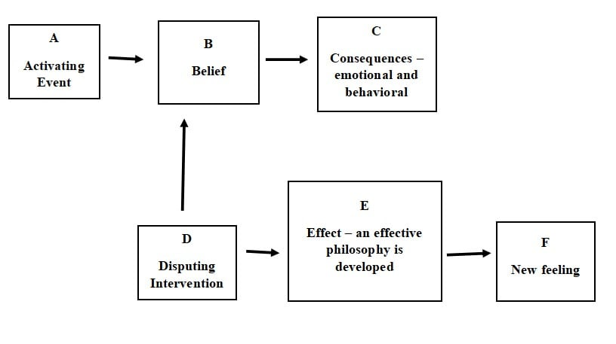
The ABCDE model of REBT

Slide 13
A is for the Activating Event i.e. the trigger; it is the situation which triggers our emotional responses and activates our irrational beliefs.
B is for Irrational Beliefs at the core which are attached to our emotional and behavioural responses to the activating event. Irrational beliefs are thoughts you might have about an event or situation.
C is for Consequences which are the result of activating events and irrational beliefs, there are two types of consequences;
1. Emotional consequences and 2. Behavioral consequences.
D is Disputing which is basically an effort to dispute/change the irrational beliefs which in turn helps to change unhealthy negative emotion to healthy negative emotions.
E is the New Effect i.e. the change that happens once you have replaced irrational beliefs with rational ones.

Slide 14
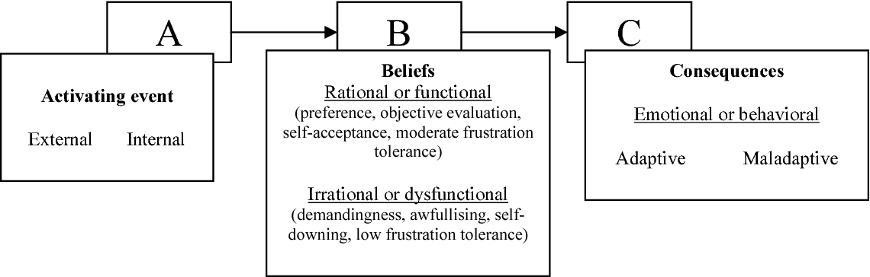
Goal of REBT is to identify unhealthy negative emotions and replace them with healthy negative emotions, this is done by identifying the C i.e. consequences (both behavioural and emotional) and examining the A- i.e. activating events and B i.e. irrational beliefs role in this and eventually changing irrational beliefs to rational beliefs.

Slide 15
What questions to ask assess the ABC?
To assess C, Emotional consequences- How were you feeling when (the mentioned event) happened?
To assess C, Behavioral consequences- What did you do when you were feeling (the mentioned emotion by the client) for e.g. What did you do when you were experiencing the emotion of anxiety?
To assess the “A” event – when did you first experience this feeling (the mentioned emotion by the client)? What was happening just before you experienced this emotion?
To assess the “B” Irrational beliefs- What were your thoughts when this happened (this – the mentioned event)

Slide 16
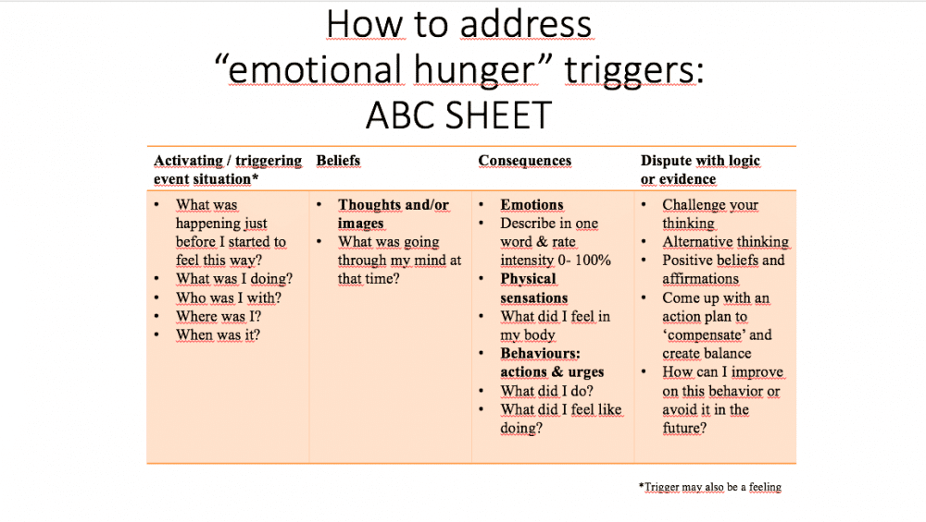

Slide 17
Disputing Irrational Beliefs
Disputing is about challenging irrational beliefs and replacing it with rational beliefs by critically analyzing and examining their irrational beliefs, but it is important to keep in mind that while doing this the Client needs to realize him/herself that the beliefs that he/she is having is irrational
The process should be Elicitive and it is a process of self discovery for the client
Disputing irrational beliefs is the primary method of REBT. There are different kinds of disputations:
Functional disputes – questioning whether the belief helps accomplish desired goals.
Empirical disputes – questioning whether the “facts” are accurate.
Logical disputes – questioning the logic of thinking processes.
Philosophical disputes – (Which is not philosophical in the technical sense) questioning whether despite dissatisfactions if some pleasure can be derived from life anyway.
Alternative Dispute- questioning what can be another way of looking at the problem?
Friend analogy- what would you advice your friend If your friend was in a similar situation?

Slide 18
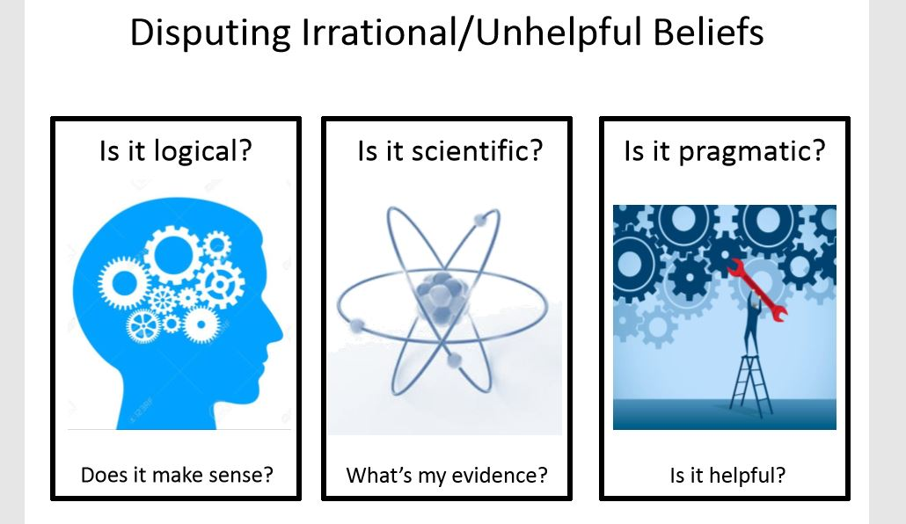

Slide 19
Styles of Disputing
A didactic style is explanatory, educational, and efficient but involves giving information rather than using dialogue.
A Socratic style involves using questions to promote client reasoning.
A metaphorical style uses analogies, especially from the client's own experience, to dispute beliefs.
A humorous style disputes the belief in a lighthearted way"

Slide 20
Styles of Disputing
Didactic Style:
Didactic disputing involves therapists directly explaining to their clients that their irrational beliefs are inconsistent with reality, illogical and dysfunctional and why their alternative rational beliefs are, by contrast, consistent with reality, logical and functional. When using this disputing style, therapists are advised to check whether or not their clients understand and agree with the points being made. The purpose of didactic disputing is client learning not just therapist teaching.

Slide 21
Styles of Disputing
Socratic Style:
Here therapists dispute their clients' irrational beliefs and help them to test out their newly constructed rational beliefs by asking them questions designed to make them think for themselves about the empirical and logical status of both sets of beliefs. When clients provide the incorrect answers to these open-ended questions their Socratic therapists follow up with more open-ended questions and this process continues until the clients are helped to arrive at the correct responses (correct, that is, according to REBT theory)

Slide 22
Styles of Disputing
Metaphorical Style:
In this style of disputing therapists tell their clients a metaphor which is designed to show clients why their irrational beliefs are irrational and/or why their rational beliefs are rational. As with didactic disputing, when using a metaphorical dispute it is important that the therapist ensures that the client has understood and concurs with the point that the metaphor is designed to make. The metaphors should be relevant with client’s experiences

Slide 23
Styles of Disputing
Humorous Style:
Ellis and other experienced therapists often show clients that their irrational beliefs are irrational in a very humorous manner. Here they make clear that the target of the humor is the clients' beliefs not the clients themselves.

Slide 24
Some techniques used in REBT
Modeling - asking a client to emulate someone who demonstrates the desired behavior.
Roleplaying – A role reversal where the client will act as the therapist and vice versa
Refermenting – cost benefit analysis of the behavior
Cognitive homework – e.g. identifying and disputing irrational beliefs, maintain a thought log, identifying cognitive distortions
Bibliotherapy and psychoeducational assignments – books, lectures, groups
Proselytizing – sharing the approach with others
Recording sessions – allows clients to review ideas they may have missed and to reinforce other ideas.
Reframing – viewing a problem from a different perspective, which gives it a different meaning.
Stop and monitor – establish cues to stop and notice thought processes throughout the day.
Unconditional acceptance by the therapist
Teaching unconditional self-acceptance and unconditional other acceptance

Slide 25
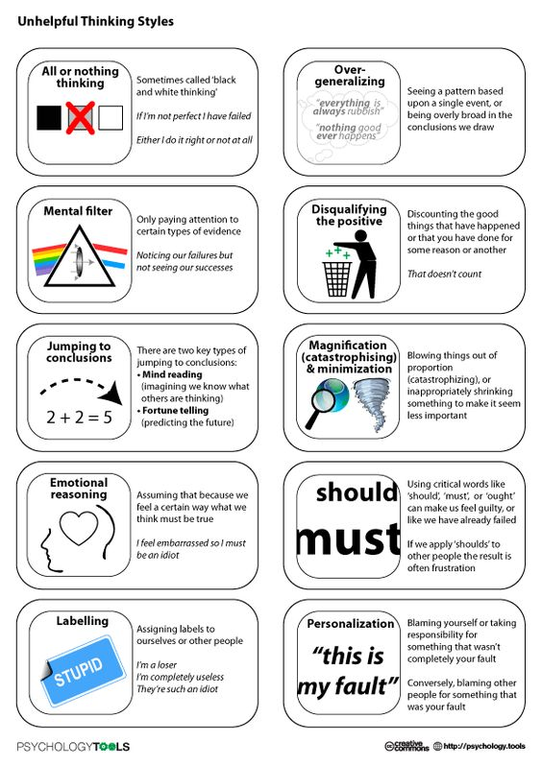
Cognitive Distortions

Slide 26
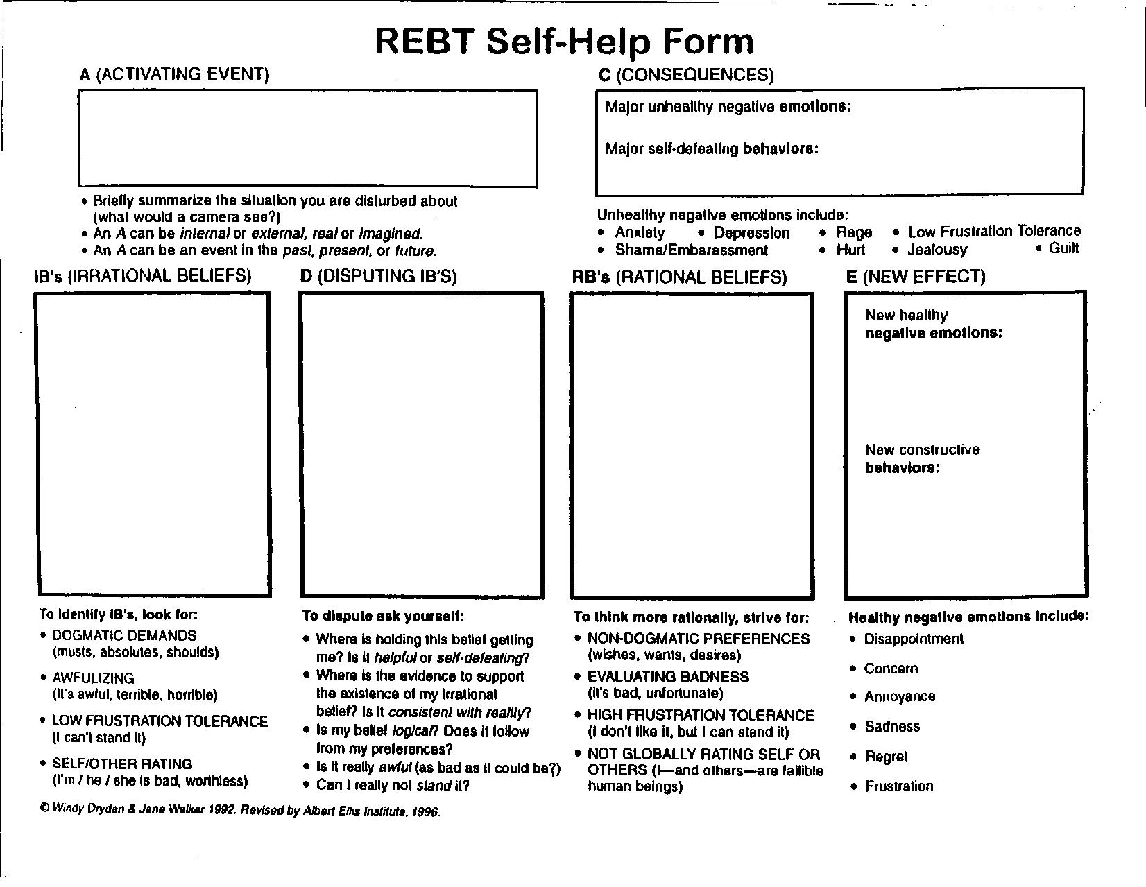

Slide 27
Thank you ☺
Questions are welcome
Contact us on: www.emotionoflife.in info@emotionoflife.in
7678694626

