Slide 1
Self-Esteem
Prepared by- Tejasvi Acharekar
Guide- Shyam Gupta, CLINICAL PSYCHOLOGIST & THERAPIST
MEHEK ROHIRA, PSYCHOLOGIST

Slide 2
What is Self-esteem ?
Self-esteem is used to describe a person's overall sense of self-worth or personal value.
In other words, how much you appreciate and like yourself.
It involves a variety of beliefs about yourself, such as the appraisal of your own appearance, beliefs, emotions, and behaviors.

Slide 3
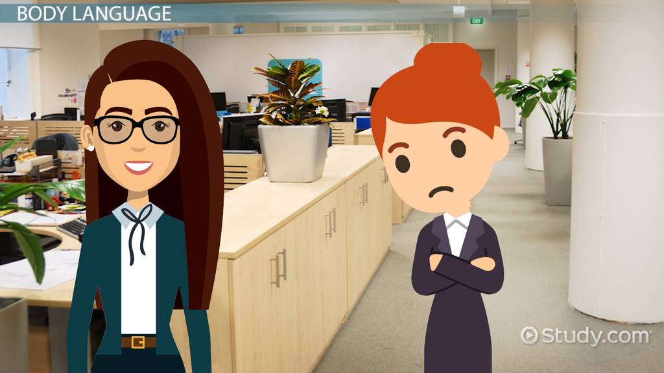
Does self-esteem affect communication ?

Slide 4
Does self-esteem affect communication ?
Talking firmly
Use a wide & flexible vocabulary
Be able to give positive vibes
Be able to accept failure

Slide 5
Does self-esteem affect communication ?
Are defensive about themselves
Have slack body posture
Do not appear confident
Are reluctant to take risks in social encounters
Talk about themselves & try putting themselves down
Have speech patterns which are hesitant (e.g. Verbal ticks, Yaa know)

Slide 6
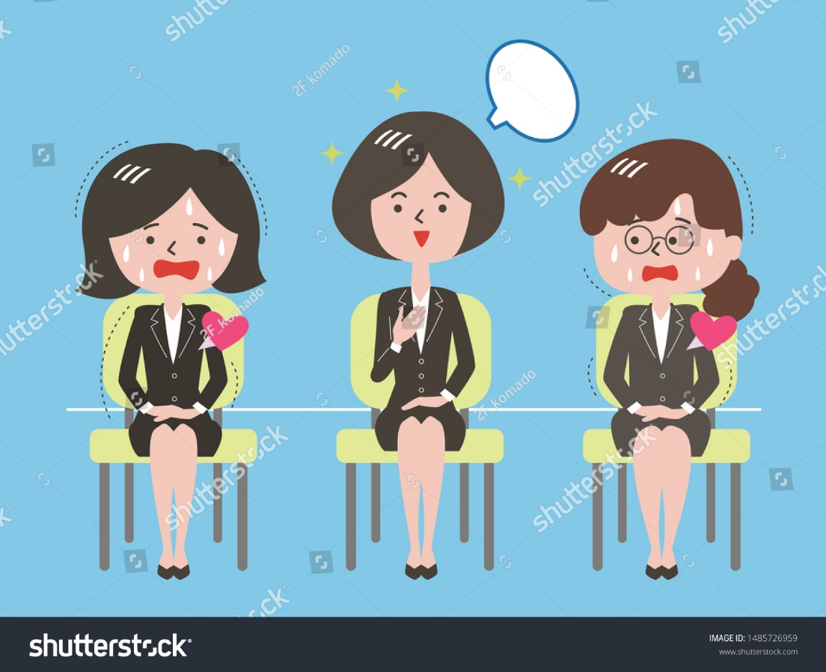
Does self-esteem affect Behaviour ?

Slide 7
Does self-esteem affects Behaviour ?
Avoid Risk -taking
Comparing your self with others
Feel anxious in new situation
Always viewing yourself as a victim
Be reluctant to speak your mind

Slide 8
Does self-esteem affect Relationship ? Why?
Attachment Style
Warmth & loving, accepting minor shortcoming of partners, responsive to their partners & their needs
Secure
You may play games or manipulate your partner to get attention, provoking jealousy, threating to leave.
Anxious
Easily able to cut-off difficult emotions, your independence & self-sufficiency are more important.
Avoidant

Slide 9
Why Self-esteem is Important?
Self-esteem can play a significant role in your motivation and success throughout your life.
Low Self-Esteem | Healthy Self - Esteem | High Self-Esteem
Can hold back to succeeding as one doesn’t believe in their capability | Can help you achieve success because you navigate life with a positive attitude and believe you can accomplish your goals. | Can put one in a situation which has unrealistic goals

Slide 10
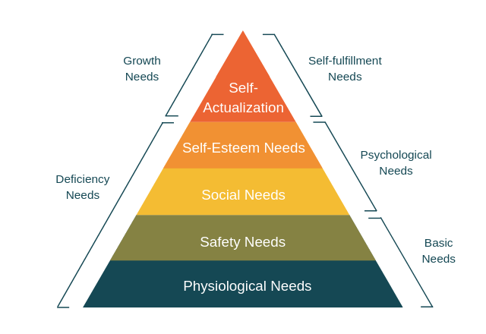
Maslow’s Hierarchy of needs
Maslow’s hierarchy of needs suggested people need esteem from other people as well as inner self-respect.
According to this theory, Self-esteem need is a psychological need of a person. This need is unique from individual to individual, it varies from X generation & Y generation. It includes self respect, achievement, recognition, attention

Slide 11
Factors influencing Self-Esteem
Your inner thinking
Age
Any potential illnesses
Disabilities
Physical limitations
Job.
Genetic factors that help shape a person's personality can play a role, but it is often our experiences that form the basis for overall self-esteem.
Constant criticism
Negative assessments

Slide 12
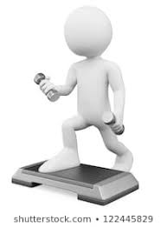

Self-Esteem Vs Self-Directed, Traits & States
Self-Esteem vs. Self-Concept
Self-concept is the perception that we have of ourselves, our answer when we ask ourselves the question “Who am I?”
Self-concept is an overarching construct that self-esteem is one of the components of it
Self-concept
Who I am?
Self- concept is one the component to build Self-Esteem

Slide 13

Self-Esteem vs. Self-Image
Self-image is similar to self-concept in that it is all about how you see yourself. Instead of being based on reality, however, it can be based on false and inaccurate thoughts about ourselves.
Similar to Self-concept. But may or may not be real

Slide 14

Self-Esteem vs. Self-Worth
Self-esteem is a similar concept to self-worth but with a small difference.
Self-esteem is what we think, feel, and believe about ourselves, while self-worth is the more global recognition that we are valuable human beings worthy of love.
Global recognition of our worth

Slide 15
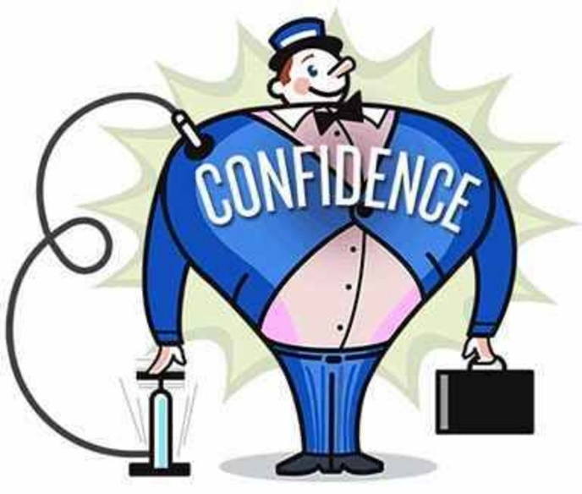
Self-Esteem vs. Self-Confidence
Self-esteem is not self-confidence self- confidence is about your trust in yourself and your ability to deal with challenges, solve problems, and engage successfully with the world.
One can have high self-confidence, particularly in a certain area or field, but still lack a healthy sense of overall value or self-esteem.
Low Self-Esteem

Slide 16

Self-Esteem vs. Self-Efficacy
Self-efficacy refers to the belief in one’s ability to succeed at certain tasks.
Unlike self-esteem, self-efficacy is more specific rather than global, and it is based on external success rather than internal worth.
I do have ability. But I don’t think so I can win.

Slide 17
How to increase Self-Esteem
Set realistic expectations.
Stop being a perfectionist.
Explore yourself.
Be willing to adjust your self-image.
Stop comparing yourself to others.
Meditate

Slide 18
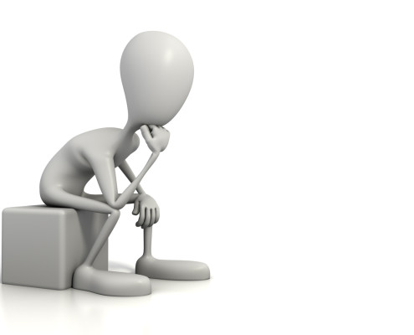
How to strengthen attitude towards Yourself.
1.Spend time with people who lift you up
2. Give back by helping others
3. Celebrate your achievements, no matter the size
4. Do what makes you happy
5. Change what you can – and let go of what you can’t
6. Let go of perfectionism ideals
7. Speak to yourself like a friend
8. Get involved in extra-curriculars
9. Own your uniqueness
10. Create a positive self-dialogue.

Slide 19
Thank You
As long as you look for someone else to validate who you are by seeking their approval, you are setting yourself up for disaster. You have to be whole and complete in yourself. No one can give you that. You have to know who you are—what others say is irrelevant.” - Nic Sheff

