Slide 1
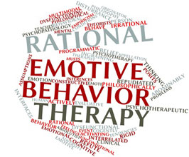
Rational Emotive Behaviour Therapy
Created by : Yoshima Singh
Under the guidance of
Mr. Shyam Gupta
Clinical Psychologist & Therapist
Emotion of Life

Slide 2
What is it?
Rational emotive behavior therapy (REBT) is a type of therapy introduced by Albert Ellis in the 1950s. It’s an approach that helps you identify irrational beliefs and negative thought patterns that may lead to emotional or behavioral issues.
Once you’ve identified these patterns, a therapist will help you develop strategies to replace them with more rational thought patterns.

Slide 3
Albert Ellis
Albert Ellis (September 27, 1913 – July 24, 2007) was an American psychologist who in 1955 developed Rational Emotive Behavior Therapy (REBT).
He held MA and PhD degrees in clinical psychology from Columbia University and the American Board of Professional Psychology (ABPP).
He also founded and was the President of the New York City-based Albert Ellis Institute for decades.

Slide 4
Albert Ellis
He is generally considered to be one of the originators of the cognitive revolutionary paradigm shift in psychotherapy and an early proponent of cognitive-behavioral therapies.
Based on a 1982 professional survey of US and Canadian psychologists, he was considered the second most influential psychotherapist in history.

Slide 5
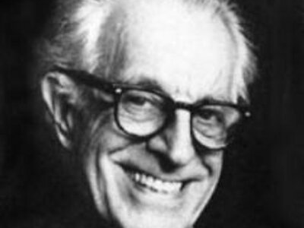
Albert Ellis

Slide 6
Beliefs in REBT
Ellis placed Irrational Beliefs at the very heart of REBT, as these are the primary reason for human misery and dysfunction. By challenging, questioning, disputing and acting against our Irrational Beliefs we can change our emotional responses to events, from unhealthy to healthy, which better aid us in achieving our goals in life.

Slide 7
What are Rational beliefs?
The four types of Rational Beliefs
Preferences: Rather than demanding, preferring is a much more helpful attitude to have about life.
Anti-awfulising: Nothing in this world could not be worse, and anti-awfulising beliefs reflect this.
High Frustration Tolerance (HFT): HFT enables us to face difficulty with more courage and resilience.
Unconditional Self (other, life) Acceptance: We are far to complex to be rated in one aspect or dimension. In fact it is impossible to truly define a human being in any one way. We are better off rating our behavior, not ourselves.

Slide 8
What are Irrational beliefs?
The four types of Irrational Beliefs
Demands: These are the primary Irrational belief. They often feature phrases such as must, absolute should, have to, need and ought. All other Irrational Beliefs following from the demand.
Awfulising: In REBT awful is defined as anything that is evaluated as being worse than 100% bad.
Low Frustration Tolerance (LFT): LFT beliefs feature an acknowledgement of a struggle and an assertion that the struggle is truly unbearable or cannot be stood.
Conditional Self (other, life) Acceptance: Otherwise known as self-downing, this is where we define our self based on one aspect.

Slide 9

ABCs of REBT

Slide 10
A of REBT
A refers to the (a)ctivating event or situation that triggers a negative reaction or response. In this example, the A is the lack of reply.

Slide 11
B of REBT
B refers to the (b)eliefs or irrational thoughts you might have about an event or situation. The B in the example is the belief that they don’t want to see you anymore or that you’ve done something wrong and that you will be alone for the rest of your life.

Slide 12
C of REBT
C refers to the (c)onsequences, often the distressing emotions, that result from the irrational thoughts or beliefs. In this example, that might include feelings of worthlessness or not being good enough.

Slide 13
Techniques used in REBT
Problem-solving techniques
Cognitive restructuring techniques
Coping techniques

Slide 14


Slide 15
Problem-solving techniques
These strategies can help address the activating event (A)
They often include working to develop:
problem-solving skills
assertiveness
social skills
decision-making skills
conflict resolution skills

Slide 16
Cognitive restructuring techniques
These strategies help you to change irrational beliefs (B)
They might include:
logical or rationalizing techniques
guided imagery and visualization
reframing, or looking at events in a different way
humor and irony
exposure to a feared situation
disputing irrational thoughts

Slide 17
Coping techniques
Coping techniques can help you better manage the emotional consequences (C) of irrational thoughts.
These coping techniques include:
Relaxation
Hypnosis
Meditation

Slide 18
Effectiveness in REBT
REBT is generally accepted as an effective type of therapy. A 2017 review Trusted Source of 84 published articles on REBT concluded it’s a valid treatment that can help with obsessive-compulsive disorder, social anxiety, depression, and disruptive behavior.
A small 2016 study looked at the benefits of regular REBT sessions with a social worker for long-term depression. After a year, the participants made fewer trips to their primary care doctor. The use of prescription medications also decreased.

Slide 19

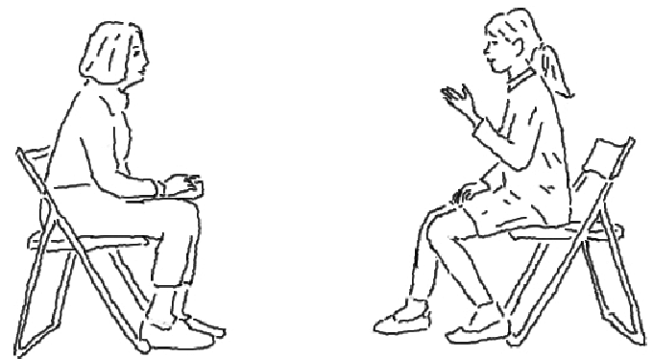
Created by:
Yoshima Singh
Under the guidance
Mr, Shyam Gupta
Clinical Psychologist & Psychotherapist
Emotion of Life
For further question please write us
info@emotionoflife.in

