Slide 1
Self-Esteem
Prepared by- Tejasvi Acharekar
Guide- Shyam Gupta, CLINICAL PSYCHOLOGIST & THERAPIST
MEHEK ROHIRA, PSYCHOLOGIST

Slide 2
What is Self-esteem ?
Self-esteem is used to describe a person's overall sense of self-worth or personal value.
In other words, how much you appreciate and like yourself.
It involves a variety of beliefs about yourself, such as the appraisal of your own appearance, beliefs, emotions, and behaviors.
The term self-esteem is used to describe a person's overall subjective sense of personal worth or value. In other words, self-esteem may be defined as how much you appreciate and like yourself regardless of the circumstances. Your self-esteem is defined by many factors including:
Self-confidence
Feeling of security
Identity
Sense of belonging
Feeling of competence

Slide 3
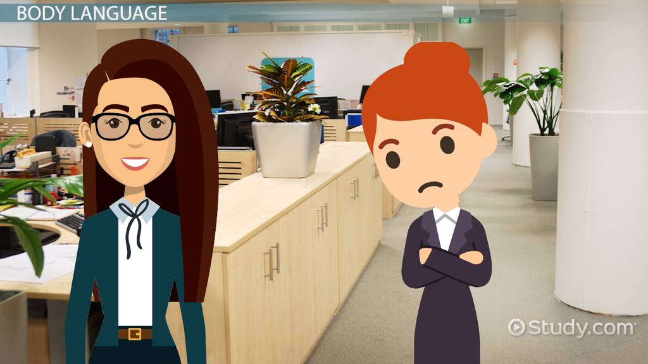
Does self-esteem affect communication ?

Slide 4
Does self-esteem affect communication ?
Talking firmly
Use a wide & flexible vocabulary
Be able to give positive vibes
Be able to accept failure

Slide 5
Does self-esteem affect communication ?
Are defensive about themselves
Have slack body posture
Do not appear confident
Are reluctant to take risks in social encounters
Talk about themselves & try putting themselves down
Have speech patterns which are hesitant (e.g. Verbal ticks, Yaa know)

Slide 6

Does self-esteem affect Behaviour ?

Slide 7
Does self-esteem affects Behaviour ?
Avoid Risk -taking
Comparing your self with others
Feel anxious in new situation
Always viewing yourself as a victim
Be reluctant to speak your mind

Slide 8
Does self-esteem affect Relationship ? Why?
Attachment Style
Warmth & loving, accepting minor shortcoming of partners, responsive to their partners & their needs
Secure
You may play games or manipulate your partner to get attention, provoking jealousy, threating to leave.
Anxious
Easily able to cut-off difficult emotions, your independence & self-sufficiency are more important.
Avoidant

Slide 9
Different types of self-esteem:-
Self-esteem can play a significant role in your motivation and success throughout your life.
Low Self-Esteem | Healthy Self - Esteem | High Self-Esteem
Can hold back to succeeding as one doesn’t believe in their capability | Can help you achieve success because you navigate life with a positive attitude and believe you can accomplish your goals. | Can put one in a situation which has unrealistic goals

Slide 10
Benefits of Healthy self-esteem:-
There are some simple ways to tell if you have healthy self-esteem. You probably have healthy self-esteem if you:
Avoid dwelling on past negative experiences
Believe you are equal to everyone else, no better and no worse
Express your needs
Feel confident
Have a positive outlook on life
Say no when you want to
See your overall strengths and weaknesses and accept them
Having healthy self-esteem can help motivate you to reach your goals, because you are able to navigate life knowing that you are capable of accomplishing what you set your mind to.

Slide 11
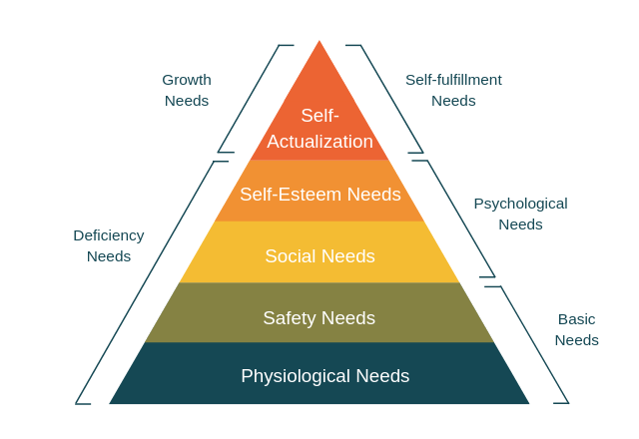
Maslow’s Hierarchy of needs
Maslow’s hierarchy of needs suggested people need esteem from other people as well as inner self-respect.
According to this theory, Self-esteem need is a psychological need of a person. This need is unique from individual to individual, it varies from X generation & Y generation. It includes self respect, achievement, recognition, attention

Slide 12
Factors influencing Self-Esteem
Your inner thinking
Age
Any potential illnesses
Disabilities
Physical limitations
Job.
How you react to situations
Genetic factors that help shape a person's personality can play a role, but it is often our experiences that form the basis for overall self-esteem.
Constant criticism
Negative assessments

Slide 13
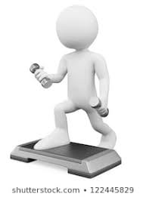

Self-Esteem Vs Self concept
Self-concept is the perception that we have of ourselves, our answer when we ask ourselves the question “Who am I?”
Self-concept is an overarching construct that self-esteem is one of the components of it
Self-concept is how an individual views who they are based on their habits, skills and temperament. In other words, it is the ability to reflect on one's own traits, skills and behavior. On the other hand,
Self-esteem is an attitude or view that an individual has about him or herself. It also refers to factors that we accept and value in ourselves and can be either negative or positive.
Self-concept
Who I am?
Self- concept is one the component to build Self-Esteem

Slide 14
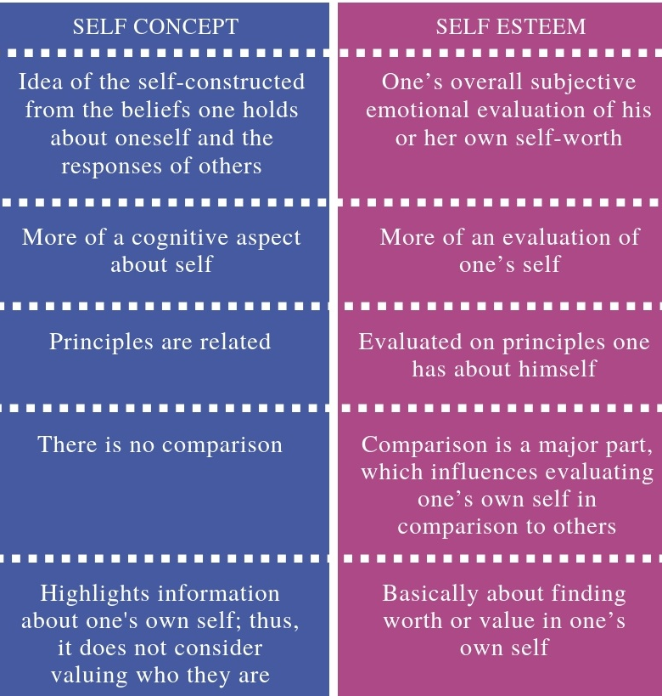

Slide 15

Self-Esteem vs. Self-Image
Self-image is similar to self-concept in that it is all about how you see yourself. Instead of being based on reality, however, it can be based on false and inaccurate thoughts about ourselves.
Similar to Self-concept. But may or may not be real

Slide 16

Self-Esteem vs. Self-Worth
Self-esteem is a similar concept to self-worth but with a small difference.
Self-esteem is what we think, feel, and believe about ourselves, while self-worth is the more global recognition that we are valuable human beings worthy of love.
Global recognition of our worth

Slide 17
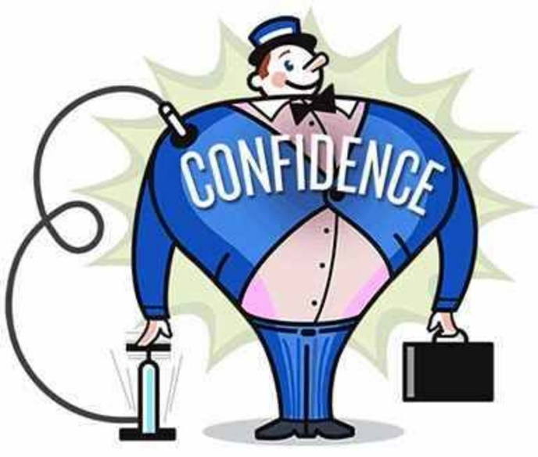
Self-Esteem vs. Self-Confidence
Self-esteem is not self-confidence self- confidence is about your trust in yourself and your ability to deal with challenges, solve problems, and engage successfully with the world.
One can have high self-confidence, particularly in a certain area or field, but still lack a healthy sense of overall value or self-esteem.
Low Self-Esteem

Slide 18
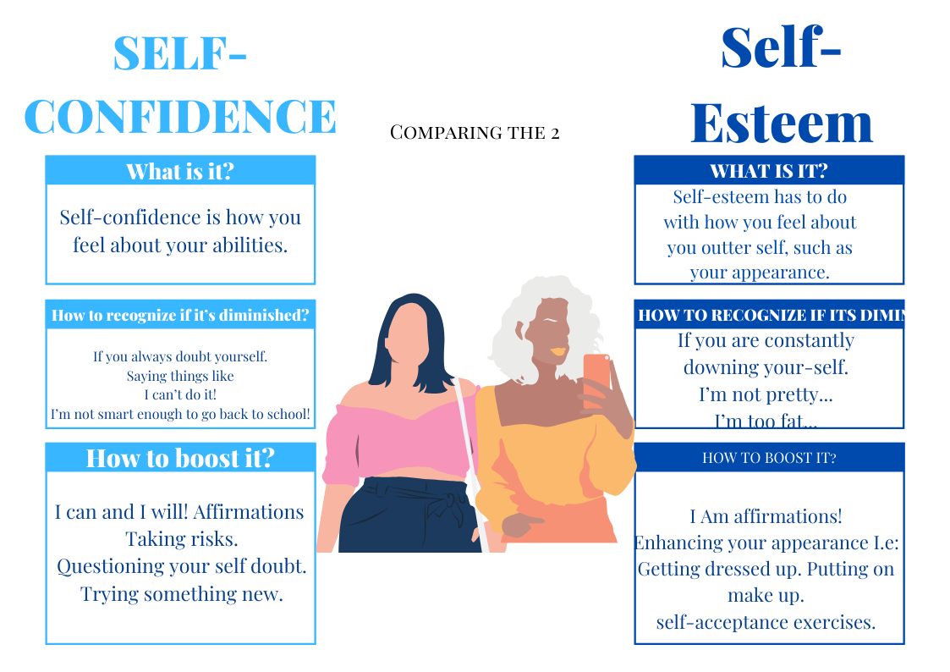

Slide 19

Self-Esteem vs. Self-Efficacy
Self-efficacy refers to the belief in one’s ability to succeed at certain tasks.
Unlike self-esteem, self-efficacy is more specific rather than global, and it is based on external success rather than internal worth.
I do have ability. But I don’t think so I can win.

Slide 20
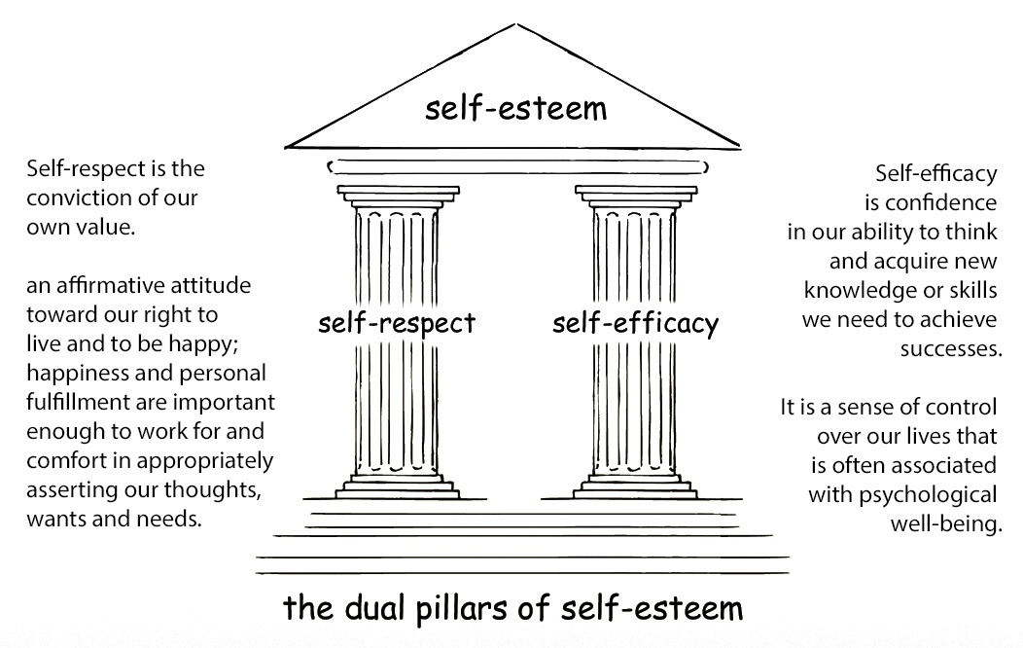

Slide 21
How to increase Self-Esteem
Set realistic expectations.
Stop being a perfectionist.
Explore yourself.
Be willing to adjust your self-image.
Stop comparing yourself to others.
Meditate
Practise assertiveness

Slide 22
CBT TECHNIQUE TO INCREASE
SELF ESTEEM:-
1. Identify troubling conditions or situations
Think about the conditions or situations that seem to deflate your self-esteem. Common triggers might include:
A work or school presentation
A crisis at work or home
A challenge with a spouse, loved one, co-worker or other close contact
A change in roles or life circumstances, such as a job loss or a child leaving home

Slide 23
2. Become aware of thoughts and beliefs
Once you've identified troubling situations, pay attention to your thoughts about them. This includes what you tell yourself (self-talk) and your interpretation of what the situation means. Your thoughts and beliefs might be positive, negative or neutral. They might be rational, based on reason or facts, or irrational, based on false ideas.
Ask yourself if these beliefs are true. Would you say them to a friend? If you wouldn't say them to someone else, don't say them to yourself.

Slide 24
3. Challenge negative or inaccurate thinking
Your initial thoughts might not be the only way to view a situation — so test the accuracy of your thoughts. Ask yourself whether your view is consistent with facts and logic or whether other explanations for the situation might be plausible.
Be aware that it can be hard to recognize inaccuracies in thinking. Long-held thoughts and beliefs can feel normal and factual, even though many are just opinions or perceptions.
Also pay attention to thought patterns that erode self-esteem:
All-or-nothing thinking. You see things as either all good or all bad. For example, "If I don't succeed in this task, I'm a total failure."
Mental filtering. You see only negatives and dwell on them, distorting your view of a person or situation. For example, "I made a mistake on that report and now everyone will realize I'm not up to this job."
Converting positives into negatives. You reject your achievements and other positive experiences by insisting that they don't count. For example, "I only did well on that test because it was so easy."
Jumping to negative conclusions. You reach a negative conclusion when little or no evidence supports it. For example, "My friend hasn't replied to my email, so I must have done something to make her angry."
Mistaking feelings for facts. You confuse feelings or beliefs with facts. For example, "I feel like a failure, so I must be a failure."
Negative self-talk. You undervalue yourself, put yourself down or use self-deprecating humor. For example, "I don't deserve anything better."

Slide 25
4. Adjust your thoughts and beliefs
Now replace negative or inaccurate thoughts with accurate, constructive thoughts. Try these strategies:
Use hopeful statements. Treat yourself with kindness and encouragement. Instead of thinking your presentation won't go well, try telling yourself things such as, "Even though it's tough, I can handle this situation."
Forgive yourself. Everyone makes mistakes — and mistakes aren't permanent reflections on you as a person. They're isolated moments in time. Tell yourself, "I made a mistake, but that doesn't make me a bad person."
Avoid 'should' and 'must' statements. If you find that your thoughts are full of these words, you might be putting unreasonable demands on yourself — or on others. Removing these words from your thoughts can lead to more realistic expectations.
Focus on the positive. Think about the parts of your life that work well. Consider the skills you've used to cope with challenging situations.
Consider what you've learned. If it was a negative experience, what might you do differently the next time to create a more positive outcome?
Relabel upsetting thoughts. You don't need to react negatively to negative thoughts. Instead, think of negative thoughts as signals to try new, healthy patterns. Ask yourself, "What can I think and do to make this less stressful?"
Encourage yourself. Give yourself credit for making positive changes. For example, "My presentation might not have been perfect, but my colleagues asked questions and remained engaged — which means that I accomplished my goal."

Slide 26
Techniques based on acceptance and commitment therapy:-
1. Identify troubling conditions or situations
Again, think about the conditions or situations that seem to deflate your self-esteem. Once you've identified troubling situations, pay attention to your thoughts about them.
2. Step back from your thoughts
Repeat your negative thoughts many times or write them down in an unusual way, such as with your nondominant hand. Imagine seeing your negative thoughts written on different objects. You might even sing a song about them in your mind.
These exercises can help you take a step back from thoughts and beliefs that are often automatic and observe them. Instead of trying to change your thoughts, distance yourself from your thoughts. Realize that they are nothing more or less than words.

Slide 27
3. Accept your thoughts
Instead of fighting, resisting or being overwhelmed by negative thoughts or feelings, accept them. You don't have to like them, just allow yourself to feel them.
Negative thoughts don't need to be controlled, changed or acted upon. Aim to lessen the power of your negative thoughts and their influence on your behavior.
These steps might seem awkward at first, but they'll get easier with practice. As you begin to recognize the thoughts and beliefs that are contributing to your low self-esteem, you can counter them or change the way you think about them. This will help you accept your value as a person. As your self-esteem increases, your confidence and sense of well-being are likely to soar.
In addition to these suggestions, try to remember on a daily basis that you're worth special care. To that end, be sure to:
Take care of yourself. Follow good health guidelines. Try to exercise at least 30 minutes a day most days of the week. Eat lots of fruits and vegetables. Limit sweets, junk food and animal fats.
Do things you enjoy. Start by making a list of things you like to do. Try to do something from that list every day.
Spend time with people who make you happy. Don't waste time on people who don't treat you well

Slide 28
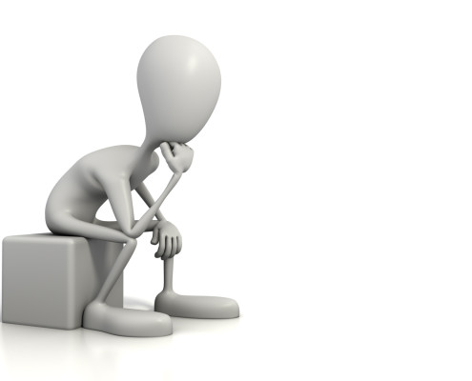
How to strengthen attitude towards Yourself.
1.Spend time with people who lift you up
2. Give back by helping others
3. Celebrate your achievements, no matter the size
4. Do what makes you happy
5. Change what you can – and let go of what you can’t
6. Let go of perfectionism ideals
7. Speak to yourself like a friend
8. Get involved in extra-curriculars
9. Own your uniqueness
10. Create a positive self-dialogue.

Slide 29
Thank You
As long as you look for someone else to validate who you are by seeking their approval, you are setting yourself up for disaster. You have to be whole and complete in yourself. No one can give you that. You have to know who you are—what others say is irrelevant.” - Nic Sheff

