Slide 1
Freud’s Psychosexual Stages of Development and Defense Mechanisms
By
Daniya Zabeen
Psychologist
Emotionoflife

Slide 2
Sigmund Freud
According to the famous psychoanalyst Sigmund Freud, children go through a series of psychosexual stages that lead to the development of the adult personality.
He described how personality develops over the course of childhood.

Slide 3
Psychological Development
Freud (1905) believed that life was built round tension and pleasure.
He also believed that all tension was due to the build-up of libido (sexual energy) and that all pleasure came from its discharge.
He used the term 'sexual' in a very general way to mean all pleasurable actions and thoughts.

Slide 4
Contd..
Freud proposed that psychological development in childhood takes place during five psychosexual stages.
These are called psychosexual stages because each stage represents the fixation of libido (sexual drives or instincts) on a different area of the body.
According to Freud, as a person grows physically certain areas of their body become important as sources of potential frustration (erogenous zones), pleasure or both.

Slide 5
Contd..
Freud stressed that the first five years of life are crucial to the formation of adult personality.
The id must be controlled in order to satisfy social demands; this sets up a conflict between frustrated wishes and social norms.
The ego and superego develop in order to exercise this control and direct the need for gratification into socially acceptable channels. Gratification centers in different areas of the body at different stages of growth, making the conflict at each stage psychosexual.

Slide 6
Psychosexual Stages
Freud proposed that psychological development in childhood takes place during five psychosexual stages:
Oral
Anal
Phallic
Latency
Genital

Slide 7
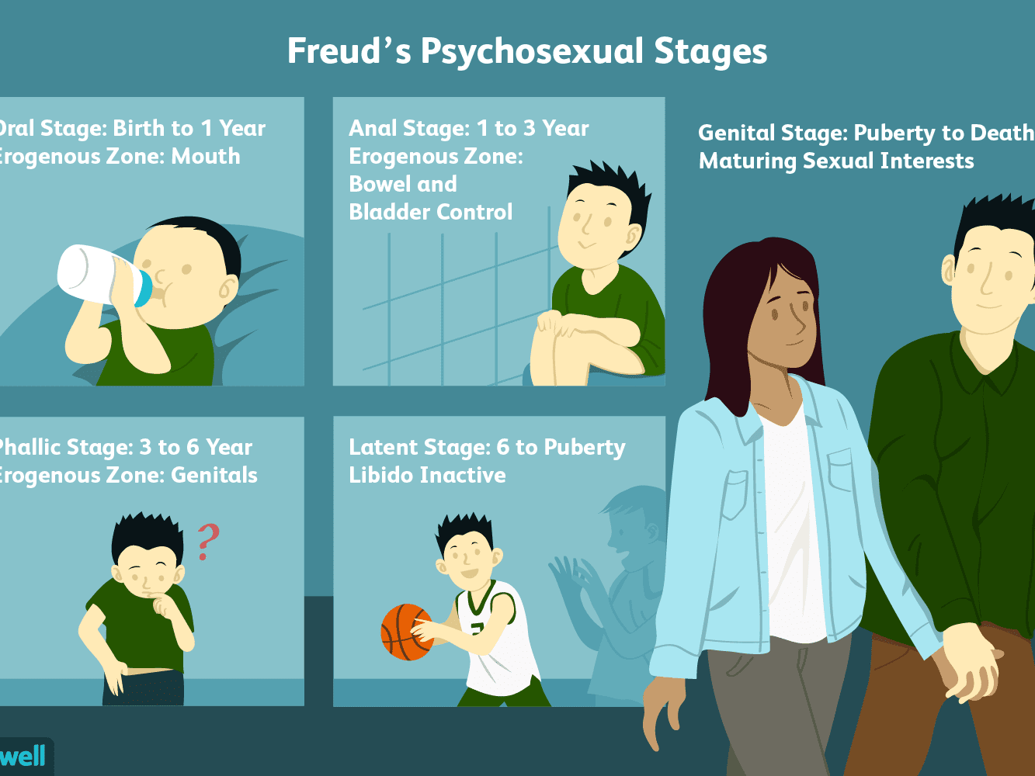
Contd..

Slide 8
Oral Stage (Birth to 1 year)
Erogenous Zone: Mouth
The libido is centered in a baby's mouth.
It gets much satisfaction from putting all sorts of things in its mouth to satisfy the libido, and thus its id demands.
Such as sucking, swallowing, biting, and breastfeeding.
Freud said oral stimulation could lead to an oral fixation in later life. Oral personalities such as smokers, nail-biters, finger-chewers, and thumb suckers.
Oral personalities engage in such oral behaviors, particularly when under stress.

Slide 9
Anal Stage (1 to 3 Years)
Erogenous Zone: Bowel and Bladder Control
The libido now becomes focused on the anus.
The child is now fully aware that they are a person in their own right and that their wishes can bring them into conflict with the demands of the outside world.
Such as withholding, expelling faeces.
Their ego has developed.
Early or harsh potty training can lead to the child becoming an anal-retentive personality who hates mess, is obsessively tidy, punctual and respectful of authority. They can be stubborn and tight-fisted with their cash and possessions.

Slide 10
Phallic Stage (3 to 6 Years)
Erogenous Zone: Genitals
Sensitivity now becomes concentrated in the genitals and masturbation becomes a new source of pleasure.
The child becomes aware of anatomical sex differences, which sets in motion the conflict between erotic attraction, resentment, rivalry, jealousy and fear which Freud called the Oedipus complex (in boys) and the Electra complex (in girls).
This is resolved through the process of identification, which involves the child adopting the characteristics of the same sex parent.

Slide 11
Latency Stage (6 Years to Puberty)
Erogenous Zone: Sexual Feelings Are Inactive
Freud thought that most sexual impulses are repressed during the latent stage, and sexual energy can be sublimated towards school work, hobbies, and friendships.
Much of the child's energy is channeled into developing new skills and acquiring new knowledge, and play becomes largely confined to other children of the same gender.
The latent period is a time of exploration in which the sexual energy repressed or dormant. This energy is still present, but it is sublimated into other areas such as intellectual pursuits and social interactions. This stage is important in the development of social and communication skills and self-confidence.

Slide 12
Genital Stage (Puberty to Death)
Erogenous Zone: Maturing Sexual Interests
It is a time of adolescent sexual experimentation, the successful resolution of which is settling down in a loving one-to-one relationship with another person.
Sexual instinct is directed to heterosexual pleasure, rather than self-pleasure.
The goal of this stage is to establish a balance between the various life areas.
If the other stages have been completed successfully, the individual should now be well-balanced, warm, and caring.

Slide 13
THANK YOU
Emotion Of Life www.emotionoflife.co.in
Email: info@emotionoflife..in
Phone: 7678694626

