Slide 1
Defense
Mechanisms
By
Daniya Zabeen
Psychologist
Emotionoflife

Slide 2
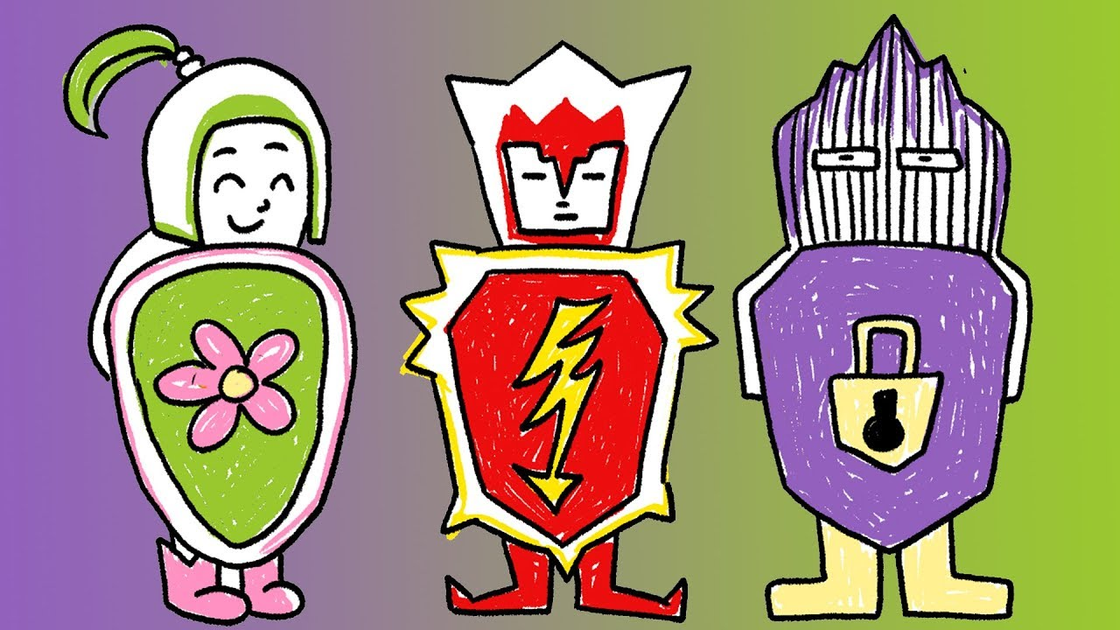
Defence Mechanism

Slide 3
Defence Mechanism
Defense mechanisms are behaviors people use to separate themselves from unpleasant events, actions, or thoughts. These psychological strategies may help people put distance between themselves and threats or unwanted feelings, such as guilt or shame that are developed during the stages of development.
In most cases, these psychological responses are not under a person’s conscious control.

Slide 4
Contd..
A defence mechanism is an unconscious psychological mechanism that reduces anxiety arising from unacceptable or potentially harmful stimuli.
Defence mechanisms may result in healthy or unhealthy consequences depending on the circumstances and frequency with which the mechanism is used.
Defence mechanisms are psychological strategies brought into play by the unconscious mind to manipulate, deny, or distort reality in order to defend against feelings of anxiety and unacceptable impulses and to maintain one's self-schema or other schemas.

Slide 5
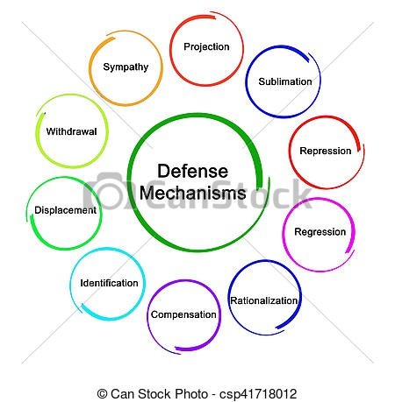
Types of Defenses

Slide 6
Repression
It "ensures that what is unacceptable to the conscious mind, and would if recalled arouse anxiety, is prevented from entering into it.
Unsavory thoughts, painful memories, or irrational beliefs can upset you. Instead of facing them, you may unconsciously choose to hide them in hopes of forgetting about them entirely.
That does not mean, however, that the memories disappear entirely. They may influence behaviors, and they may impact future relationships. You just may not realize the impact this defense mechanism is having.
The burying of a painful feeling or thought from one's awareness even though it may resurface in a symbolic form.
When a feeling is hidden and forced from the consciousness to the unconscious because it is seen as socially unacceptable.
Example:
An adult suffers a nasty spider bite as a child and develops an intense phobia of spiders later in life without any recollection of the experience as a child..
Associated disorders: Somatoform Disorders, Body Dysmorphic Disorders

Slide 7
Regression
Some people who feel threatened or anxious may unconsciously “escape” to an earlier stage of development.
This type of defense mechanism may be most obvious in young children. If they experience trauma or loss, they may suddenly act as if they’re younger again. They may even begin wetting the bed or sucking their thumb.
Adults can regress, too. Adults who are struggling to cope with events or behaviors may return to sleeping with a cherished stuffed animal, overeat foods they find comforting, or begin chain smoking or chewing on pencils or pens. They may also avoid everyday activities because they feel overwhelming.
Associated disorders: Substance Abuse, Schizophrenia, Generalized Anxiety & Panic Disorder, OCD

Slide 8
Rationalization
Some people may attempt to explain undesirable behaviors with their own set of “facts.” This allows you to feel comfortable with the choice you made, even if you know on another level it’s not right.
Rationalization encourages irrational or unacceptable behavior, motives, or feelings.
For example, people who might be angry at co-workers for not completing work on time could be ignoring the fact that they’re typically late, too.
Example:
“I didn’t pass the exam because it was way more difficult than previous years.”
“I didn't get the job that I applied for, but I really didn't want it in the first place.”

Slide 9
Denial
Denial is one of the most common defense mechanisms. It occurs when you refuse to accept reality or facts. You block external events or circumstances from your mind so that you don’t have to deal with the emotional impact. In other words, you avoid the painful feelings or events.
This defense mechanism is one of the most widely known, too. The phrase, “They’re in denial” is commonly understood to mean a person is avoiding reality despite what may be obvious to people around them.
Example:
A student may refuse to recognize their obvious lack of preparedness for an exam.
Smokers may refuse to admit to themselves that smoking is bad for their health.
Associated disorders: Substance abuse

Slide 10
Projection
Some thoughts or feelings you have about another person may make you uncomfortable. If you project those feelings, you’re misattributing them to the other person.
Includes severe prejudice and jealousy, hyper vigilance to external danger, and "injustice collecting", all with the aim of shifting one's unacceptable thoughts, feelings and impulses onto someone else, such that those same thoughts, feelings, beliefs and motivations are perceived as being possessed by the other.
Example:
A cheating spouse who suspects their partner is being unfaithful.
You may dislike your new co-worker, but instead of accepting that, you choose to tell yourself that they dislike you. You see in their actions the things you wish you could do or say.

Slide 11
Displacement
You direct strong emotions and frustrations towards a person or object that doesn’t feel threatening. This allows you to satisfy an impulse to react, but you don’t risk significant consequences.
A good example of this defense mechanism is getting angry at your child or spouse because you had a bad day at work. Neither of these people is the target of your strong emotions, but reacting to them is likely less problematic than reacting to your boss.
Example:
An employee who is angry with their boss. They take out their anger on their spouse when they get home. Now angry themselves, the spouse might be irritable with their children. In turn, the kids might take their frustrations out on each other.
A client is aggressive at his doctor, does not express it but, becomes verbally abusive to the nurse.
Associated disorders: Phobias

Slide 12
Sublimation
This type of defense mechanism is considered a positive strategy. That’s because people who rely on it choose to redirect strong emotions or feelings into an object or activity that is appropriate and safe.
For example, instead of lashing out at your employees, you choose to channel your frustration into kickboxing or exercise. You could also funnel or redirect the feelings into music, art, or sports.
Example:
You have an almost obsessive need to have control over even the smallest details in your life.
(I hate my dad, I wish to beat him)I play violent video games.

Slide 13
Reaction Formation
People who use this defense mechanism recognize how they feel, but they choose to behave in the opposite manner of their instincts.
A person who reacts this way, for example, may feel they should not express negative emotions, such as anger or frustration. They choose to instead react in an overly positive way.
Example:
Treating someone you strongly dislike in an excessively friendly manner in order to hide your true feelings.
A boy may really like a girl but act like hew does not and disinterested around her.
Associated disorders: Delusional Disorder, Mood Disorders (Depression), Obsessive-Compulsive Disorder

Slide 14
Compartmentalization
Separating your life into independent sectors may feel like a way to protect many elements of it.
A defense mechanism that we use to avoid the anxiety that arises from the clash of contradictory values or emotions.
Example:
A manager can think of himself as nurturing and sensitive at home, but a hard-nosed tough guy at work.
When you choose to not discuss personal life issues at work, you block off, or compartmentalize, that element of your life. This allows you to carry on without facing the anxieties or challenges while you’re in that setting or mindset.

Slide 15
Intellectualization
When you’re hit with a trying situation, you may choose to remove all emotion from your responses and instead focus on quantitative facts.
The person avoids uncomfortable emotions by focusing on facts and logic.
A defense mechanism by which reasoning is used to block confrontation with an unconscious conflict and its associated emotional stress – where thinking is used to avoid feeling. It involves removing one's self, emotionally, from a stressful event.
Example:
A person told they have cancer asks for details on the probability of survival and the success rates of various drugs.
You may see this strategy in use when a person who is let go from a job choose to spend their days creating spreadsheets of job opportunities and leads.

Slide 16
Compensation
Overachieving in one area to compensate for failures in another.
Is a strategy whereby one covers up, consciously or unconsciously, weaknesses, frustrations, desires, or feelings of inadequacy or incompetence in one life area through the gratification or (drive towards) excellence in another area.
Example:
Individuals with poor family lives may direct their energy into excelling above and beyond what is required at work.
A physically handicapped boy is unable to play football, so he compensates by becoming a great scholar.

Slide 17
Identification
An attempt to increase self worth by acquiring certain attributes and characteristics of an individual one admires.
The process whereby the individual assimilates an aspect, property, or attribute of the other and is transformed wholly or partially by the model that other provides. It is by means of a series of identifications that the personality is constituted and specified.
Example:
A group of people who like the same music.
A teenaged boy who required lengthy rehabilitation after an accident decides to become a physical therapist as a result of his experiences.
Associated disorders: Schizophrenia, Mood Disorders (Depression)

Slide 18
Undoing
Trying to make up for what one feels are inappropriate thoughts, feelings, or behaviors (e.g., if you hurt someone's feelings, you might offer to do something nice for them in order to assuage your anxiety or guilt).
The defense mechanism by which individuals avoid conscious awareness of disturbing impulses by thinking or acting in a way intended to revert (“make un-happen”) those impulses, even if only at a symbolic level
Example:
After thinking about being violent with someone, one would then be overly nice or accommodating to them.
A daughter shouts at her father as there is no petrol in the car and is getting late for office, brings a favorite film for her father to watch. This is an example of undoing her behavior of shouting and then bringing a film.
Associated disorders: OCD

Slide 19
Some other defenses used are:
Avoidance: Refusing to deal with or encounter unpleasant objects or situations.
Fantasy: Avoiding reality by retreating to a safe place within one's mind.
Altruism: Satisfying internal needs through helping others.
Humor: Pointing out the funny or ironic aspects of a situation.

Slide 20
THANK YOU
Emotion Of Life www.emotionoflife.co.in
Email: info@emotionoflife..in
Phone: 7678694626

