Slide 1
Emotion of life
OCD recovery and CURE IS POSSIBLE
                OCD
                By: Shyam Gupta
Senior Psychologist and OCD Therapist
Exclusive provider of OCD Management as treatment in India

Slide 2
OBSESSIVE COMPULSIVE DISORDER
Obsessive-compulsive disorder (OCD) is a thought process, Cognitive and Perception issue. The person who suffer with OCD feel urges to perform certain routines /acts /rituals as a compulsion repeatedly or has certain uncontrollable thoughts or urges. While suffering with OCD, the person is not able to control either the thoughts or compulsions for more than a short period of time.
In simple words, it means excessive thoughts (obsessions) that lead to repetitive behaviors (compulsions). OCD causes repeated unwanted thoughts (obsessions) or the desire to do something over and over again as an act (compulsions).

Slide 3
OBSESSIVE COMPULSIVE DISORDER
Some people have only obsessions or compulsions, but most sufferers have both. OCD is not always about habits like thinking negatively. Obsessive thought might be related with some specific body posture, some colors or some numbers that the sufferer considers as “good” or “bad” whereas a compulsive habit can be to wash your hands multiple times like 5 times or 15 times and after touching something person feel dirty.
Though you might not want to think or do these things you usually feel powerless to stop those obsessions and compulsions. People with OCD take actions or have thoughts that are beyond their control that others likely manage at their own.

Slide 4
OBSESSIVE COMPULSIVE DISORDER
Obsessions are those thoughts and beliefs which we know that those thoughts and beliefs are illogical and irrational.
But these obsessional thoughts and beliefs are such complex and rigid, even though we know that these thoughts are not true and real, we are still not able to come out of those rigid chains of thoughts.
Once these obsessive thoughts and beliefs comes in our mind these thought create anxiety and to get rid from this anxiety we do a certain compulsion/ act/ ritual either on a physical level or a mental level.
Once we do these compulsions, we feel little relived.

Slide 5
OBSESSIVE COMPULSIVE DISORDER
This relief can be achieved by performing the ritual 1 to 20 times. This state of mind of being less anxious can remain for few second/minutes and this relax state varies from individual to individual.
Once these obsessional thoughts come back it further create anxiety and distress again. So again and again person having OCD cycle do the compulsive act to get rid of the anxiety.
This is the vicious cycle of obsessive compulsive disorder.

Slide 6
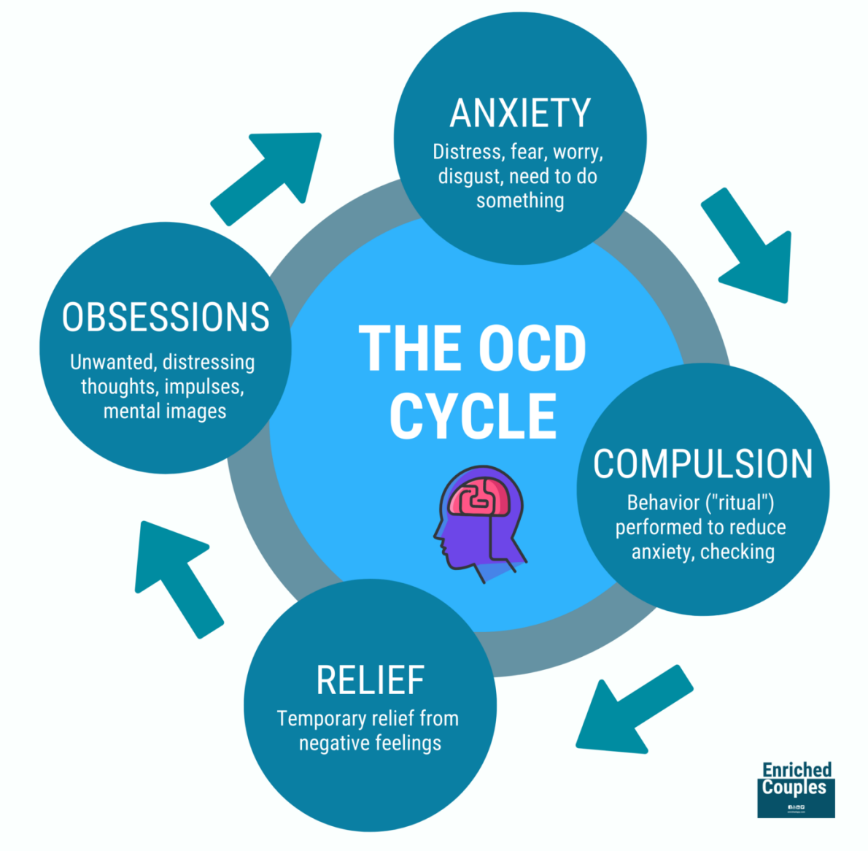
Vicious cycle of OCD

Slide 7
Solution of OCD
For recovery from OCD, we need to deal with all those obsessional thoughts with rational thinking and logical pattern framework. During the journey of recovery with your therapist you learn socially adaptive believe system related with your obsessions which is already in use and in practice by others in society.
We need to put out all the problem situations (our obsessional thoughts) which we are facing with our subject matter expert during the therapy as cognitive restructuring process to get rid and recovered and cure from OCD.

Slide 8
What need to kept in mind for OCD Management
OCD is neither a physical health issue nor a mental issue. OCD is a perception issue related to thought processing and cognitive issues. So, it is very important to prioritize this issue and to take your OCD suffering to a therapist/psychologist who can help in cognitive restructuring.
Psychological intervention is the first choice of treatment instead of visiting a psychiatrist or doctor.

Slide 9
Choice of treatment for OCD
Medicine does not 100% cure OCD. Medicine can help higher side 20% to 30 %. Therapeutic intervention is a permanent solution and cure.
Therapy sessions is first choice of treatment which will help you to prevent your further worsening impact of OCD like disrupting activities, poor daily routine and overall quality of life And put you in path of OCD recovery.

Slide 10
OCD Recovery Rate in CBT
OCD is 100% curable and recoverable with dedicated effort by your client, therapist and family members with strategic planning and execution of therapy plan implementation with consistent review of therapy application for cognitive restructuring as course correction without medicine.
You can witness 25% improvement each month and get recovered from OCD in 4 months daily session model. if follow the process and recommendation of CBT process and ERP activity.

Slide 11
SYMPTOMS in Obsessions
Common symptoms obsessions are impulsivity, compulsive repetitive behavior, sometimes meaningless repetition of own words, social isolation, agitation, feeling persistent anxiety, panic attack, feeling guilty, hyper vigilance about body functioning, nightmares, certain thought which might create perspiration randomly or repeated intrusive thoughts.

Slide 12
SYMPTOMS in Obsessions
1. The fear of falling ill due to the contamination of germs and bacteria.
2. Fear of losing control
3. Paying extreme attention to symmetry (order)
4. Apprehensive approach in day-to-day life like expecting negative outcome
5. Fear of harming self or someone close (especially family member)
6. Violent and aggressive intrusive thoughts, visuals & images
7. Having excessive beliefs about morality; like things must be or should be by them self
8. Doubt about whether they have locked or turned off properly, like gate lock, turn off tap, light switches, gas nob, car lock, almirah lock, other electronic device like laptop or mobile
9. Feeling loosing valuable article like gold, mobile, keys, money etc.
10. Doubting what if they have posted inappropriate, personal information on social media
11. Intrusive thoughts related with sexual thought, images, visual, doing sexual activity with God or someone within family or close one.

Slide 13
SYMPTOMS in Obsessions
12. Trying to do things or task in perfect and best possible way
13. Persistent unclear suspicion of something bad will happen
14. Hyper vigilant about their own bodily function like pulse rate, heart rate, swallowing, sensation in leg, hand, eye, stomach, shoulder and other body movement
15. Having the doubt whether they have shut down electronic device laptop, mobile, email properly or not
16. Intrusive thought related with their own gender whether they are male or female
17. Doubt whether they are gay or bisexual or lesbian or about their sexual preference.
18. Doubting about their own photo and video someone will take and post on internet for inappropriate use and their name will defame
19. Mistrust with partner like they will leave them or have doubt that their partner will have other relationship
20. Having the doubt they will loose skill like writing skill, painting, sports related skills, whether good study habits will remain with them or not or they will forget
21. Doubt related with own existence with mindset like why they are living and why people are living, what is need to live
22. Having the doubt whether god exist in universe or not.

Slide 14
Common symptoms in compulsion
1. Trying to too rigorous cleaning of self like hand or any other body part like legs, face, arms or most of the time individual own house and person stuff repeatedly and frequent complain about others is not maintaining cleaning and pushing them for cleaning.
2. Trying to do continuous worship in different way throughout the day more than 3 hours.
3. Trying to check their electronic device if something they might have post by mistake.
4. Trying to seek reassurance from family members about their own safety and others in family members safety related questions repeatedly and not getting satisfy even after dozen of reassurance from care giver.
5. Trying to maintain high level of perfection in day to day life & trying to do at most best else feel restless.
6. Try to validate if their intrusive thought is happening or not from different sources.
7. Trying to arrange things multiple time and not getting satisfy,
8. Trying to check different locked item multiple time and not getting satisfaction and trying to validate from self and others and remain bother out of those compulsion.
9. Doing certain act and ritual in unique way regardless of need
10. Counting numbers, things, floor tiles, houses number, and something which other might not need to do or following certain pattern but even after doing feeling restless.
11. Avoiding places, situations, people, group and certain social media and television channel and episode.

Slide 15
Impact of OCD in life
OCD create negative Impact in following areas of your Life:
A· Professional life
B· Academic life
C· Social life
D· Mental Health
E. Emotional Health
F· Sexual life
G· Spiritual life
H. Personality and over all quality of life
OCD affect your overall existence, if someone have OCD, they may spend up to 12 - 18 hours in thinking and compulsive acts and it vary person to person OCD severity and range and type of pattern and frequency.

Slide 16
DIAGNOSTIC CRITERIA OF OCD:
Obsession symptoms or compulsive acts or both must be present on most days for at least 2 successive weeks and be a source of distress or interference in life. The obsession symptoms should have the following:
1. They must be recognized as the individuals’ own thoughts or impulses.
2. There must be at least one thought or act that is still resisted unsuccessfully, even though others may be present which the sufferer no longer resists.
3. The thought of carrying out the act must not in itself be pleasurable.
4. The thoughts, images or impulses must be unpleasantly repetitive.

Slide 17
PSYCHOLOGICAL CAUSES OF OCD
There are certain feelings and emotions majority of OCD sufferer have in their thought process that make them vulnerable for developing and maintaining OCD. Those feeling and emotion are mention below.
A. Feeling of Guilt
B. Feeling of Rejection
C. Feeling of Failure
D. Feeling of Extreme un-satisfaction in life
E. Feeling of regret
F. Stuck with unexpressed emotions
G. Imitation of act from their surrounding in contamination and religious OCD
H. Poor parenting in late childhood and early adolescent age

Slide 18
Guilt and regret associated with OCD
Out of 100, 95 Plus percent of OCD victims have these minimum 3 feelings and negative emotions in their thought process that make them vulnerable to have OCD and continuation of these feelings that further aggravate OCD.
Due to not getting rid of these constant feelings at thought process at conscious level or unconscious level, OCD continues in sufferer life. Even after years of medication sufferer are not able to come out from their OCD.
What an OCD sufferer need for recovery is to identify these feelings and emotions from their different level of consciousness through systemic process of personality dynamic assessment, unconscious mind study, analysis of their OCD pattern and trends with therapist and work on them with systematic integrated approach of recovery.

Slide 19
OCD recovery process
Once these thoughts and feelings are mapped and client start working on removing and restructure these negative emotion and feeling from conscious and unconscious mind and once client start adapting new socially acceptable thought process the chain of OCD cycle get end. After completing this recovery process sufferer become free from OCD.
Reaching to cure state in OCD management further require 6-month to 12 months structure follow-up and supervision is require to maintain new adopted thought process adherence and all these things require your assign therapist active engagement with client and family to eliminate any future relapse and to achieve cure state and ones life free from OCD.

Slide 20
recovery process and stages in Emotion of life “OCD recovery and cure program”
STRATEGIC PLANNING & EXECUTION OF THERAPY SESSIONS
1. Initial discussion over Call
2. First consultation for need assessment
3. Complete Personality assessment
4. OCD pattern and Trend Analysis
5. Developing customized Therapy plan
6. Discussion & explaining therapy plan
7. Foundation building as therapy preparedness session
8. CBT and ERP sessions 100 Days
9. Family Therapy Sessions must weekly
10. Progress monitoring monthly
11. Corrective measure if needed
12. Midterm evaluation
13. Relapse Management
14. End Term Evaluation
15. Termination of sessions after recovery.
16. Follow up, up to 6 months

Slide 21
Types of OCD
1. OCD of Contamination: Fear of dirt, cleaning, excessive hand wash, over time investment in bathing, too much sensitivity toward bodily fluid, and external environment.
2· OCD of Checking and Rechecking: such as locks, alarm systems, ovens, or light switches.
3· OCD Symmetry & Ordering: Need to have things lined up in a certain way.
4· OCD of perfection: doing things in perfect way
5· Ruminations and intrusive thoughts: an obsession with a line of thought.
6· OCD related with violent or disturbing.
7· OCD of Spirituality, Religion, God related fear, doing worship multiple times in a day
8· OCD related with Health Anxiety
_{9· OCD of Death}
10. OCD of Self Harm or Harm Others
11· OCD of Sexual Intrusive thoughts
12· OCD of Sexual orientation, Same-gender attraction, and Gender Identity

Slide 22
Types of OCD
13· OCD of Relationship
14· OCD of Existence about life
15· OCD of Hoarding
16· OCD related with child abuse Pedophilia
17· OCD of Hair Pulling
18· OCD of Magical thinking
19· OCD of sensory motor
20· OCD with comorbidity like depression or eating disorder or mood swings
21· OCD of moral responsibility
22. Post partum OCD, Fear of harming own child by mistake or unitentianally along with trying to too much care over children health safty after delivery
23. False memory OCD
24. Staring OCD
25. Multiple OCD, OCD type in which there are more than 3 sub types in person

Slide 23
Are all type of OCD is recoverable ??
People who have been diagnosed with OCD is most likely struggling to manage their obsession and compulsion along with associated negative emotions and to live a normal and healthy balance life. The challenge of managing, stopping or coping with the obsessive thoughts & managing compulsive behaviors can be extremely tiring for people in day to day life which may take lot of time in a person life and causing severe impairment in functioning. But there is always hope for recovery from your issues, Though anyone with OCD condition, regardless of what the thoughts and compulsive behaviors are present or how serious the symptoms they all are recoverable.
People with OCD with severe issue and low functioning can benefit from treatment in residential setting care specially in contamination OCD condition. In residential care person with OCD can focus on learning how to manage symptoms and overcome them and this can be accomplished under the guidance and supervision of a trained OCD therapist and Psychologist. Dedication efforts for OCD treatment for recovery a person can learn to successfully manage obsession and compulsion and can restore function to their normal lives.

Slide 24
Are all type of OCD is recoverable
Additionally along with CBT and ERP intervention in residential care person with OCD make able to use and practice exercises, nutrition counseling, group support, peer counseling, other therapeutic intervention based on customized need including family therapy session which help in holistic management that help a person to prepare to live successfully at home again.
OCD is a such a such issue that need to be given attention by person with OCD along with family members and caregiver without delay. once you identified the OCD issue because it can cause significant dysfunction, emotional disturbance and may further lead to other impairment in personality and mental health and in worse scenario it can lead to more complex mental health issue.
Regardless of the types of OCD as obsessional thoughts or behaviors as compulsion, OCD can be treated and managed without doubt but under supervision and guidance of professional. The prognosis of OCD is good if client is committed to dedicated treatment and to practicing healthy ways of coping with and managing obsessions and compulsions.

Slide 25
Consistency and trust is key
All the above OCD patterns and compulsions are completely recoverable with strategic planning and efforts by your therapist and by client. Consistence compliance of recommendations during recovery journey will assure definite results as well as complete recovery and cure.

