Slide 1




Overcoming Unwanted
Intrusive thoughts
Part 2
Volunteer - Shalini Sengupta
Under Guidance of - Mr. Shyam Gupta
30.05.23

Slide 2



Natural voices of the mind classified
Interplay of natural voices make our mental lives interesting and are responsible for decision making, choices to adapt to daily life.
Eg - JUdgemental inner voice criticising for mistakes, making us feel we are as good as others or the opposite- ego preservation.
In context of UIT - 3 voices are relevant - Worried voice, False comfort, Wise Mind.
Interplay of above three in unbalanced way perpetuates the problem of UIT.
The goal is to learn and recognise the dialogue between above 3 and intrude it to relate more neutrally to thoughts.

Slide 3


Understanding the Trifactor
  WORRIED VOICE - ‘ WHAT IF???’ . the voice responsible for articulating fears, doubts and misguided conclusions which predict the worst outcomes and tragedy. It is the Anxiety alarm. It seems irrational and even downright crazy. It issues strange and most often not needed urgent warnings. It annoys and interrupts and scares when it jumps to our mind. In OCD context, this is the obsession.
  FALSE COMFORT - FOLLOWS WV, IS DISTURBED AND TORMENTED BY WV. TRIES TO REMOVE THE DISCOMFORT CAUSED BY WV. BUT DOESN’T ACHIEVE IT’S PURPOSE AT ALL. INSTEAD JUST GIVES TEMPORARY RELIEF AND ILLUSION OF RATIONALITY. IT VEHEMENTLY TRIES TO PUT DOWN ALL THE NEGATIVITY BROUGHT ABOUT BY WV. IT IS SO SCARED OF WV, THAT IT TRIES TO ARGUE, CONTROL, AVOID, SUPPRESS, REASON WITH OR NEUTRALISE WV. IRONICALLY, FAILS HORRIBLY AT IT AND MAKES WV STRONGER, MAKES WV BRING UP MORE AND MORE LOOPY WHAT IF SCENARIOS THAT CASCADE. THE MORE FC TRIES TO GET RID OF WV, THE MORE WV STAYS AND FIGHTS BACK STRONGER. WV ANF FC GO INTO A LONG TUG OF WAR FOR UIT AND IS THE ESSENCE OF INTRUSIVE UNWANTED THOUGHT.
  Wise Mind - Our real friend. The state of compassionate awareness to the present, moment by moment. Involves observation of thoughts, feelings and sensations without acting on it, no act of jusdgmenet, evaluation or argument or justification. It’s the real time observer who can stand back and look at your experiences. This is the key to freedom from unwanted intrusive thoughts.

Slide 4



Example of interplay between the trifactor
That kitten is so cute and vulnerable, so petite. What if I strangle it? My fingers fit perfectly around it’s neck! No, you’re a nice person, you won’t do it. How do you know I’m nice? I felt rage yesterday on streets, what if I can’t control my anger? It’s natural to get angreya t times, but you didn’t act on it, stop thinking rubbish. It won’t happen. How can you be so sure? What IF I am a really disgusting sick idiot inside? Why else would such thought come? Argh, stop obsessing! Think about something else, you are not talking sense, you’re just being crazy. Now quickly think of something else before you again irritate me! Oh, so you think I’m becoming crazy? If I can have this thought now, who knows, what will happen tomorrow, maybe I will act, what if I become completely crazy?? What if I’m sent to an asylum? What if I ahrm myself or others….? What iF..? What if..? Okay I will intervene. These are just thoughts, mind always forms associations. I’m observing your dialogue. The more you try to justify, the more you both fight. The more you make it seem like a real issue which needs attention because you fight and make them seem important and something that needs to be solved. It’s actually just an intrusion and could happen to anyone. Has no real meaning. What if we just let it be? Let’s just let them remain as thoughts. :-)

Slide 5



Why thoughts get stuck? - Imp of the mind!
Exercise - Set timer for 5 mins. Close eyes and think about anything but carrots! Not the word, not their taste, not their smell, not orange, even not thinking that you can’t think of carrot. No salad. Everytime you catch yourself having any carrot thought, RESET timer and redo.
Result??
Most probably you thought about carrots immediately or after a few secs, reset, repeat, reset, repeat and on and on till you got frustrated, annoyed. The thoughts seem to come back sooner with every loop of trial! WHAT THE HELL?? tHE MORE i AM TRYING NOT TO THINK, THE MORE I AM!

Slide 6



IMPISH IRONIC MIND
Congratulations! We successfully created a stuck thought in our mind from last exercise.
The content is ‘carrot’ as uncontroversial and non-upsetting as can be, but we just made it very important to the mind. If we weren’t specifically being cautious to NOT think about it, we wouldn’t even care and probably carrot would not come to mind or we would let it go.
Learning - Attempt to control your mind has backfired!
What you resist tends to persist.
Thoughts stick because of the energy you expend to fight them off! What you fight, fights right back at you!

Slide 7
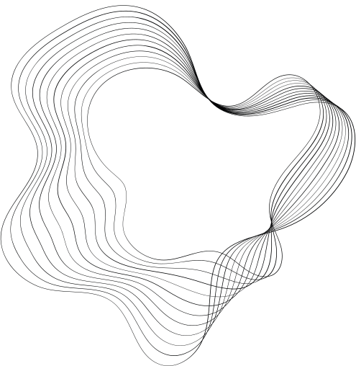

WHICH THOUGHTS ARE LIKELY TO GET STUCK?
ANY THEME IN THE THOUGHT WHICH DOES NOT ALIGN WITH OUR CURRENT VALUE SYSTEM ARE LIKELY TO GET STUCK.
If its opposite of what we believe in, we try very hard to remove the thought lets it makes us what we don’t want to be. Lest we do something which is uncharacteristic of what is right and correct to us. Eg, the most non violent person if has a violent thought, will associate his identity to it and be scared that he is violent and opposite of the lifestyle he currently values.
Again, you fight them they fight back.
Content is the opposite of what you WANT to think or happen. Opposite of values, wishes and character.

Slide 8
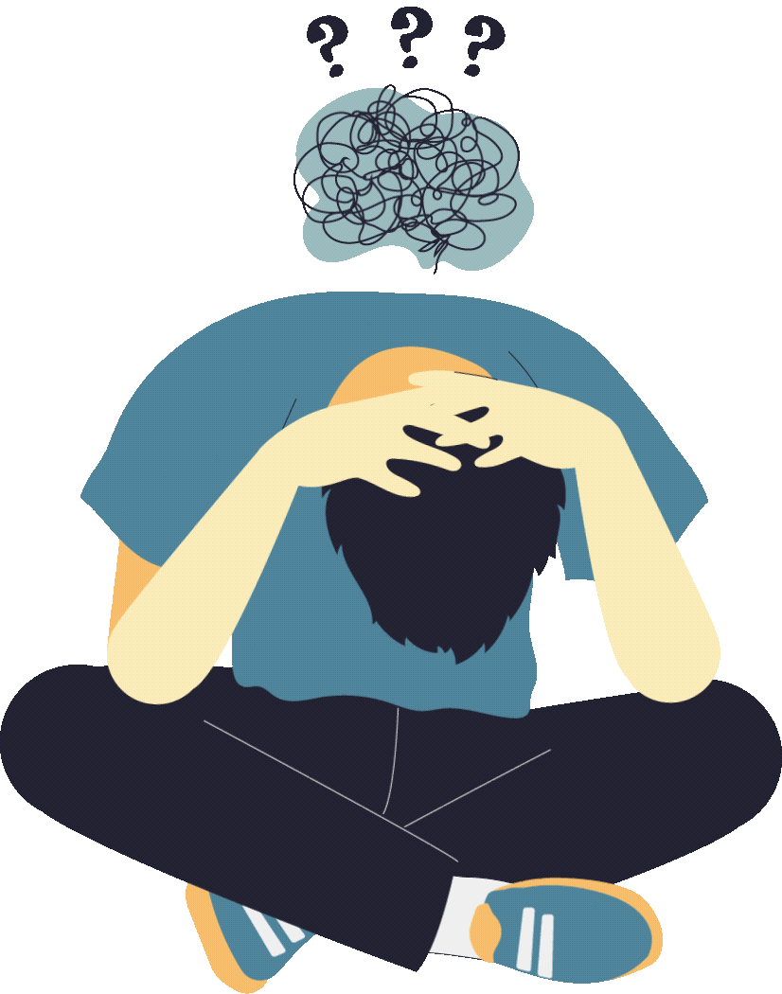
INTRUSIVE THOUGHTS VS IMPULSES
We are scared that we will act on out IT, do things the thought apprehensive poses. The more we struggle with this fear and try our best to push it away in mind or action- intensity increases. Soon the thought is accompanied by fear, disgust, shame, anger. Soon we feel compelled to do acts to avoid the feeling or feel like we will act impulsive on our fears. But this is a false alarm.
Suffering from UIT is a disorder of overcontrol. Accompanied by doubt/fear of uncertainty. Trying to control things you can’t control (thoughts) + need to be 100 percent sure nothing bad will happen - recipe for uit.
For eg. suffering from pedophillia fear might think they will harm a child but they believe they will impulsively do it. Fallacy!
Impulse is opposite of UIT because in former action precede thought and latter is vice versa.

Slide 9
When are UITs more likely?
WHEN MIND IS MORE ‘STICKY’ YOU GET STUCK IN THOUGHTS.
Hormones during menstruation, bad mood, bad sleep, drug use are all sticky aiding factors.
You feel sticky even about factors that make you stuck, you try to avoid them, as FC says that if you avoid sticky factors you'll not get stuck. Again starting UIT about not wanting UIT itself.
WM to rescue - It's okay if some days are sticky, if wes top our work because of it, it reinforces the belief that they are dangerous when they are just thoughts. Keep going about your day even when sticky!
High stakes + Uncertain situation + need to be 100 percent sure = thoughts will stick! Cascading thoughts which increase stakes increase stickiness sometimes more than the original thought.
WM is acceptance and surrender; IT points out seeking 100 percent security is useless unachievable and self defeating; SO, WV and FC would be happier if they stopped justifying and answering back and forth between themselves and let things be;

