Slide 1

The Poison of Perfectionism
Mr. Shyam gupta, Therapist,Emotion of life

Slide 2
MEANING
Perfectionism, in psychology, is a personality trait characterized by a person's striving for flawlessness and setting high performance standards, accompanied by critical self-evaluations and concerns regarding others' evaluations.

Slide 3
Normal vs. Neurotic
Normal perfectionists are more inclined to pursue perfection without compromising their self-esteem, and derive pleasure from their efforts.
Neurotic perfectionists are prone to strive for unrealistic goals and feel dissatisfied when they cannot reach them.

Slide 4
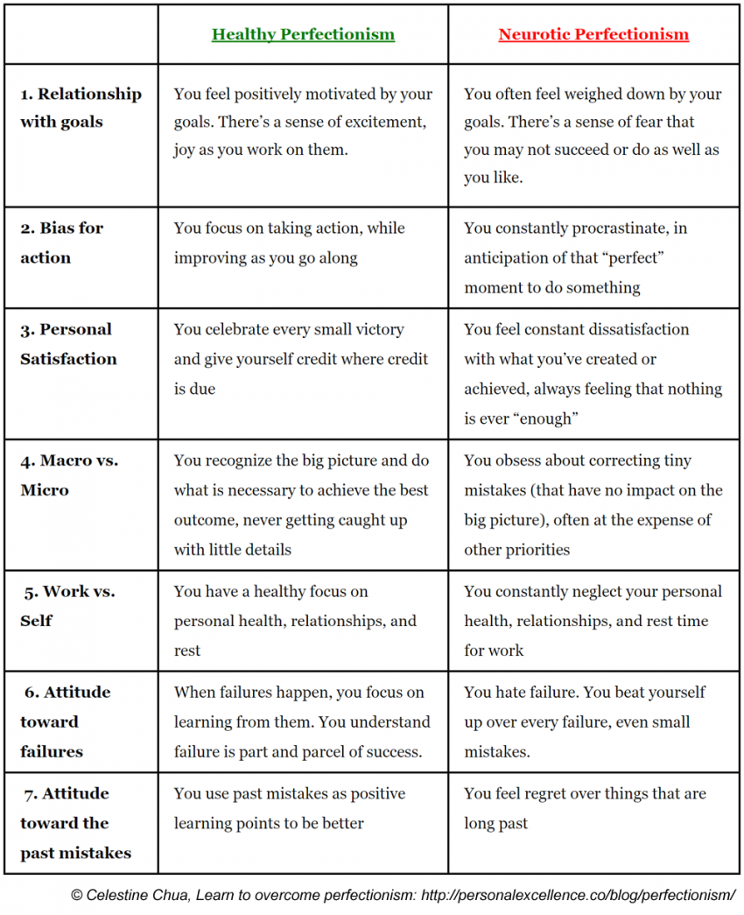

Slide 5
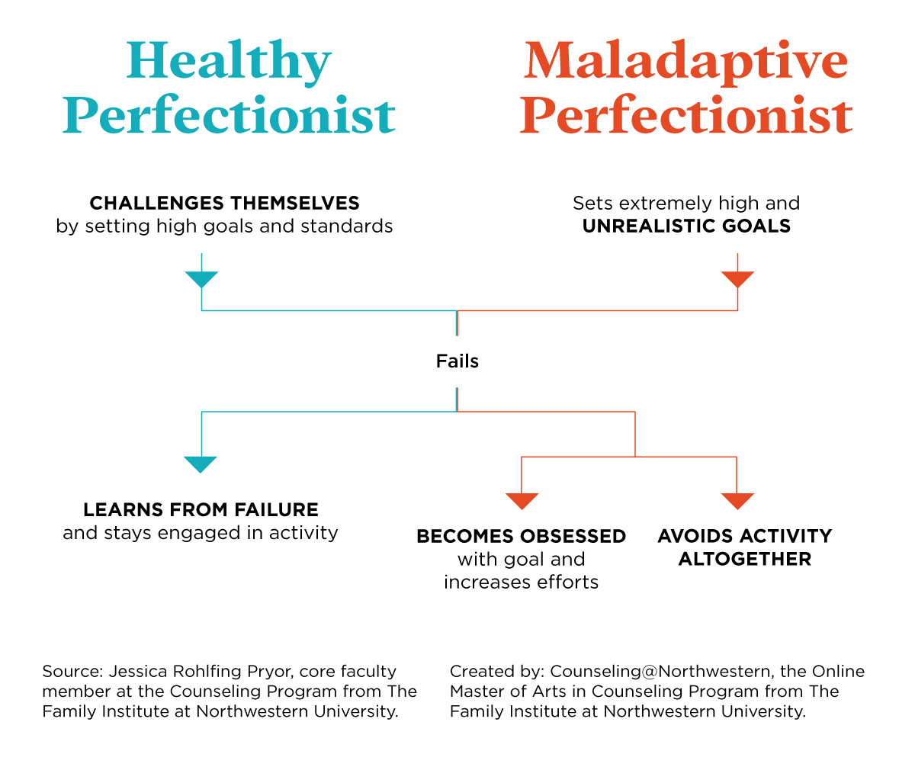
STRIVINGS VS. CONCERNS
Perfectionism consists of two main dimensions:
  Perfectionistic strivings
  Perfectionistic concerns.

Slide 6

Psychological implications
Socially prescribed perfectionism in young women has been associated with greater body-image dissatisfaction and avoidance of social situations that focus on weight and physical appearance.
Perfectionists are obsessives who need to feel in control at all times to protect themselves and ensure their own safety.

Slide 7
Components of Perfectionism
Self-oriented perfectionism is an intrapersonal dimension characterized by a strong motivation to be perfect, setting and striving for unrealistic self-standards, focusing on flaws, and generalization of self-standards.
Other-oriented perfectionism involves similar behaviors, but these behaviors are directed toward others instead of toward the self.
Self-oriented Socially prescribed perfectionism entails the belief that others have perfectionistic expectations and motives for oneself.

Slide 8

Positive aspects
Drive people to accomplishments and provide the motivation
Preferences for order and organization, a persistent striving for excellence, and conscientious orientation to tasks and performance .
Exceptionally talented people and geniuses are also often perfectionists.

Slide 9
Negative Aspects
Perfectionism has been associated with numerous other psychological and physiological complications:
  Suicide
  Anorexia nervosa
  Medical complications
  Narcissism
  General Applications

Slide 10
Negative Aspects
Suicide
Anorexia Nervosa
The tendency of perfectionists to have excessively high expectations of self and to be self-critical when their efforts do not meet the standard they have established combined with their tendency to show a "perfect face" to the world increases their risk of suicide ideation while decreasing the likelihood they will seek help when they should.
Perfectionism is a life enduring trait in the biographies of anorexics. It is felt before the onset of the eating disorder, generally in childhood, during the illness , and also, after remission.
The incessant striving for thinness among anorexics is itself a manifestation of this trait, of an insistence upon meeting unattainably high standards of performance.

Slide 11
Negative Aspects
General Applications
Medical complications
In the workplace, perfectionism is often marked by low productivity and missed deadlines. This can lead to depression, social alienation, and a greater risk of workplace "accidents".
In intimate relationships, unrealistic expectations can cause significant dissatisfaction for both partners.
They may be inflexible to change and lack creativity if problems arise.
Perfectionism is a risk factor for obsessive compulsive disorder, obsessive compulsive personality disorder, eating disorders, social anxiety, social phobia, body dysmorphic disorder, workaholism, self harm, substance abuse, and clinical depression as well as physical problems like chronic stress, and heart disease.

Slide 12
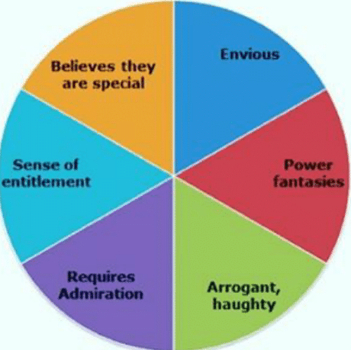

Narcissism
Narcissists often are pseudo-perfectionists and require being the center of attention and create situations where they will receive attention.

Slide 13
Signs You’re a Perfectionist
You can not stop thinking about a mistake you made.
You are intensely competitive and can't stand doing worse than others.
You either want to do something “just right” or not at all.
You demand perfection from other people.
You will not ask for help if asking can be perceived as a flaw or weakness.
You will persist at a task long after other people have quit.
You are a fault-finder who must correct other people when they are wrong.
You are highly aware of other people's demands and expectations.
You are very self-conscious about making mistakes in front of other people.
*You noticed the error in the title of this list

Slide 14
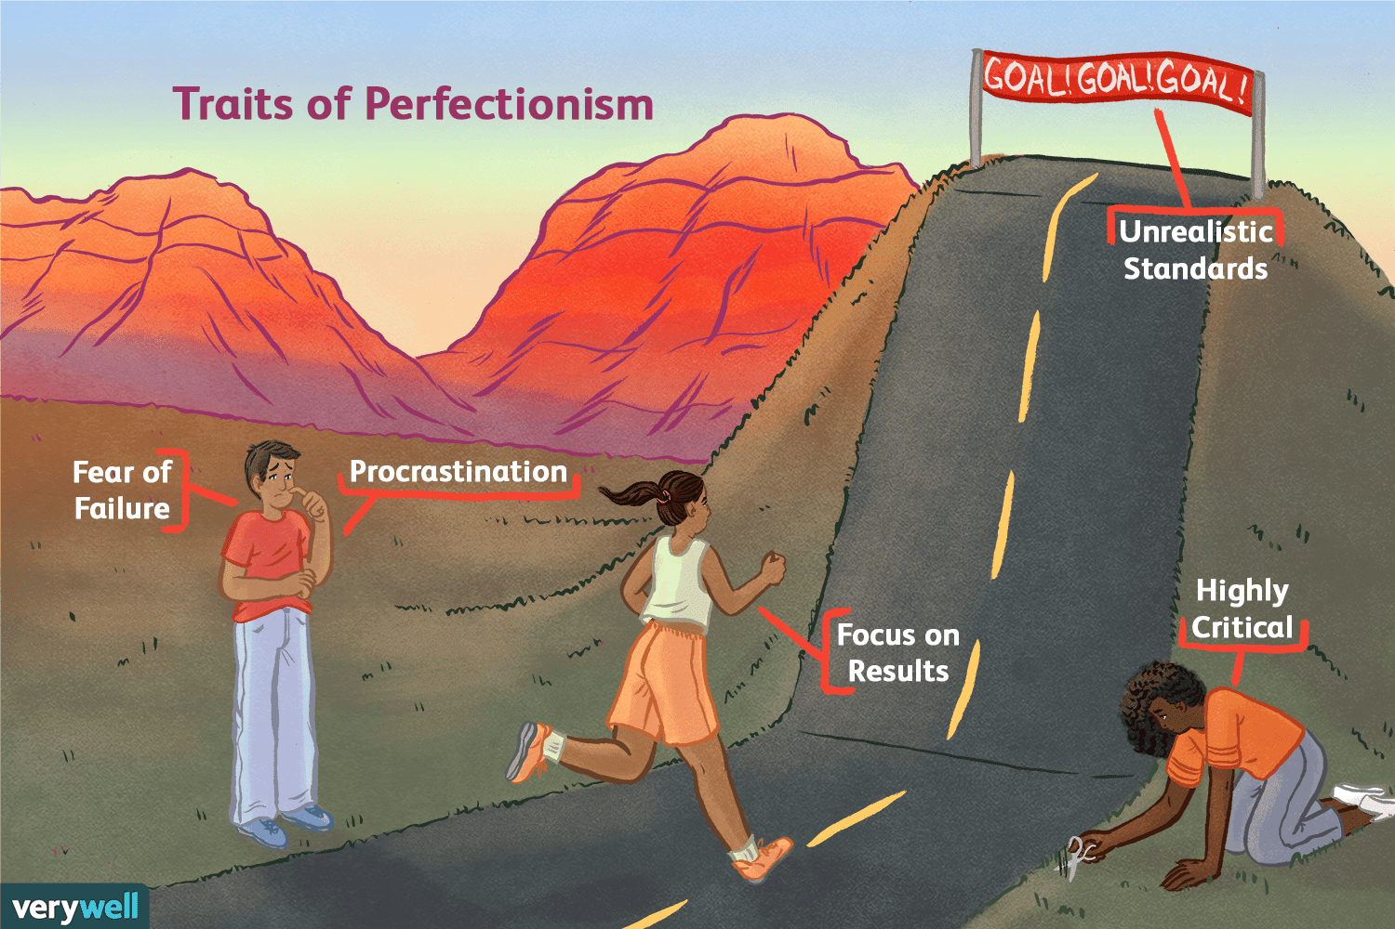
Common Traits of a Perfectionist
The following are ten traits of perfectionists, that you may be able to spot in yourself or in the people you know.
  All-or-Nothing Thinking
  Highly Critical
  Pushed by Fear
  Unrealistic Standards
  Focused on Results
  Depressed by Unmet Goals
  Fear of Failure
  Procrastination
  Defensiveness
  Low Self-Esteem

Slide 15

DOMAINS OF PERFECTIONISM
In the workplace or at school
Intimate relationships or friendships
Physical activity
Environment or surroundings
Hygiene and health
How one speaks or writes
Physical appearance

Slide 16

Causes of Perfectionism
Rigid, high parental expectations
Highly critical, shaming, or abusive parents
Excessive praise for your achievements
Low self-esteem or feeling inadequate
Believing your self-worth is determined by your achievements
Black-and-white thinking
Efforts to feel in control
Cultural and institutional expectations

Slide 17
4 Parenting Styles That Contribute to Perfectionism
Demanding Parents
  Demanding parents value achievements—external markers of success such as awards, grades, money, and titles — and are overly concerned with what other people think.
  Demanding parents tend to tell their children what to do rather than ask what the child wants, needs, or feels.
  Children with demanding parents become extremely hard on themselves. They constantly feel like they aren’t living up to their parents’ expectations, leaving them with a sense of shame, failure, and inadequacy. They internalized their parents’ goals and expectations.
  They also learn that love is conditional — that they are loveable only when they please others. Perfection becomes a way to gain acceptance, love, and praise.

Slide 18
Perfectionist Parents
Perfectionism can also be learned by children growing up with goal-oriented, driven, perfectionist parents who modeled or rewarded this way of thinking and acting.
Perfectionism is encouraged when children are praised excessively for their achievements rather than their efforts or progress. The focus is on what the child accomplishes rather than the process — or who he is as a person.
They model their value of a perfect family, house, and appearance through achieving at extremely high levels and attaining academic, career, or monetary success.

Slide 19
Distracted Parents
A distracted parent could be one who works eighty hours a week and isn’t physically or emotionally available.
Distracted parents usually meet their children’s physical needs but often neglect their emotional needs.
Perfectionism is a way for children of distracted parents to either get noticed or help their parents out.
They may not outwardly demand perfection, but some such parents give the message that success is what makes you worthwhile, while others relay the message that the child isn’t enough to garner their attention.

Slide 20
Overwhelmed Parents
Some parents are chronically overwhelmed due to their own trauma, mental illness, addiction, or cognitive impairment or by chronic stressors such as a very sick child, unemployment, poverty, health problems, or living in a violent community.
There is either a lack of consistent rules and structure or overly harsh or arbitrary rules.
Children develop perfectionist traits as a way to compensate for feelings of blame and a deep sense of being flawed and inadequate.

Slide 21
Treatments
Cognitive-behavioral therapy has been shown to successfully help perfectionists in reducing social anxiety, public self-consciousness, obsessive-compulsive disorder (OCD) behaviors, and perfectionism. By using this approach, a person can begin to recognize their irrational thinking and find an alternative way to approach situations.
Exposure and response prevention (ERP) is also employed by psychologists in the treatment of obsessive-compulsive symptoms, including perfectionism. This form of therapy is premised on encouraging individuals to stop their perfectionistic behavior in tasks that they would normally pursue toward perfection.

Slide 22

Treatments
Acceptance-based behavior therapy (ABBT) was demonstrated to have increasing awareness, increasing acceptance, and living a meaningful life. These practices were shown to help reduce anxiety, depression, and social phobia. This approach has been shown to be effective six months post to the therapy.

Slide 23
Recommendations - How to make the best of their innate temperament.
Learn to relax and trust that the world will not ‘come to an end’ if you aren’t always on watch.
Have patience and understand that not everyone sees things the same way as you.
Allow others as well as yourself to make mistakes without becoming overly annoyed or irritated.
Get in touch with your emotions and understand they are a vital and valid part of you rather than something that must be ignored and contained.
Step back and try to understand that your repressed and self-righteous anger toward others not doing the ‘right thing’ as prescribed by you damages your relationships. It also proves harmful to your own physical and emotional wellbeing.

Slide 24
Thank you
Contact us at info@emotionoflife.in
www.emotionoflife.in

