Slide 1
PHILOSOPHY OF LIFE
By - aisha
Guided by mr. shyam gupta

Slide 2

PHYLOSOPHY OF LIFE
Quite literally, the term "philosophy" means, “love of wisdom”.
Philosophy is a way of thinking about the world, the universe, and society.

Slide 3

PHYLOSOPHY OF LIFE
Formal Sense
Informal Sense
In the formal sense, philosophy is an academic study of the fields of aesthetics, ethics, epistemology, logic, metaphysics, as well as social and political philosophy.
One's "philosophy of life" is philosophy in the informal sense, as a personal philosophy, whose focus is resolving the existential questions about the human condition.

Slide 4

The human situation appears to be a struggle between what is (existence) and what ought (essence) to be.
Essence
Existence
Normative situations -Alternatives, Choice, Freedom, Values, Standards, Ideals, Obligation, Responsibility.
Existential predicament –
Finitude, Alienation, Anxiety, Guilt, Ambivalence, Thrownness.

Slide 5

By “philosophy of life” I mean a mental framework for understanding how the world works and how you fit into the world. The philosophy of life would include things like how you decide what is “good” and “bad”, what “success” means, what your “purpose” in life is (including if you don’t think there is a purpose), whether there is a God, how we should treat each other, etc.

Slide 6
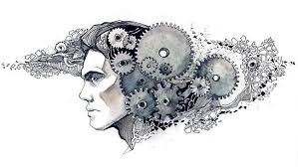
There are many names you might be use to label your philosophy of life: Libertarian, Feminist, Liberal, Conservative, Buddhist, Christian, Entrepreneur, Artist, Environmentalist, Tea Party and any number of others. Maybe you feel you could summarize your philosophy of life with one of those words, but for most of us I’d suspect that our actual philosophies of life are more complex and nuanced.

Slide 7
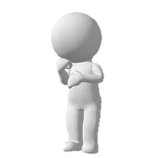
The difference between different People’s philosophy is almost entirely internal.
You wouldn’t be able to pick them out on the street. But their internal experience of life will be entirely different.
One man plays squash because he has a true north philosophy about pushing himself to his limits, maintaining his health and investing in friendships with his playing partners.
I think it is healthy to have a comprehensive framework for life and to live in line with it.
Another may value these same things but couldn’t articulate them. He just knows he likes to play.
A third has no real reason for playing other than someone asked him to. Maybe he just wants to be seen at the racquet club. Maybe he just likes being asked.

Slide 8
PERSONAL PHILOSOPHY
Philosophy is a set of ideals, standards or beliefs used to describe behavior and thought.
Philosophy is defined as the most basic beliefs, concepts, and attitudes of an individual or group. My focus is on personal philosophy, and the essential philosophical elements are centered on beliefs, concepts or ideas, and attitudes.
Personal Philosophy is a set of guiding ways set in our mind by the way we live life, how we look at life, the society, the world, the universe. It helps us solve our problems & make better decisions.
How you think influences how you act! We should be positive & also practical.
Also we shouldn’t make rigid beliefs without being sure if they are right or wrong.

Slide 9
My philosophy to life!
Happiness is a choice! We can be as happy as our mind permits. The best thing we can gift to our self is THE PERMISSION TO BE HAPPY! If we choose to be happy we will at least find 10 points/things we already have in our life to be Happy!
Positivity is very important. It is within us but that needs to be highlighted and taken care of. To reach the super positive mind a guide is required to show the path – how to find positivity in every phase of life or in every happening of life!
Endless positive quotes are available online & endless books on positivity are available, mostly they help & motivate, but a guide is required to answer your particular query.

Slide 10
How I think we should face problems?
ACCEPTANCE IS MY RELIGION!
In case of any problem, small or big, at professional level or personal, firstly, we need to be positive & accept it. Do not run. Stay Calm, just smile (even if it doesn’t come, just smile), after that think how can we solve it. If required take help from others. But never make the mistake of thinking why this happened to me! Yes we need to find out where was my mistake and correct it.
But never think why this has happened to me. Rather find the positivity in it. Because everything that has happened or is going to happen has happened for GOOD FROM THE ALMIGHTY!
Many suggest to divert mind, stay busy to come out of problems. I feel we should give it time and face it well. And not run from the problem. Running will never help.
And after that yes we can think of staying busy & doing activities to keep us happy, this can be a good support not a solution!

Slide 11
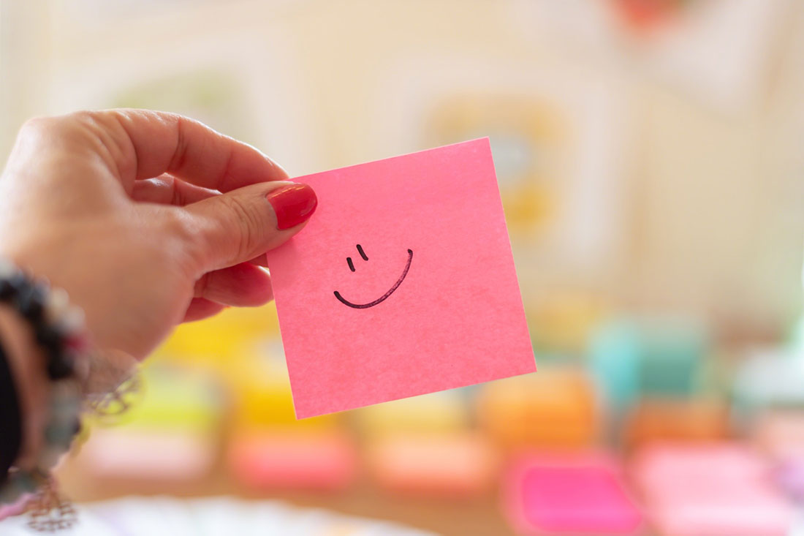
POSITIVITY- We are stronger than the problem!
One should always have a positive view to life. Being positive helps us to face issues & also realise there is nothing which I can’t deal with (shouldn’t be mixed with being rude). Every problem in this world has a solution. I cant find the solution, no problem; go to someone who is a specialist in that field and ask for suggestion without hesitation. There is no harm in asking help/ support.
Use the problem as a stepping stone, every problem in life makes you more stronger, happier & more beautiful inside.
Just believe in yourself that you can do it!
Remember - There is nothing which can break you, unless you allow it to.

Slide 12
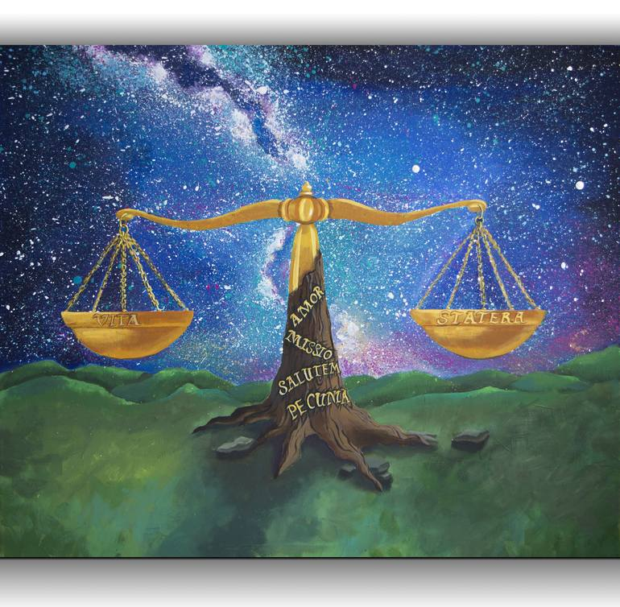
Balance in life!
Striking a good balance helps you lead to happiness. Ensures your growth as an individual & secures your mental peace and well being.
Expect the unexpected & be prepared for it.
Maintain a positive mindset. Positivity is the most important in life. But we always need to make a balance of it. We can’t go blind with positivity also, at times people take our advantage & at the end we are hurt, this should not happen. Mind should be very active every time.
If we don’t face challenges, we can never grow!
Sweet dish is always preferred after the meal.
“After storm, comes calm.’’

Slide 13
THANK YOU
Remember - There is nothing which can break you, unless you allow.
- AISHA

