Slide 1
Anxiety and panic attacks management
By: Annjala Moni Mathews
Ii m.sc applied psychology
Internee at emotion of life

Slide 2
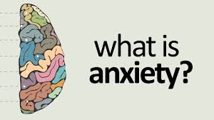
Anxiety is a common emotion when dealing with daily stresses and problems. But when these emotions are persistent, excessive and irrational, and affect a person’s ability to function, anxiety becomes a disorder. There are different types of anxiety disorders, including phobias, panic and stress disorders, and obsessive compulsive disorder.

Slide 3
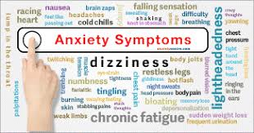
worry and apprehension
restlessness
sleep problems
difficulty concentrating
irritability
sadness
feeling pressure and hurried
Physical symptoms include:
changes in heart rate
tension in the head or neck
headache
nausea or diarrhea
sweating
Dry mouth
tightness in the throat and difficulty breathing
trembling or shaking
feeling faint

Slide 4
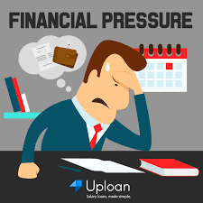

Slide 5
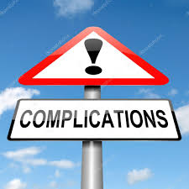
Persistent stress and anxiety can lead to other problems, such as:
depression
an anxiety disorder
Physical health problems that may arise include:
frequent colds and infections
Heart disease
High blood pressure
diabetes

Slide 7
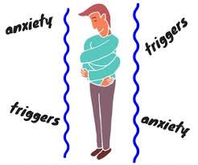
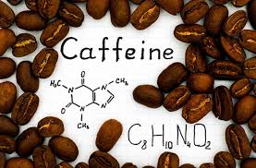
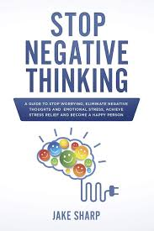
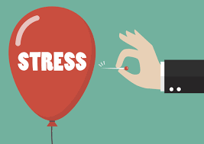

Slide 8
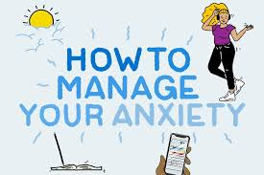
Know the signs
Know your triggers
Diet
Exercise
Learn some relaxation techniques
Try a new activity
Be social
Set goals

Slide 9
Tips for identifying triggers
Start a journal
Work with a therapist.
Be honest with yourself.

Slide 10
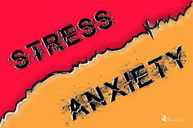
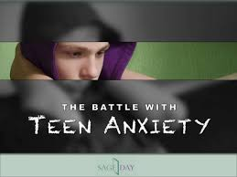
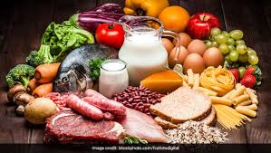
salmon
turmeric
Dark chocolate
yogurt
Green tea
Stress and anxiety are two sides of the same coin.
The most common treatments for anxiety in teenagers are talk therapy and medication. These treatments also help address depression symptoms.
Anxiety treatment for children includes cognitive behavioural therapy (talk therapy) and medications.

Slide 11
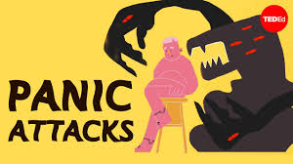
A panic attack is a sudden and intense feeling of terror, fear, or apprehension, without the presence of actual danger.
The symptoms of panic attack usually happen suddenly, peak within 10 minutes.

Slide 12
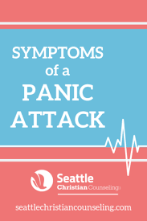
Chest pain or discomfort
Chills or hot sensations
Feeling of choking
Feeling dizzy, unsteady, lightheaded, or faint
Fear of dying
Fear of losing control or going crazy
Feelings of unreality (derealization) or being detached from oneself (depersonalization)
Nausea or abdominal distress
Numbness or tingling sensations
Palpitations, pounding heart, or accelerated heart rate
Sensations of shortness of breath or smothering
Sweating
Trembling or shaking

Slide 13
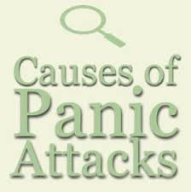
The exact causes of panic attacks are not known, but there are a number of different factors that are believed to play a role. These include:
Brain chemistry
Genetics and family history
Life stress
Personality and temperament

Slide 14
Spontaneous or uncued panic attacks occur without warning or “out of the blue.”
Situationally bound or cued panic attacks occur upon actual or anticipated exposure to certain situations.
Situationally predisposed panic attacks don’t always occur immediately upon exposure to a feared situation or cue, but the person is more likely to experience an attack in such situations.

Slide 15
Although the exact causes of panic attacks and panic disorder are unclear, the tendency to have panic attacks runs in families. There also appears to be a connection with major life transitions such as graduating from college and entering the workplace, getting married, or having a baby.
Panic disorder is characterized by repeated panic attacks, combined with major changes in behaviour or persistent anxiety over having further attacks.
Panic disorder symptoms:
Anticipatory anxiety
Phobic avoidance

Slide 16
Antidepressants such as selective serotonin reuptake inhibitors (SSRIs) like Zoloft, etc if you are also experiencing symptoms of depression
Anti-anxiety medications that act as depressants on the central nervous system including benzodiazepines
CBT is focused on helping people identify the thoughts that contribute to feelings of fear and anxiety and replace them with more helpful, realistic ones.
Exposure therapy in the case of panic attacks and panic disorder allows a person to experience the physical sensations of panic in a safe and controlled environment, giving you the opportunity to learn healthier ways of coping.

Slide 17
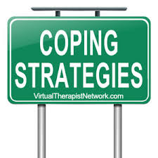
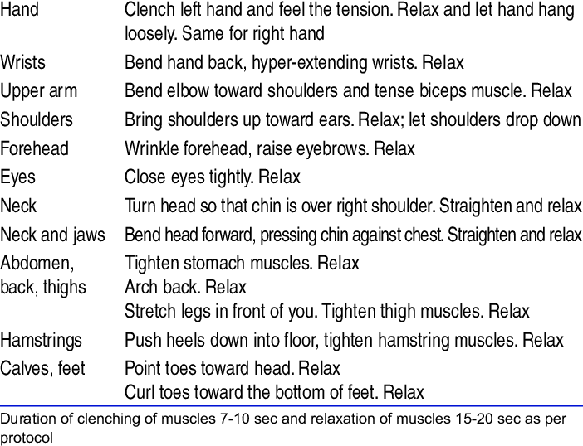

Slide 18
SELF HELP TIPS FOR PANIC ATTACKS
Learn about panic and anxiety.
Avoid smoking, alcohol, and caffeine.
Learn how to control your breathing.
Connect face-to-face with family and friends.
Exercise regularly.
Get enough restful sleep.

Slide 19
How to help someone having a panic attack
Stay calm yourself.
Focus your loved one on their breathing.
Get your friend out of their own head
Encourage your loved one to seek help.

