Slide 1
Understanding Postpartum OCD
Postpartum OCD is a subtype of OCD that appears after childbirth, marked by intrusive thoughts and compulsive behaviors centered on the baby's safety.
Emotion of life
www.emotionoflife.in

Slide 2
Postpartum Period Defined
Physical Changes
Emotional Shifts
Postpartum signifies a woman's body returning to pre-pregnancy conditions.
Mood swings and fatigue are common, sometimes leading to depression or anxiety.
New Adjustments
Adjusting to motherhood is crucial for well-being and bonding with the newborn.

Slide 3
Characteristics of Postpartum OCD
1
Intrusive Thoughts
2
Compulsive Acts
Obsessions about the baby's safety cause distress.
Compulsions are performed to neutralize fears.
3
Impact on Life
These symptoms can lead to exhaustion and isolation.

Slide 4
Distinguishing Postpartum OCD
Unique Obsessions
Specific Compulsions
Postpartum Challenges
Postpartum OCD focuses on the newborn's safety.
Compulsions relate to newborn care, like excessive checking.
Stressors of new parenthood intensify OCD symptoms.

Slide 5
Causes of Postpartum OCD
Hormonal Changes
Hormones fluctuate significantly postpartum.
Genetic Predisposition
Family history may increase OCD risk.
Psychological Stress
New parenthood stressors can trigger symptoms.

Slide 6
Personal Impact of Postpartum OCD
1
Fear and Anxiety
Overwhelming concerns about the baby's safety.
2
Guilt and Shame
Feelings of guilt for having intrusive thoughts.
3
Hyper-vigilance
Constant need to check on the baby's well-being.

Slide 7
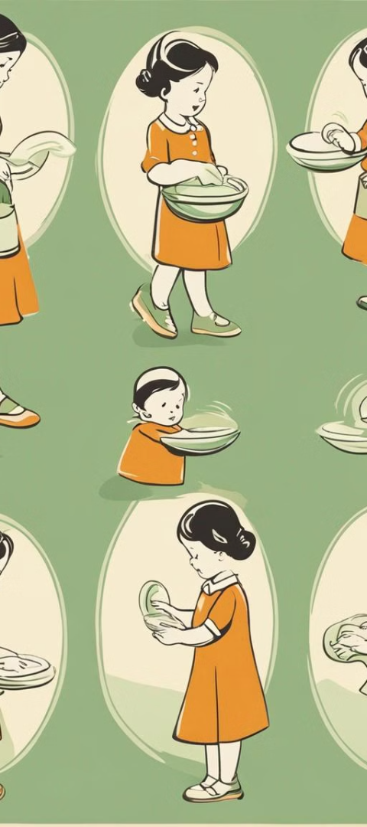
Behavioral Patterns in Postpartum OCD
Excessive Checking
Continuous monitoring of the baby's state.
Compulsive Cleaning
Sanitizing baby items beyond necessity.
Avoidance Behaviors
Steering clear of perceived risks to the baby.

Slide 8
Common Obsessions in Postpartum OCD
Fear of Harm
Health Concerns
Protective Urges
Anxiety about accidentally injuring the baby.
Worries about contamination and the baby's health.
Obsessions over the baby's security and safety.

Slide 9
Challenges in Treating Postpartum OCD
1
Stigma and Misdiagnosis
2
Medication Concerns
Shame and healthcare gaps hinder treatment.
Breastfeeding mothers face tough choices.
3
Therapy Access
Finding specialized care can be difficult.

Slide 10
Supporting Loved Ones
1
2
Listen
Educate
Provide a non-judgmental space for sharing.
Learn about postpartum OCD to understand better.
3
4
Assist
Encourage
Help with tasks to reduce stress.
Support seeking professional treatment.

Slide 11
Emotion Of Life.
Contact US : 9368503416
Email: info@emotionoflife.in

