Slide 1
Balanced Diet And Nutrition
BY : Pratibha Gupta

Slide 2
NUTRITION
The food that we eat and the way it effects our health.
Nutrition is a natural demand for every source of life on earth.
Being deprived of nutrition is as severe as being deprived of any other fundamental rights . Lack of nutrition can give rise to diseases.
It is important to have knowledge about classification of nutrients.

Slide 3
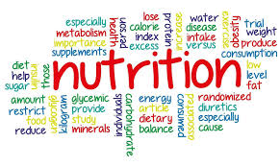
NUTRIENTS
Nutrients are defined as the substances found in food .The food we eat is a source of nutrients .
WE NEED NUTRIENTS TO :
Repair body cells and tissues
To grow
Fuel your energy
Maintain daily task

Slide 4
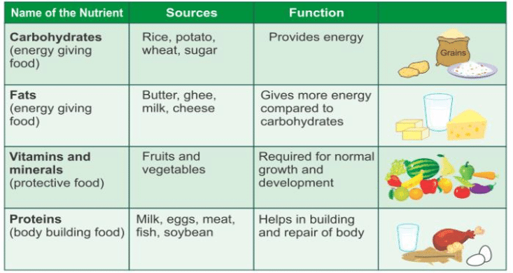
CLASSIFICATION OF NUTRIENTS

Slide 5
WHAT HAPPENS IF NUTRIENTS ARE IN EXCESS OR LOW ?
IF THEY ARE IN EXCESS
Weight gain
Diabetes
Heart diseases
IF THEY ARE LACKING
Constipation
Low mental performance
Malnutrition
Anemia
Weakness or dizziness

Slide 6
BALANCED DIET
A balanced diet is a diet in which all the nutrients are present in appropriate proportion to maintain health.
A nutritionally balanced diet fulfills all nutritional needs of the body.
Each body needs a specific amount of nutrients and calories to stay active and healthy.
A diet that contains all the vital nutrients required by the human body.

Slide 7
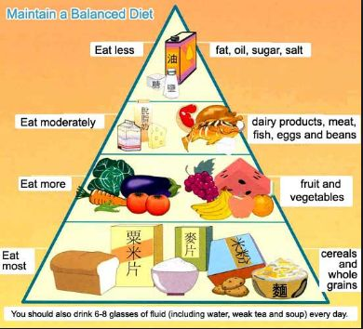
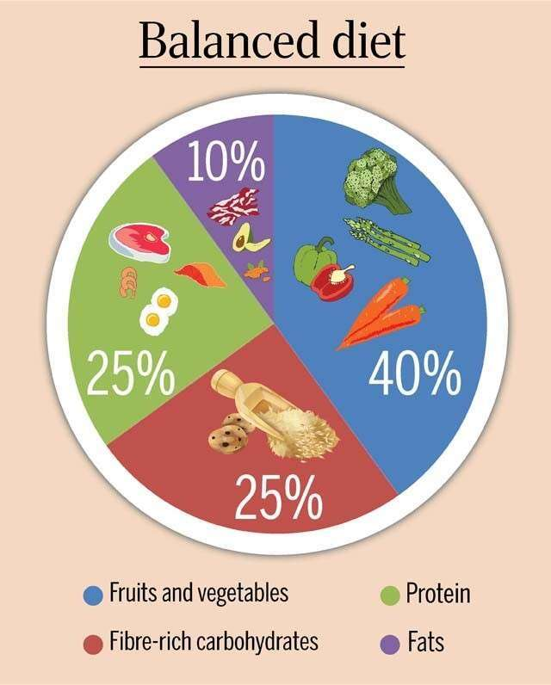

Slide 8
ADVANTAGES OF BALANCED DIET
It helps us to live longer
Boosts immunity
Strengthens bones and muscles
Lower the risk of multiple diseases like – Heart diseases, Diabetes, Cancer etc
Supports healthy pregnancies

Slide 9
HOW BALANCED DIET EFFECTS MENTAL HEALTH
A well balanced diet can help us think clearly and feel more alert.
It can also improve concentration.
An inadequate diet can lead to fatigue , impaired decision making and can slow down reaction time.
Sugar and processed food can lead to inflammation through out the body which may contribute to mood disorders , anxiety and depression.
People either eat too much or too little when they are depressed or under stress .Eating too much can cause weight gain and eat too little can cause malnutrition.

Slide 10
FOOD PLAN
EARLY MORNING
(7:00a.m.-8:00a.m.)
BREAKFAST
(9:00a.m.-10:a.m.)
1-2 glasses of lukewarm water.(MANDATORY)
Tea/glass of milk/coffee/fresh juices etc

