Slide 1
Dialectical Behavior Therapy
Resource Person: Ms. Pratyasha
Psychologist, Emotion of Life,
Online Platform for MentalHealth Services www.emotionoflife.in info@emotionoflife.in call: 9368503416 / 7678694626

Slide 2
Introduction
The American Psychological Association (APA) define DBT as a flexible psychotherapy that comprises elements of behavior therapy, cognitive behavior therapy (CBT), and mindfulness.
The term “dialectical” refers to the combination of two opposing ideas.
The first of these ideas is the acceptance of the reality of a person’s life and behaviors.
The second opposing idea is the change of situations and dysfunctional behaviors.
DBT connects cognitive and behavioral therapies as a way of helping an individual learn and adapt healthier methods of coping with painful emotions, often through acceptance and change.

Slide 3

Dialectics
In a nutshell, dialectics means trying to balance opposite directions and look at how they go together.
It means to examine, discuss and reconcile opposite ideas. The idea is that change can only begin to happen when you accept things as they are.

Slide 4
A collision of two truths?
In DBT, there might be your truth, my truth but there is no search for absolute truth.
Instead, there will be a dialog about our contradictory positions in which both can find a new meaning.

Slide 5

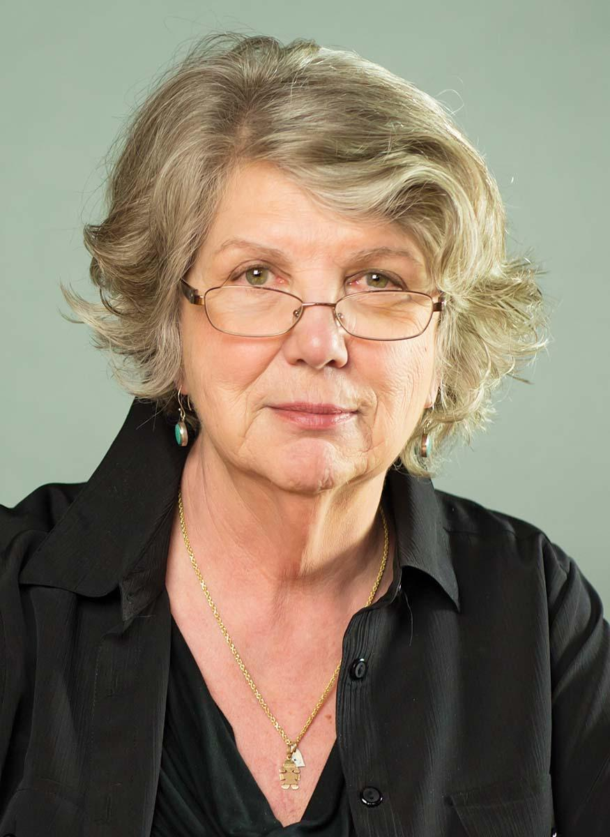
Marsha Linehan
Born: 5th May, 1943
American Psychologist

Slide 6
The main philosophy of DBT is to create a life
‘worth living’.

Slide 7
DBT Strategies
Life Skills

Slide 8
Mindfulness
Based on Eastern Zen philosophy.
Awareness of thoughts, feelings, behaviors and behavioral urges.
Absorbing information with all our senses and no thoughts in our mind.

Slide 9


Slide 10
2. Distress Tolerance
Manage distress in a healthy way.
When you can’t control the situation but can manage your own response.
Distress is inevitable
Low distress tolerance = experience negative life events as unbearable and overwhelming.
Radical Acceptance: Accepting the reality without trying to fight it.

Slide 11

People with low distress tolerance:
Spend a considerable amount of their life thinking about past failures, mistakes and painful situations.
Get overly anxious thinking about future and the possibilities of mistakes and failures.
Isolation from people and situations to minimize distress.
Use of alcohol or drugs to soothe emotions.

Slide 12
4 skills that can be applied to increase distress tolerance:
Distracting
Self-soothing
Improving the moment
Focusing on pros and cons

Slide 13
Distracting
Changing the focus from something negative to something more neutral or enjoyable.
ACCEPTS
Activities that are healthy and enjoyable
Contribution
Comparing oneself to less fortunate (gratitude)
Emotion (Acting in opposite)
Pushing away
Thoughts (counting)
Sensations

Slide 14
2. Self Soothing
Taking care of oneself in a nurturing way.
5 senses
Vision
Hearing
Smell
Taste
Touch

Slide 15
3. Improving the Moment
IMPROVE
Imagery
Meaning or purpose from the pain
Prayer
Relaxation
One activity in the moment
Vacation
Encouragement

Slide 16
4. Focusing on pros and cons
Pros of tolerating the situation
It makes me more resilient to stress.
I’m learning to cope with stress.
Cons of tolerating the situation
Ix will fail to withstand any further pressure.
I’m using alcohol or drugs to cope.

Slide 17
3. Emotion regulation
Understanding and experiencing the emotion, learning to be in control of the emotion and finding new responses to the situations that cause certain emotions.
Intense emotions can drive behavior
When applying emotion regulation, we look for:
Situation that triggered certain emotions
Afterthought about the event and their reaction to it
Physical sensations during their immediate emotions
Behavior afterwards

Slide 18
Emotion regulation skill includes 3 aspects:
Understanding one’s emotions
Reducing emotional vulnerability
Decreasing emotional suffering

Slide 19
Understanding one’s emotions
Learning to label emotions
Primary vs secondary emotions
Targeting primary emotions
Secondary emotions lead to dysfunctional thinking and unhelpful behavior.
Lastly, understanding that purpose of all emotions is to alert us about our environment and communicate effectively with others.

Slide 20
2. Reducing Emotional Vulnerability
Please Master
PL: Treating pain or illness; physical and mental health
Eating a balanced diet
Avoiding any mood altering substances
Sleep regulation
E: Getting regular exercise
Mastery: Engaging into activities that help to build confidence and competency.

Slide 21
3. Decreasing Emotional Suffering
Learning skills:
Letting go: Being mindful of the emotion, and then letting it go without trying to suppress, alter or dwell on it.
Taking opposite action: Using the opposite emotion or behaviour to what is naturally occurring.
Counteract the suffering you might feel with a distressing emotion.

Slide 22
4. Interpersonal Effectiveness
Establish and maintain positive relationships with others.
Understanding how one’s behavior affects relationship with others and then make positive changes.
3 skills:
Objective effectiveness
Relationship effectiveness
Self Respect effectiveness

Slide 23
Objective Effectiveness
Clear understanding about what needs to be gained from a certain interaction with another person.
Dear Man
Describe what is wanted in a clear and concise manner
Expressing one's emotions and feelings to others clearly
Assertiveness
Reinforce desired behaviors (smiling, thank you)
Mindful during interactions
Appearing confident
Negotiations

Slide 24
2. Relationship Effectiveness
Conflict free and balanced relationship with others.
GIVE
Gentle interaction (no judgements or attacks)
Interested in the interactions
Validation of feelings
Easy attitude (light hearted)

Slide 25
3. Self Respect Effectiveness
Remembering one’s own values and beliefs during interactions and thus, gaining self respect during the process.
FAST
Fairness
Apologies (only when it is appropriate)
Standing up for one’s own values
Truthful with others

Slide 26
Conclusion
DBT Life Skills:
Mindfulness
Distress Tolerance (Distracting, self soothing, improving the moment, pros and cons of tolerance)
Emotion Regulation (Understanding emotion, reducing emotional vulnerability, decreasing emotional suffering)
Interpersonal Effectiveness (Objective, Relationship and Self Respect)

Slide 27
DBT for OCD
Distress Tolerance: When faced with distress from intrusive thoughts.
Emotion Regulation: Manage the anxiety caused from obsessions and emotions related to fear while trying to not give in to compulsions.
Interpersonal Effectiveness: Manage their feelings related to interactions including the need to seek reassurance.
Mindfulness: Redirection to present moment when intrusive thoughts occur as well as acceptance of intrusive thoughts.

Slide 28
Resources
https://linehaninstitute.org/
https://www.therapistaid.com/therapy-worksheets/dbt/none
https://www.dbtselfhelp.com/
“Building a Life Worth Living: A Memoir “ by Marsha M. Linehan
“DBT Skills Training Manual, Second Edition” by Marsha M. Linehan, 2014.

