Slide 1
RESILIENCE
EMOTION OF LIFE
Online Platform For Mental Health Services
Specialized in OCD RECOVERY & CURE PROGRAM
Visit: www.emotionoflife.in
Email: info@emotionoflife.in
Call: 9304716064

Slide 2

Hello!
CREATOR: POOJAA. N
INTERN – EMOTION OF LIFE
SUBMITTED TO: Mr. SHYAM GUPTA

Slide 3

DEFINITION
WHAT IS RESILIENCE?
1

Slide 4
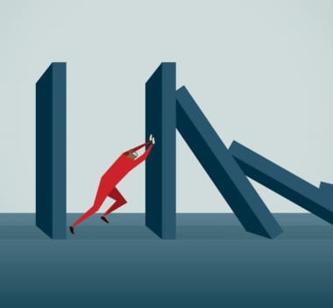
RESILIENCE
Psychological resilience is the ability to mentally or emotionally cope with a crisis or to return to pre-crisis status quickly.
In layman/general terms resilience means that a person is able to withstand or recover from difficult situations of life. Resilience can help deal with heartbreaks, failures, and life stressors.

Slide 5
Resilience exists when the person uses "mental processes and behaviors in promoting personal assets and protecting self from the potential negative effects of stressors".
In simpler terms, when we build psychological resilience we are able to recover from hardships and setbacks in a more healthy way. It is very similar to the time when our body suffers from a virus and the body gets weak. But in no time the energy and strength returns because our system is designed to be resilient.
In popular accounts, psychological resilience is some what like a "psychological immune system". Our emotions needs to be as strong as it’s a vital element in human perseverance.

Slide 6
“Resilience is knowing that you are the only one that has the power and the responsibility to pick yourself up.”
Mary Holloway

Slide 7

IMPORTANCE
2
OF RESILIENCE!

Slide 8
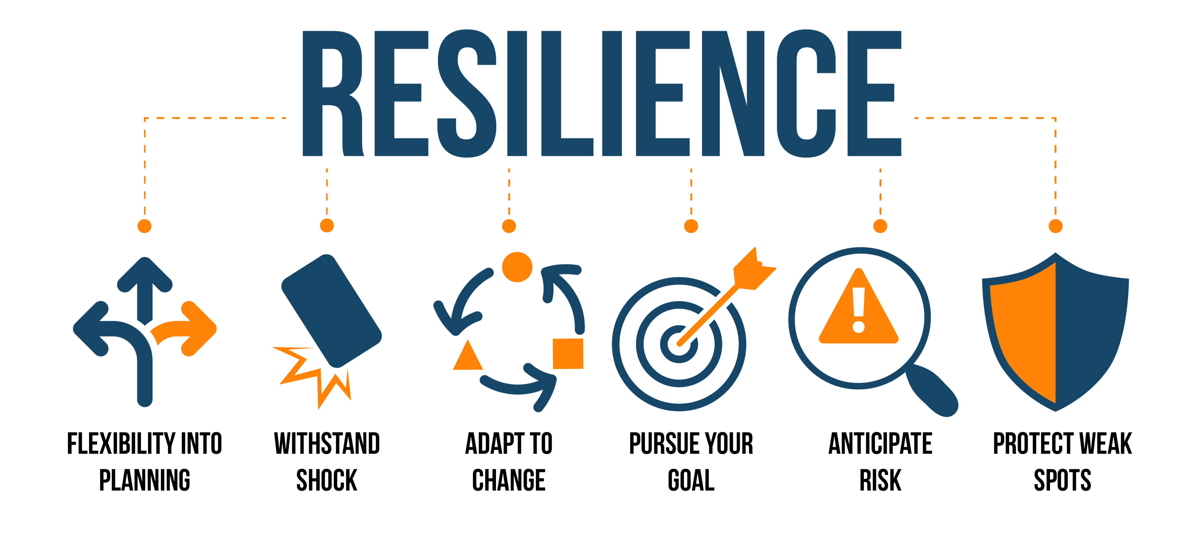
IMPORTANCE
Resilience is generally thought of as a "positive adaptation" after a stressful or adverse situation.
When a person is "bombarded by daily stress, it disrupts their internal and external sense of balance, presenting challenges as well as opportunities.“
However, the routine stressors of daily life can have positive impacts which promote resilience.

Slide 9
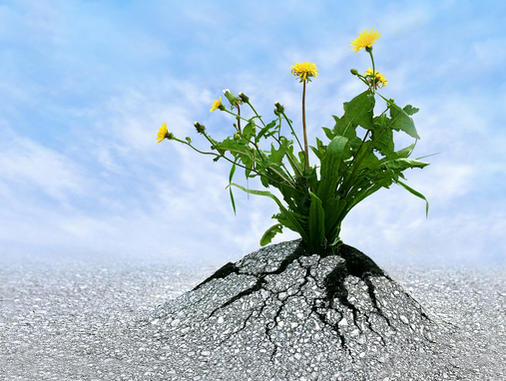
IMPORTANCE
IT HELPS WITH CONFIDENCE
The more and more a person is challenged and have to go through a difficult times/ situation, the more confidence one has after surviving it and one knows that they can survive even worse.
The more it happens, the stronger one becomes to be able to handle it.
IT MAKES ONE A BETTER PROBLEM SOLVER
Being able to figure out what strategy was used before for moving forward will make problem solving in other areas of life much easier.
IT INCREASES EMOTIONAL INTELLIGENCE
It helps individuals become more aware to exactly how are they going to feel in those situations in order to be able to get through them
IT HELPS TO SEE THINGS POSITIVELY
Once a person overcomes a thing, they know that looking things in positive way has helped in it.
From then on they start to see things in a positive manner.

Slide 10
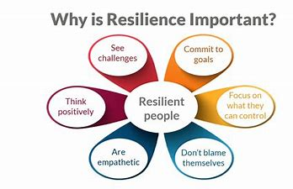

Slide 11
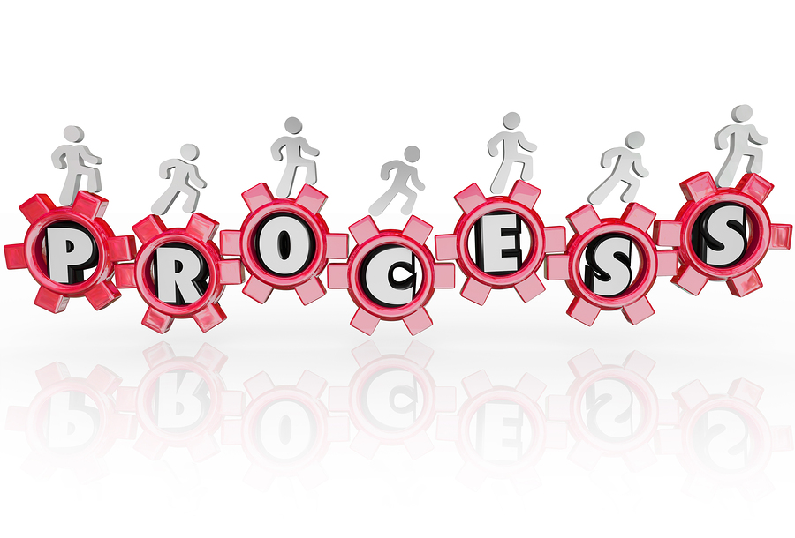
PROCESS
3
OF RESILIENCE!

Slide 12

PROCESS OF RESILIENCE
Resilience is best understood as a process.
Resilience is the result when individuals interact with their environments and the processes that help in either promoting their well-being or protecting them against the overwhelming influence of risk factors/ stressful events.
It is essential to understand the process or this cycle of resiliency. When people are faced with an adverse condition, there are three ways in which they may approach the following situations:
a. Erupt with anger
b. Implode with overwhelming negative emotions like go numb and becoming unable to react.
c. Simply becoming upset about the disruptive change

Slide 13

PROCESS OF RESILIENCE
Only the third approach promotes well-being. It is employed by resilient people, who become upset about the disruptive state and thus change their current pattern to cope with the issue.
The first and second approaches lead people to adopt the victim role by blaming others and rejecting any coping methods even after the crisis is over. These people prefer to instinctively react, rather than respond to the situation.
Those who respond to the adverse conditions by adapting tend to cope, spring back, and halt the crisis. Negative emotions involve fear, anger, anxiety, distress, helplessness, and hopelessness which decrease a person's ability to solve the problems they face and weaken a person's resiliency.

Slide 14
RELATED FACTORS
4
OF RESILIENCE!

Slide 15
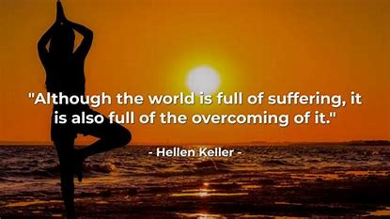
RELATED FACTORS
There are several factors which develop and sustain a person's resilience:
a) The ability to make realistic plans and being capable of taking the steps necessary to follow through with them
b) Confidence in one's strengths and abilities
c) Communication and problem-solving skills
d) The ability to manage strong impulses and feelings

Slide 16
RESILIENCE
5
AND POSITIVE EMOTIONS

Slide 17
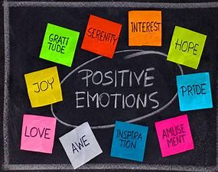
Maintaining Positive Emotions while facing adversity promotes flexibility in thinking and problem solving.
Positive emotions serve an important function in their ability to help an individual recover from stressful experiences and encounters.
Maintaining a positive emotions counteracts the physiological effects of negative emotions.
It also facilitates adaptive coping skills, builds enduring social resources and increases personal well-being.

Slide 18
The formation of conscious perception and the monitoring of one's own socio-emotional factors is considered a stabile aspect of positive emotions.
Resilient individuals who have a propensity for coping strategies that concretely elicit positive emotions, such as benefit-finding and cognitive re-appraisal, humor, optimism, and goal-directed problem-focused coping.
Individuals who tend to approach problems with these methods of coping may strengthen their resistance to stress by allocating more access to these positive emotional resources.

Slide 19
WAY TO ENHANCE
6
RESILIENCE

Slide 20


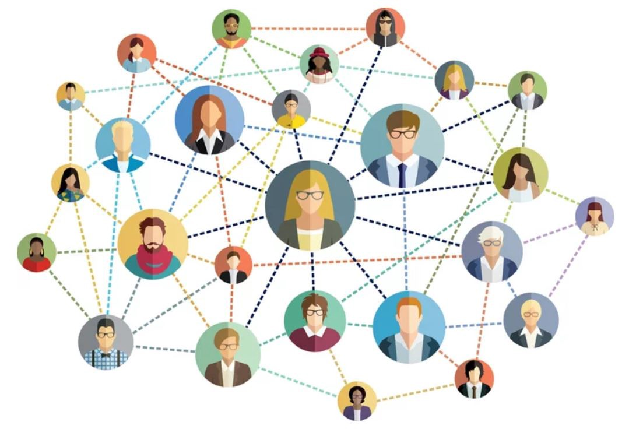
Find a Sense of Purpose
When one has or develops a purpose to live then motivation, ability & desire to move forward increases.
Believe in Your Abilities
Confidence in one’s ability plays a very important part in resilience. It helps to respond and to deal with a crisis situation.
Develop a Strong Social Network
When a person has people around him/her who are caring and supporting them. This acts as a protective factor at the time of crisis and also when individuals shares their problems with their loved ones then this helps a lot in relieving stress & coming up with some positive solution.
Notes:
1) After her 13-year-old daughter was killed by a drunk driver, Candace Lightner founded Mother's Against Drunk Driving (MADD). Lightner focussed her energy on creating awareness of the dangers of drunk driving. "I promised myself on the day of Cari's death that I would fight to make this needless homicide count for something positive in the years ahead," she later explained.
In the face of crisis or tragedy, finding a sense of purpose can play an important role in your recovery. This might mean becoming involved in your community, cultivating your spirituality, or participating in activities that are meaningful to you.
2) Having confidence in your own ability to cope with the stresses of life can play an important part in resilience. Becoming more confident in your own abilities, including your ability to respond to and deal with a crisis, is a great way to build resilience for the future.
Listen for negative comments in your head. When you hear them, practice immediately replacing them with positive ones, such as, "I can do this," "I'm a great friend/mother/partner," or "I'm good at my job."
Research has demonstrated that your self-esteem plays an important role in coping with stress and recovering from difficult events. Remind yourself of your strengths and accomplishments.
3) It's important to have people you can confide in. Having caring, supportive people around you acts as a protective factor during times of crisis. While simply talking about a situation with a friend or loved one won't make your troubles go away, it allows you to share your feelings, get support, receive positive feedback, and come up with possible solutions to your problems.
4) Flexibility is an essential part of resilience. By learning how to be more adaptable, you'll be better equipped to respond when faced with a life crisis. Resilient people often utilize these events as an opportunity to branch out in new directions. While some people may be crushed by abrupt changes, highly resilient individuals are able to adapt and thrive.
5) Staying optimistic during dark periods can be difficult, but maintaining a hopeful outlook is an important part of resiliency. What you are dealing with may be difficult, but it's important to remain hopeful and positive about a brighter future.
Positive thinking does not mean ignoring the problem in order to focus on positive outcomes. It means understanding that setbacks are temporary and that you have the skills and abilities to combat the challenges you face.

Slide 21
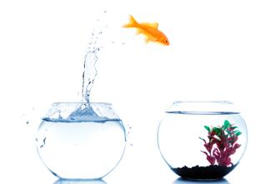


Embrace Change
A person who is flexible is better equipped to respond when in a crisis situation.
Be Optimistic
Thinking positive does not mean to ignore the negatives. It means to understand the setbacks and find a positive solution to it and move forward.
Develop Problem-Solving Skills
Whenever faced with a challenging situation one need to make a list or think of all possible ways to cope with it and following the best way out of it.
Practising this on a regular basis one becomes better prepared to handle if a more serious problem emerges.
Notes:
1) After her 13-year-old daughter was killed by a drunk driver, Candace Lightner founded Mother's Against Drunk Driving (MADD). Lightner focussed her energy on creating awareness of the dangers of drunk driving. "I promised myself on the day of Cari's death that I would fight to make this needless homicide count for something positive in the years ahead," she later explained.
In the face of crisis or tragedy, finding a sense of purpose can play an important role in your recovery. This might mean becoming involved in your community, cultivating your spirituality, or participating in activities that are meaningful to you.
2) Having confidence in your own ability to cope with the stresses of life can play an important part in resilience. Becoming more confident in your own abilities, including your ability to respond to and deal with a crisis, is a great way to build resilience for the future.
Listen for negative comments in your head. When you hear them, practice immediately replacing them with positive ones, such as, "I can do this," "I'm a great friend/mother/partner," or "I'm good at my job."
Research has demonstrated that your self-esteem plays an important role in coping with stress and recovering from difficult events. Remind yourself of your strengths and accomplishments.
3) It's important to have people you can confide in. Having caring, supportive people around you acts as a protective factor during times of crisis. While simply talking about a situation with a friend or loved one won't make your troubles go away, it allows you to share your feelings, get support, receive positive feedback, and come up with possible solutions to your problems.
4) Flexibility is an essential part of resilience. By learning how to be more adaptable, you'll be better equipped to respond when faced with a life crisis. Resilient people often utilize these events as an opportunity to branch out in new directions. While some people may be crushed by abrupt changes, highly resilient individuals are able to adapt and thrive.
5) Staying optimistic during dark periods can be difficult, but maintaining a hopeful outlook is an important part of resiliency. What you are dealing with may be difficult, but it's important to remain hopeful and positive about a brighter future.
Positive thinking does not mean ignoring the problem in order to focus on positive outcomes. It means understanding that setbacks are temporary and that you have the skills and abilities to combat the challenges you face.

Slide 22

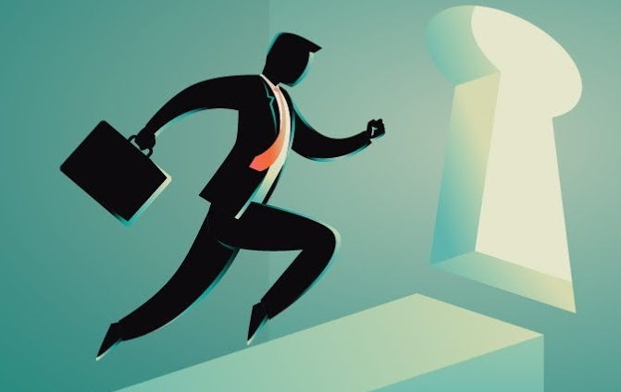

Establish Goals
A resilient person is able to see their problems in a more realistic way and set goals to come out or cope with it.
Take Action
Wait and watch approach only prolongs the crisis. One needs to take steps towards resolving issues.
Keep Working on Skills
Struggling to cope with problematic situations in the beginning is nothing to be discouraged about. Every one needs their own time. Individuals should just make sure to keep working on them.
Notes:
1) After her 13-year-old daughter was killed by a drunk driver, Candace Lightner founded Mother's Against Drunk Driving (MADD). Lightner focussed her energy on creating awareness of the dangers of drunk driving. "I promised myself on the day of Cari's death that I would fight to make this needless homicide count for something positive in the years ahead," she later explained.
In the face of crisis or tragedy, finding a sense of purpose can play an important role in your recovery. This might mean becoming involved in your community, cultivating your spirituality, or participating in activities that are meaningful to you.
2) Having confidence in your own ability to cope with the stresses of life can play an important part in resilience. Becoming more confident in your own abilities, including your ability to respond to and deal with a crisis, is a great way to build resilience for the future.
Listen for negative comments in your head. When you hear them, practice immediately replacing them with positive ones, such as, "I can do this," "I'm a great friend/mother/partner," or "I'm good at my job."
Research has demonstrated that your self-esteem plays an important role in coping with stress and recovering from difficult events. Remind yourself of your strengths and accomplishments.
3) It's important to have people you can confide in. Having caring, supportive people around you acts as a protective factor during times of crisis. While simply talking about a situation with a friend or loved one won't make your troubles go away, it allows you to share your feelings, get support, receive positive feedback, and come up with possible solutions to your problems.
4) Flexibility is an essential part of resilience. By learning how to be more adaptable, you'll be better equipped to respond when faced with a life crisis. Resilient people often utilize these events as an opportunity to branch out in new directions. While some people may be crushed by abrupt changes, highly resilient individuals are able to adapt and thrive.
5) Staying optimistic during dark periods can be difficult, but maintaining a hopeful outlook is an important part of resiliency. What you are dealing with may be difficult, but it's important to remain hopeful and positive about a brighter future.
Positive thinking does not mean ignoring the problem in order to focus on positive outcomes. It means understanding that setbacks are temporary and that you have the skills and abilities to combat the challenges you face.

Slide 23
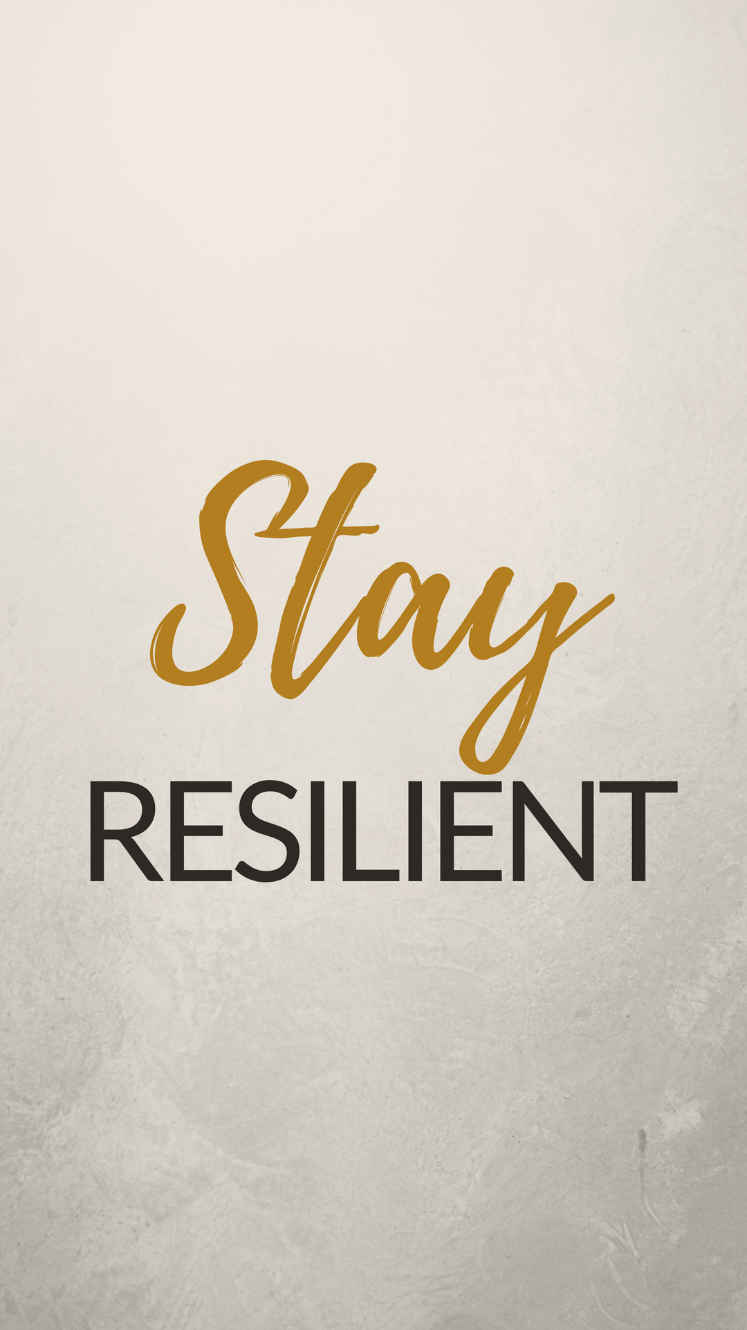
Resilience is the ability to withstand adversity and bounce back from difficult life events.

Slide 24
“Resilience is very different than being numb. Resilience means you experience, you feel, you fail, you hurt. You fall. But, you keep going.”
Yasmin Mogahed

Slide 25

Thank You !!
For The Valuable Time

Slide 26
Questions Are Welcome
Contact us on:
www.emotionoflife.in
info@emotionoflife.in
Call us: 9368503416

