Slide 1
Level of Consciousness
By: POOJAA. N
Reach out to us via email: info@emtionoflife.in
Visit us : www.emotionoflife.in
Call us: 9368503416

Slide 2
1.
CONSCIOUSNESS
DEFINITION

Slide 3

Consciousness in psychology simply as awareness. It's awareness of your internal processes like thinking, feeling, sensing, and perceiving. It knows who you are and what you possess. Consciousness can mean the awareness of memories. Awareness of external stimuli includes seeing the light from the sun, feeling the warmth of a room, and hearing the voice of a friend. We experience different states of consciousness and different levels of awareness on a regular basis.

Slide 4
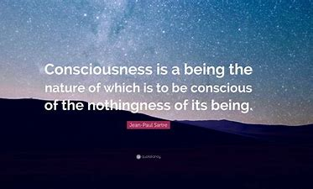

Slide 5
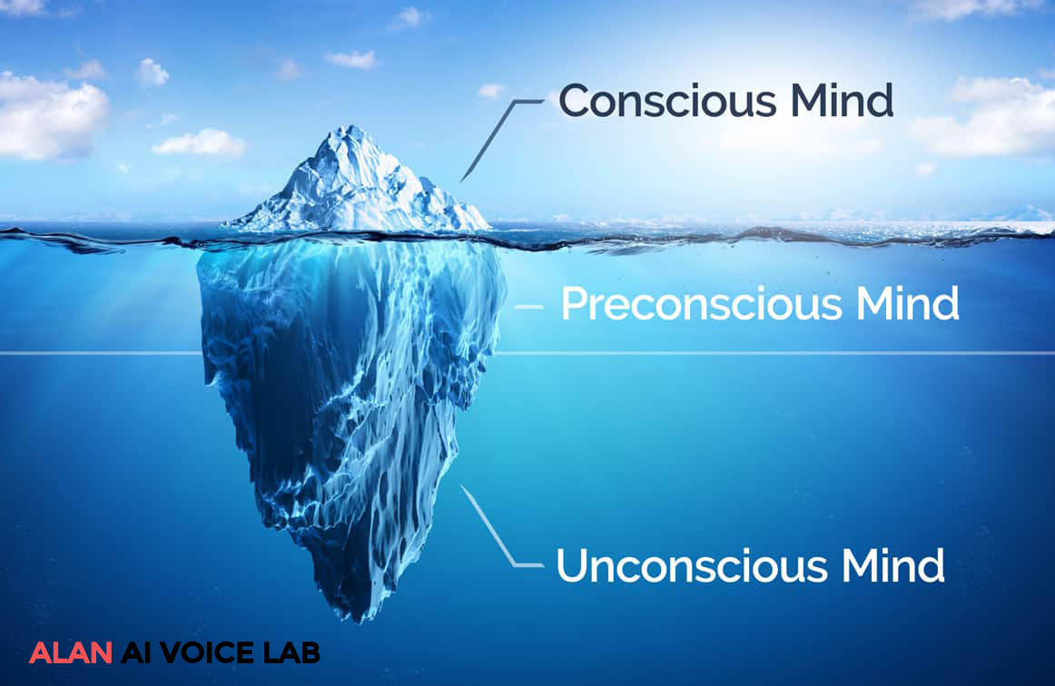

Slide 6
2.
UNCONSCIOUSNESS
DEFINITION

Slide 7

The unconscious consists of deeper mental processes not readily available to the conscious mind.

Slide 8
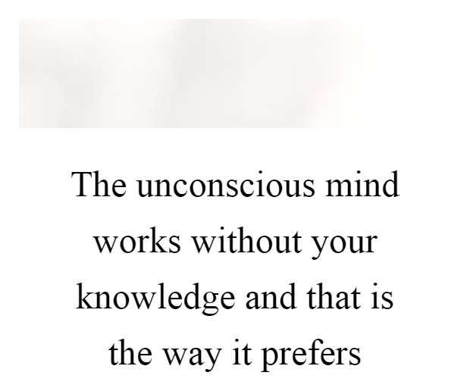

Slide 9
3.
SUBCONSCIOUSNESS
DEFINITION

Slide 10
The word subconsciousness refers to the state of not being wholly conscious, when your conscious mind is at rest. 50-60% of your mental processes consist of subconscious activity, which applies to any activity outside active conscious awareness.
The subconscious plays a crucial role in shaping personality, behavior, and character. It is the storehouse of memories, experiences, and values within the mind.

Slide 11
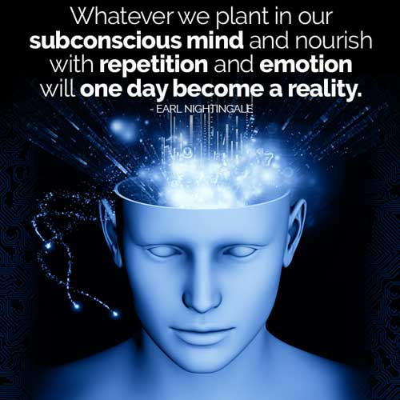

Slide 12

THANK
YOU!!

Slide 13
Specialized in
1. OCD Recovery & Cure Program
( Scientific Process, Evidence-based, Customized & Based on best practices with hundreds of recovered clients)
2. Depression Management .
3. Anorexia Recovery Program
4. Human Sexuality and Related Issues
Emotion of life
Online Platform for mental health professional services of
Psychologist, Therapist, Counselor, Psychiatrist
20 years of the glorious history of client satisfaction
Reaching the last mile of humanity
Making Mental Health Services Accessible & Affordable
Join us as a volunteer, intern, professional, peer mentor.

