Slide 1
Art of living
Created by: Ms. Trannum Gupta
Mr. Shyam Gupta, Clinical Psychologist & Psychotherapist
Ms. Mehek Rohira, Psychologist, Mumbai

Slide 2
Meaning
Simply saying “To live well, is to practice the art of living .”
Our lives are not just given to us but need to be made.
One needs to explore oneself and find the meaning, purpose and happiness throughout the journey of birth and death.

Slide 3
Definition
In the expression ‘Art of Living’ the word ‘art’ refers to skill and ‘living’ refers to a manner of life, meaning thereby the capability of leading a good life and to take pleasure from life .

Slide 4

Pillars of AOL
To understand this simple Art of Living we need to begin with a single step to acceptance
Admit “I don’t know”
But say “I am curious to learn “
The path surrounds around two foundations of: Curiosity and Finding Out
Be open and willing to be exposed to subtleties of life
It has following important pillars to explore and understand:
  Clarity and observation
  Mindfulness
  Accepting the reality without any judgement
  Don’t try to manipulate yourself or others
  Don’t try to conform to the stories you tell yourself

Slide 5
Facets of Art of Living
Success and leadership
Health and Well Being
Happiness
Love ,Compassion and Relationships
Kindness
Spirituality
Values of humanity
Emotions and feelings
Social community

Slide 6

Love and compassion
Instead of being angry or frustrated, I find the pain in others, and open my heart to them.
This includes compassion for myself.

Slide 7
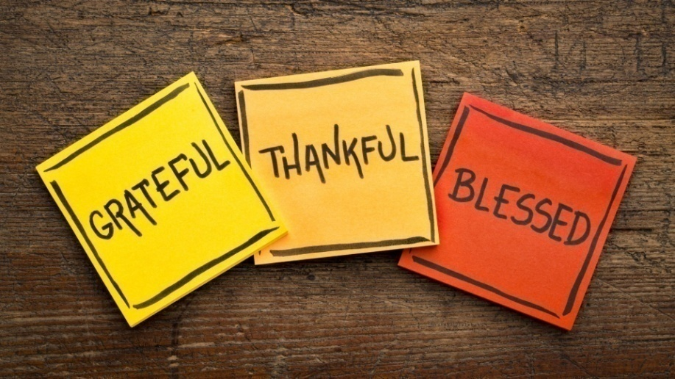
Gratitude
Life is filled with wonder, and the people around me as well.
I try to open myself to that wonder, and be grateful it’s there, instead of complaining!!!

Slide 8

Joy-fear
When we take chances and do something outside of our comfort zone that both excites us and makes us face the possibility of failure.
Embrace these moments rather than avoiding them!!

Slide 9
Not avoiding discomfort or uncertainty
When we avoid discomfort, we are limited by our comfort zone, and new learning and new ventures become impossible.
When we avoid uncertainty, we only stick to what we know.
But we can purposely practice them in small bite-sized chunks, over and over.

Slide 10
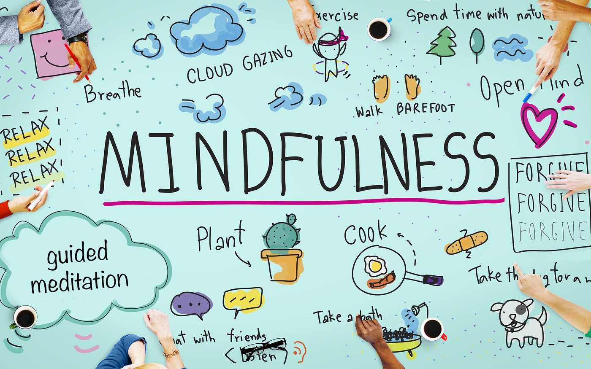
Living in the moment
Sounds wonderful!!
But actually staying in the present moment is the hardest of all.
Practice MINDFULNESS and MEDITATION.

Slide 11
Relationships are everything
Imagine being in your death bed at the age of 80 …
Will your sense of being right and in control comfort you when you have no good relationships, no one who has loved you?
Put relationships first.

Slide 12
Not holding on to expectations & judgments
Expectations and judgments prevent me from enjoying what I have, from enjoying the simple presence of someone else in my life.
I practice with noticing these expectations and judgments, and practice with holding them loosely, letting them go.

Slide 13
Letting go
It’s letting go of :
  Judgments & expectations
  wanting to be right & to control
  fear of discomfort
  fear of uncertainty
  fear of failure
  fear of boredom
  comparing self to others
  fear of distraction
  being irritated
  complaining.
Notice , when I’m holding these, and letting go.
Loosen my heart’s grip on any of these and letting go.
And then letting go again. And again.

Slide 14
Art of living is a practice, one that doesn’t end, that doesn’t have a mastery level.
It’s a constant letting go, a constant picking up again, and then letting go again and falling, and getting up without beating yourself up.

Slide 15
Thank you
For any questions reach out to us
info@emotionoflife.in

