Slide 1
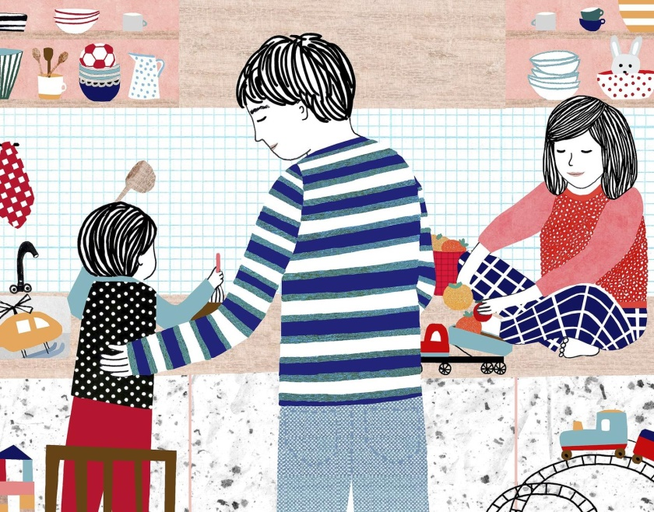
PARENTING AND ITS CONCUSSIONS
Presented by: SHWETA MITTAL
(M.PHARM STUDENT)
Presented to: Mr Shyam Gupta

Slide 2

PARENTING
Parenting is the process of raising children and providing them with protection and care in order to ensure their healthy development into adulthood.

Slide 3
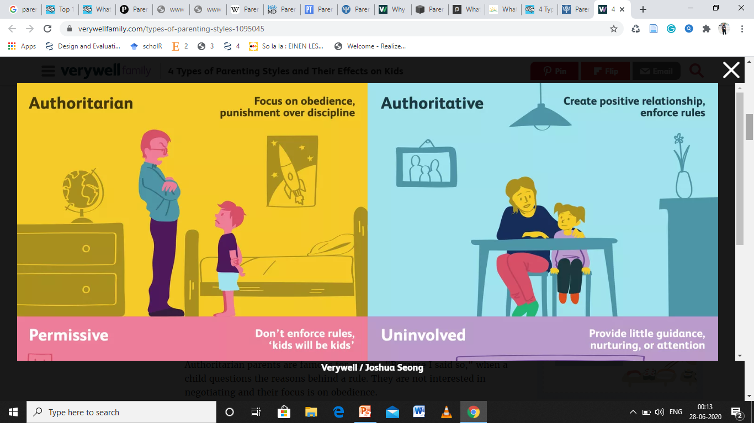
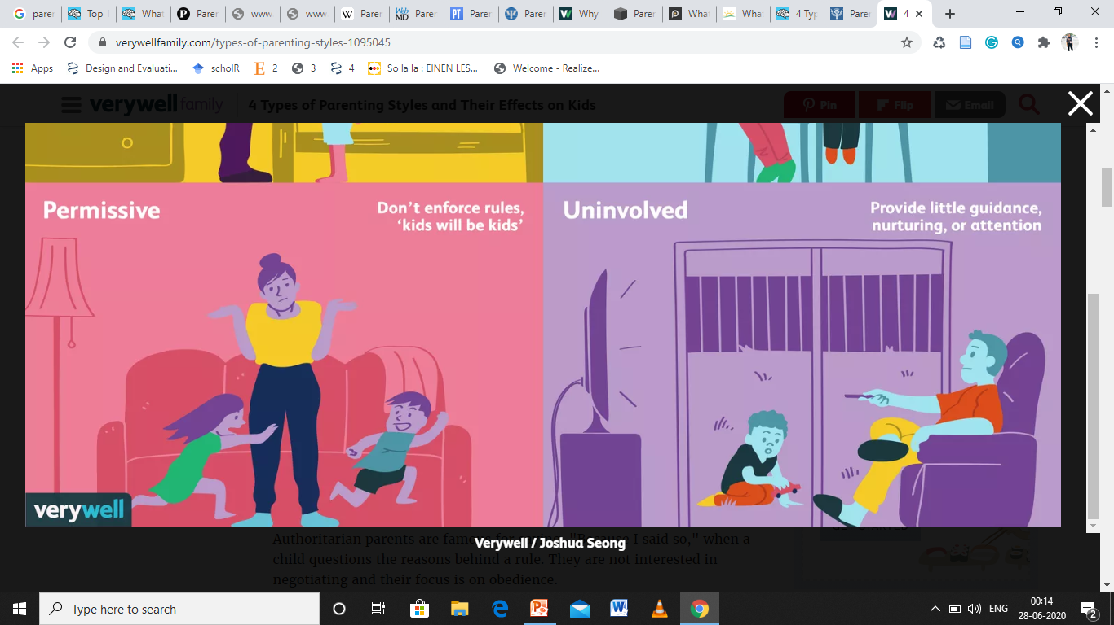
PARENTING STYLES

Slide 4
AUTHORITARIAN
SIGNS OF AUTHORITARIAN PARENTS
believe kids should be seen and not heard
When it comes to rules, believe it's "my way or the highway.“
don't take the child's feelings into consideration.
not interested in negotiating and their focus is on obedience.
don't allow kids to get involved in problem-solving challenges or obstacles.
Authoritarian parents may use punishments instead of discipline.
they make their children feel sorry for their mistake rather than teaching them to make correct choices.
OUTCOME ON CHILDREN
Their obedience is at stake.
may become hostile or aggressive.
they think much on their anger on parents rather than their career.
good liars to avoid punishment.
Have an unhappy disposition.
Be less independent.
Appear insecure.
Possess lower self-esteem.
Exhibit more behavioural problems​
Perform worse academically.
Have poorer social skills.
Be more prone to mental issues​​.
Be more likely to have drug use problems​

Slide 5
AUTHORITATIVE
SIGNS OF AUTHORITATIVE PARENTING
put a lot of effort into creating and maintaining a positive relationship with your child.
explain the reasons behind your rules.
take your child's feelings into consideration.
use positive discipline strategies to reinforce good behaviour, like praise and reward systems.
OUTCOME ON CHILDREN
become responsible adults
comfortable in expressing their opinions.
more likely to be good at making decisions and evaluating safety risks on their own.
Appear happy and content.
Are more independent.
Achieve higher academic success​
Develop good self-esteem​.
Interact with peers using competent social skills​​.
Have better mental health — less depression, anxiety, suicide attempts, delinquency, alcohol and drug use​.
Exhibit less violent tendencies

Slide 6
PERMISSIVE
SIGNS OF PERMISSIVE PARENTING
set rules but rarely enforce them.
don't give out consequences very often.
think your child will learn best with little interference from you.
Permissive parents are lenient.
often only step in when there's a serious problem.
quite forgiving and they adopt an attitude of "kids will be kids."
might give privileges back if a child begs or they may allow a child to get out of time-out early if he promises to be good.
more of a friend role than a parent role.
OUTCOMES ON CHILD
more likely to struggle academically.
exhibit more behavioural problems as they don't appreciate authority and rules.
have low self-esteem and may report a lot of sadness.
Are at a higher risk for health problems, like obesity, because permissive parents struggle to limit junk food intake.
Cannot follow rules.
Have worse self-control.
Possess egocentric tendencies.
Encounter more problems in relationships and social interactions.

Slide 7
UNINVOLVED
SIGNS OF UNINVOLVED PARENTS
don't ask your child about school or homework.
rarely know where your child is or who she is with.
don't spend much time with your child.
Children may not receive much guidance, nurturing, and parental attention.
expect children to raise themselves
A parent with mental health issues or substance abuse problems, for example, may not be able to care for a child's physical or emotional needs on a consistent basis.
overwhelmed with other problems, like work, paying bills, and managing a household.
OUTCOME ON CHILD
likely to struggle with self-esteem issues.
tend to perform poorly in school.
exhibit frequent behaviour problems and rank low in happiness.
Are more impulsive.
Cannot self-regulate emotion.
Encounter more delinquency and addictions problems.
Have more mental issues e.g. suicidal behaviour in adolescents.

Slide 8
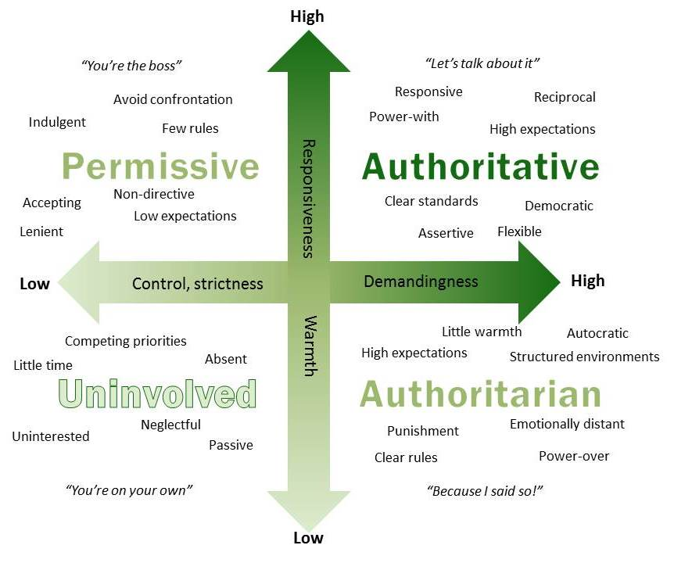
PARENTING STYLES

Slide 9
GOOD PARENTING
focuses on developing independence in children
involves a style that considers children’s age and stage of development
there is a match between expectations, discipline and resilience-building strategies and children’s developmental age.
aims at socialising kids.
develops a growth mind-set in kids rather than a mind-set that says that a child’s intelligence is fixed.
encouragement over praise, consequences over punishment and cooperation over obedience.
insists that kids help at home without being paid so that learn to be givers, not takers.
the best parenting style is an authoritative style which is a balance of firmness and nurturance. The outcomes are generally best for kids in terms of academic success, mental health and good well-being when they are raised by parents that use an authoritative style.

Slide 10
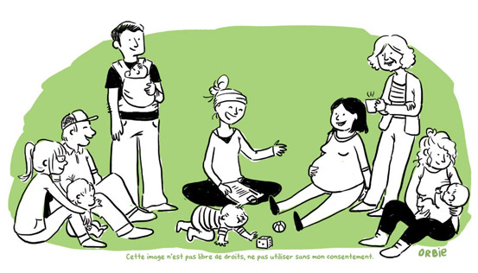
GOOD PARENTING

Slide 11
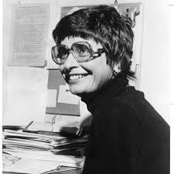
PSYCHOLOGICAL THEORY
EMERGENCE OF PARENTING AS A PSYCHOLOGICAL THEORY
In the 1960s, Baumrind noticed that pre-schoolers exhibited distinctly different types of behaviour. Each type of behaviour was highly correlated to a specific kind of parenting. Baumrind’s theory is that there is a close relationship between types of parenting styles and children’s behaviour, which leads to different child development and outcomes in their lives.
Based on extensive observation, interviews and analyses, Baumrind initially identified three different types of parenting styles: authoritative parenting, authoritarian parenting and permissive parenting​.

Slide 12

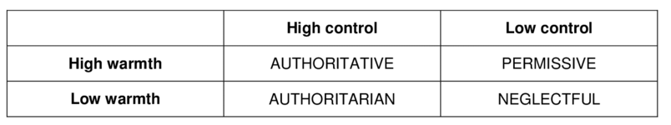
Although Diana Baumrind is known for her work on categorizing parenting styles, Maccoby and Martin (1983) were the ones who expanded this 3-parenting-styles model using a two-dimensional framework​2​.
They expanded Baumrind’s permissive parenting style into two different types: permissive parenting (also known as indulgent parenting style) and neglectful parenting (also known as uninvolved parenting style).
These four parenting styles are sometimes called the Baumrind parenting styles or Maccoby and Martin parenting styles.

