Slide 1

INTERPERSONAL COMMUNICATION SKILLS

Slide 2
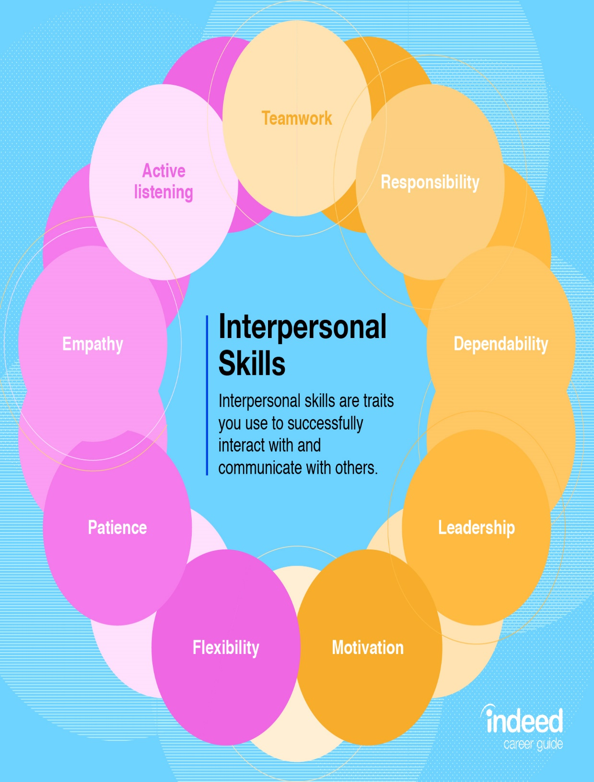
WHAT ARE INTERPERSONAL SKILLS
Interpersonal skills are the skills required to effectively communicate, interact, and work with individuals and group
Those with good interpersonal skills are strong verbal and non verbal communicators and often considered to be “good with people”.
Whether they are used in your career or personal life, these skills are important for success.

Slide 3


Most of what we do in life requires interaction with other people. Strong interpersonal skills will enable you to talk to and work with all types of people including managers, coworkers and customer.

Slide 4


Interpersonal skills form an intergral part of your professional toolbox. From collaborating on a project with a colleague to liaising with an important external stakeholder, you need confidence, empathy and communication skills to make the most of every interaction.

Slide 5

Strong relationships with the people you work with will help you succeed in the workplace

Slide 6
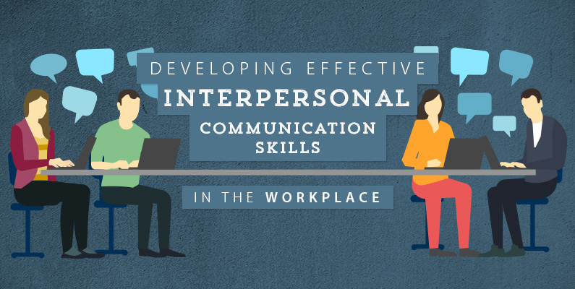
HOW

Slide 7
Have a difficult coworker or manager?
Managing relationships
Always remain polite and professional towards that person. If you need to confront that person make sure you do it thoughtfully. You never know! A difficult coworker could become a friend over time.
You can begin to understand why it is so important to have good relationships with your coworkers and managers! Good relationships will help you get along well with people and help you to do your job better.

Slide 8
WAYS TO IMPROVE YOUR ATTITUDE AT WORK:
Avoid negative thinking and complaining
Spend time with people who have a positive attitude
Be thankful for your job
Give yourself a chance to recharge
Reward yourself for doing a good job
Having a Great Attitude
A great attitude will help you cope with pressure and stress as well as help you be more flexible in your job. Always sharing a positive attitude will help you grow in your position and ultimately help you move forward in your career.

Slide 9
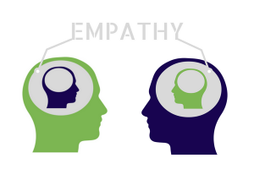
PRACTICE EMPATHY
The ability to understand and relate to the feelings of others is called empathy. Having empathy will help you develop strong relationships with other people. When you have empathy, people feel that you understand them and how they feel.

Slide 10
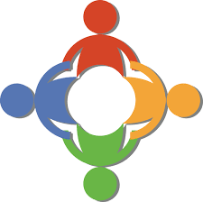
Cooperating with others
Cooperating, or working well with others, is an important part of interpersonal skills in the workplacegoal is to help the company be successful. Without cooperation, the workplace can be an unpleasant place, and the company will not succeed.

Slide 11


APPROPRIATE CONTACT
Interpersonal skills are not just about the things you say at work, they also include your actions, or the things you do. The way you act toward people at work will determine whether or not they feel comfortable around you. Start by always standing an appropriate distance away from the person with whom you are talking.

Slide 12

ACTIVE LISTENING
Active listening means you are fully engaged while listening to someone talk. You’re completely focused on the person speaking. You are giving them eye contact, nodding, and occasionally asking clarifying questions to make sure you understand.

Slide 13
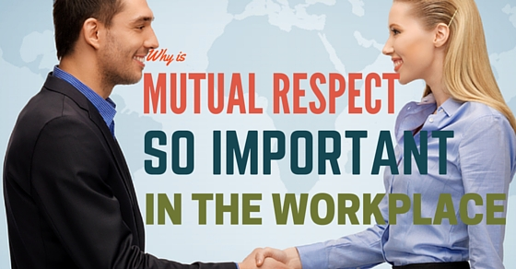
Always remember to say please and thank you
SHOWING RESPECT
When you show respect for others in the workplace, people will show respect for you. You can show respect for others by being polite and using your manners..
When people are talking to you, listen to what they are saying and make eye contact to show that you are listening. Wait until other people have finished talking before you respond so that you don’t cause them to forget what they wanted to say.

Slide 14
WAYS TO MAKE PEOPLE LIKE YOU
Become genuinely interested in other people.
Smile
Remember that a person’s name is to that person the sweetest and most important sound in any language.
Be a good listener
Talk in terms of other person’s interest
Make the other person feel important- and do it sincerly

Slide 15


