Slide 1
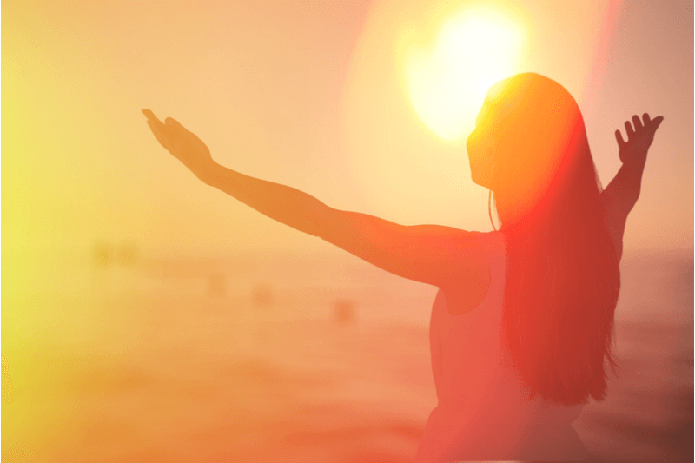
Gratitude
Presented by: Shweta
Mentor: Mr. Shyam Gupta, Clinical Psychologist, Therapist
Ms. Mehek Rohira, Psychologist, Mumbai
t

Slide 2
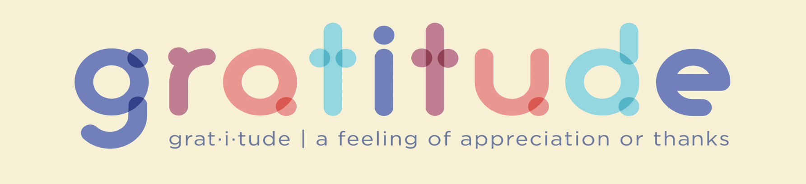
A thankful appreciation for what an individual receives, whether tangible or intangible.
A social emotion that signals our recognition of the things others have done for us
Has been conceptualized as an emotion, a virtue, a moral sentiment, a motive, a coping response, a skill, and an attitude.

Slide 3
SYNONYMS
acknowledgment;
appreciativeness;
grace;
gracefulness;
gratefulness;
praise;
recognition;
requital;
responsiveness;
thankfulness.

Slide 4
STATES OF GRATITUDE
According to Dr. Robert Emmons, the feeling of gratitude involves two stages (2003):
First comes the acknowledgment of goodness in one’s life.
say yes to life. life is good, has elements that make worth
living,
Second, gratitude is recognizing that goodness lies outside the self. One can be grateful to other people, to animals, and to the world.
The two stages of gratitude comprise the recognition of the goodness in our lives.

Slide 5
PURPOSE OF GRATITUDE
Form new social relations or to strengthen current ones.
Used to apologize, make amends and help solve other problems.
People may feel gracious because it can be an intrinsically rewarding process.
Motivate oneself to seize the day.

Slide 6
WHY GRATITUDE WORKS?
Selfless act
Acts are done unconditionally, to show to people that they are appreciated.
A gift that is freely given
Even when we do not expect a return, sometimes they happen
Gratitude can be contagious, in a good way.

Slide 7
CATHARSIS
RECIPROCITY
Individual releases strong emotions.
To illustrate this, consider the guilt associated with “failing” to meet obligations. Perhaps in this situation, you would express gratitude to who you let down, in an attempt to release that guilt.
The acts are meant to convey the appreciation that the friends possess, despite a recent disappointment.
Exchanging of actions.
When someone performs an act of gratitude for another person, in turn, that person may be motivated to do something gracious for the former person or continue the favour for a stranger.

Slide 8
TRAIT V/S STATE
TRAIT
STATE
An individual practices gratitude as part of their daily life
Character strength, to possess gratitude
Can be developed with practice and awareness
When a person experiences the rich emotion from someone expressing gratitude for them.

Slide 9
RELIGIOUS AND SPIRITUAL PERSPECTIVE
Many religions referred to gratitude strictly regarding the need to be thankful for a higher power.
Christianity, Islam and Judaism stressed gratitude as an integral step on the path to a good life.
In Judaism, it is encouraged to start every day by being grateful for waking up again.
Christianity - “gratitude to God” that binds many Christians together.
For Islam, the purpose of the five daily prayers is not to ask Allah for anything, but instead, to show gratitude towards Allah.

Slide 10
MODERN PSYCHOLOGICAL PERSPECTIVE
Enhanced Well-being
Deeper Relationships
Improved Optimism
Increased Happiness
Stronger Self-Control
Better Physical and Mental Health
An Overall Better Life
Stronger Athleticism
Stronger Neurologically-Based Morality

Slide 11
ENHANCED WELL-BEING
Grateful people are more agreeable, more open, and less neurotic
Gratitude is related inversely to depression, and positively to life satisfaction
DEEPER RELATIONSHIPS
People who express their gratitude for each other tend to be more willing to forgive others and are less narcissistic
Giving thanks to those who have helped you strengthens your relationships and promotes relationship formation and maintenance.

Slide 12
IMPROVED OPTIMISM
People who are focused on gratitude show more optimism in many areas of their lives, including health and exercise
More likely to act in ways that support a healthy lifestyle
INCREASED HAPPINESS
Gratitude offers a long-lasting effect in a positive-feedback loop
The more gratitude we experience and express, the more situations and people we may find to express gratitude towards.

Slide 13
STRONGER SELF-CONTROL
Emotions can foster self-control, and discovering a way to reduce impatience with a simple gratitude exercise opens up tremendous possibilities for reducing a wide range of societal ills from impulse buying and insufficient saving to obesity and smoking.
BETTER PHYSICAL AND MENTAL HEALTH
Reduced inflammation, improved sleep, and better moods
Reduced symptoms of heart failure after only 8 weeks.
Healthier minds, and with that healthier bodies.

Slide 14
AN OVERALL BETTER LIFE
More energy
More optimism
More social connections
More happiness
Reduce levels of stress
Decrease levels of depression and anxiety

Slide 15
STRONGER ATHLETICISM
Athlete’s level of gratitude for their success can influence their levels of well-being
More satisfied and tend to have higher levels of self-esteem.
Stronger fan support and pride can influence the performance and pride of the team itself for representing a greater team.

Slide 16
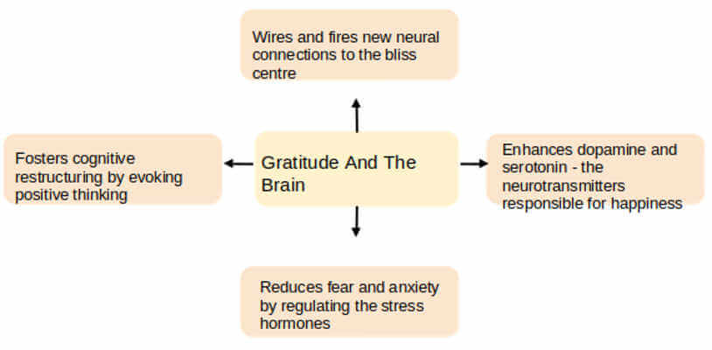
STRONGER NEUROLOGICALLY –BASED MORALITY
Gratitude increases activity in areas of the brain that deal with morality, reward, and judgment.

Slide 17
Expressing gratitude not only helps people appreciate what they’ve received in life, but it also helps people feel like they have given something back to those who helped them.
Effectively, gratitude can create social networks and help individuals work towards goals and challenges, and overall, simply have stronger coping skills for life’s hardships.

Slide 18
APPLY IT TO YOUR LIFE!
This very evening, before you go to sleep, think of the positive things that happened during the day.
Consider a gratitude journal as well.
Before getting out of bed, consider three things—however small—that you are grateful for.
Share what you’re grateful for and set examples
If you feel that you have neglected to thank someone in your life, maybe write them a letter explaining your gratitude.
Acting kindly towards a stranger because someone did that for you.

Slide 19
A TAKE-HOME MESSAGE
Gratitude is an important social emotion
Gratitude is a tool for increasing well-being.
Gratitude is related to a desire to build people and societies that are healthy and thriving.
There are so many ways to practice gratitude.

Slide 20
THANK YOU
For any questions reach out to us
info@emotionoflife.in

