Slide 1
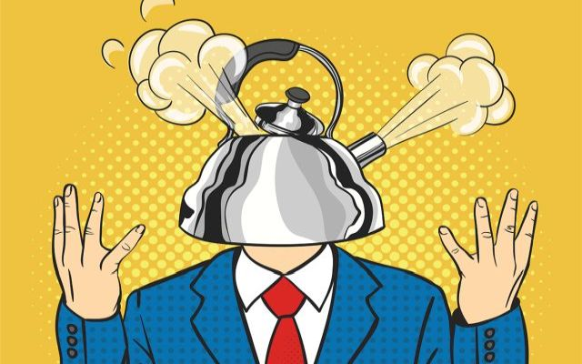
Anger Management
Made by : Trannum Gupta
Under the guidance of
Mr, Shyam Gupta, Clinical Psychologist & Psychotherapist, Gwalior
Ms. Mehek, Psychologist, Mumbai

Slide 2
WHAT IS ANGER?
Anger is a natural response to perceived threats. It causes your body to release adrenaline, your muscles to tighten, and your heart rate and blood pressure to increase. Your senses might feel more acute and your face and hands flushed.
Anger is related to the “fight, flight, or freeze” response of the sympathetic nervous system; it prepares humans to fight
Anger becomes the predominant feeling behaviorally, cognitively, and physiologically when a person makes the conscious choice to take action to immediately stop the threatening behavior of another outside force.

Slide 3
DEFINITION
Charles Spielberger, PhD, a psychologist who specializes in the study of anger, describes anger as “an emotional state that varies in intensity from mild irritation to intense fury and rage”.
Anger is an emotion we feel, like sadness, fear, joy, and happiness.
Anger is caused by two basic things:
  Frustration: Not getting what we want, especially if we are expecting to get it
  Feeling that others do not respect us or care how we feel

Slide 4
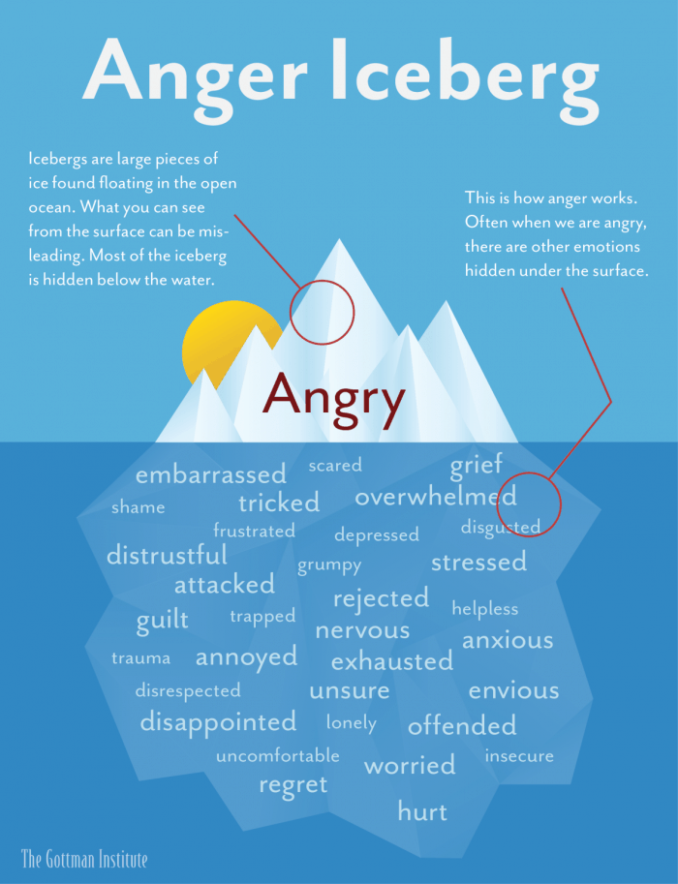
Anger can be used as a shield to protect us from emotional distress, due to the endorphins released from our nervous system and the physical/emotional distance it puts between us and others.
“How much more grievous are the consequences of anger than the causes of it.” - Marcus Aurelius.

Slide 5
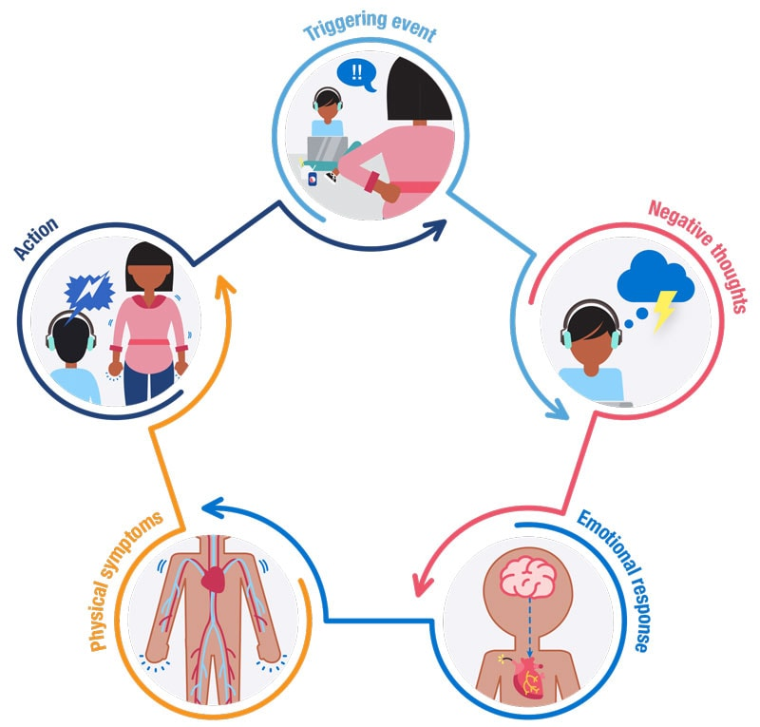
THE ANGER AROUSAL CYCLE
The arousal cycle of anger has five phases:
  Triggering event
  Negative thoughts
  Emotional response
  Physical symptoms
  Behavioural response
  Understanding the cycle helps us to understand our own reactions and those of others.

Slide 6
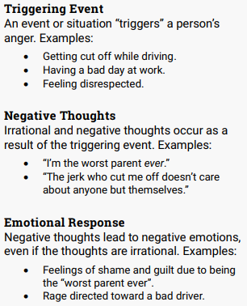
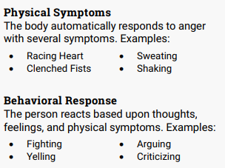
THE ANGER AROUSAL CYCLE

Slide 7
TYPES OF ANGER
Justifiable Anger : Justifiable anger is having a sense of moral outrage at the injustices of the world — whether it’s the destruction of the environment, oppression of human rights, cruelty towards animals, violence in the community, or an abusive relationship at home.
Annoyance Anger : This is the most common type of anger and can arise from the many frustrations of daily life: a driver cuts you off on the road, your partner said something insensitive, the kids aren’t listening, your boss is a real jerk, etc. When we focus on the negative and personalize/internalize other people’s words and actions, it’s easy to experience annoyance anger on a regular basis.

Slide 8
TYPES OF ANGER
Aggressive Anger : Aggressive anger is often used in situations where one individual attempts to exercise dominance, manipulation or control over another. When expressed repeatedly in relationships, aggressive anger becomes bullying, oppression, psychological violence, and emotional abuse. We may recognize a deep sense of fear and inadequacy within someone who tries to mask his or her weaknesses and flaws by attempting to control others.
Temper Tantrums : Temper tantrums (sometimes intertwined with aggressive anger) can be characterized as disproportional outbursts of anger when an individual’s selfish wants and needs are not fulfilled, no matter how unreasonable and inappropriate. This type of anger often originates in childhood and is typically part of a young person’s developmental and maturation process. People with chronic temper tantrums often have difficulty forming healthy and successful relationships

Slide 9
CAUSES OF ANGER
According to Behavior Modification Therapy, behavior can be altered if we change the antecedent (what comes before the behavior) or the consequence (what happens immediately after) the behavior. Since anger is a result of primary emotions, we need to address the antecedent or cause of that emotion.

Slide 10
CAUSES OF ANGER
Sadness – family or friends arguing, no one to talk to, divorce or separation, death of a close one, change of location, long distance relationships, etc.
Fear – worry about not having enough money to pay bills or participate in activities, sick family member, personal illness, loved one forming a danger job (military, police, firefighter), etc.
Frustration – low academic/professional performance, underdeveloped social skills, physical development/abilities, comparison to high-achieving fellow mates, sense of lack of control, etc.

Slide 11
CAUSES OF ANGER
Guilt – sexual abuse victimization, let someone down, feelings of responsibility for a divorce or death, hurt someone (emotionally or physically), failure to follow directions, etc.
Disappointment – didn’t get chosen for a group activity, poor performance, change in plans, financial limitations, etc.
Embarrassment – social – in front of peer groups, physical appearance, feeling “stupid”, feeling “worthless”, awkwardness in social situations, low social skills, etc.

Slide 12
CAUSES OF ANGER
Jealousy – friendships, siblings, classmates, parents‘ or spouses’ time/attention, possessions, social status, etc.
Hurt – abandonment, break-up of a friendship or romantic relationship, rejection, peer or family betrayal, etc.
Anxiety – inconsistency, poor boundaries, social pressure, personal expectations, biological – anxiety disorders, etc.
Shame – Inability to meet the expectations of others, Abuse (emotional/physical/sexual), Substance abuse (self or family), Previous disciplinary action, inability to control behaviors. Etc.

Slide 13
COMMON PRESENTATIONS OF ANGER
There are several ways that people commonly express anger. These include:
  aggressiveness,
  passive-aggressiveness
We commonly associate anger with violence, but violent behavior is not, in fact, the most common way that anger presents itself. There are many other more subtle expressions of anger, each of which can disrupt healthy relationships.
These more subtle or passive indicators of anger may include:
  insults,
  sarcasm,
  spreading rumors,
  gossiping,
  ignoring or avoiding another person, and
  damaging another person’s property.
Furthermore, anger can sometimes become displaced, meaning that anger with one person or due to one event spills over and leads the individual to become angry with another person or with regards to a different situation.

Slide 14
CONSEQUENCES OF ANGER
Physical and mental health disorders
Broken relationships
Persisting negativity
Poor performance
Inability to concentrate
Loneliness
Poor friendships
Loss of trust
Loss of work
Poor health of loved ones
Accidents

Slide 15
ANGER MANAGEMENT
Anger management is a psycho-therapeutic program for anger prevention and control.
The purpose of anger management is to help a person decrease anger. It reduces the emotional and physical arousal that anger can cause. It is generally impossible to avoid all people and settings that incite anger. But a person may learn to control reactions and respond in a socially appropriate manner.

Slide 16
ANGER MANAGEMENT THERAPY
The goal of anger management therapy is to teach people how to examine their triggers. It also helps people adjust how they look at situations.
Successful anger management therapy develops healthy ways for people to express anger and frustration. Some techniques used in anger management therapy include:
  Impulse control
  Self-awareness
  Meditation
  Frustration management (sometimes by writing in an anger diary)
  Breathing techniques
  Relaxation strategies
  Personal Reflection, and
  Emotional Awareness.

Slide 17
COPING WITH ANGER
Because anger is a perfectly normal emotional response, the goal of anger management therapy is not to eliminate anger from people’s lives but to help them find healthier ways to cope with anger. These improved coping strategies help individuals respond in less damaging ways to situations that make them angry.
Coping strategies introduced during anger management therapy typically include:
  journaling,
  exercise,
  mindfulness meditation,
  finding a constructive hobby, and
  emotional reframing.

Slide 18
COGNITIVE RESTRUCTURING AND CBT FOR ANGER MANAGEMENT
Simply put, this means changing the way you think. Angry people tend to curse, swear, or speak in highly colorful terms that reflect their inner thoughts. When you're angry, your thinking can get very exaggerated and overly dramatic.
  Try replacing these thoughts with more rational ones.
  Be careful of words like "never" or "always" when talking about yourself or someone else. They serve to make you feel that your anger is justified and that there's no way to solve the problem. They alienate and humiliate people who might otherwise be willing to work with you on a solution.
  Remind yourself that getting angry is not going to fix anything, that it won't make you feel better (and may actually make you feel worse).
  Logic defeats anger, because anger, even when it's justified, can quickly become irrational. So use cold hard logic on yourself. Remind yourself that the world is "not out to get you," you're just experiencing some of the rough spots of daily life.
  As part of their cognitive restructuring, angry people need to become aware of their demanding nature and translate their expectations into desires. When you're unable to get what you want, you will experience the normal reactions—frustration, disappointment, hurt—but not anger.

Slide 19
OTHER HELPFUL WAYS
Problem solving : There is also a cultural belief that every problem has a solution, and it adds to our frustration to find out that this isn't always the case. The best attitude to bring to such a situation, then, is not to focus on finding the solution, but rather on how you handle and face the problem.
Better Communication :Angry people tend to jump to—and act on—conclusions, and some of those conclusions can be very inaccurate. The first thing to do if you're in a heated discussion is slow down and think through your responses. Don't say the first thing that comes into your head, but slow down and think carefully about what you want to say. At the same time, listen carefully to what the other person is saying and take your time before answering.

Slide 20
OTHER HELPFUL WAYS
Using Humor :"Silly humor" can help defuse rage in several ways. For one thing, it can help you get a more balanced perspective. When you get angry and call someone a name or refer to them in some imaginative phrase, stop and picture what that word would literally look like. This will take a lot of the edge off your fury; and humor can always be relied on to help unknot a tense situation. Anger is a serious emotion, but it's often accompanied by ideas that, if examined, can make you laugh.
Changing Your Environment : Sometimes it's our immediate surroundings that give us cause for irritation and fury. Problems and responsibilities can weigh on you and make you feel angry at the "trap" you seem to have fallen into and all the people and things that form that trap . Give yourself a break. Make sure you have some "personal time" scheduled for times of the day that you know are particularly stressful.

Slide 21
Thank You

