Slide 1
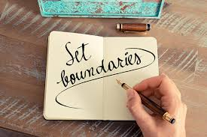
Maintaining healthy boundaries
Emotion of life
www.emotionoflife.in
info@emotionoflife.in
call: 9368503416

Slide 2
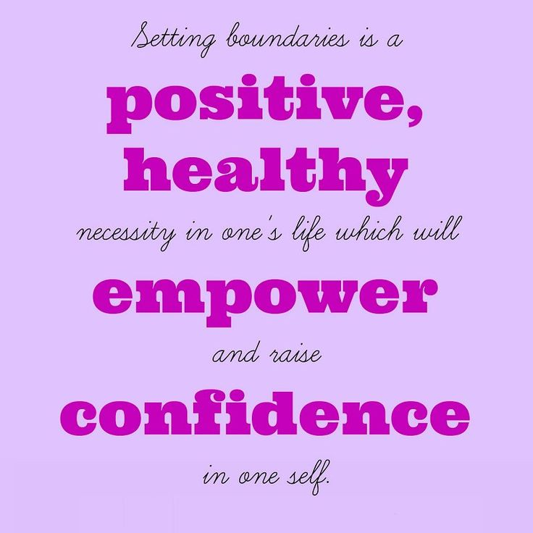

Slide 3
WHAT ARE (Healthy) boundaries?
Boundaries can be defined as the limits we set with other people, which indicate what we find acceptable and unacceptable in their behavior towards us.
Boundaries can be physical or emotional, and they can range from being loose to rigid, with healthy boundaries often falling somewhere in between.
Boundaries are basic guidelines that people create to establish how others are able to behave around them. For example, they may involve what behavior is okay and what is not and how to respond if someone passes those limits. Setting boundaries can ensure that relationships can be mutually respectful, appropriate, and caring.
Healthy boundaries can serve to establish one’s identity. Specifically, healthy boundaries can help people define their individuality and can help people indicate what they will and will not hold themselves responsible for.
Boundaries help you feel safe and comfortable in your relationships.
They are a way for you to share your expectations and set limitations with yourself and others. Boundaries are a healthy way to show up for yourself.
Personal boundaries are the limits and rules we set for ourselves within relationships. A person with healthy boundaries can say “no” to others when they want to, but they are also comfortable opening themselves up to intimacy and close relationships.
Healthy Personal Boundaries = Taking responsibility for your own actions and emotions, while NOT taking responsibility for the actions or emotions of others

Slide 4
Unhealthy boundaries – Types and characteristics :
A person who always keeps others at a distance (whether emotionally, physically, or otherwise) is said to have rigid boundaries. Alternatively, someone who tends to get too involved with others has porous boundaries
Characteristics:
Rigid Boundaries | Porous Boundaries
Avoids intimacy and close relationships. | Overshares personal information.
Unlikely to ask for help. | Difﬁculty saying “no” to the requests of others.
Has few close relationships. | Overinvolved with others’ problems.
Very protective of personal information. | Dependent on the opinions of others.
May seem detached, even with romantic partners. | Accepting of abuse or disrespect.
Keeps others at a distance to avoid the possibility of rejection. | Fears rejection if they do not comply with others.

Slide 5
Characteristics and traits of healthy Boundaries :
Healthy Boundaries -
Values own opinions.
Doesn’t compromise values for others.
Shares personal information in an appropriate way (does not over or under share).
Knows personal wants and needs, and can communicate them.
Accepting when others say “no” to them and knows how to say “no” to others without hurting someone’s feelings or emotions.

Slide 6
Most people have a mix of different boundary types. For example, someone could have healthy boundaries at work, porous boundaries in romantic relationships, and a mix of all three types with their family.
The appropriateness of boundaries depends heavily on setting. What’s appropriate to say when you’re out with friends might not be appropriate when you’re at work.
Some cultures have very different expectations when it comes to boundaries. For example, in some cultures it’s considered wildly inappropriate to express emotions publicly. In other cultures, emotional expression is encouraged.

Slide 7
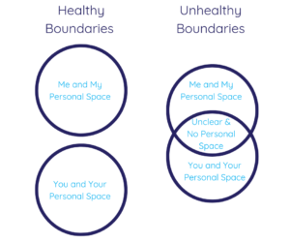
What healthy and unhealthy boundaries look like?

Slide 8
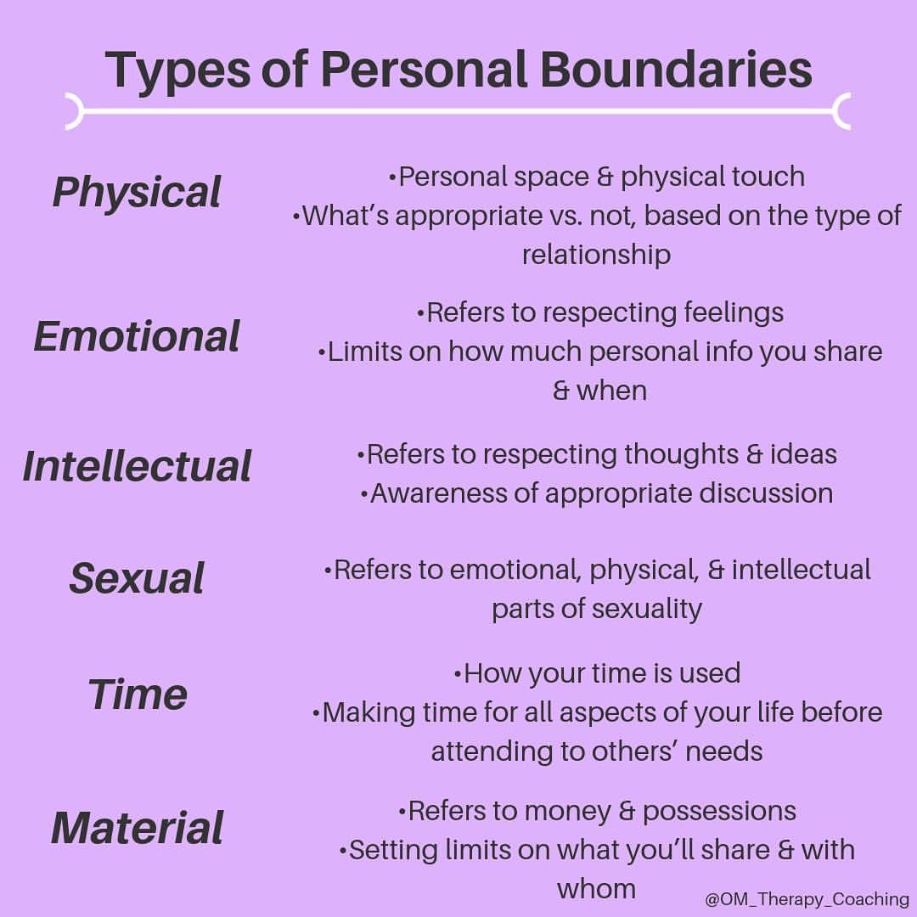

Slide 9
Why do we need to establish Healthy Boundaries?
Setting clear personal boundaries is the key to ensuring relationships are mutually respectful, supportive and caring. Boundaries are a measure of self-esteem. They set the limits for acceptable behavior from those around you, determining whether they feel able to put you down, make fun, or take advantage of your good nature.
If you often are made uncomfortable by others’ treatment of you, it may be time to reset these boundaries to a more secure level. Weak boundaries leave you vulnerable and likely to be taken for granted or even damaged by others. On the other hand, a healthy self-respect will produce boundaries which show you deserve to be treated well. They also will protect you from exploitative relationships and help you avoid getting too close to people who don’t have your best interests at heart.
In short we need healthy boundaries for :
For protection and personal security
To create order
To define ourselves clearly
To gain a clearer sense of ourselves in relation to others
To empower us to determine how we will be treated by others

Slide 10
How to set Healthy boundaries?
Define your boundaries and be honest
Know your limits
Be assertive
Learn to Say no
Practice / Be consistent

Slide 11
You might need boundaries with
Family
Friends
Romantic Partner
Co-workers
Social Media
Yourself
Work
Neighbors
Relatives
Your time

Slide 12
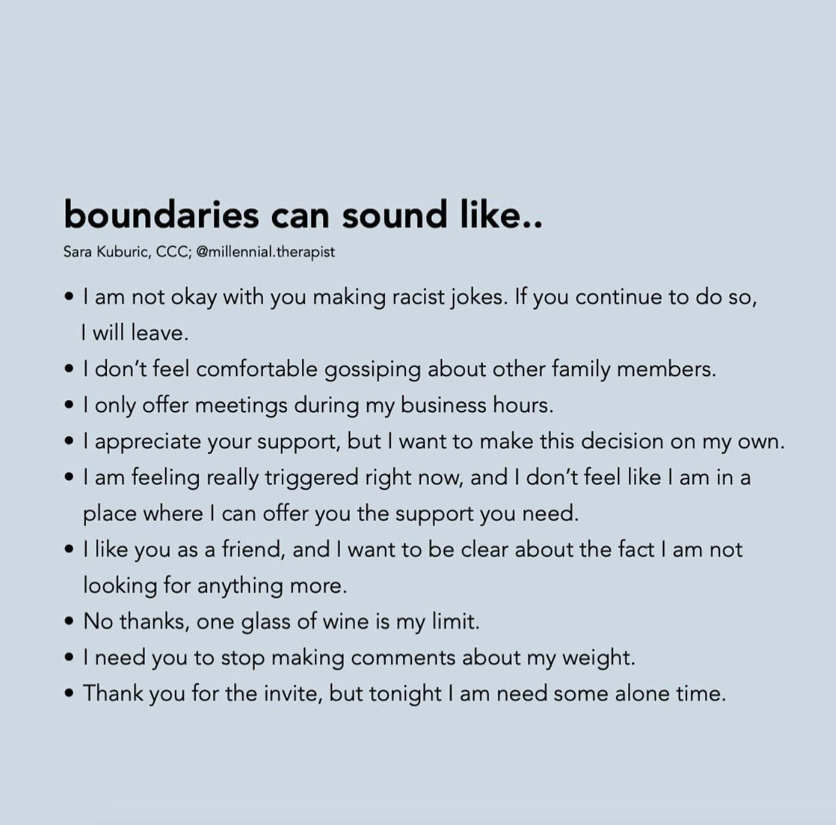
What can boundaries sound like?

Slide 13
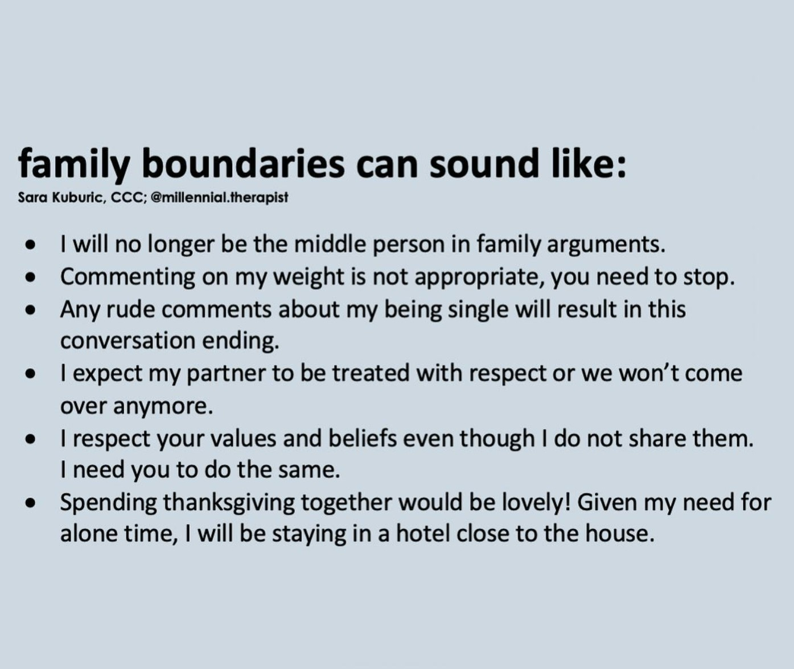
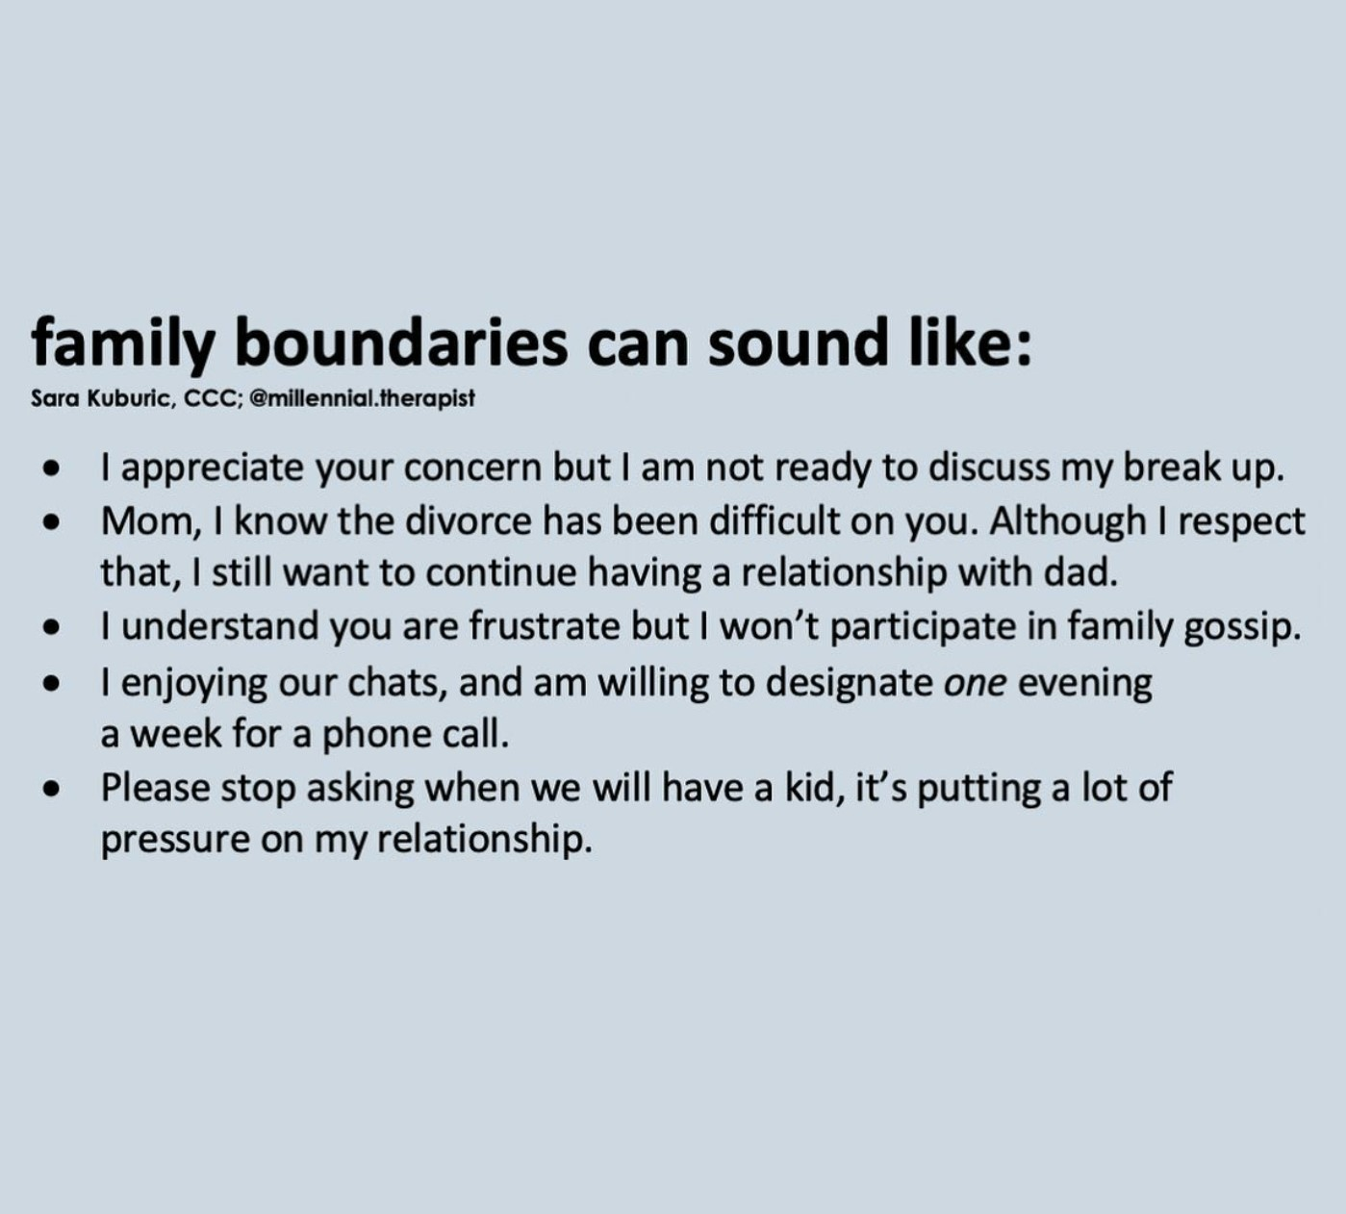

Slide 14
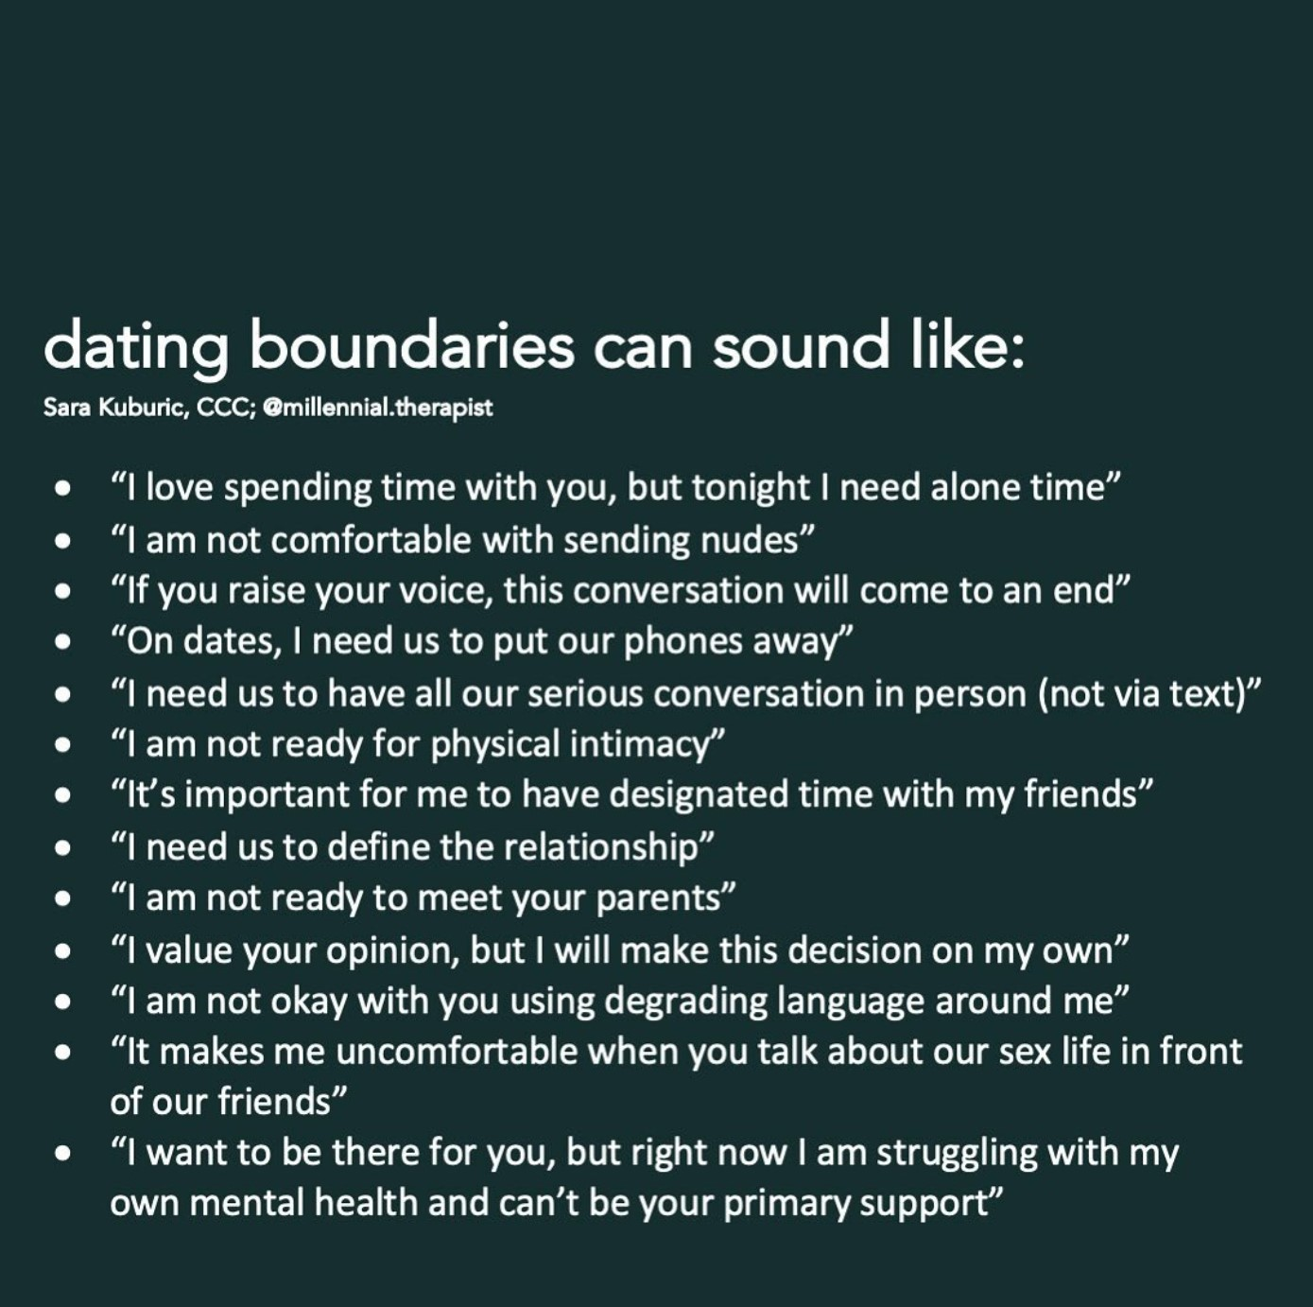
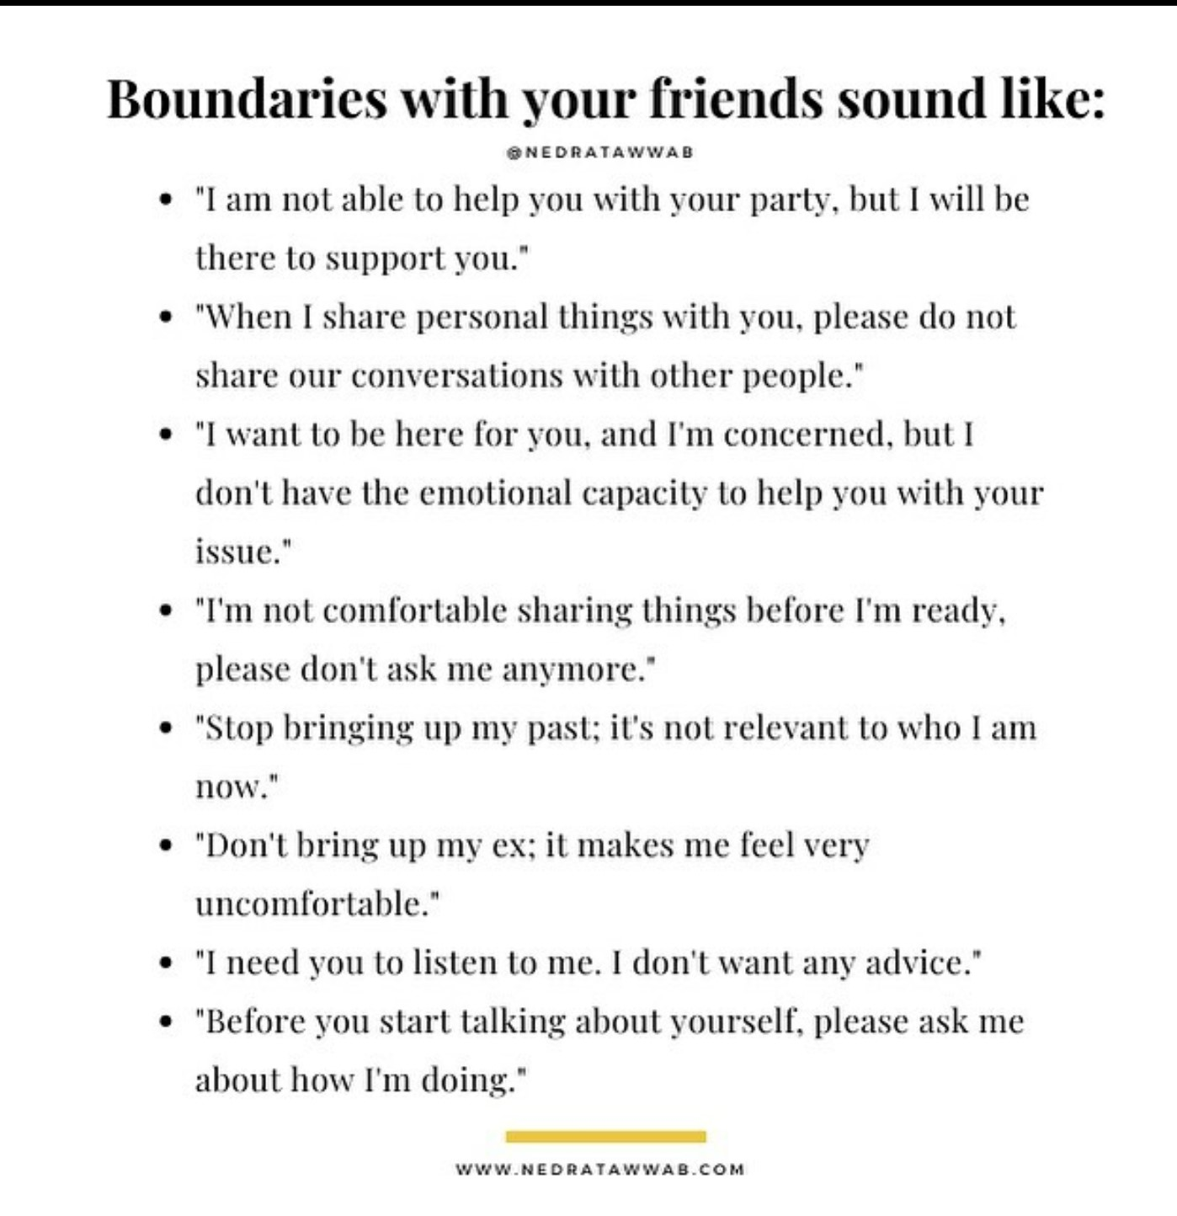

Slide 15
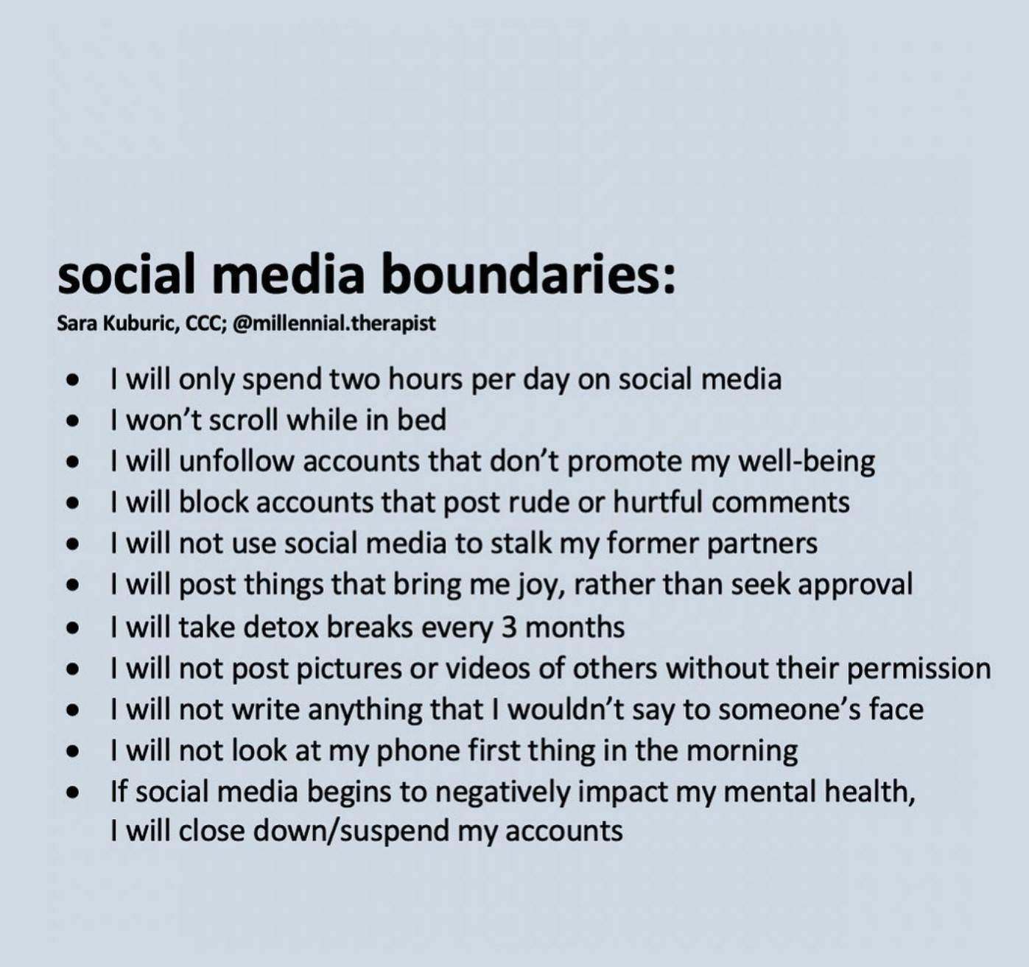
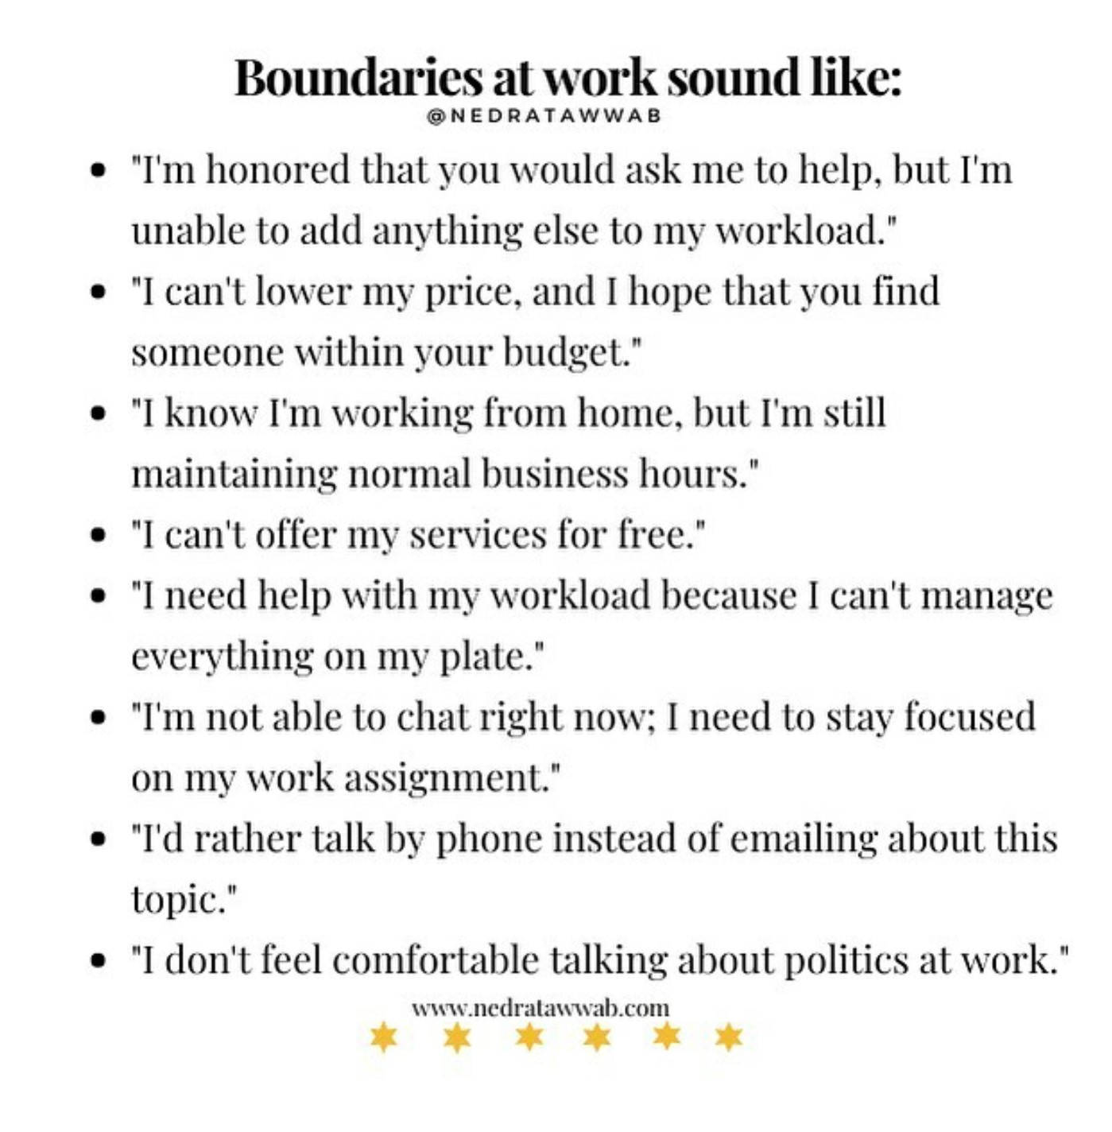

Slide 16
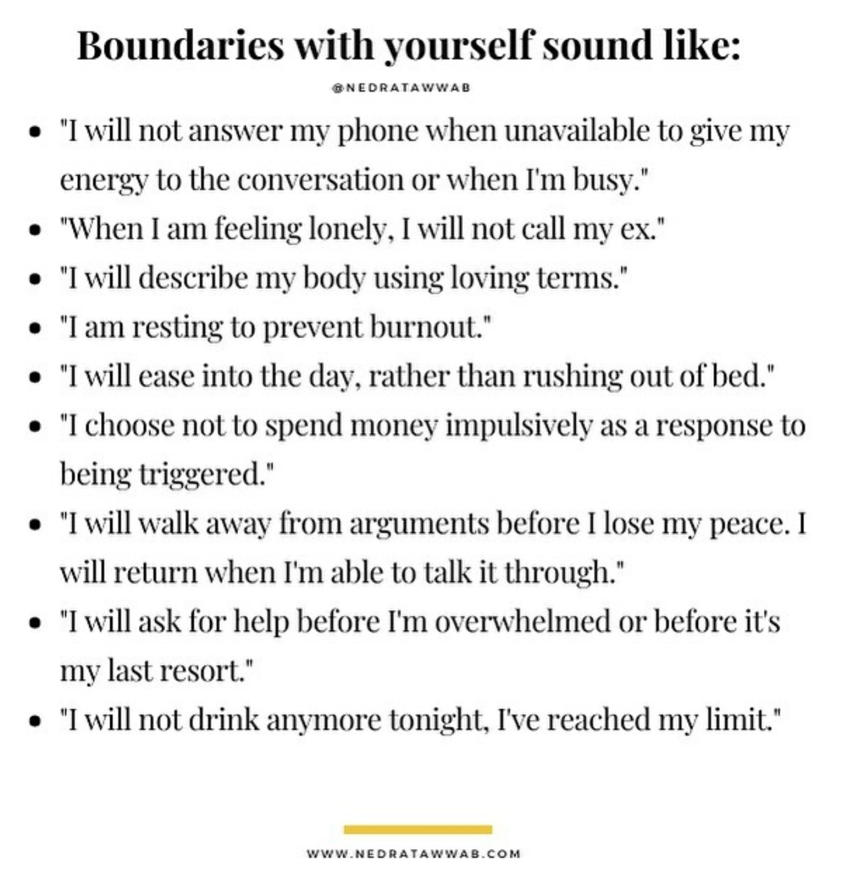

Slide 17
Benefits of Having Healthy Boundaries
Your life will be less stressful, cluttered, and distracted.
You’ll experience a new sense of calmness and direction.
The people who truly care about you will adjust to your new boundaries.
Over time, you will get better at setting and maintaining boundaries that feel good to you. (As I mentioned earlier, boundary setting is a skill and can be improved upon.)
You’ll make more room in your life for the people who appreciate you and enrich your life.
You’ll start attracting others who have healthy boundaries into your life.
You’ll be able to focus on enhancing your life rather than repairing it or just surviving each day.
You’ll have more energy to pursue your dreams and your life purpose.
You’ll feel more hopeful and enthusiastic about your life and your future.
You’ll feel more in control of your life’s trajectory and equipped to make good decisions.
You’ll respond immediately and assertively to boundary violations without feeling guilty.
You’ll be more respectful of other people’s boundaries.
It will promote closeness with others and you’ll be better able to manage your conflicts

Slide 18
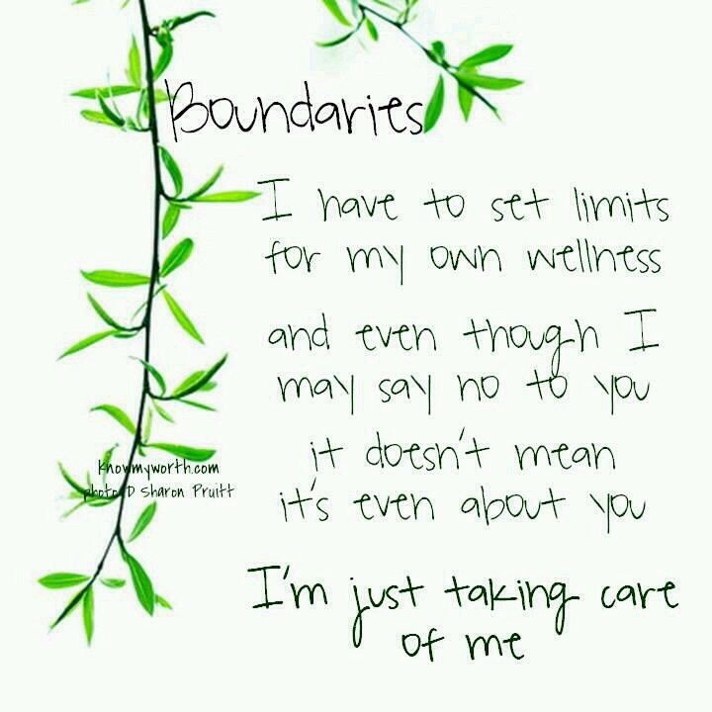

Slide 19
Thank you ☺
For any questions reach out to us info@emotionoflife.in https://emotionoflife.in/

