Slide 1
COGNITIVE PROCESS
Cognition is a term referring to the mental processes involved in gaining knowledge and comprehension.
Different cognitive processes include thinking, knowing, remembering, judging, and problem-solving

Slide 2
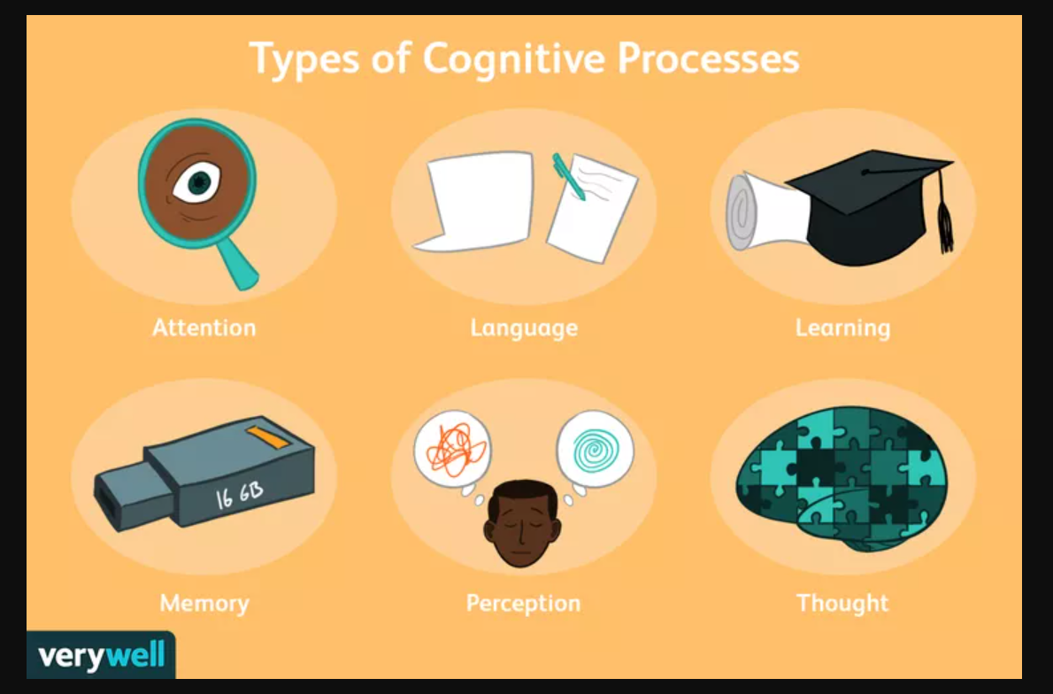
TYPES OF COGNITIVE PROCESS

Slide 3
Types of Cognitive Processes and there definition
Attention: Attention is a cognitive process that allows people to focus on a specific stimulus in the environment.
Language: Language and language development are cognitive processes that involve the ability to understand and express thoughts through spoken and written words. This allows us to communicate with others and plays an important role in thought.
Learning: Learning requires cognitive processes involved in taking in new things, synthesizing information, and integrating it with prior knowledge.
Memory: Memory is an important cognitive process that allows people to encode, store, and retrieve information. It is a critical component in the learning process and allows people to retain knowledge about the world and their personal histories.
Perception: Perception is a cognitive process that allows people to take in information through their senses, then utilize this information to respond and interact with the world.
Thought: Thought is an essential part of every cognitive process. It allows people to engage in decision-making, problem-solving, and higher reasoning.

Slide 4
Factors that affect cognitive processes
Age
- Research indicates that as we age, our cognitive function tends to decline. Age-related cognitive changes include processing things more slowly, finding it harder to recall past events, and a failure to remember information that was once known (such as how to solve a particular math equation or historical information).
Attention Issues
- Selective attention is a limited resource, so there are a number of things that can make it difficult to focus on everything in your environment. Attentional blink, for example, happens when you are so focused on one thing that you completely miss something else happening right in front of you.
Cognitive Biases
- A cognitive bias is a systematic error in thinking that occurs when people are processing and interpreting information in the world around them and affects the decisions and judgments that they make.
Genetics
-Some studies have connected cognitive function with certain genes. For example, a 2020 study published in Brain Communications found that a person's level of brain-derived neurotrophic factor (BDNF), which is 30% determined by heritability, can impact the rate of brain neurodegeneration,7 a condition that ultimately impacts cognitive function.

Slide 5
Impact of Cognition
Impact of Cognition
Our cognitive processes have a wide-ranging impact that influences everything from our daily life to our overall health.
Perceiving the World
As you take in sensations from the world around you, the information that you see, hear, taste, touch, and smell must first be transformed into signals that the brain can understand. The perceptual process allows you to take in this sensory information and convert it into a signal that your brain can recognize and act upon
Forming Impressions
The world is full of an endless number of sensory experiences. To make meaning out of all this incoming information, it is important for the brain to be able to capture the fundamentals. Events are reduced to only the critical concepts and ideas that we need.
Filling in the Gaps
In addition to reducing information to make it more memorable and understandable, people also elaborate on these memories as they reconstruct them. In some cases, this elaboration happens when people are struggling to remember something. When the information cannot be recalled, the brain sometimes fills in the missing data with whatever seems to fit

Slide 6
Tips for Improving Cognition
Cognitive processes are influenced by a range of factors, including genetics and experiences. While you cannot change your genes or age, there are things that you can do to protect and maximize your cognitive abilities:
Stay healthy. Lifestyle factors such as eating a nutritious diet and getting regular exercise can have a positive effect on cognitive functioning.
Think critically. Question your assumptions and ask questions about your thoughts, beliefs, and conclusions.
Stay curious and keep learning. A great way to flex your cognitive abilities is to keep challenging yourself to learn more about the world.
Skip multitasking. While it might seem like doing several things at once would help you get done faster, research has shown it actually decreases both productivity17 and work quality.

