Slide 1
Defence
Mechanisms
Created by: Ms. Trannum Gupta
Mr. Shyam Gupta, Clinical Psychologist , Psychotherapist
Ms. Mehek Rohira, Psychologist, Mumbai

Slide 2
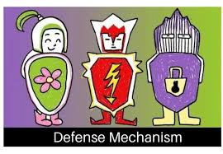
MEANING
Defense mechanisms are psychological strategies that are unconsciously used to protect a person from anxiety arising from unacceptable thoughts or feelings.

Slide 3
NEED FOR EGO DEFENSES
Defense mechanisms are used to protect ourselves from feelings of ANXIETY or GUILT, which arise because we feel threatened, or because our ID or SUPEREGO becomes too demanding.

Slide 4
CONCEPT
Defense mechanisms are psychological strategies brought into play by the unconscious mind to manipulate, deny, or distort reality in order to defend against feelings of anxiety and unacceptable impulses and to maintain one's self-schema or other schemas.
Defense mechanisms may result in healthy or unhealthy consequences depending on the circumstances and frequency with which the mechanism is used.

Slide 5
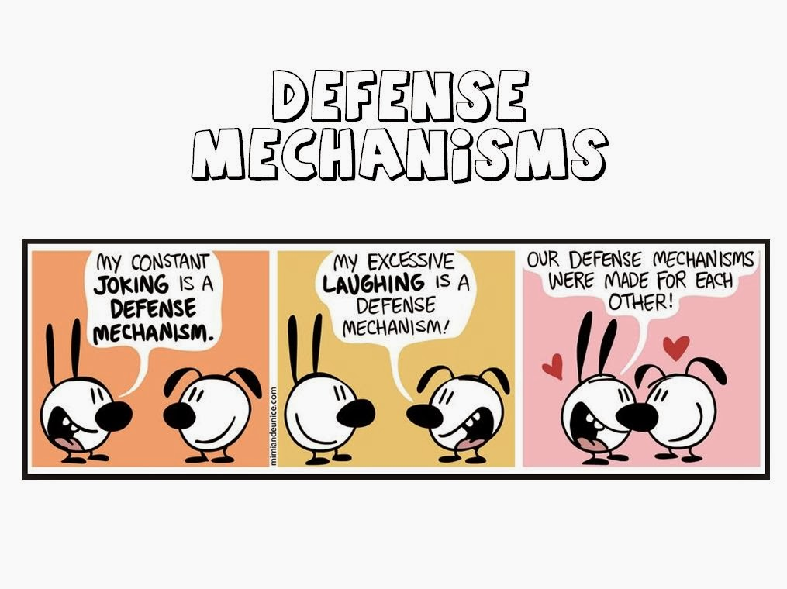

Slide 6
Defence mechanism
Bodily Defence Mechanism
Ego Defence Mechanism

Slide 7
MENTAL DEFENSE MECHANISMs OR EGO DEFENSE MECHANISMs

Slide 8
INTRODUCTION
Sigmund Freud in 1904 used this term “defense mechanism” to refer to the unconscious process that defends or protects a person against anxiety, shame, loss of self esteem, conflict or unacceptable feelings.
According to Freud, when Id is in serious conflict with ego and superego, the individual suffers from tension or anxiety.
Defense mechanisms enable a person to resolve conflicts and reduce stress and anxiety.
Usually all defense mechanisms are operated at the unconscious level.
Most of the defense mechanisms are self-deceptive in nature.

Slide 9
DEFINITION
Defense mechanism is a pattern of adjustment through which an individual relieves anxiety caused by an uncomfortable situation that threatens one’s self-esteem.
When these defense mechanisms are used moderately, they are harmless, but if used excessively and persistently, defense use can become extremely harmful.

Slide 10
CLASSIFICATION OF DEFENCE MECHANISM
  POSITIVE DEFENCE MECHANISMS
  1. Compensation
  2. Substitution
  3. Sublimation
  4. Rationalization
  5. Repression
  6. Undoing
  7. Identification
8. Transference
9.Intellectualization
10. Introjection
  NEGATIVE DEFENCE MECHANISMS
  1. Suppression
  2. Displacement
  3. Projection
  4. Regression
  5. Fixation
  6. Fantasy
  7. Reaction formation
  8. Conversion
  9. Dissociation
  10. Denial

Slide 11
TYPES OF DEFENSE MECHANISM
In the first definitive book on defense mechanisms, The Ego and the Mechanisms of Defense (1936), Anna Freud enumerated the ten defense mechanisms that appear in the works of her father, Sigmund Freud: repression, regression, reaction formation, isolation, undoing, projection, introjection, turning against one's own person, reversal into the opposite, and sublimation or displacement

Slide 12
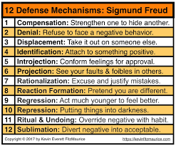
Major types of defence mechanism

Slide 13
COMPENSATION
Covering up a real or perceived weaknesses by emphasizing a trait one considers more desirable.
Example:
A physically handicapped boy is unable to play football, so he compensates by becoming a great scholar.

Slide 14
DISPLACEMENT
Transfer of feelings from one target to another that is considered less threatening or less neutral.
Example :
A client is aggressive at his doctor, does not express it but, becomes verbally abusive to the nurse.
Associated disorders: Phobias

Slide 15
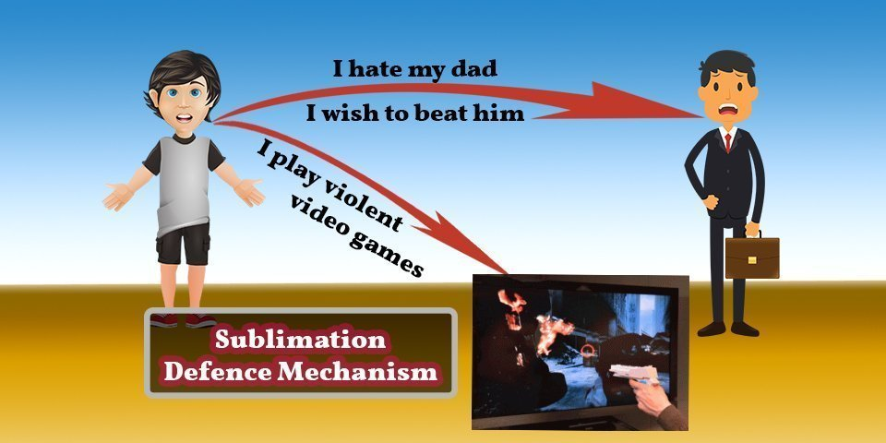
SUBLIMINATION
You find a way to do what you consider unacceptable, by making it acceptable.
EXAMPLE:
.

Slide 16
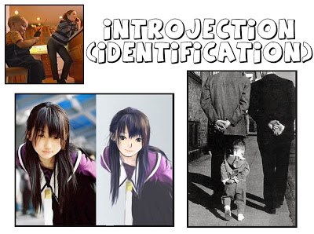
IDENTIFICATION
An attempt to increase self worth by acquiring certain attributes and characteristics of an individual one admires.
Example :
A teenaged boy who required lengthy rehabilitation after an accident decides to become a physical therapist as a result of his experiences.
Associated disorders: Schizophrenia, Mood Disorders (Depression)

Slide 17
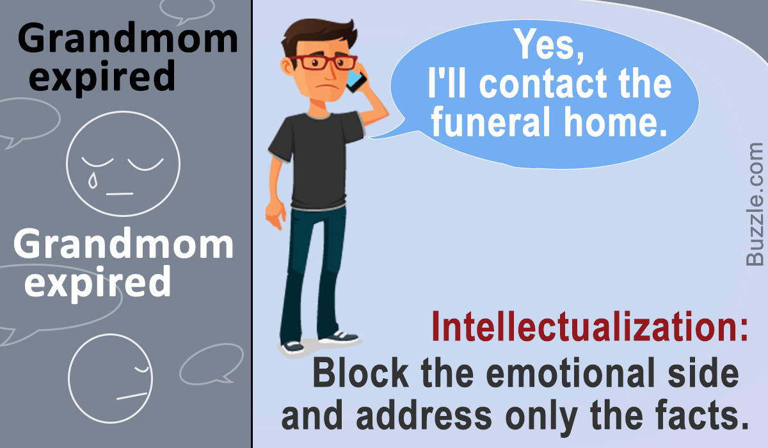
INTELLECTUALISATION
An attempt to avoid expressing actual emotions associated with stressful situations by using the intellectual processes of logic, reasoning and analysis.
Example :
A husband is transferred with his job to a city far away from the wife’s parents home and now she hides her anxiety by explaining the advantages associated with the move.

Slide 18
SUPRESSION
The conscious decision to delay paying attention to a thought, emotion, or need in order to cope with the present reality; making it possible later to access uncomfortable or distressing emotions whilst accepting them.
EXAMPLE:
Thinking about sweets kept in kitchen and wanting to eat them all while on a diet.

Slide 19
ISOLATION
Separation of feelings from ideas and events.
Example :
Without showing any emotion a young woman describes being attacked and raped.
Associated disorders : Obesessive-Complusive Disorder, Dissociative Disorders (Amnesia, multiple personalities), Somatoform Disorders, Personality Disorders

Slide 20
PROJECTION
Projection reduces anxiety by allowing the expression of the undesirable impulses or desires without becoming consciously aware of them; attributing one's own unacknowledged, unacceptable, or unwanted thoughts and emotions to another; includes severe prejudice and jealousy, hypervigilance to external danger, and "injustice collecting", all with the aim of shifting one's unacceptable thoughts, feelings and impulses onto someone else, such that those same thoughts, feelings, beliefs and motivations are perceived as being possessed by the other..

Slide 21
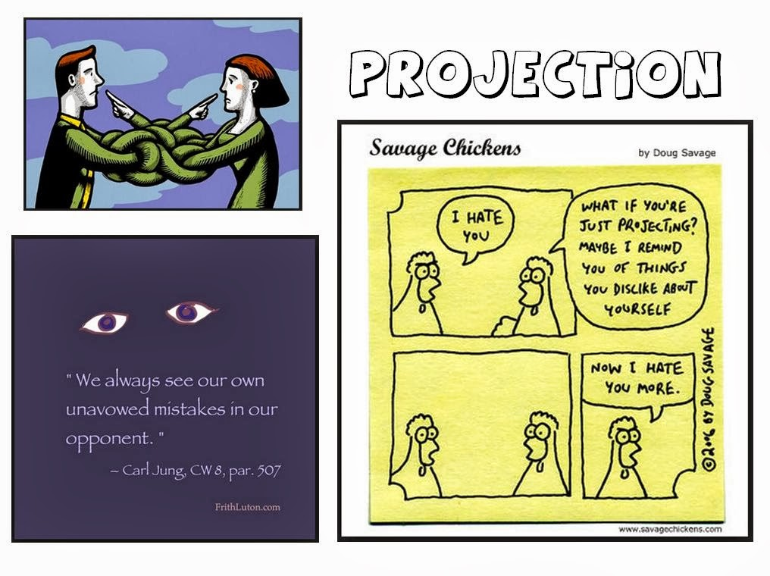
PROJECTION
Associated disorders : Substance Abuse, Substance Abuse, Substance Abuse

Slide 22
REACTION FORMATION
Converting unconscious wishes or impulses that are perceived to be dangerous or unacceptable into their opposites; behaviour that is completely the opposite of what one really wants or feels; taking the opposite belief because the true belief causes anxiety.
Example :
A boy may really like a girl but act like hew does not and disinterested around her.
Associated disorders: Delusional Disorder, Mood Disorders (Depression), Obsessive-Compulsive Disorder

Slide 23
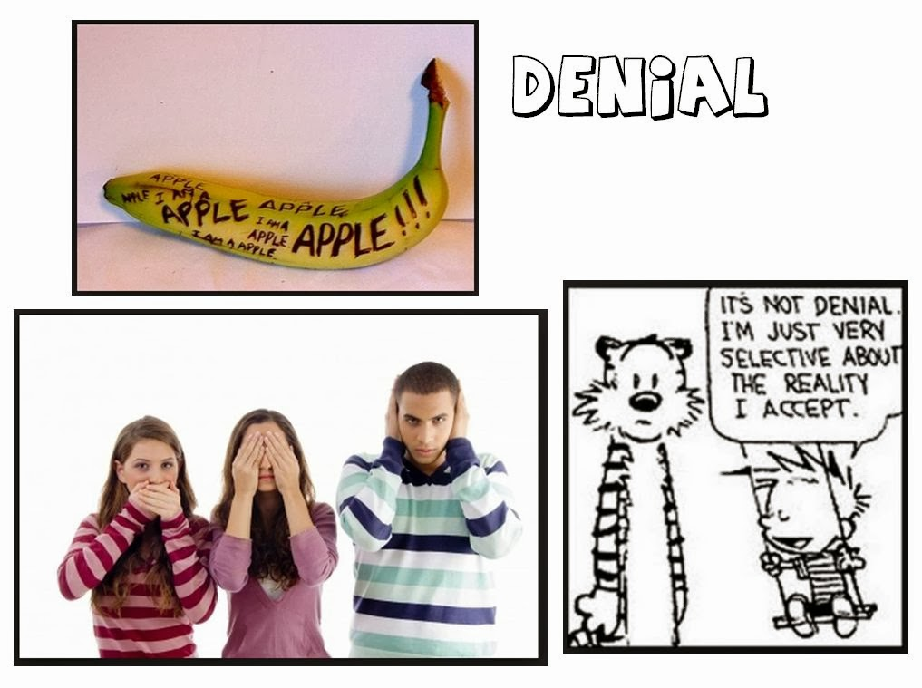
DENIAL
Refusal to Acknowledge the existence of a real situation or the feelings associated with it.
Example :
Smokers may refuse to admit to themselves that smoking is bad for their health.
Associated disorders: Substance abuse

Slide 24
REPRESSION
The process of attempting to repel desires towards pleasurable instincts, caused by a threat of suffering if the desire is satisfied; the desire is moved to the unconscious in the attempt to prevent it from entering consciousness; seemingly unexplainable naivety, memory lapse or lack of awareness of one's own situation and condition; the emotion is conscious, but the idea behind it is absent.
EXAMPLE:
An accident victim can remember nothing about the accident.
Associated disorders: Somatoform Disorders, Body Dysmorphic Disorders

Slide 25
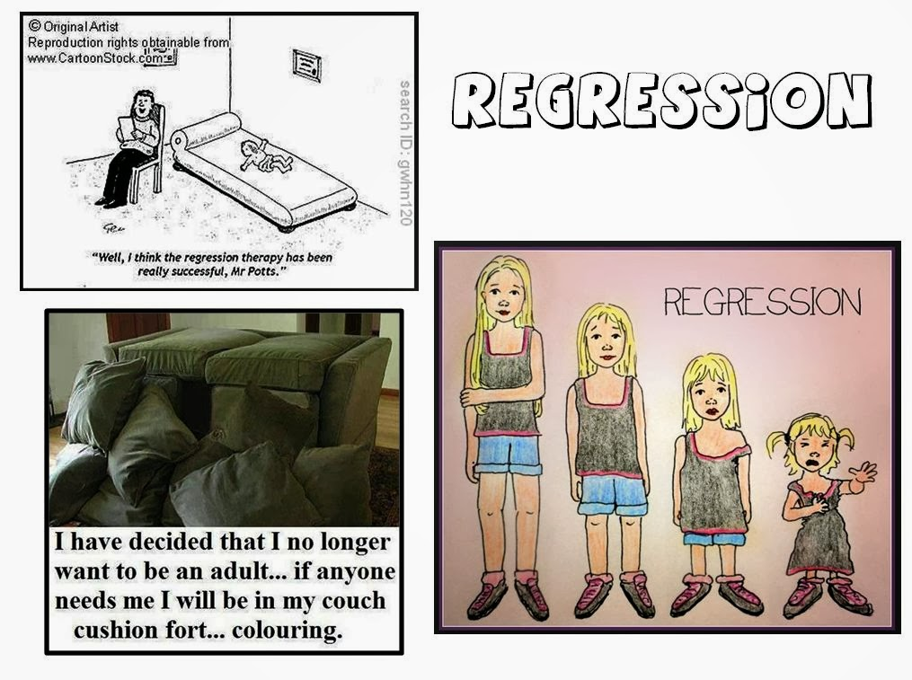
REGRESSION
Temporary reversion of the ego to an earlier stage of development rather than handling unacceptable impulses in a more adult way, for example, using whining as a method of communicating despite already having acquired the ability to speak with an appropriate level of maturity.
Associated disorders: Substance Abuse, Schizophrenia, Generalized Anxiety & Panic Disorder, OCD

Slide 26
RATIONALIZATION (MAKING EXCUSES)
Convincing oneself that no wrong has been done and that all is or was all right through faulty and false reasoning. An indicator of this defense mechanism can be seen socially as the formulation of convenient excuses..
Example :
“I didn’t pass the exam because it was way more difficult than previous years”

Slide 27
UNDOING
A person tries to 'undo' an unhealthy, destructive or otherwise threatening thought by acting out the reverse of the unacceptable. Involves symbolically nullifying an unacceptable or guilt provoking thought, idea, or feeling by confession or atonement.
EXAMPLE:
A daughter shouts at her father as there is no petrol in the car and is getting late for office, brings a favorite film for her father to watch. This is an example of undoing her behavior of shouting and then bringing a film.
Associated disorders: OCD

Slide 28
Thank You
For any questions reach out to us
info@emotionoflife.in

