Slide 1


LAW OF
ATTRACTION

Slide 2

LAW OF ATTRACTION
OVERVIEW
It is believed that there are many universal laws, which govern our own energy, the energy of the earth and of course the energy of the whole universe. The LOA is just one of these ‘energy laws’. Other spiritual laws are as follows:
The Law of Vibration
The Law of Action
The Law of Correspondence
The Law of Cause and Effect
The Law of Compensation
The Law of Attraction
The Law of Perpetual Transmutation of Energy
The Law of Relativity
The Law of Polarity
The Law of Rhythm

Slide 3
The Law of Attraction is based on a simple concept, which is that ‘like attracts like’. There are many other phrases which capture the energetic concept of the LOA, such as ‘thoughts become things’, ‘ask believe receive’ and ‘what you can conceive you can achieve.’
The Law of Attraction is based on the idea that we are creating our own lives. If this is true it would be important to realize that if we hold such power within us, we should use it well.

Slide 4

Thoughts and feelings come before actions
Ideas and feelings are innately linked and they seem to come at about the same time. So sometimes we just feel like doing something and other times the feeling is first generated by the thought.
Either way, these two creative powers are the essence of creation… thought powered by feeling, or feeling powered by thought.
Of course we can always begin with words and actions but without the feeling that drives it, it may not flow or be as quick or easy to manifest.

Slide 5

The importance of passion and excitement
The two main creative energies or feelings are Excitement and Passion. Without these thoughts and feelings which hold extremely positive energy the process of creation will work, but not as easily or quickly.
Another way to illustrate the importance of positive feelings is to look at affirmations. These short, positive and motivating phrases can be a very helpful support as we use our will and intention to create positive change in our lives.
They are used as a way to magnify our thoughts and will during the process of creating what we want

Slide 6

Living with the LOA
Living with the LOA can be likened to the boat getting a captain and navigating it around those dangerous rocks and waters. Using maps, the boat sails through calm waters to safe ports where it can anchor and stay feeling safe and knowing it can do productive things while it is there. The captain has a plan and knows that he / she is in control of the destiny and direction of the ship.
So living with the LOA is like using a map by which to live your life rather than being at the mercy of what you are unwittingly ignoring or not realizing you can be mindful about as you create your life.

Slide 7

The real ‘secret’ to attracting what you want into your life and quite quickly involves five basic processes:
Ask
Believe
Feel
Action
Receive

Slide 8

The Law of Attraction works better if you focus on what you do want, rather than on eliminating what you don't want. This is because if you think negatively, you attract negative things. It’s likely that you won’t be able to avoid negative thoughts completely, but you can reduce their power by concentrating on positive alternatives.
Your thoughts are powerful and can create the reality that you desire.

Slide 9

HOW IT
WORKS
The Law of Attraction is most simply put as ‘like attracts like’. In other words, you get what you put your energy and focus on. Everything around you is made up of energy. If everything is energy, this also means everything is connected.
For example, you may have thought about a person you have not heard from in a long time, and suddenly they phone you. This is because you are attracting a situation that is in resonance with how you are feeling. When similar thoughts bring people together, we often describe it as a coincidence.

Slide 10
When you have a thought, it immediately flows into the universe and attracts like thoughts. These thoughts attract manifestations of the similar energies.
We can’t sense the power of a magnet, only see its effect. Similarly, our thought vibrations can’t be seen or felt. They can be viewed as similar to sound waves that are beyond the human range of hearing.
When you feel good, your vibrations are harmonising with the deeper vibrational fields of existence. You are more aligned with the universe. If you feel unworthy or unhappy, you are out of sync with the universe.

Slide 11

STORY-
OPRAH WINFREY
WORD FILE

Slide 12
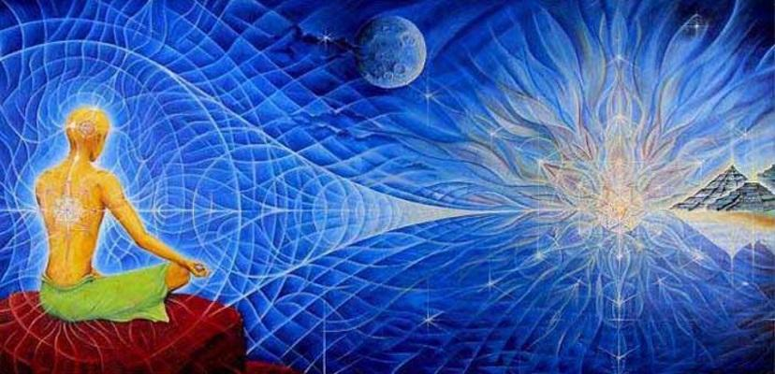
LAW OF
QUANTUM PHYSICS
Quantum physicists have discovered that electrons, neutrons, and protons aren’t the smallest units of matter, but that they break down in to smaller units called quarks. In their most basic form, these are energy. Energy cannot be created or destroyed, but changes in to form, moves through form, and out of form. It vibrates in waves called frequencies and energy waves are attracted to other energy waves of the same frequencies.

Slide 13

Studies of the brain have shown that ‘mirror neurons’ act in precisely this way. These mirror neurons mirror the behaviour of someone who is being observed. In other words, when we observe someone doing something, the same pattern of brain activation that allows that person to do what they are doing (for example, smiling) is mirrored in the brain of the observer as if they are doing those same things.
It has also been shown that fear activates a collection of nerve cells in the brain called the amygdala. When you show people fearful faces, the amygdala activates as if they were experiencing fear themselves. Fear in others will register in our brains as fear. In other words, we ‘attract’ the fear because we are connected to other people and their brains. This is why anxious people make other people anxious.

Slide 14
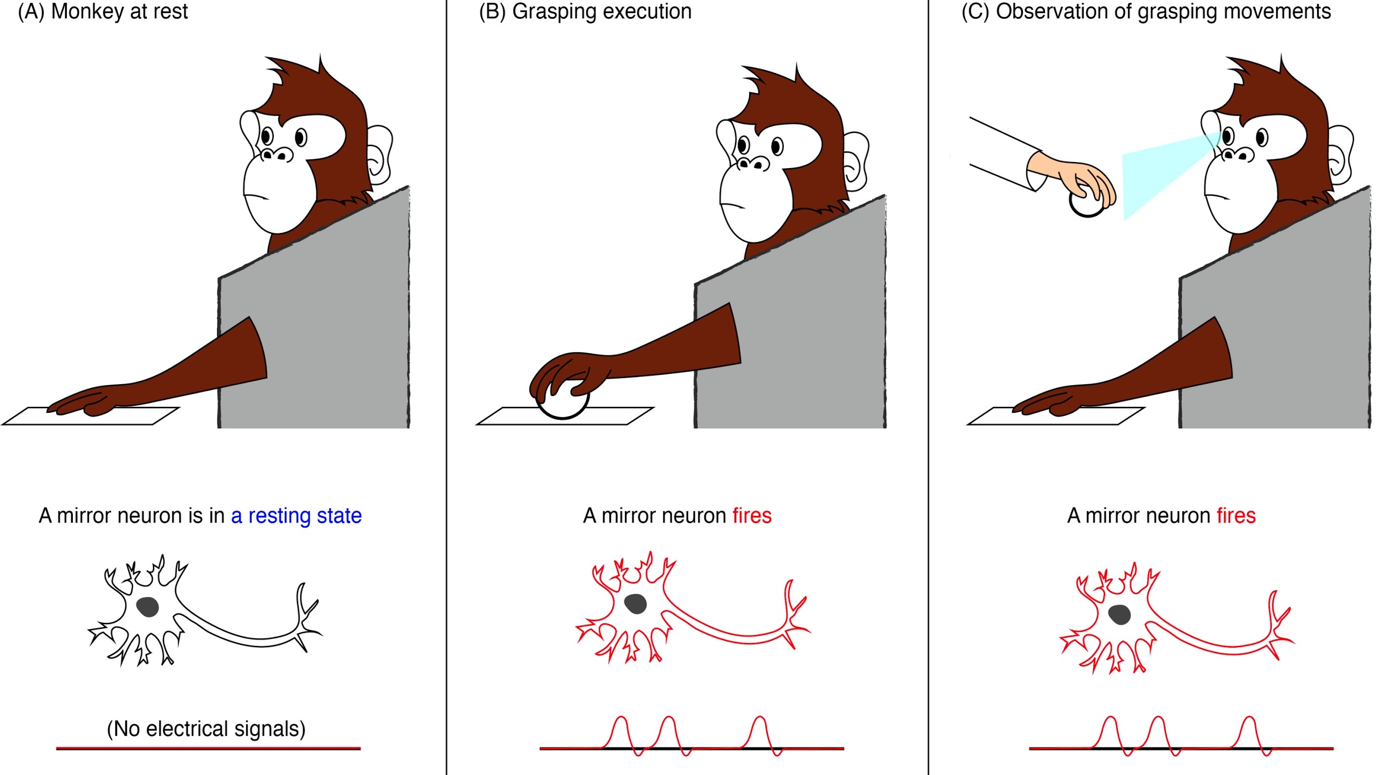

Slide 15

In terms of how thought can affect us physically, the placebo effect is well known. When a number of people are spIit into two groups and one group is given an active drug and another a dummy pill to patients, those taking the fake often feel better too.
It used to be thought that the placebo effect was psychological, but more recent studies have shown that expecting a benefit can trigger the same neurological pathways of healing as the real drug does. In other words, being convinced that the pill is going to work can be enough to ensure it does.

Slide 16
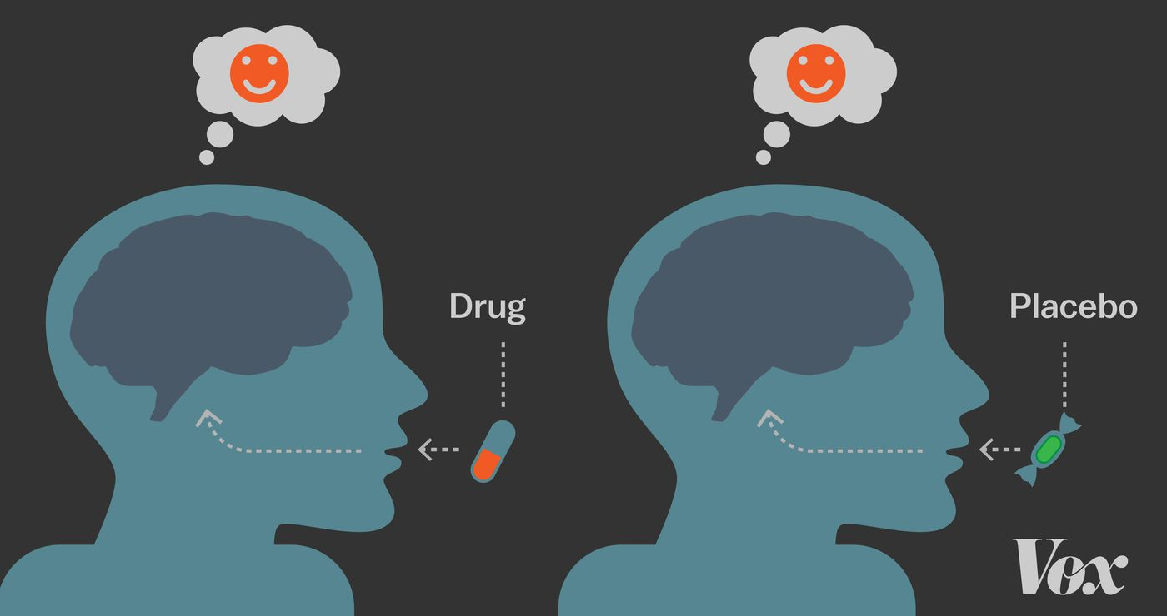

Slide 17

Similarly, when Dr Fabrizio Benedetti was treating patients with Parkinson's disease, he connected them to a computerised morphine injection system. Sometimes the computer administered a dose without them knowing and sometimes a nurse pretended to give it to them. The morphine was up to 50% percent more effective when patients knew it was coming.

Slide 18

LAW OF ATTRACTION
HISTORY
The History of the Law of Attraction
Ideas relating to how the Law of Attraction operates can be found in many ancient texts.
For example, Buddha said, ‘All that we are is the result of what we have thought’.
And in the book of Mathew in the Bible we read, ‘Ask, and it shall be given you; seek, and ye shall find; knock, and it shall be opened unto you’.
The origin of the Law of Attraction may lie in the Hindu theory of the universe – the theory that one is all, and that all is one and that one substance manifests itself as the seeming many elements of the material world. According to this theory, you should never dwell on the negative as your thoughts determine your destiny.

Slide 19
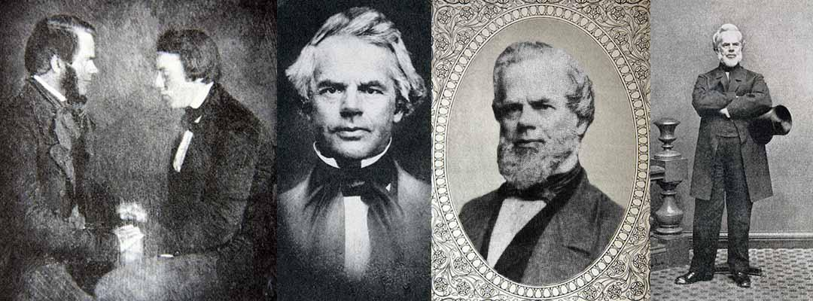
Phineas Parkhurst Quimby (1802-1866) is generally accepted and acknowledged as the father of New Thought. In 1838, Quimby took up mesmerism after attending a lecture. He met Lucius Burkmar, who while in a trance, could diagnose disease and prescribe remedies and they travelled together giving exhibitions.
At first, Quimby believed that his healing was the result of animal magnetism and connected with electricity. Later, he concluded that healing occurred through the power of the mind. He reasoned that mind was spiritual matter and that mind and body interact with each other.

Slide 20
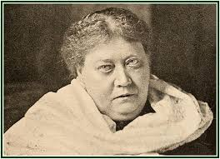
The first time the term ‘law of attraction’ appeared was in 1877 in the book Isis Unveiled by Helena Blavatsky, one of the founders of the Theosophical Society.
By the end of the nineteenth century, the term was being used by New Thought authors such as Prentice Mulford and Ralph Waldo Trine, who considered that the Law of Attraction affected health every aspect of our lives.
The Law of Attraction works unceasingly throughout the universe, and the one great and never changing fact in connection with it is, as we have found, that like attracts like.

Slide 21
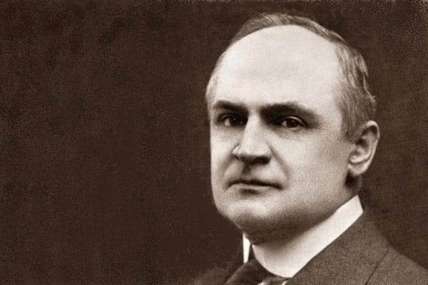
One of the first teachers of the law of attraction was William Walker Atkinson (1862-1932), the editor of several New Thought journals. Atkinson came to New Thought after experiencing a breakdown owing to stress caused by his work as a lawyer.
In 1906, his Thought Vibration or the Law of Attraction in the Thought World was published. In this, he used the phrase ‘law of attraction’, stating that ‘like attracts like’.
The same principle was expressed by Bruce MacLelland in his book Prosperity Through Thought Force(1907) as ‘You are what you think, not what you think you are’.

Slide 22
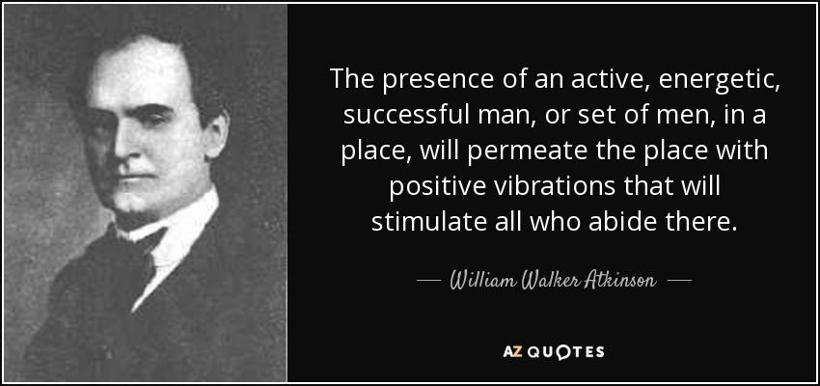

Slide 23

THE
SECRET
The Secret
In 2006 the concept of the Law of Attraction gained renewed exposure with the release of the film The Secret, which was developed into a book of the same title in 2007. For many people, this was their first introduction to the ideas behind the Law of Attraction.
The book introduces and explains the mechanisms of the Law of Attraction, and offers historical examples of its use. It highlights gratitude and visualisation as the main processes by which to manifest your desires. Specific examples are given regarding how to use the Law of Attraction in terms of money, relationships and health. It concludes with a more spiritual perspective on the Law of Attraction.

Slide 24
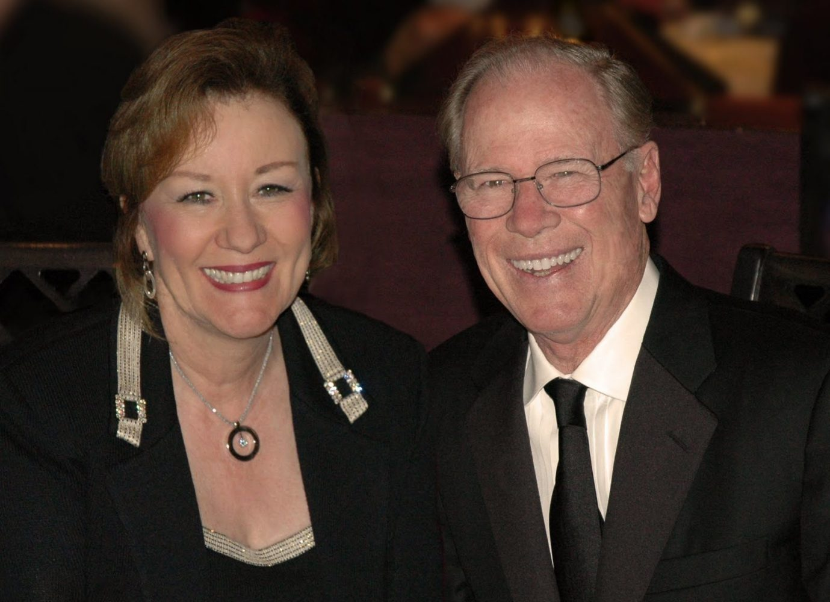
Abraham-Hicks
Esther and Jerry Hicks began publishing books about the Law of Attraction in 1995. Esther Hicks’ teachings (referred to as Abraham-Hicks teachings) are based on the ideas that people create their own reality through their thoughts and their emotions guide them to where they want to go.

Slide 25

Other fundamental ideas that are at the basis of Hicks’ teachings include:
Individuals are physical extensions of the non-physical.
People are in their bodies because they chose to be.
The basis of life is freedom; the purpose of life is joy.
People create with their thoughts.
Life is not meant to be a struggle, but a process of allowing.
Actions and money are by-products of focusing on joy.
Individuals may depart their body without illness or pain.
People cannot die; their lives are everlasting.
The nature of the universe is infinite and expanding.
Individuals are not only a part of the universe but are the source of it.

Slide 26

STORY-
WILL SMITH
WORD FILE

Slide 27

STORY-
JIM CARREY
WORD FILE

Slide 28

Making the Law of Attraction Work for You
Maintain a positive mental attitude
When you think good thoughts, you attract good things into your life. Therefore, maintaining a positive mental attitude is an essential part of making the Law of Attraction work.
To take advantage of the wealth around you, you need to affirm to yourself, ‘I will have what I desire,’ and your subconscious mind will act on that thought.
Telling yourself you’re going to be successful reprograms your subconscious to expect success. You will work harder towards achieving what you want, even if just to prove yourself right.
Even past failures can be used positively – they are steps to where you want to be and you can learn through your setbacks.

Slide 29

Take responsibility for your actions
It’s easy to become set in your ways and blame others for your failures. However, you need to take responsibility for your own actions. This means you might need to learn to see the world differently.
For example, you might spend time moaning about your financial problems and focusing on what you don’t have. Instead, you need to imagine yourself as having plenty of money.

Slide 30

Be in control
It isn’t possible to control how the Law of Attraction will bring you what you want. You need to allow things to happen – the right people, resources, and opportunities will find you.
When you hear someone complain about something they don’t want, ask them what they do want. Do the same for your own complaints. When you say, ‘I can’t,’ ask yourself ‘What can I do?

Slide 31

Assert yourself
Part of being in control is standing up for your rights and expressing your thoughts clearly and fearlessly. This requires being assertive.
Being assertive doesn’t imply you don’t consider the needs and feelings of others. You act in your own best interests while considering others.

Slide 32

Keep Calm
The third option is clearly the best, but you need to be calm and call on your inner strength to do it. This takes practice.If you behave passively and accept what others say, you are allowing other people to control your life.
You might choose to be passive to:
Avoid disagreements
Avoid the risk of being disliked
Avoid having to say ‘no’

Slide 33
Be friendly and approachable – you are likely to receive the same in return.
Help other people –you have to help other people in order to succeed.
Appreciate where you are in life now, even if you feel you have a long way to go.
Don't concentrate on a person’s faults. Find something that they are doing well and compliment them and they will find something they appreciate about you.
Change your negative attitude. If you find feel angry about something, focus on something you love. Allow yourself time to change your negative attitude.
Set your goals and maintain a positive attitude.

Slide 34

Strengthen your willpower
You can strengthen your willpower by training and exercising. One effective way is by avoiding procrastination and doing what you need to do immediately, regardless of how you feel at that moment and what you might be doing.
Change a habit. Choose one small habit and change it now. For example, if you always leave the washing up until later, rather than washing up immediately after a meal, from now on wash up the moment you have finished eating. Don’t make excuses; simply do it.

Slide 35

Concentrate
You may need to discipline yourself to improve your powers of concentration. Your mind may not be used to discipline and may resist your efforts to concentrate. You could be tempted to postpone doing anything to improve your powers of concentration and make excuses that you have something else more important or urgent to do.
Choose a word or phrase and repeat it silently in your mind for five minutes. When you find this easy, try to achieve ten minutes of uninterrupted concentration.

Slide 36

When your mind is unfocused, it jumps from one thought to another. When your mind is focused, you can understand everything better, faster and more clearly.
Controlling your mind doesn’t mean that you are holding yourself back or denying your freedom. You are the one who chooses how to control your mind and therefore are always in control.
Take a book and count the words in any one paragraph. Then, count them again, to be sure that you have counted them correctly. Next do this with two paragraphs. When this becomes easy, count the words of a whole page. Do the counting mentally. Don’t use your finger to point at each word.

Slide 37

Take a shower and pay attention to every part of the body you are washing.
When you clean your house, concentrate on each act and movement without thinking about anything else.
Focus your mind on what you are doing, as if it is the only important thing in the world.When talking to people, listen attentively
While eating, focus your mind on your food and enjoying it.

Slide 38

Take a piece of fruit. Examine it closely while keeping your whole attention focused on it. Dismiss any irrelevant thoughts. Simply focus your attention on the fruit without thinking about anything else. Consider its shape, smell, taste and feel.
Put the fruit down, close your eyes, and try to see, smell, taste and touch the fruit in your imagination. If this is too difficult, open your eyes, look at the fruit again and then close your eyes and repeat.

Slide 39

Words have power
It’s important to be aware of the words you speak on a daily basis. Do you complain about the smallest thing? Always mention the most negative possible outcome of a situation?
For example, you might be focusing on your goal of manifesting more money while saying to everyone, ‘I am so broke’.
This means you are affirming how you feel about your finances. Despite your stated goal, you are focusing your attention on the negative.
Use ‘I am’ and ‘I have’ statements when you think about what you want. Not ‘I want to’, because wanting means you’re focused on not having.

Slide 40

Stay motivated
In order to be motivated, you need to know exactly what you want and be willing to do what it takes to accomplish your goal.
Staying motivated is easier with short-term goals. Therefore, it’s better to start with small goals or to break up bigger goals into smaller .
Consider whether it really is something you truly desire, or if it something you think you should desire.
Don't wait for the right time. The right time is now.
Have a 10-minute conversation with a friend like you already have all the things you want. Talk about everything you want to attract like you already have it.

Slide 41

The ultimate goal
The ultimate gift in life is to be happy. However, your own true happiness must come from within. No-one else can make you happy.
You need to ensure that you spend time doing things you love to do. Although you might have the goals of getting a better job or making more money, remember that life is supposed to be fun.
When you’re angry with someone, you don’t feel good. When you laugh, you do. Focusing on good feelings as far as possible will improve your health.
Carry an item in your pocket (or bag) to remind you to think positive thoughts. It can be any small item. Whenever you reach in your pocket, you will feel it and remember to think about good things.

Slide 42

Don’t be afraid to make mistakes
The fear of making mistakes can make you stick to what’s familiar. This will prevent you from making changes in your life. Although trying new things can be intimidating, it’s essential if you are going to achieve your goals.
Defining your fears will help you to deal with them. Are you:
Afraid you might make mistakes?
Scared of looking foolish?
Worried about criticism?
Unsure you are capable of doing what you want to do?

Slide 43

It can be easier to cope with these fears if you allow yourself to imagine what would happen if they came true.
For example, what would happen if you made a mistake? You would have learned that the way you were doing that thing wasn’t the right way and would be able to do it better next time.
What would happen if you looked foolish? You might provide some inadvertent entertainment for a few minutes and then people would move on to the next thing.
What about if someone criticised you? They could offer valuable advice to stop you repeating your mistakes in future. Looking for the potential positive results of taking action will help you to redefine your fears.

Slide 44
When you first wake up, write at the top of a piece of paper, ‘Today I want to feel.’ Without thinking about it too much,write whatever comes to you. This is different to writing affirmations, because there’s nothing in your mind to contradict the statement. Therefore, it reduces the chance of resistance. Review your list at the end of the day and make the connection between what you asked for and how your day went.

Slide 45

Create goals
You need to direct your mind towards bringing your goals into manifestation.
Decide on a specific and clear goal.
Be sure you really want to achieve your goal.
Create a clear mental image of your goal.
Feel a strong desire to achieve your goal.
Ignore doubts and thoughts about failure.
Show confidence and faith and persevere until you achieve your goal.

Slide 46

For example, perhaps if your question was: ‘How can I find a partner this year?’ your solutions could include:
I could go to places where I have more chance of meeting people.
I could accept more invitations.
I could start a new activity to meet people.
I could contact old friends and suggest getting together.
I could approach more people at social events and start a conversation.
I could join a dating agency.
I could spend time with people I wouldn’t normally consider.

Slide 47

Make a manifesting shopping list. Every day, write down what you want from the universe. You can use your mobile phone or a notebook. Writing these lists will help you clarify what you want. The more you forget about your lists, the easier it will become for these things to manifest in your life. Sometimes, focusing hard means your energies become those of worry and lack, so creating resistance.

Slide 48

STORY-
Lady gaga

Slide 49

Clear the way
To achieve your desires, you need to create space in your life for change. If you cling on to old beliefs and habits, there won’t be enough room for your desire to enter your life.
Whenever you think something negative, stop that thought midstream. You could keep a rubber band around your wrist and whenever you think or say something negative, pull the band away from your skin and let it snap back. This will make you more aware of your thoughts.
You can also step outside your situation by imagining a friend is telling you about having this experience and thinking about what you’d advise them to do.

Slide 50

When it comes to attracting your dreams into your life, you are the most important part of the process. Stand in front of a mirror and look at your reflection. Move your arms or head and watch your reflection as you move. Stare into your eyes to see what you are feeling at this moment. When you begin to fill with happiness, the exercise is complete.

Slide 51

Focus
Continue to dismiss negativity from your life and regularly review your goals and how you plan to achieve them. Be ready to change anything that limits the possibilities of your situation. The next section on tools you can use to make the Law of Attraction work will be helpful in maintaining your focus.

Slide 52
Be passionate
Part of discovering your life purpose is figuring out what you love to do. When what you do makes you feel happy and inspired, it is easy for you to achieve your goals.
When you do what you love, it doesn’t feel like work.
What does it mean to be passionate about something?
You want to talk about it all the time
You think about it all the time
You don’t worry about what other people think
By being passionate, you strengthen your intention and feel an incentive to grasp any opportunity that comes your way.

Slide 53

Write a ‘cheque’ to yourself that clearly states what you want to achieve (it doesn’t only have to be money). Place the cheque in a prominent location and look at it as often as possible.

Slide 54

STORY-
Maureen O’Hara
When Maureen O’Hara was asked in an interview how she became so successful, and whether she was surprised by her success, she responded: ‘I wasn’t surprised or stunned… it is what I intended!

Slide 55

Articulate Your Intention
Once you’re ready to focus on what you want, it helps to articulate your intention. You can do this by saying it aloud or by writing it down.
When you write down what you want, it can help to use the present tense. This will help you to picture yourself with your goal already achieved.
The best way to ‘ask’ for what you want is to picture your life as if it has already happened. Don’t worry about whether you need it or if you deserve it. You have already made the decision that this is what you want in your life.

Slide 56

Daydream about what your life will be like when you achieve your goal. Record your dream or write it down. Be as descriptive as possible and describe how you will deal with the changes in your life. When in a relaxed state, listen to the recording/read your description every day for two weeks.

Slide 57

Imagine It Happening
By imagining what you want has already happened, you create the situation for it to happen. Although you need to visualise yourself in a situation where you have achieved your goal, you need to do more than just visualise yourself. You also need to create the emotional state you will be in once you’ve achieved your goal.

Slide 58

Spend a few minutes each day imagining yourself in the emotional state you would be if your desire had already manifested. Then repeat the process more frequently (you only need to spend a few minutes each time). You can use tools to help you to focus. For example;
A target word about your desire on a piece of card. Carry it with you and look at it regularly and / or stick it somewhere you pass regularly in your home.
An image that describes what you want to achieve. For example, for a new relationship, you could use a photo of a happy couple. Again, keep it with you and look at it regularly and / or stick it somewhere you pass regularly in your home.
Make a recording describing what you think life will be like once you have achieved your goal and play it to yourself when in bed or simply when relaxed

Slide 59

Find an image of an object, person, or thing that describes your goal. When in a relaxed state, look at the picture and imagine reaching your goal. Do this for 20 minutes every day for a month. Stick copies of the picture in places you will see them as you go about your day.

Slide 60

STORY-
NOEL EDMONDS

Slide 61

Take Action
Whatever your goals, you will have to take some sort of action to manifest them. In fact, it’s likely you will have to do several things. The Law of Attraction isn’t a magical process by which everything you want will drop into your lap because you desire it in the right way.
For example, if you desire money, you won’t necessarily win the lottery. It’s more likely that you’ll increase your income through a new job. You need to be open to opportunities and ready to make sure you act on them.

Slide 62

It can help if you make a list of the steps you need to take. For example, if you are taking action towards getting a new job, you might have to take the following steps:
Rewrite your CV
Sign up with relevant job agencies
Spend half an hour each day looking at website or reading advertisements in trade magazines
Brush up on your interview techniques
Improve your LinkedIn account
Decide on the steps you need to take, make a list, and work your way through the items on your list, one by one.

Slide 63

Allow it to happen
Allowing things to happen doesn’t mean sitting back and doing nothing. Rather, it means that you take action consistent who you will be in a given circumstance – the person you have imagined yourself to be.
If you are aware of the little things that happen every day, it will be easier to understand how to attract what you want. To reinforce your awareness, you could write down every day something that came into your life because you manifested it – even the smallest things. After all, the bigger things are often achieved in small steps.

Slide 64
Take five minutes to remember the details of an occasion that made you feel good. Think of how you felt at the time, run through every part of the event in your head. When you’ve finished, open your eyes and look around you. Doesn’t everything seem brighter and more vivid?

Slide 65
LOA IN EVERYDAY LIFE

Slide 66

Visualisation
Visualisation entails creating a mental picture. For example, when someone tells you about their holiday, you might create an image so you can relate to what they’re saying.
Visualisation is using your imagination constructively. For example, when you lose something, you probably replay your recent actions in your mind to help you to find it. That is visualisation.
If, for example, you are going to face a difficult day at work, you can visualise how you are going to behave or react. Your subconscious mind will then help you act in that way in the actual situation.

Slide 67

HOW TO PERFORM
VISUALISATION
1) Choosing a Safe & Relaxing Place
2) Start Your Immersion
3) Relax Your Body
4) Go to the imaginary world
5) Practise
Notes:
Choosing a Safe & Relaxing Place –
A clean space that is aesthetically pleasing. What sights, smells and sound abide in the environment is important. make sure you are not experiencing any forms of discomfort.
2) Start Your Immersion
Close your eyes and start imagining yourself there. Where are you? What’s around you? What do you see? Why is it so relaxing? What do you hear? What do you smell? What gentle things can you touch?
3) Relax Your Body – The individual must make a conscious effort to feel completely relaxed. If the muscles are tensed up, ensure that they are fully relaxed before the exercise can begin.

Slide 68
Close your eyes.
“See” in your mind’s eye a beautiful beach. The sun is shining warmly, the breeze coming from the ocean is soft and warm, palm trees are overhead and a few seagulls circle about. Imagine walking barefoot in the warm sand, feel your feet sink in the sand with each step.
Walk toward the water’s edge and let the water roll over your feet. Jump in the water; it is warm, gentle and very refreshing. Come out of the water and walk to your big beach towel, lay down and relax. Rest for a while in all the peace and beauty surrounding you. Imagine how it looks, how it sounds, how it smells. Breathe in deeply the warm ocean air, stay as long as you like.
When you are ready to leave, go to the edge of the water and throw in anything that has been bothering you, anything you wish to be rid of in your life, anything you are feeling sad or angry about, anything you worry about
(e.g. problems at home, violence in your neighborhood, bullies, death of a loved one, issues with friends). Picture it as a big rock, a chain, a heavy bag over your shoulders, or any image that helps you see it as undesirable.Throw it in the ocean as far as you can. Watch it sink and get taken by the
waves. When the “visit” is done, be thankful for the release of the burden,the problem, the worry; then walk peacefully back through the warm sand and take a rest on your beach towel.

Slide 69

Meditation
Meditation can be a useful tool in helping you to focus and improving your skills of visualisation as it enables you to slow down your mind.
There are numerous ways of meditating – it doesn’t matter which method you choose. A good way to clear your mind is to concentrate on focused breathing.

Slide 70

When you feel ready to meditate:
Choose somewhere as free from outside noise and distractions as possible.
Sit up straight in a comfortable chair in an attentive but relaxed position. Put your feet flat on the floor so you’re alert but still comfortable.
Stretch and relax, releasing any tension you might feel in your body.
Take a deep breath through your nose and breathe out through your mouth, making the exhale longer than the inhale. As you exhale, push out any negative emotions. Continue breathing like this until you feel relaxed.
Close your eyes and focus on the stillness (if you find this difficult, focus on a candle flame or picture on a wall).
Don't try to force your mind to be silent, but equally don’t latch on to thoughts; let them float by you.

Slide 71

A vision or dream board
A vision or dream board is a powerful visualisation tool. It can be dedicated to a single theme such as creating more money, or you can create a board with all the things that you wish to attract into your life.

Slide 72
Decide what you are trying to attract.
Buy a cheap notice board or take a sheet of light wood or heavy cardboard.
Write along the top of it a description of your desire.
Gather magazines or print out pictures from the internet that illustrate the things you would like to attract into your life. For example, if you would like to lose weight, choose an image of someone who is the approximate weight you would like to be. You can also use drawings or photographs.
Select as many pictures as you like for your board – you can continue to add to it or change images if you come across better ones.
Place the pictures onto your board in a way that makes you feel good.
Glue the images onto your board.
Add any words you wish such as ‘health’, ‘happiness’, ‘fulfilment’ or prosperity.
You can add a photo of yourself somewhere on your board to remind you that this is your DREAM.
Place the board in an area where you can see it every day.

Slide 73

Affirmations
Affirmations are a type of autosuggestion in which you state an intention and repeat it to implant the idea in your mind. They are always phrased in the first person and usually in the present tense (I am). An affirmation takes three forms:
A statement of who you are (I am courageous, generous, relaxed etc.)
A statement of your potential (I can lose weight, be more self-confident, control my temper etc.)
A statement of positive change (I will smile more, control my temper, manage my time better etc.)

Slide 74
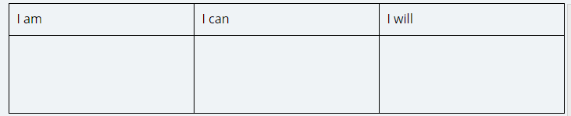
How to use affirmations
You can simply make a list of some affirmations to use on a daily basis. Alternatively, you could use the worksheet below as a guide.
Affirmations are most effective when repeated in a quiet and restful state of mind. An affirmation must feel good to you in order for it to work. It should be something you feel comfortable saying and something you can say with sincerity.

Slide 75
Choosing Your Affirmations
I can think and dream in unlimited ways
I love my work
I look forward to my day
I appreciate all that I have
I create what I want
I will always be OK
I deserve to be happy
I have all that I want and desire
Day by day I am becoming happier and more satisfied
It is easy to achieve success
Success is flowing into my life
I am letting happiness manifest in my life
My body is infused with the energy of health
I am healthy
I am happy
I am financially secure
I am loved
I am beautiful
I am successful
I am a powerful creator
This is a beautiful day
I expect only the best to happen and it does
My mind is peaceful and clear

Slide 76

If you have something specific in mind, your affirmations are likely to be related to that. For example, if you wanted an improvement in your financial situation, you could say:
Money flows to me easily and freely
I receive money from multiple sources
I will always have the money to do or buy whatever I desire

Slide 77

Making Lists
Creating lists is an on-going process. As things in your life change, you will need to amend your lists so they more truly reflect your current situation and desires.
Goals
Your goals will be individual to your own needs and desires. They may relate to your career, relationships, finances – practically anything in your life. Having a list of your goals will help you to have a direction in life as well as give you a sense of achievement when you are able to cross one off your list

Slide 78

Tasks
In seeking to achieve your goals, you will have tasks it’s necessary to complete. You can make monthly, weekly and daily lists that will help you to avoid things piling up and to resolve problems. Some of your tasks will be related to personal fulfilment, for example, learning to play a musical instrument.
Plans
As well as listing your own personal goals, it’s helpful to be aware of plans that involve others. Keep a list of upcoming important events so that you are prepared. You will also need to consider how a change in one area of your life will affect another. For example, if you decide to spend more time with your family, you will obviously have to spend less time elsewhere. Consider how you will deal with any issues that might arise from this.
Making Lists

Slide 79

Helpful people
You can’t manage everything on your own. You will already know skilful, capable and talented people who can help you in the future. A list of all important contacts, even if you can’t envisage needing their help just now, could save you valuable time and effort in the future. It’s also important to be ready to offer a helping hand when others are in need. Any favours you do for people now could be repaid many times over in the future.
Making Lists

Slide 80

Expenses
An important part of increasing your money is being aware of the money you already have at your disposal. By listing your expenses you will have a much clearer idea of where your money is going.
Tools
Life is much easier with modern technology. However, many people don’t use it to its full advantage. You can save a lot of valuable time and energy in creating a list of useful tools such as websites. Similarly, it’s worth investigating all the things your mobile phone is capable of. There may be function you have never used that could make your life much easier if you took advantage of them.
Making Lists

Slide 81

Self-improvement
Make a list of the things you would like to improve or change about yourself, then consider how you can implement those changes. These changes can be physical, spiritual or mental in nature. You won’t be able to relive yourself of all your bad habits overnight, but making a list will help you to prioritise and show you where you have succeeded so far.
Good ideas
When an idea pops into your mind, write it down immediately before you forget it. You can consider it later and decide whether it’s worth following up. Letting your good ideas slide is wasted potential.
Making Lists

Slide 82


JOURNALING
Journaling requires the application of the analytical, rational left side of the brain; while the left hemisphere is occupied, the right hemisphere is given the freedom to wander and produce. Allowing your creativity to flourish can be cathartic and provides a healthy, calming outlet to vent.

Slide 83

Benefits Of Journaling
Boost your mood
Enhance your sense of wellbeing
Reduce feelings of depression.
Reduce intrusion and avoidance symptoms
Improve your working memory
Letting go of negative thoughts/thought patterns
Allows for a free way to explore past/current experiences with anxiety
Enhances your ability for self-evaluation & awareness & teaches you to identify your triggers.

Slide 84

When It Doesn’t Work
Resistance
Have you ever said things like, 'I don’t deserve…' 'I’m not good enough at…' or 'I’m not…'? This phrases can indicate that you are resisting change. Making a list of such phrases you regularly use will help, although you might have to ask a friend or family member to help you as it’s likely they’re much more aware of negative statements you make than you are.
If you think about what you want to achieve and imagine yourself in a situation where you have already done so, this will help you to overcome any inner resistance.

Slide 85

Attracting negatives
It’s easy to allow negative ideas into your thoughts. Ideas like ‘I won’t succeed’ can become stuck until you think they’re true. If you repeat negatives, you attract negatives.
Chances are that it’s simply habit to focus on your low paying job (for example).
It takes effort to break a bad habit, especially a long standing one. Be kind to yourself. You can slowly change to a positive midst by focusing on positive images.
You need to clear away the things that are stopping you from making changes and create space in your life for change.
When It Doesn’t Work

Slide 86

Dealing with negative people
Imagine that you are watching a television soap and the person standing in front of you is playing their role.
Visualise the negative person holding an umbrella that is shielding them from any good stuff to reaching them.Think of the your favourite song and play it loudly in your mind as if the other person is singing it for you.
When It Doesn’t Work

Slide 87

Lack of Clarity
If you don’t really know what it is, you probably won’t get it. The more specific it is, the more likely it will happen. It’s important to articulate what you want. Instead of simply saying to yourself that you want to be happy, think about what thing would make you happiest just now.
When It Doesn’t Work

Slide 88

Fear
Perhaps you’re worried of something happening in your life and so attract the very thing you want to avoid. For example, if you keep saying to yourself that you can’t afford to lose your job, you may that you have problems at work. The solution is to focus more strongly on the positives than the negatives.
When It Doesn’t Work

Slide 89

Impatience
It’s tempting to think that you can make a list of what you want and you’ll get it instantly. Perhaps you will get fast results, but if you become disheartened when you don’t get what you want immediately, you’re not placing your full trust in the Law of Attraction.
Success is achieved step by step. For example, you won’t find a new partner by ignoring a friendly overture from a stranger. You need to recognise your successes.

Slide 90
Resignation
If you resign yourself to not having what you want, you’ll feel hopeless and discouraged. When you don’t get what you’re are trying to attract, you can feel frustrated and that will attract more of what frustrates you. You can achieve change by holding your new intentions consistently.
When It Doesn’t Work

Slide 91
Daily Law of attraction tips
Managing your own stress / anxiety
Focus on the Positive
Adopting a Mindful approach
Editing your thinking: refining the mind

Slide 92

Mindful Forms of Exercise for Use with the Law of Attraction
Yoga
Practise being Mindful, while slowly moving the body and staying in pose. Mindfulness is not a part of yoga; however, it is possible to do a waking meditation or to bring in present moment awareness while practising yoga.

Slide 93

Thai Chi
This practice could be referred to as moving meditation. It is where slow, measured body movements are performed, which brings about a disciplined and peaceful mind set. Again, if you bring in a present moment awareness while performing the moves, it would work well and be even more beneficial.

Slide 94

Qigong (Chi gong)
This is another moving therapy which encourages the person who practises it to adopt a meditative mind state while carrying out the movements. It is based in the martial arts, as is Thai Chi, but the moves have been slowed down and used in a more present moment mind set. This practice also works with the breath, which makes it a therapy that aligns well with Mindfulness and the Law of Attraction.

Slide 95

Daily Mindful Moments
Mindful eating
Here are some points to remember when eating mindfully.
As soon as you sit down with your food, intentionally bring in awareness of the present moment and take a deep breath before starting.
Now with each mouthful, eat slowly and chew fully before swallowing.
Focus only on how it tastes – don’t think or analyse how it tastes, just focus on the taste only and staying in the present.
Now that you are doing this, you will notice how much you can taste and appreciate the food much more than usual.
Every time a thought comes in to distract you, bring your attention back to the food and taste.
When you have finished your meal, allow your thoughts to come back in.

Slide 96

Mindful breathing
Breathing is another thing that we do naturally. As soon as you focus on your breath and its calming rhythm, you will immediately start to feel more focused and less anxious.
When we have referred to focusing on the body, during this course, it is helpful to focus on the breath first; doing this will make it easier to then become aware of the body sensations generally. So it is possible to breathe Mindfully, by bringing your attention to the breath only and nothing else.
When doing this, there is no need to change the breathing in any way; just focus on the rhythm of your breathing and you will immediately start to feel more centred and relaxed.

Slide 97

Mindful Sleep
The act of falling asleep can be made easier with a meditative or Mindful approach.
Next time you have trouble falling asleep, observe your thoughts. The fact that the brain hasn’t switched off yet is creating energy. This energy is keeping you awake.
Therefore, the next time you are aware that this is happening, bring in a present moment awareness and focus only on your breathing and how your body is feeling.
This meditative approach to falling asleep is very effective and easy to do, especially if you are already used to bringing in Mindful present moment awareness or meditating.

Slide 98
Ten Tips for Daily Law of Attraction
Do one thing at a time
When you’re doing something, just focus on that one thing only and be in the moment.
Do it slowly and deliberately
While doing anything, try to slow down and be deliberate in your actions; this will be easier when you are in the moment.
Do less
Where possible, try not to overfill your day. Plan to do things one thing at a time, deliberately and Mindfully. This won’t be possible if you overfill your day. So prioritise your tasks and let go of the ones that can wait or that you don’t need to do at all, for there’s always tomorrow.

Slide 99
Leave space
As you Mindfully do all of the above, leave space between jobs and tasks where possible. Leaving room for error can lead to a more relaxed feeling as you move from task to task.
Spend at least five minutes daily doing nothing
The best way to do this is to meditate, although this is not doing nothing at all.
Focus on the present
When you catch yourself feeling stressed because you are either imagining a future that might not happen (worrying) or remembering something negative about the past, let it go – and come back to the present moment
Ten Tips for Daily Law of Attraction

Slide 100
Eat, walk and do everything slowly
You can only do this if it is appropriate. But when you can, and you are being present, slow down, be deliberate in your actions and savour the moment fully.
Cultivate compassion and gratitude
A lot of us say that we are grateful, but sometimes don’t make the time to feel it fully. So now that you are becoming more Mindful, you are noticing all the things you are truly grateful for. When dealing with others, try to cultivate an inclusive state of mind, where you are thinking of their needs as well as your own.
Ten Tips for Daily Law of Attraction

Slide 101
Try not to judge
We are all only ever responsible for our own life and our own karma. It would be unwise to focus on the faults of others and not attend to our own personal growth.
Being flexible
The mind and ego want to jump in and put control and boundaries around most things. Once you have come out of the mind and into the heart, you will find it easier to adopt a more flexible and less rigid attitude.
‘The more rigid we are, the less Mindful we are’.
Ten Tips for Daily Law of Attraction

Slide 102

Benefits of Mindful Law of Attraction Workers
A Mindful person can experience the following benefits at work from their practice:
Stress reduction
Increased clarity of mind, balance, energy and zest for life
Improved complex problem-solving and decision-making abilities
Enhanced leadership
More emotional intelligence, less reactivity
Mood regulation and immune system enhancement
Increased self-awareness and awareness of others
Attentive listening
Clear communication
Improved focus

Slide 103

How to Manage Stress in the Workplace
Avoid unnecessary stress: not all stress can be avoided, but by learning how to say no, distinguishing between ‘shoulds’ and ‘musts’ on your to-do list, and steering clear of people or situations that stress you out, you can eliminate many daily stressors.
Alterthe situation: if you can’t avoid a stressful situation, try to alter the way you look at it. Be more assertive and deal with problems head on. Instead of bottling up your feelings and increasing your stress, respectfully and assertively let others know about your concerns, or be more willing to compromise and try meeting others half-way on an issue.

Slide 104
Adapt to the stressor: when you can’t change the stressor, try changing yourself. Reframe problems or focus on the positive things in your life. If a task at work has you stressed, focus on the aspects of your job you do enjoy. And always look at the big picture: is this really something worth getting upset about?
Accept the things you can’t change: there will always be stressors in life that you can’t do anything about. Learn to accept the inevitable rather than getting angry at a situation you can’t change and making it even more stressful. Look for the upside in a situation: even the most stressful circumstances can be an opportunity for learning or personal growth. Learn to accept that no one, including you, is ever perfect and use these situations to practise non-judgement.

Slide 105
Mindfulness – the team builder
Research on Mindfulness suggests that it can also help to:
reduce the cost of staff absenteeism caused by illness, injury and stress
improve cognitive functioning, memory, learning ability and creativity
improve productivity and improve overall staff and business wellbeing
reduce staff turnover and associated costs

