Slide 1
BEAUTY OF POSITIVE AFFIRMATION IN HUMAN LIFE

Slide 2
"I'm never going to be able to do this job; I'm just not smart enough.“
"Why does my boss want me to run the presentation? I'm a terrible public speaker, and I'll just embarrass the team.“
Many of us have negative thoughts like these, sometimes frequently. When we think like this, our confidence, mood and outlook can become negative, too.
But
if we deliberately do the opposite and use positive thoughts about ourselves, the effect can be just as powerful but far more helpful.

Slide 3

What are affirmations
Affirmations are positive statements that can help us to challenge and
Overcome self sabotaging and negative thoughts.
When we repeat them often, and believe in them, we can start to make positive changes.

Slide 4
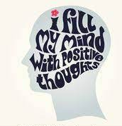
“Watch your thoughts, they become your words; watch your words, they become your actions; watch your actions, they become your habits; watch your habits, they become your character; watch your character, it becomes your destiny.”

Slide 5
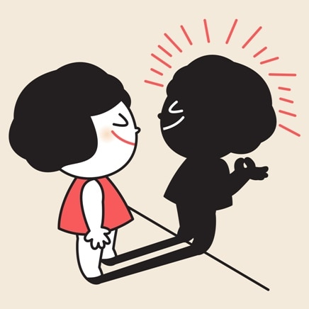
BENEFITS OF POSITIVE AFFIRMATIONS
Control negative feelings such as frustration, anger, or impatience.
Enhance better sleep
Reduce anxiety
Overcome a bad habbit
Motivation to change for the better.
Motivation to achieve fitness goals and other goals.
Change negative thought patterns into positive ones
Build self esteem and confidence
Decreases stress levels and improves overall health, including mental health.
Cope better with disappointment and sad news.

Slide 6
is there science behind affirmation??
A study published in the journal Social Cognitive and Affective Neuroscience (1) used MRI to reveal that practising self-affirmation activates the reward centres in your brain. Simply say to yourself “I will earn that promotion” and it’ll light up the same reward centres that respond to other pleasurable experiences, such as eating great food. or winning a prize. It fires up your neural pathways and makes changes to those areas of the brain that makes you happy and positive.
YES

Slide 7

Examples of Affirmation
Affirmation are personal to us and specific to what we want to achieve or change
I am proud of myself.
I'm grateful for the job I have.
I'm bringing a positive attitude to work every day.
I am excellent at what I do.
I am resilient.
I am not afraid to stand up for myself.
I am successful.
I am confident.
I am strong.
I am getting better and better every day.
All I need is within me right now.
I will never give up.

Slide 8
How to Use Positive Affirmations
Steps to Follow:
Start in the morning as soon as you wake up and take deep breaths, think positively about your day.
Say your positive affirmation clearly and little loudly so your ears can hear your words.
Repeat the affirmations 2-4 times in a day and think about your goals.
When you are finished, take deep breaths, absorb the positive energy, and let go of any negative thoughts

Slide 9
things to keep in mind when using affirmations:
we should have confidence that affirmations work
Affirmations must be firm, defined thoughts
Avoid words like hope,wish,or should
Keep them in present
Repetition and frequency are important
At night right before bed and first thing in the morning are great times for affirmations
Say them out loud and write them down
Keep them at manageable number like 2-3

Slide 10
“The mind is everything. What we think we become.” ~Buddha

