Slide 1

Leadership
By- Alisha Jain
Under Guidance Shyam Gupta
Clinical Psychologist & Behaviour Therapist
www.emotionofliffe.in

Slide 2
What is leadership?
1. Leadership is the ability of an individual or a group of individuals to influence and guide followers or other members of an organization.
2.Leadership involves making sound and sometimes difficult decisions, creating and articulating a clear vision, establishing achievable goals and providing followers with the knowledge and tools necessary to achieve those goals.

Slide 3

Characteristics of a great leader
Integrity
Ability to delegate
Communication
Self-awareness
Gratitude
Learning agility
Influence
Empathy
Courage
Respect

Slide 4
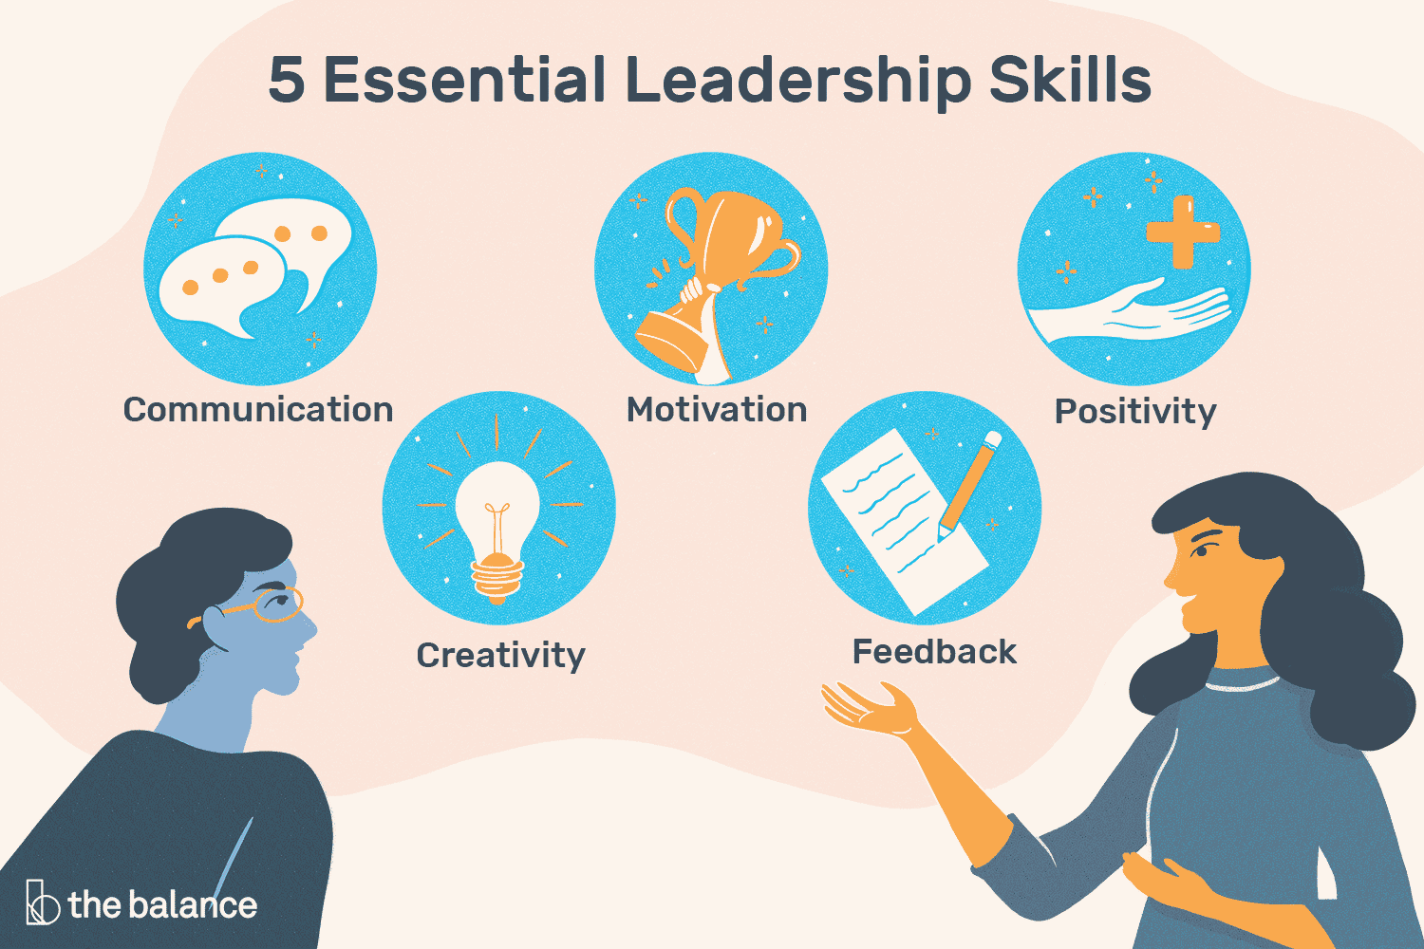

Slide 5
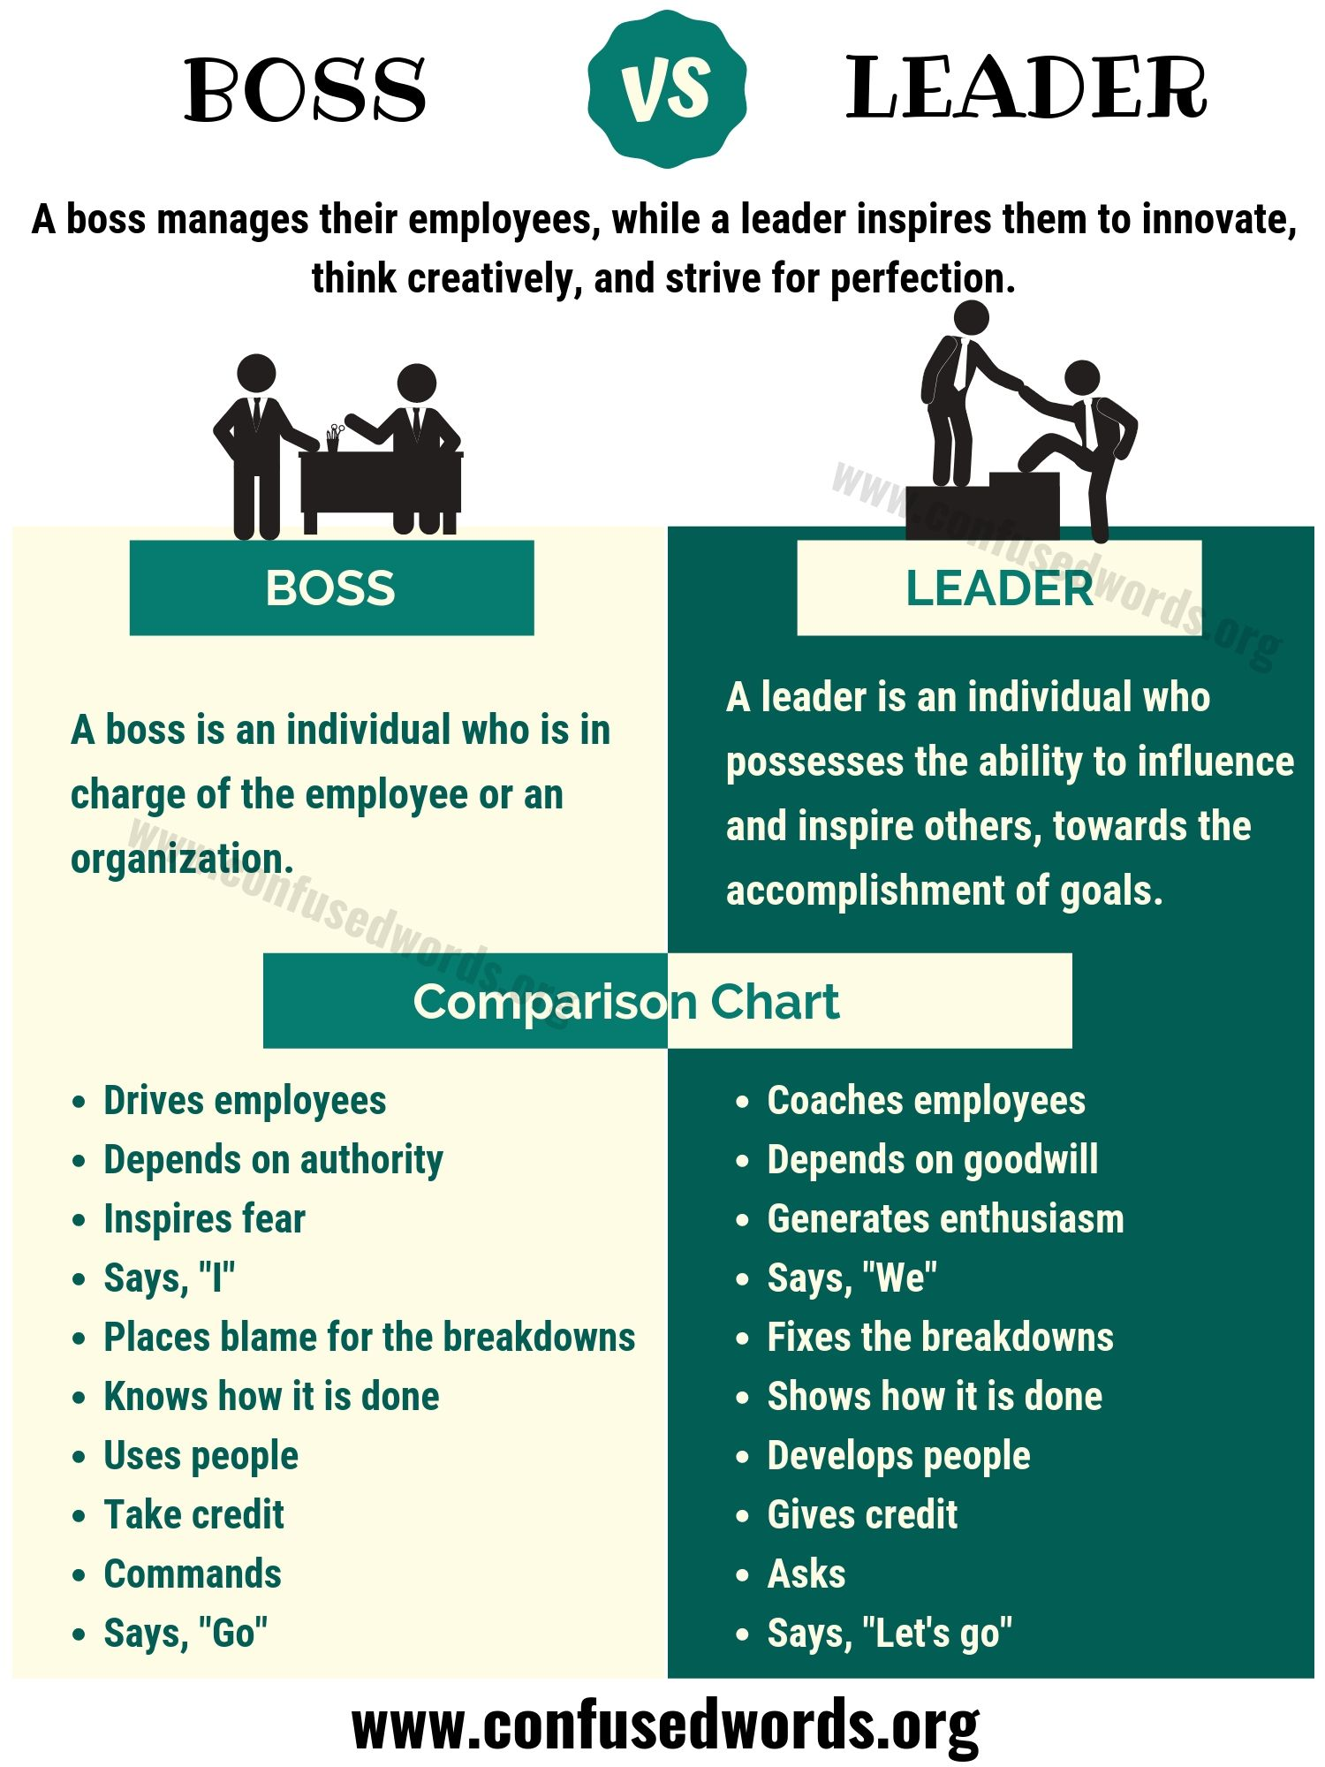
DIFFERENCE BETWEEN A “BOSS” AND A “LEADER”

Slide 6
Skills good leaders need/HAVE:
Strategic Thinking Skills: The best strategic thinkers see the big picture, and are not distracted by side issues or minor details. All their decisions are likely to be broadly based on their answer to the question ‘does this take me closer to where I want to be?
2. Planning and Delivery Skills: Alongside strategic thinking, therefore, go organising and action planning, both essential for delivery of your vision and strategy. Project management and project planning are also helpful skills for both managers and leaders. Good risk management is also important to help you avoid things going wrong, and manage when they do.

Slide 7
In continuation..
4. Change Management and Innovation Skills: A leader needs to understand change management in order to lead an organisation through the process. For example, change management requires the creation and communication of a compelling vision. It also requires the change to be driven forward firmly, and leadership to make it ‘stick’ if the organisation is not to revert within a very short period.
. Good leaders know how to innovate, and also how to encourage innovation in others

Slide 8
In continuation..
5. Communication Skills:Good leaders tend to be extremely good listeners, able to listen actively and elicit information by good questioning. They are also likely to show high levels of assertiveness which enables them to make their point without aggression, but firmly. They know how to build rapport quickly and effectively, to develop good, strong relationships with others, whether peers or subordinates. These skills come together to help to build charisma, that quality of ‘brightness’ which makes people want to follow a leader.

Slide 9
IN CONTINUATION..
6. Persuasion and Influencing Skills: Leaders also need tools to help them understand the way that others behave, and create positive interactions. As a first step, it may be helpful to understand more about emotional intelligence—another vital quality for leaders to possess—but there are a number of other tools that may also be useful, including Transactional Analysis, and Myers-Briggs.

Slide 10
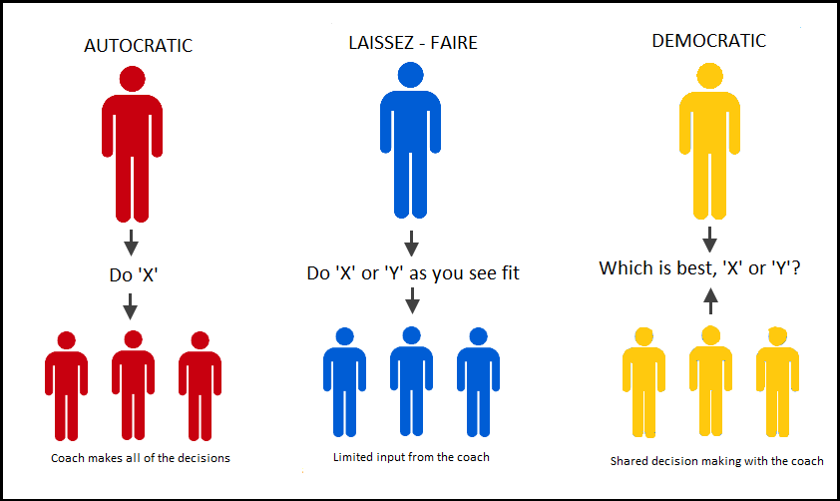
Basic leadership style
Autocratic leadership
Bureaucratic leadership
Laissez-faire leadership
Democratic leadership

Slide 11
Autocratic leadership style
The classical approach leadership style.
Manager retains as much power and decision making authority as possible.
Does not consult staff, nor allowed give any inputs.
Staff expected to obey orders without receiving any explanations.
Structured set og rewards and punishment.
Perfect example of autocratic leadership is “hitler”

Slide 12
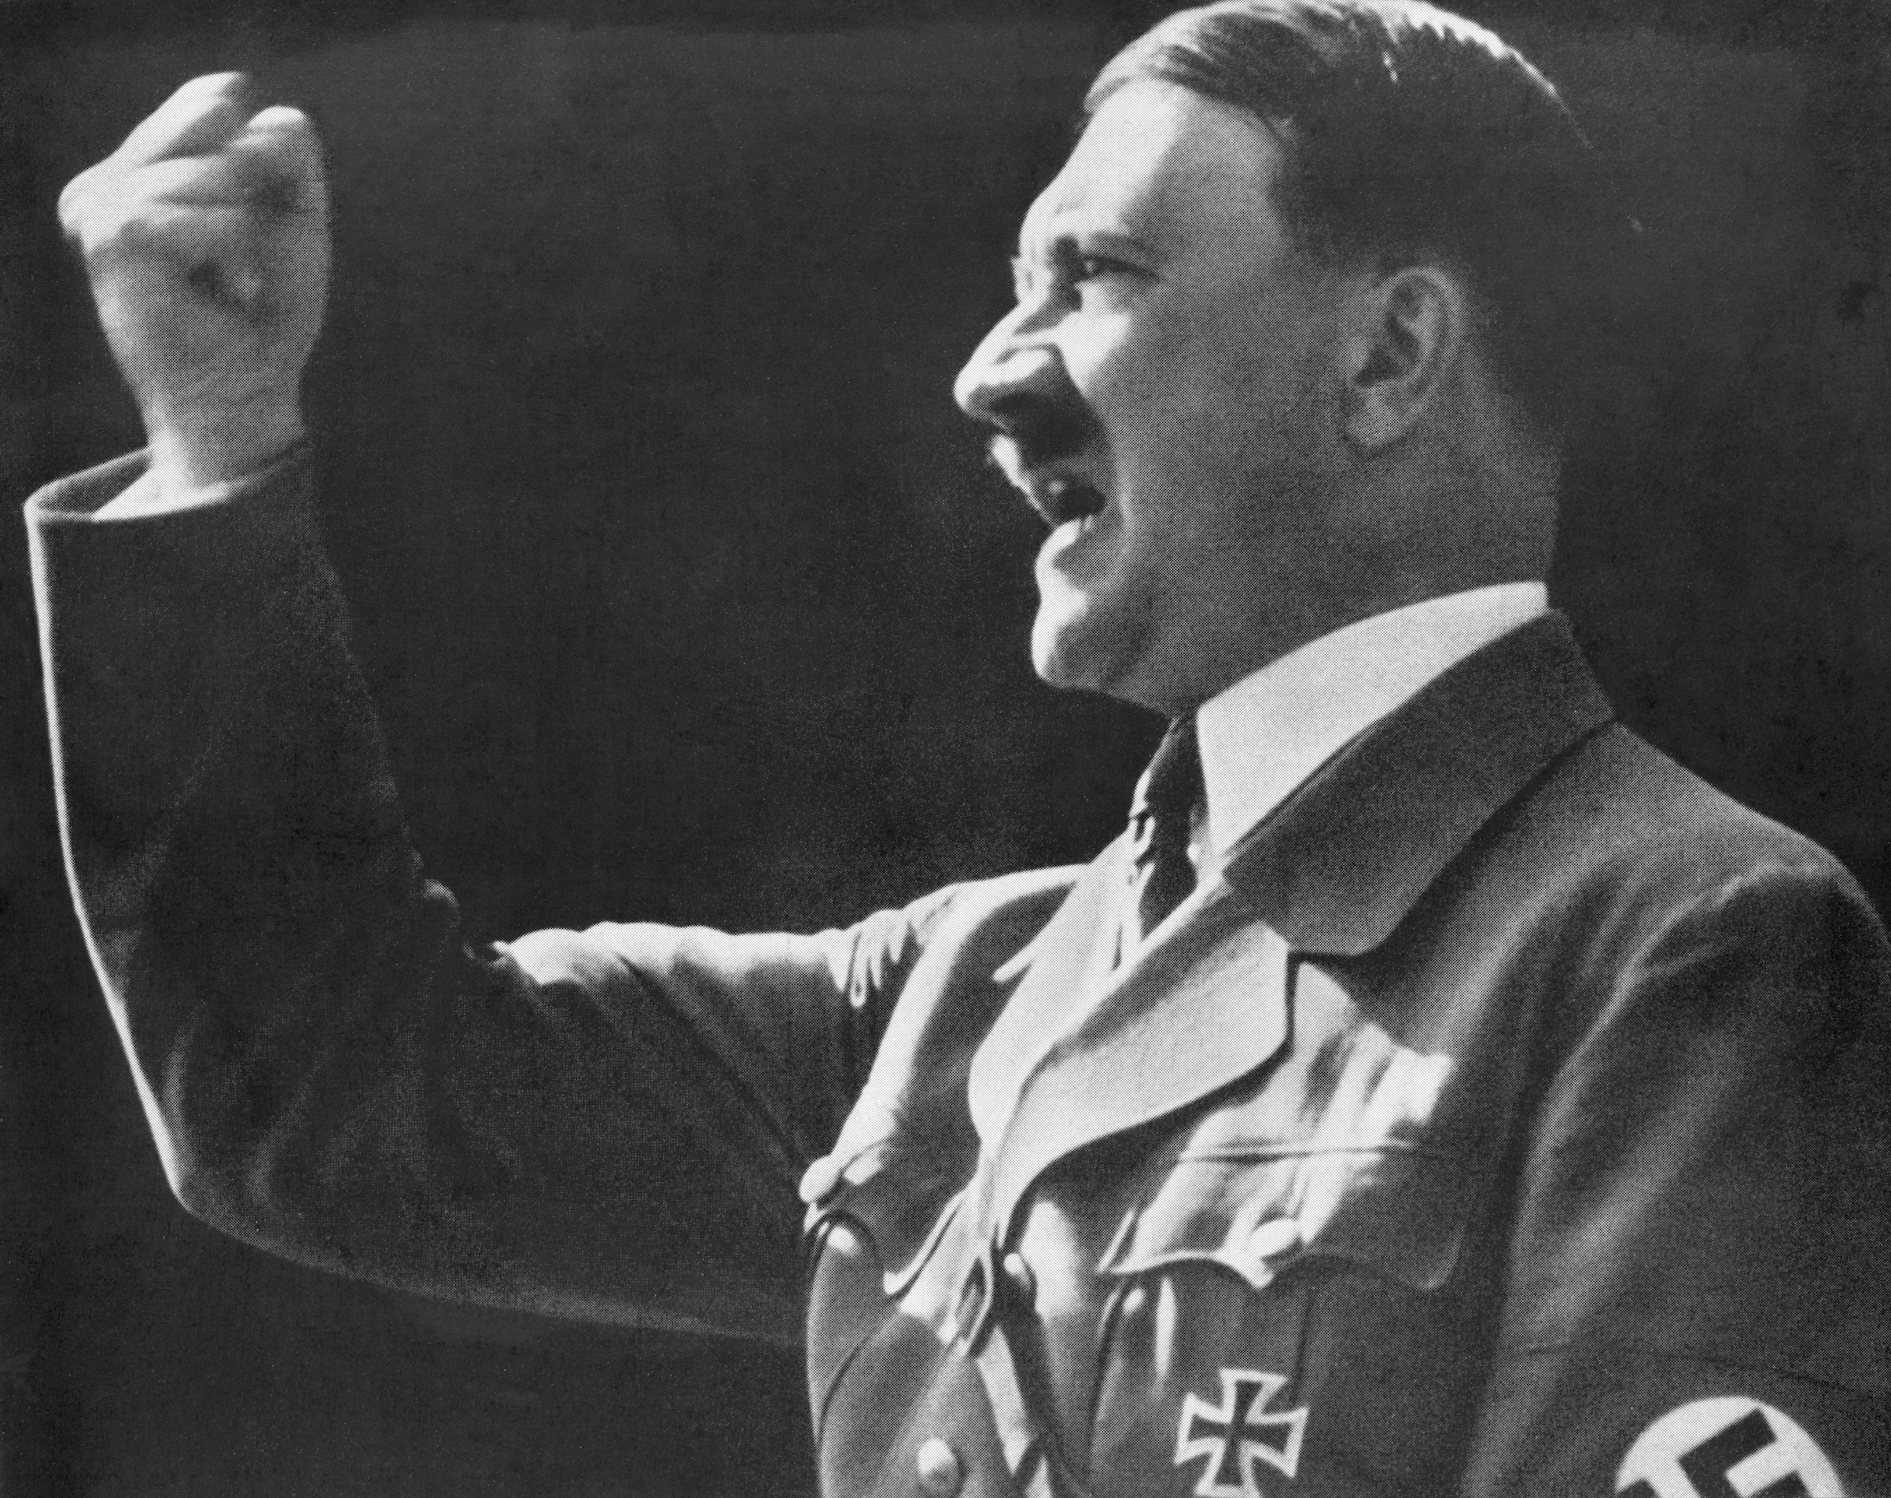
When can it be used:
New ,untrained staff.
Effective supervision can be provided only through detailed orders and instructions
Staff do not respond to any other leadership style.
Limited time in which decision is to be made.

Slide 13
Bureaucratic leadership style
Manages “by the book”
Everything done according to procedure or policy.
A police officer not a leader.
Enforces the rules.
Perfect example of this leadership style used today is by “mcdonalds”

Slide 14

When can it be used:
When staff is performing routine tasks over and over.
When staff need to understand certain standards or procedure.
When staff is performing tasks that require handling cash.

Slide 15
Democratic leadership style
This leadership style is also known as participative style.
Encourages staff to be a part of the decision making.
Keeps staff informed about everything that affects their work and shares decision making and problem solving responsibilities.
The example of this leadership is “barack Obama” the 44th U.S president.

Slide 16
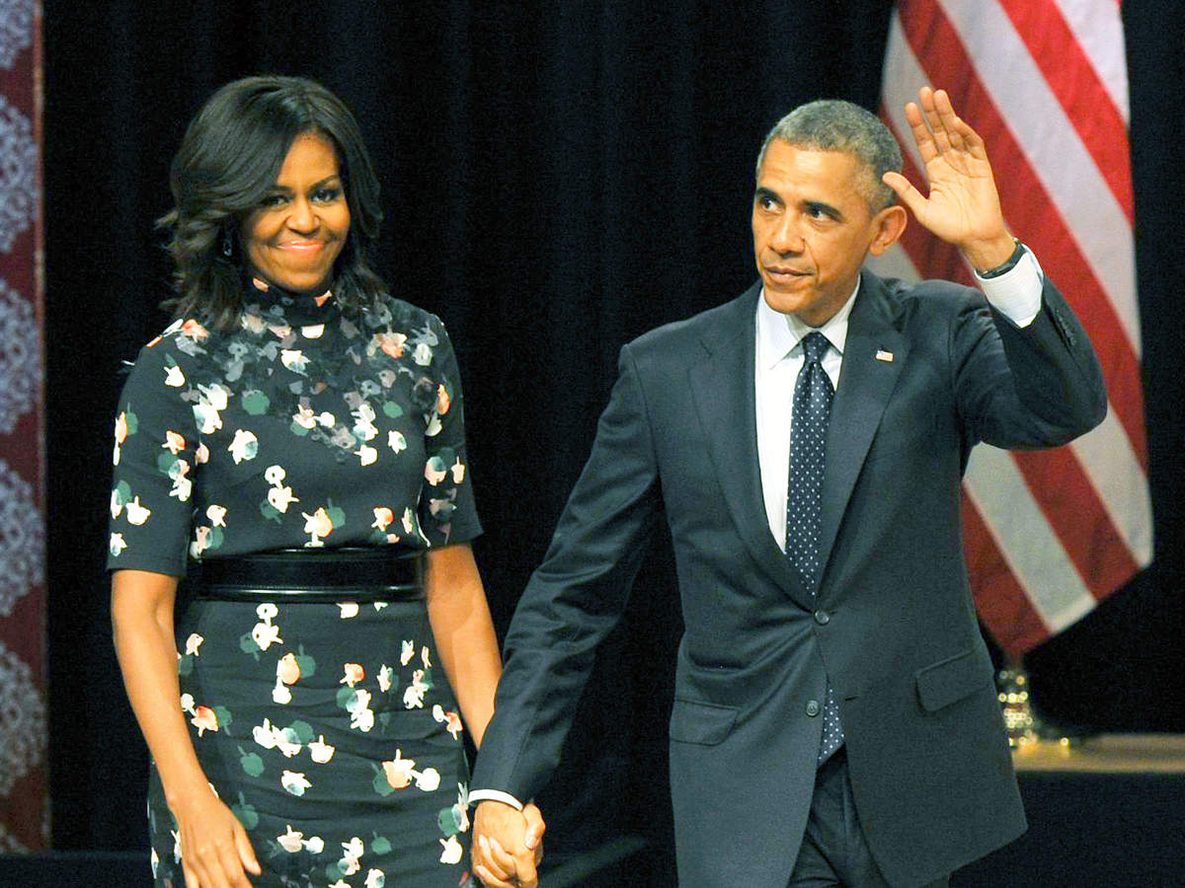
When can it be used:
Wants to keep staff informed about matters that affect them.
Wants staff to share in decision making and problem solving duties.
Wants to provide opportunities for staff to develop a high sense of personal growth and job satisfaction.
Wants to encourage team building and participation.
A large or complex problem that require lots of input to solve.

Slide 17
Laissez-faire leadership style
Also known as the “hands-off”style
The manager provides little or no direction and gives staff as much as freedom as possible.
All authority or power given to the staff and they determine goals, make decisions, and resolve problems on their own.
The example of this leadership is “Queen Victoria”

Slide 18
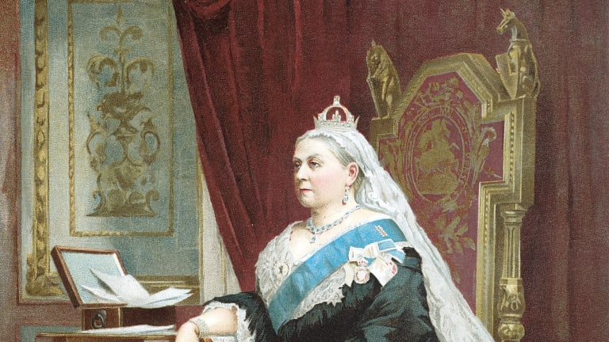
When can it be used.
Staff highly skilled , experienced and educated.
Staff have pride in their work and the drive to do it successfully on their own.
Outside experts, such as staff specialists or consultants used.
Staff trustworthy and experienced.

Slide 19

10 ways to become a better leader
Start by Understanding Your Leadership Style.
Encourage Creativity.
Serve as a Role Model.
Be Passionate.
Listen and Communicate Effectively.
Have a Positive Attitude.
Encourage People to Make Contributions.
Motivate Your Followers.
Offer Rewards and Recognition.
Keep Trying New Things.

Slide 20
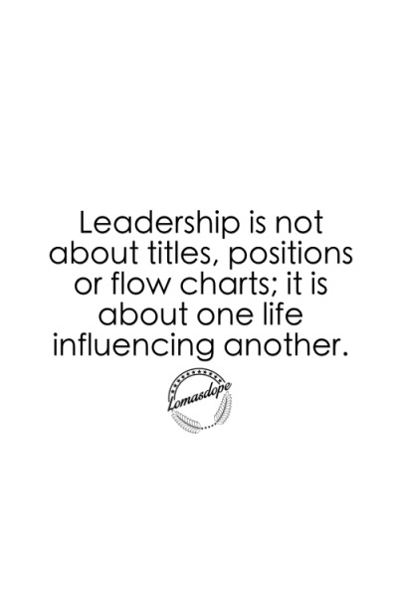
Thankyou
If you have any query write to us on info@emotionoflife.in

