Slide 1

Identity crises
Created by : Ms. Tejasvi
Mr. Shyam Gupta, Clinical Psychologist & Psychotherapist

Slide 2

What is an Identity crisis ?
An identity crisis is a time of intensive analysis and exploration of different ways of looking at oneself.

Slide 3
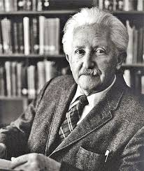
Where did the concept of Identity crisis originate?
The concept originates in the work of developmental psychologist Erik Erikson, who believed that the formation of identity was one of the most important parts of a person's life.
Theorist Erikson coined the term identity crisis and believed that it was one of the most important conflicts people face in development.

Slide 4
Erikson's
8 Psychosocial Stages
Trust vs. Mistrust
Autonomy vs. Shame & Doubt
Initiative & Guilt
Industry vs. Inferiority
Identity & Confusion
Generativity & Stagnation
Integrity vs. Despair

Slide 5
Trust vs. Mistrust: This stage occurs between the ages of birth and 1.5 years and is centered on developing a sense of trust in caregivers and the world. Children who receive responsive care are able to develop the psychological quality of hope.
Autonomy vs. Shame and Doubt: This stage takes place between the ages of 18 months and 3 years and involves gaining a sense of independence and personal control. Success in this stage allows people to develop will and determination.
Initiative vs. Guilt: Between the ages of 3 and 6 years, children begin to explore their environment and exert more control over their choices. By successfully completing this stage, children are able to develop a sense of purpose.
Industry vs. Inferiority: The stage that takes place between the ages of about 6 and 12 years is focused on developing a sense of personal pride and accomplishment. Success at this point in development leads to a sense of competence.

Slide 6
Identity vs. Confusion: The teen years are a time of personal exploration. Those who are able to successfully forge a healthy identity develop a sense of fidelity. Those who do not complete this stage well may be left feeling confused about their role and place in life.
Intimacy vs. Isolation: The stage that takes place in early adulthood is all about forging healthy relationships with others. Success leads to the ability to form committed, lasting and nurturing relationships with others.
Generativity vs. Stagnation: At the stage occurring during middle adulthood, people become concerned with contributing something to society and leaving their mark on the world. Raising a family and having a career are two key activities that contribute to success at this stage.
Integrity vs. Despair: The final stage of psychosocial development takes place in late adulthood and involves reflecting back on life. Those who look back and feel a sense of satisfaction develop a sense of integrity and wisdom, while those who are left with regrets may experience bitterness and despair.

Slide 7

Identity Status theory
Researcher James Marcia (1966, 1976, 1980) has expanded upon Erikson's initial theory. According to Marcia and his colleagues, the balance between identity and confusion lies in making a commitment to an identity.
Marcia also developed an interview method to measure identity as well as four different identity statuses. This method looks at three different areas of functioning: occupational role, beliefs and values, and sexuality.

Slide 8
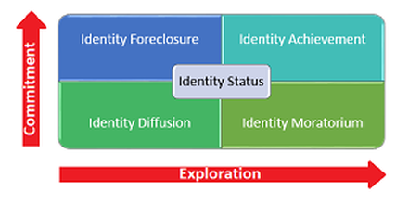
Identity Status theory
Identity Foreclosure status is when a person has made a commitment without attempting identity exploration.
Identity Achievement occurs when an individual has gone through an exploration of different identities and made a commitment to one.
Identity Diffusion occurs when there is neither an identity crisis or commitment. Those with a status of identity diffusion tend to feel out of place in the world and don't pursue a sense of identity.
Identtity Moratorium is the status of a person who is actively involved in exploring different identities but has not made a commitment.
Commitment
Exploration

Slide 9

Symptoms of Identity crises
You’re questioning who you are — overall or with regards to a certain life aspect such as relationships, age, or career.
You’re experiencing great personal conflict due to the questioning of who you are or your role in society.
Big changes have recently occurred that have affected your sense of self, such as a divorce
You’re questioning things such as your values, spirituality, beliefs, interests, or career path that have a major impact on how you see yourself.
You’re searching for more meaning, reason, or passion in your life.

Slide 10

Causes
People tend to experience them at various points throughout life, particularly at points of great change, including:
Beginning a new relationship
Ending a marriage or partnership
Experiencing a traumatic event
Having a child
Learning about a health condition
Losing a loved one
Losing or starting a job
Moving

Slide 11
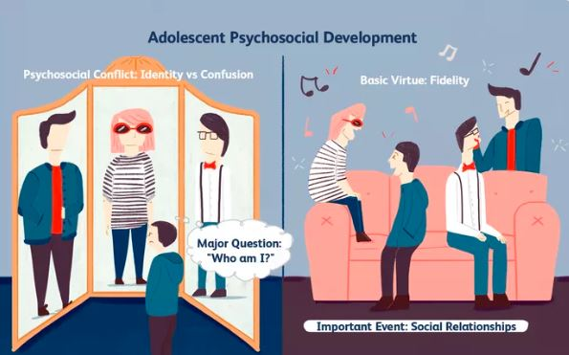
5th stage of psychosocial development – ( identity vs. role confusion )
This stage occurs during adolescence between the ages of approximately 12 and 18. During this stage, adolescents explore their independence and develop a sense of self.

Slide 12
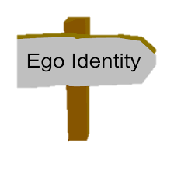
what is Ego Identity
It is the conscious sense of self that we develop through social interaction, which is constantly changing due to new experiences and information we acquire in our daily interactions with others.
E.g. Teens may begin to feel confused or insecure about themselves and how they fit into society. As they seek to establish a sense of self, teens may experiment with different roles, activities, and behaviors.
.

Slide 13
Development During the Adolescent Years
Those who receive proper encouragement and reinforcement through personal exploration will emerge from this stage with a strong sense of self and a feeling of independence and control.
Those who remain unsure of their beliefs and desires will remain insecure and confused about themselves and the future.

Slide 14

How to overcome ?
Look inward and explore
Ask yourself questions and see if you can answer
What qualities and characteristics define you? How has this changed over the years?
If you’re experiencing a major life change: How have things changed for you? Are you content with these changes? How can you cope with these new things occurring?
What are your values? Is anything working in opposition to them?
What are your interests, passions, and hobbies? Are you doing what you like to do, and if not, why not? (If you love to play tennis and haven’t for several years, what factors are preventing it?)
What grounds you? What helps you cope when you’re struggling?
What’s important to you regarding your values, purpose in life, or sense of identity? Is there anything you feel you can do to improve your sense of self?

Slide 15
How to overcome….
Search for joy and other ways to cope
Find support
Ignore internal and external judgment
Seek outside help

Slide 16




Learning from this topic
Resolving the crisis at the 5th stage of development involves committing to a particular identity.
This might involve committing to a career path, deciding what social groups to associate with and even developing a sense of personal style.
?

Slide 17


Learning from this topic
Kids who are not allowed to explore and test out different identities might be left with what Erikson referred to as role confusion. These individuals are not sure who they are or what they like. They tend to drift from one job or relationship to another, never really sure of what they want to do with their lives. Instead of feeling a sense of personal cohesiveness, they are left feeling disappointed and confused about their place in life.

Slide 18
Be who you are and say what you feel because those who mind don't matter and those who matter don't mind
Thank you
For Any question reach out to us
info@emotionoflife.in

