Slide 1
Psychological Intervention for OCD
Daniya Zabeen
Clinical Psychologist
Co-facilitator: Mr. Shyam Gupta, Clinical Psychologist
Emotionoflife

Slide 2

What is an OBSESSION?

Slide 3
Definition of an Obsession
An obsession is an unwanted intrusive thought, doubt, image or urge that repeatedly enters a person’s mind.

Slide 4
Obsessions are Universal
Intrusive thoughts, doubts or images are almost universal in the general population and their content is indistinguishable from that of clinical obsessions.
The difference between a normal intrusive thought and an obsessional thought lies both in the meaning that individuals with OCD attach to the occurrence or content of the intrusions and in their response to the thought or image.

Slide 5
Definition of an Obsession
Obsessions are distressing and ego-dystonic but are acknowledged as originating in the person’s mind and as being unreasonable or excessive. A minority are regarded as overvalued ideas and, rarely, delusions.

Slide 6

What is a COMPULSION?

Slide 7
Definition of a Compulsion
An irresistible persistent impulse to perform an act.
The state of being forced to do something

Slide 8
Compulsions
Can be overt “door checking”, or covert “mentally repeating a phrase”.
Highly reinforcing.
May function as a means of avoiding discomfort, as in obsessional slowness
Terminates when feeling comfortable not when the objective target has been achieved, e.g., hand cleaning.
Mainly safety seeking behaviour, e.g., checking for AIDs, repetitive questioning.

Slide 9
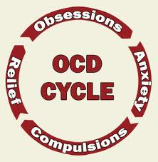

Slide 10
The OCD Vicious Circle
The content of obsessions, compulsions and avoidance behaviour in OCD are closely related.
When avoidance is high compulsions are less, e.g., avoiding hand shaking.
An ever reinforcing cycle. Behaviour is the strongest reinforcer.

Slide 11
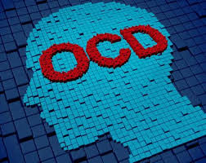
Most Common Obsessions

Slide 12



Contamination

Slide 13
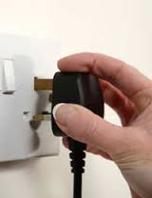


Doubt

Slide 14



Intrusive Religious or Blasphemous Thoughts

Slide 15
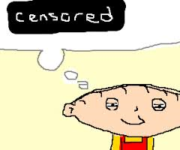

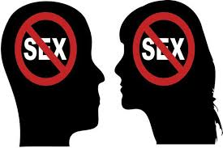
Intrusive Sexual Thoughts

Slide 16
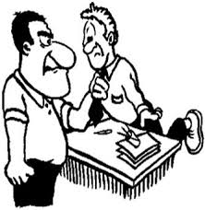

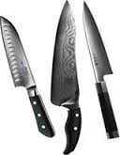
Intrusive Thoughts of Violence or Aggression

Slide 17


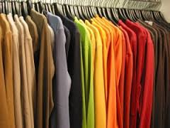
The Need for Order & Symmetry

Slide 18



Morbid Hesitancy

Slide 19
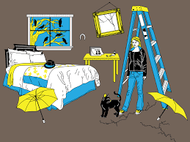


Superstition

Slide 20
Most common Compulsions
Checking (e.g. gas taps; reassurance-seeking)
Cleaning/washing
Repeating actions
Mental compulsions (e.g. special words or prayers repeated in a set manner)
Ordering, symmetry or exactness
Hoarding

Slide 21
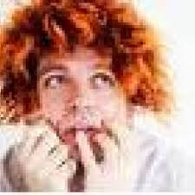
Thought Action Fusion

Slide 22
Thought Action Fusion
An important cognitive process in OCD is the way thoughts or images become fused with reality. This process is called ‘thought–action fusion’ or ‘magical thinking’
A related process is ‘moral thought–action fusion’, which is the belief that thinking about a bad action is morally equivalent to doing it.
There is also ‘thought–object fusion’, which is a belief that objects can become contaminated by ‘catching’ memories or other people’s experiences

Slide 23
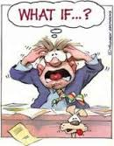
Exaggeration of Danger (WCS)

Slide 24

Responsibility

Slide 25
Responsibility
An overinflated sense of responsibility for harm or its prevention.
Patients with obsessions appraisal of the harm is usually exaggerated and leads to severe anxiety.
Individuals with OCD believe they can and should prevent harm from occurring, which leads to compulsions and avoidance behaviours.

Slide 26
Non-specific Cognitive Biases
Belief in being more vulnerable to danger
Intolerance of uncertainty, ambiguity and change
The need for control
Excessively narrow focusing of attention to monitor for potential threats
Excessive attentional bias on monitoring intrusive thoughts, images or urges
Reduced attention to real events

Slide 27

Dominant Emotions in OCD
Anxiety

Slide 28

Dominant Emotions in OCD
Disgust

Slide 29

Dominant Emotions in OCD
Shame & Guilt

Slide 30
Dominant Emotions in OCD
Anger, Frustration, Irritability & Discomfort

Slide 31
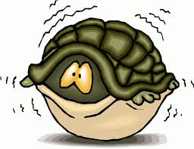
Avoidance Behaviour
An integral part of OCD.
Includes avoidance of contamination, certain situations or behaviours.

Slide 32

Part II: CBT for OCD

Slide 33
A List of Obsessions
Repeating Wedo
Counting prayers
أغسل ايدي بعد أكل الموز كذا مره
I can’t touch kids كائنات لزجه
Drink in a separate cup, bottle and never after anyone. I have to be the first to eat or drink.
Fold everything into a perfect square حتي لو ورقة بسكوت

Slide 34
A List of Obsessions
Take medicine in order from left to right.
All furniture and carpets have to be parallel or perpendicular.
Check my phone regularly after each call and every now and then
Open jars, bottles from the side not the top.
Clean tooth paste and soap.
Use odd numbers in everything 3 معالق رز, 5 معالق سلطه

Slide 35
A List of Obsessions
Wash my glasses after getting back home.
Wash and smell my hands regularly, specially after touching anything و معايا ديتول علي طول
Climb stairs with my right foot first
Can’t eat food people prepared by hands.
Re-arrange everything in order معجون الأسنان مينفعش يبقي مقلوب
Use any pen while the cap is on the left side

Slide 36
A List of Obsessions
Brush my hair from left to right.
Put brush on comb.
Open candy, chocolate bars on the right side تتفتح قبل الاسم
Hang the towel on the right side, left higher than right, dark side out.
If anything changes its place it is the end of the world.
Whenever I get back home, my clothes has to go into the laundry basket.

Slide 37
A List of Obsessions
Everything must be perfect.
Taking control if I go out.
Hate stepping on my shoes أي حد يدوس علي جزمتي لو مش لابساها
Never change my place on the couch
Have to clean the W.C after anyone, and before using it. لازم أدخل الأول

Slide 38
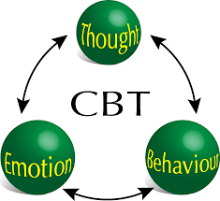
The Classical CBT Model

Slide 39
Steps of Therapy
List of Obsessions (nothing should be left out).
Help the patient create a hierarchy
Teach the patient the concept of CBT and how OCD operates.
Tackle thoughts and behaviour simultaneously
Exposure and Response prevention

Slide 40
Working on Obsessive Thoughts
Initially it involves having sufferers develop a healthy and informed understanding of how the mechanisms of OCD operate.
Help the patient understand ideas of cognitive fusion (and even test it), over estimation of danger and heightened responsibility.
(Cognitive Conceptualization)

Slide 41
Working on Obsessive Thoughts
The main target is to make the patient that he/she needs to live with doubt.
The Target is to tolerate uncertainty, not to eliminate it.

Slide 42
Working on Obsessive Thoughts
Teaching the patient to constantly re-examine the logic of the Automatic thoughts.
Keep asking WHY?
“It is not me, it is my Obsession”

Slide 43
Working on Obsessive Thoughts
Interpretation of obsessional meaning, degree of danger (evidence) and possible alternatives.
Evidence (Facts), not Interpretations or doubt (what ifs?)

Slide 44
Working on Obsessive Thoughts
Work on erroneous beliefs, e.g. safety and contamination.
Teach the patient to acknowledge & reframe their obsessive behaviour.
“I washed my hands because I could not tolerate the anxiety, not because there was a real chance of contracting AIDS.

Slide 45
Working on Obsessive Thoughts
Why isn’t medicine enough?!!!
Fighting an occupational force that will fight back.
Changing structure and habits.

Slide 46
Exposure & Response Prevention (ERP)
The goal of ERP is straightforward – to expose one’s self to the feared thought or situation, without doing any compulsive or avoidant responses.
Explain the reinforcing nature of compulsions.
Start with the least anxiety provoking obsession and move up the ladder.
The main concept is de-learning, i.e. habituation, extinction, desensitization.

Slide 47
Exposure & Response Prevention (ERP)
Exposure can happen during sessions (real and imaginary).
Point out the compulsions & avoidance behaviour that happens in session.
Learning to live with the “anxiety”, i.e. tolerating the discomfort.
Response prevention can be partial (decrease the number of compulsions).
Delaying response is a step on the way.
Distraction can be used to delay or prevent response.
Involve family when possible.

Slide 48
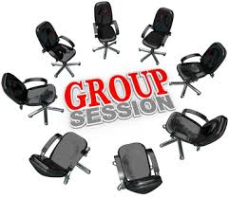

Slide 49
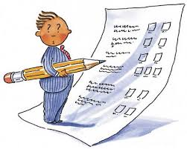
Assessment of OCD for CBT

Slide 50
Assessment
Nature of the Obsession:
Content
Degree of insight
Frequency
Triggers
Feared consequence
Meaning of the obsession to the patient

Slide 51
Assessment
Emotional State
The main emotion related to the obsession or intrusion.
Ego syntonic or dystonic.
Associated secondary mood

Slide 52
Assessment
Compulsions and Neutralizing Behaviour:
Degree of stress on resistance
Feared consequence of resistance
How is the compulsion terminated (number of repetitions, degree of comfort).
Frequency

Slide 53
Assessment
Avoidance Behavior:
Rated on a scale from 0-100
Frequency
Degree of distress that leads to avoidance

Slide 54
Assessment
Family Involvement:
Degree of accommodation of the obsessions.
Expressed emotions towards the patient’s behaviour (e.g., hoarding, bathroom use, etc….).
Degree of distress of family members.
Identify the role they can play in the treatment process.

Slide 55
Assessment
Degree of Handicap: Social, Physical & Occupational

Slide 56
Assessment
Commitment to Change and ability to join CBT

Slide 57
Assessment
Use of Scales:
The Yale–Brown Obsessive–Compulsive Scale
The Obsessive–Compulsive Inventory
Helps to set a baseline for therapy and can be used in follow-up.

Slide 58
THANK YOU
EMOTIONOFLIFE.COM

