Slide 1
Cognitive Behaviour Therapy

Slide 2
Definition
Cognitive behavioral therapy (CBT) is a type of psychotherapeutic treatment that helps people learn how to identify and change destructive or disturbing thought patterns that have a negative influence on behavior and emotions.

Slide 3
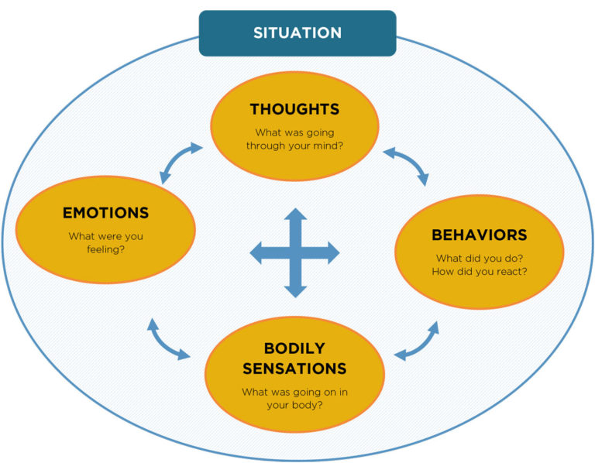

Slide 4
Cognitive Distortions:
ALL OR NOTHING THINKING
You see things in extreme or in black and white. “It is either perfect, or it is a mess”, “My friend likes me or he doesn’t.”
OVER-GENERALISATION
You see a single negative event as proof that other similar events will turn out the same way. if one person behaved in a spiteful way to you, then all people behave in this way.
MENTAL FILTER
You pick out a single negative detail and dwell on it, viewing the whole situation as negative. Refusing to notice any positives or anything that went well/you did well.

Slide 5
DISQUALIFYING THE POSITIVE
You reject positive experiences by insisting they ‘don’t count’ for some reason or another. In this way you can maintain a negative belief that is contradicted by your everyday experiences.
JUMPING TO CONCLUSIONS
You make a negative interpretation even though there are no definite facts that support your conclusion.
MAGNIFICATION (Catastrophising)
You exaggerate the importance of things, such as, something you may have thought was wrong. You inappropriately shrink your achievements or desirable qualities.
EMOTIONAL REASONING
You assume that your negative emotions necessarily reflect the way things really are “I feel like a failure, therefore, I am one”.

Slide 6
SHOULD/MUST STATEMENTS
You set your self standards of what you perceive you ‘should’ or ‘must’ be doing. These standards are often too high and unrealistic. The emotional consequence is guilt. When you direct should statements towards others, you feel anger, frustration and resentment.
LABELING AND MISLABELING
This is an extreme form of over generalising. Instead of describing your error, you attach a negative label to yourself: ‘I’m a loser’. When someone else’s behaviour bothers you, you attach a general label to them ‘he’s an idiot’. Mislabelling involves describing an event with language that is highly coloured and emotionally loaded.
PERSONALISING
You see yourself as the cause of some negative external event , when in fact you did not have primary or any responsibility.

Slide 7
Types of Cognitive Behavioral Therapy
Cognitive therapy centers on identifying and changing inaccurate or distorted thinking patterns, emotional responses, and behaviors.³﻿
Dialectical behavior therapy(DBT) addresses thoughts and behaviors while incorporating strategies such as emotional regulation and mindfulness.
Rational Emotive Behaviour Therapy(REBT) involves identifying irrational beliefs, actively challenging these beliefs, and finally learning to recognize and change these thought patterns.

Slide 8
Uses of CBT
CBT is used to treat a wide range of conditions including:
Addictions
Anger issues
Anxiety
Bipolar disorder
Depression
Eating disorders
Panic attacks
Personality disorders
Phobias
Problems with stress

Slide 9
CBT Strategies
Identify Negative Thoughts
It is important to learn how thoughts, feelings, and situations can contribute to maladaptive behaviors.﻿ The process can be difficult, but it can ultimately lead to self-discovery and insights that are an essential part of the treatment process.
CONTD…

Slide 10
Practice New Skills
It is important to start practicing new skills that can then be put in to use in real situations. For example, a person with addiction might start practicing new coping skills and rehearsing ways to avoid or deal with social situations that could potentially trigger a relapse.
Set Goals
Goal setting can be an important step in recovery from mental illness and helping you make changes to improve your health and life. During CBT, a therapist can help with goal-setting skills by teaching you how to identify your goal, distinguish between short- and long-term goals, set SMART (specific, measurable, attainable, relevant, time-based) goals, and focus on the process.
CONTD…

Slide 11
Examples of SMART goal
I would like to meet a friend for a drink 3 times a week and spend 30 minutes talking to them. I would like to achieve this within the next 3 months.
Whilst I am looking for a job, I would like to call 3 prospective employers each week and ask them about any vacancies. I would like to be able to do this within the next 3 weeks.
I would like to learn how to challenge my negative thinking so that I do not always jump to conclusions. Instead of worrying about things all day, I would like to allocate 20 minutes a day writing down all my worries and try to manage them. I would like to achieve this by the end of the mo

Slide 12
Problem Solve
Learning problem solving skills can help identify and solve problems that arise from life stressors, both big and small, and reduce the negative impact of psychological and physical illness.
Identify the problem
Identify all possible solutions
Evaluate pros and cons
Select a solution Plan
Do (put the plan into action)
Review
CONTD…

Slide 13
Self Monitor
Also known as diary work, self-monitoring is an important part of CBT that involves tracking behaviors, symptoms, or experiences over time and sharing them with your therapist. Self-monitoring can help provide the therapist with the information needed to provide the best treatment.
For example, for eating disorders, self-monitoring may involve keeping track of eating habits as well as any thoughts or feelings that went along with consuming that meal or snack.

Slide 14
Progress Gradually
In most cases, CBT is a gradual process that helps a person take steps towards a behavior change.
For example, someone with social anxiety might start by simply imagining anxiety-provoking social situations. Next, they might start practicing conversations with friends, family, and acquaintances.
By progressively working toward a larger goal, the goals easier to achieve.

Slide 15
Therapeutic session
Rapport-formation & Case-history
Identifying cognitive triad and ABC
Assessment
Downward Arrow Technique
Guided discovery & Socratic-questioning
Thought –stopping
Cognitive-errors
Daily record of Dysfunctional thoughts
Behavioural techniques
Termination of the therapy

Slide 16
Rapport Formation:
Counselling strategies to establish rapport would include: using self-disclosure to relate to the client's situation and create an emotional link.
Identifying Cognitive triad:
A- Activiting agent
B- Belief
C- Consequences.

Slide 17
Assessment
Any assessment to identify the problem by understanding the case history as narrated by the client.
Downward Arrow Technique
Through this technique, the therapist go in depth about the feelings and thoughts of the client.

Slide 18
Example of downward arrow technique where the client has lost job three times in a year
T- So if I am getting you right, you are feeling terrible about it..
P- yes…
T-what exactly made you to feel terrible? (Downward Arrow technique)
P-I lost my job again, for the third time.
T- What it means to you?
P- Financial insecurity. Future is bleak & hopeless.
T-If this is the case, what it means to you?

Slide 19
Contd.
P- I cannot take care of my family
T- What it means to you?
P-I am not a good husband and good father.
T-If it is true, what it means to you?
P-I am good for nothing.

Slide 20
Guided Discovery and Socratic Questioning
In a nutshell, guided discovery is a process that a therapist uses to help his or her client reflect on the way that they process information. Through the processes of answering questions or reflecting on thinking processes, a range of alternative thinking is opened up for each client.
Therapists use Socratic questioning verbally by asking probing questions about their clients' irrational thoughts.

Slide 21
Contd.
Date | Situation | Emotions | Automatic thoughts | Alternative Response | Outcomes
 | Any situation you are in | What emotions running in your mind at that time And also rate it | Any thought running to your mind | Any alternative way to reduce the negative | How much will you rate your emotions and belief after the alternative thoughts

Slide 22
Behaviour techniques
Any kind of hobbby that the client enjoys, the therapist can guide or motivate to do that hobby or practice it on a regular basis so that the client might feel good and other worry or anxieties might reduce.
Schedule a behaviour task for the client
Date | Activity | Feeling | Automatic thoughts | Outcome
 | Any activity or activities that the client enjoys | How did he feel | Any thought coming to the mind | How do you feel?

Slide 23
Termination and Follow Up
Once the client starts to show remarkable changes then the therapist needs to train the client for termination.
Termination takes time and it should be terminated once the client gets adequate result from the therapy and follow up to be done as required by the therapist.

Slide 24
Thank You
SREETAMA BHADURI
( Emotion Of Life)
Visit us www.emotionoflife.in
Write to us info@emotionoflife.in
Contact - 7678694626

