Slide 1

BOUNDARIES
When to say yes
How to say NO to take control of your life

Slide 2

What do we mean by word boundaries?
It is the practice of openly communicating and asserting personal values as way to preserve and protect against having them compromised or violated .The term "boundary" is a metaphor – with in-bounds meaning acceptable and out-of-bounds meaning unacceptable. Without values and boundaries our identities become diffused and often controlled by the definitions offered by others. The concept of boundaries has been widely adopted by the counseling profession.

Slide 3
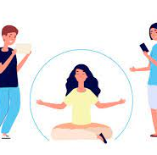
Why should one have boundaries?
Having boundaries means honoring ourselves as a separate individual with needs and wants that often differ from others. Without healthy boundaries, we allow others to override our own feelings and desires. ... The essence of boundaries is differentiating what we want from what others want from us.

Slide 4
to understand better!!
Lets take an example of sherrie!!
Sherrie is a 37 year old woman, mother of two , working as a fashion consultant at McAllister Enterprises and on a verge broken marriage.
Sherrie tries to live her life the right way.
She tries to do a good job with her marriage, her children, her job , her relationships and her Lord.
Sherrie has great difficulty in knowing that things are her responsibility and what aren't . In her desire to do the right
thing, or to avoid conflict, she ends up taking on problems that
God never intended her to take on: her mother’s chronic loneliness,
her boss’s irresponsibility, her friend’s unending crises,
her church leader’s guilt-ridden message of self-sacrifice, and
her husband’s immaturity.

Slide 5
to understand better!!
Continuation.......
And her problems don’t end there. Sherrie’s inability to say
no has significantly affected her son’s ability to delay gratification
and behave himself in school, and, in some way, this inability
may be driving her daughter to withdraw.
Any confusion of responsibility and ownership in our lives is
a problem of boundaries. Just as homeowners set physical property
lines around their land, we need to set mental, physical,
emotional, and spiritual boundaries for our lives to help us distinguish
what is our responsibility and what isn’t. As we see in
Sherrie’s many struggles, the inability to set appropriate boundaries
at appropriate times with the appropriate people can be
very destructive.

Slide 6

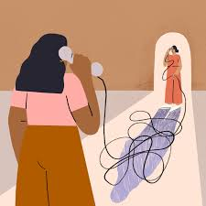
Sherrie confronted some very common questions:
Can I set limits and still be a loving person?
What are legitimate boundaries?
What if someone is upset or hurt by my boundaries?
How do I answer someone who wants my time, love, energy, or money?
Why do I feel guilty or afraid when I consider setting
boundaries?
How do boundaries relate to submission?
Aren’t boundaries selfish?

Slide 7
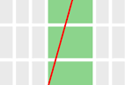






Examples of boundaries!!
Geographical
distance
Truth
Time
Words
Distance
Skin
People

Slide 8

lets understand examples better:

Slide 9
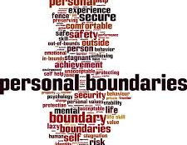
Words
In the physical world a fence or some other kind of structure usually delineates a boundary. In the spiritual world, fences are invisible. Nevertheless, you can create good protective fences with your words The most basic boundary-setting word is no. It lets others know that you exist apart from them and that you are in control of you.

Slide 10

Skin
The most basic boundary that defines you is your physical skin. People often use this boundary as a metaphor for saying that their personal boundaries have been violated:
“He really gets under my skin.”

Slide 11

Truth
Realizing the truth of his
unchangeable reality helps you to define yourself in relation to
him. When he says that you will reap what you sow To be in touch with God’s truth is to be in touch with reality, and to live in accord with that reality makes for a better life

Slide 12

time
Taking time off from a person, or a project, can be a way of
regaining ownership over some out-of-control aspect of your life where boundaries need to be set. Adult children who have never spiritually and emotionally
separated from their parents often need time away.

Slide 13
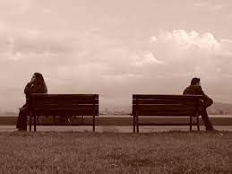
Emotional distance
Emotional distance is a temporary boundary to give your heart the space it needs to be safe; it is never a permanent way of living. People who have been in abusive relationships need to find a safe place to begin to “thaw out” emotionally. You should not continue to set yourself up for hurt and disappointment.

Slide 14

Geographical distance
Sometimes physically removing yourself from a situation will help maintain boundaries. You can do this to replenish yourself physically, emotionally, and spiritually after you have given to your limit, you can remove yourself to get away from danger and put limits on evil.

Slide 15

people
You need to depend on others to help you set and keep boundaries. People subject to another person’s addictions, control , or abuse are finding that after years and years of “loving too much,” they can find the ability to create boundaries only through a support group. Their support system is giving them the strength to say no to abuse and control for the first time in their lives.
“creating boundaries always involves a support network.”

Slide 16

Lets take a look at boundary problems!

Slide 17
Complaints: saying “yes” to the bad
Lets understand this concept with help of example of robbert!!!
Robbert the youngest child of his parents and only brother to big sisters. His sisters are seven to three years older than him.
Always taking advantage of their size and strength and wale on me until I was bruised. His sisters really hurt him and what actually bothered him was his parents behaviour , they always told him that “ You are a boy and boys don't hurt girls. Its bad manners!!!”
When parents teach children that setting boundaries or saying
no is bad, they are teaching them that others can do with them as
they wish. They are sending their children defenseless into a world
that contains much evil . Blocking a child’s ability to say no handicaps that child for life. Adults with handicaps like Robert’s have this first boundary injury: they say yes to bad things.

Slide 18
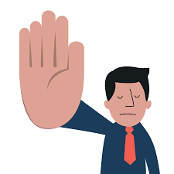

To feel safe In such an evil world, children need to have the power to say things like:
“No.”
• “I disagree.”
• “I will not.”
• “I choose not to.”
• “Stop that.”
• “It hurts.”
• “It’s wrong.”
• “That’s bad.”
• “I don’t like it when you touch me there.”

Slide 19

The inability to say no to the bad is pervasive. Not only does it keep us from refusing evil in our lives, it often keeps us from recognizing evil. Many compliant people realize too late that they’re in a dangerous or abusive relationship. Their spiritual and emotional “radar” is broken; they have no ability to guard their hearts (Prov. 4:23).

Slide 20
Avoidants: saying “no” to the good
Saying no to the good, This boundary problem is called avoidance. It’s the inability to ask for help, to recognize one’s own needs, to let others in. Avoidants withdraw when they are in need; they do not ask for the support of others.
Why is avoidance a boundary problem?
At the heart of the struggle is a confusion of boundaries as walls. Boundaries are supposed to be able to “breathe,” to be like fences with a gate that can let the good in and the bad out. Individuals with walls for boundaries can let in neither bad nor good. No one touches them.
God designed our personal boundaries to have gates. We
should have the freedom to enjoy safe relationships and to avoid
destructive ones.

Slide 21
Controllers: Not Respecting
Others’ Boundaries
Continued.......
Controllers can’t respect others’ limits. They resist taking responsibility for their own lives, so they need to control others.
The primary problem of individuals who can’t hear no—which is different from not being able to say no—is that they tend to project responsibility for their lives onto others.
Controllers come in two types:
1. Aggressive controllers. These people clearly don’t listen to
others’ boundaries. They run over other people’s fences like a
tank. They are sometimes verbally abusive, sometimes physically
abusive. But most of the time they simply aren’t aware that others
even have boundaries. It’s as if they live in a world of yes.
2. Manipulative controllers. Less honest than the aggressive
controllers, manipulators try to persuade people out of their
boundaries. They talk others into yes. They indirectly manipulate
circumstances to get their way. They seduce others into carrying
their burdens. They use guilt messages.

Slide 22
Controllers: Not Respecting
Others’ Boundaries
Lets understand this type with Steve and Frank!
Frank is working for Steve for several years now, but today he handed over his resignation letter to steve. Frank gave all to this position but steve didn't know when to back off. Time after time, Steve would insist on Frank’s spending
unpaid time at the office on important projects. Frank had even
switched his vacation schedule twice at Steve’s insistence. But the final straw was when Steve began calling Frank at home. An occasional call at home Frank could understand. But almost every day, during dinnertime, the family would wait while Frank had a telephone conference with his boss. Several times Frank had tried to talk with Steve about the time violations. But Steve never really understood how burned out Frank was. After all, he needed Frank. Frank made him look
successful. And it was so easy to get him to work harder. Steve has a problem hearing and accepting others’ boundaries. To Steve, no is simply a challenge to change the other person’s mind. This boundary problem is called control.

Slide 23
lets revise about boundaries!!!

Slide 24

If you have more rigid boundaries, you might:
Keep others at a distance
Seem detached, even with intimate partners
Have few close relationships
Avoid close relationships
If you have more loose or open boundaries, you might:
Get too involved with others’ problems
Find it difficult to say “no” to others’ requests
Over share personal information with others
Seek to please others for fear of rejection

Slide 25

How to set healthy boundaries?

Slide 26
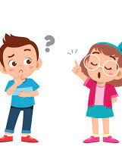
Clearly identify your boundary
Get really clear with yourself about what the boundary is that you need to set. Do you need your mother to stop calling all together or can she call you under certain circumstances? If you aren’t clear, you won’t be able to communicate your expectations. A wishy-washy boundary is not effective. Spend time figuring out what you need before taking action.

Slide 27

Be straight forward
Don’t be cryptic or purposefully vague thinking you’re going to spare someone’s feelings or avoid a conflict. The kindest and most successful approach is to be direct. Say what you mean and mean what you say.

Slide 28
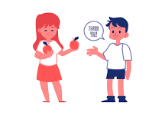
Use a calm and polite tone.
Keep your own anger in check. Don’t try to set boundaries in the middle of an argument. You want your message to be heard. Yelling, sarcasm, or a condescending tone all put others on the defensive and distract from the real issues.

Slide 29
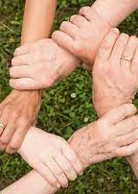
Use a support system.
Starting to set boundaries is tough! It can bring up a lot of questions, uncomfortable feelings, and self-doubt. Having a support system is invaluable whenever you’re doing something challenging.

Slide 30
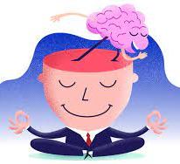
Trust your intuition
Be sure to slow down and tune into yourself. Pay attention to what you’re feeling. What is your gut telling you? If it feels wrong, make a change.

Slide 31

