Slide 1
DEFENSE MECHANISMS
Presented by : Ms. Trannum Gupta, Wellness Coach
Guided Mr. Shyam Gupta, Clinical Psychologist

Slide 2
NEED FOR DEFENSES Machanism
Defense mechanisms are used to protect ourselves from feelings of ANXIETY or GUILT, which arise because we feel threatened, or because our ID or UPEREGO becomes too demanding.

Slide 3
Definition
Defense mechanisms are psychological strategies brought into play by the unconscious mind to manipulate, deny, or distort reality in order to defend against feelings of anxiety and unacceptable impulses and to maintain one's self-schema or other schemas.
Defense mechanisms may result in healthy or unhealthy consequences depending on the circumstances and frequency with which the mechanism is used.

Slide 4
Definition
Defence mechanism is a pattern of adjustment through which an individual relieves anxiety caused by an uncomfortable situation that threaten self-esteem.
When these defence mechanisms are used moderately are harmless but excessive and persistent defence use is harmful.

Slide 5
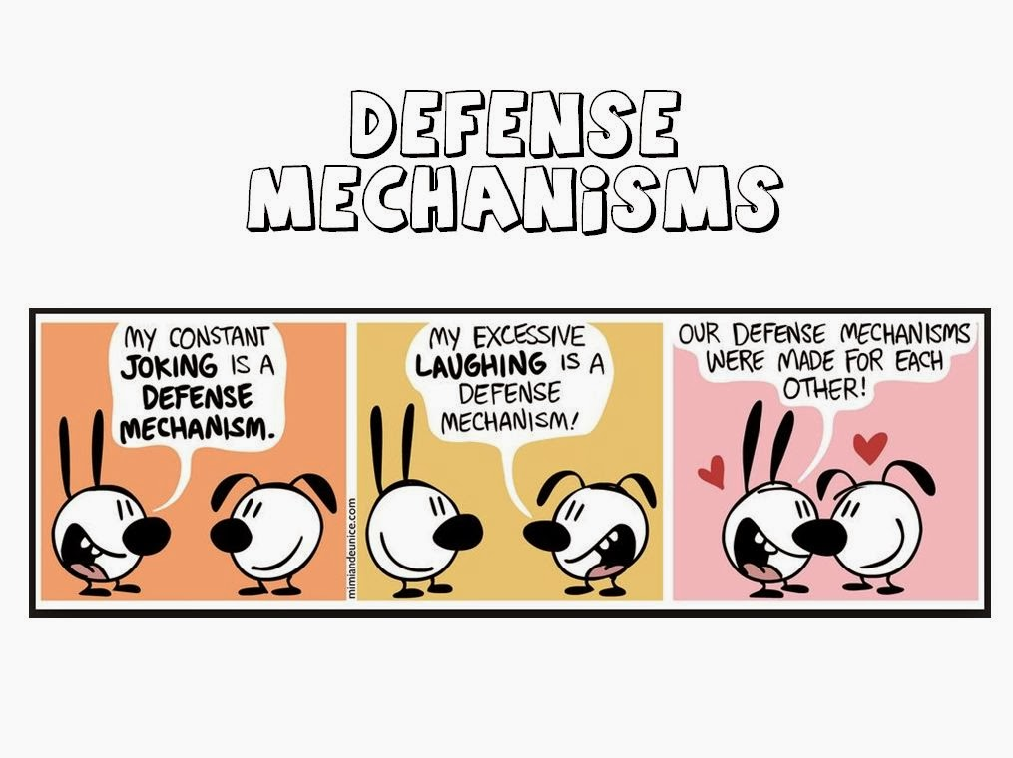

Slide 6
COMPENSATION
Covering up a real or perceived weaknesses by emphasizing a trait one considers more desirable.
Example : A physically handicapped boy is unable to play football, so he compensates by becoming a great scholar.

Slide 7
DISPLACEMENT
Transfer of feelings from one target to another that is considered less threatening or less neutral.
Example : A client is aggressive at his doctor, does not express it but , becomes verbally abusive to the nurse.

Slide 8
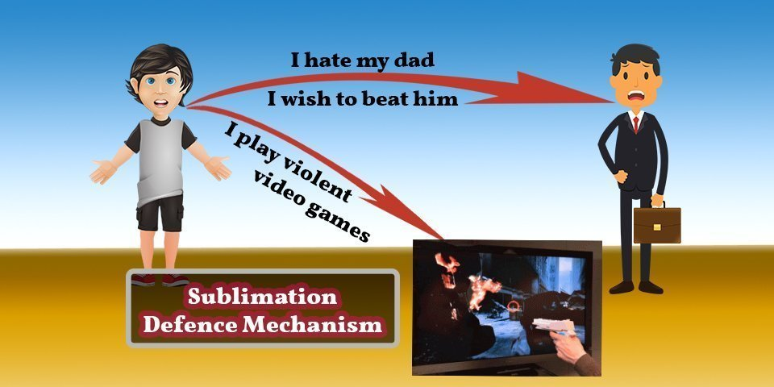
SUBLIMINATION

Slide 9
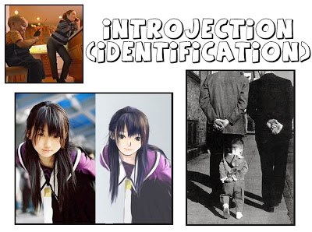
IDENTIFICATION
An attempt to increase self worth by acquiring certain attributes and characteristics of an individual one admires .
Example : A teenaged boy who required lengthy rehabilitation after an accident decides to become a physical therapist as a result of his experiences.
Associated disorders: Schizophrenia, Mood Disorders (Depression) ,

Slide 10
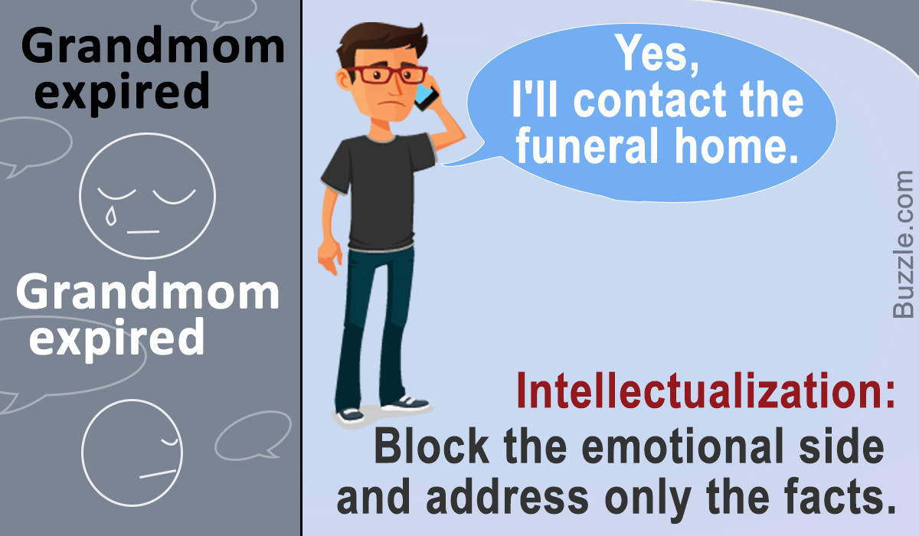
INTELLECTUALISATION
An attempt to avoid expressing actual emotions associated with stressful situations by using the intellectual processes of logic , reasoning and analysis .
if Ram is rude to Shyam, Shyam may think about the possible reasons for Ram. For Example Shyam may rationalize that Ram was having a stressful day that why Ram is behaving Rude and being harsh to me

Slide 11
SUPRESSION
The conscious decision to delay paying attention to a thought, emotion, or need in order to cope with the present reality; making it possible later to access uncomfortable or distressing emotions whilst accepting them.
EXAMPLE: Thinking about sweets kept in kitchen and wanting to eat them all while on a diet.

Slide 12
ISOLATION
Separation of feelings from ideas and events.
Example : Without showing any emotion a young woman describes being attacked and raped.
Associated disorders : Obsessive-Compulsive Disorder, Dissociative Disorders , Amnesia, multiple personalities, Somatoform Disorders, Personality Disorders

Slide 13
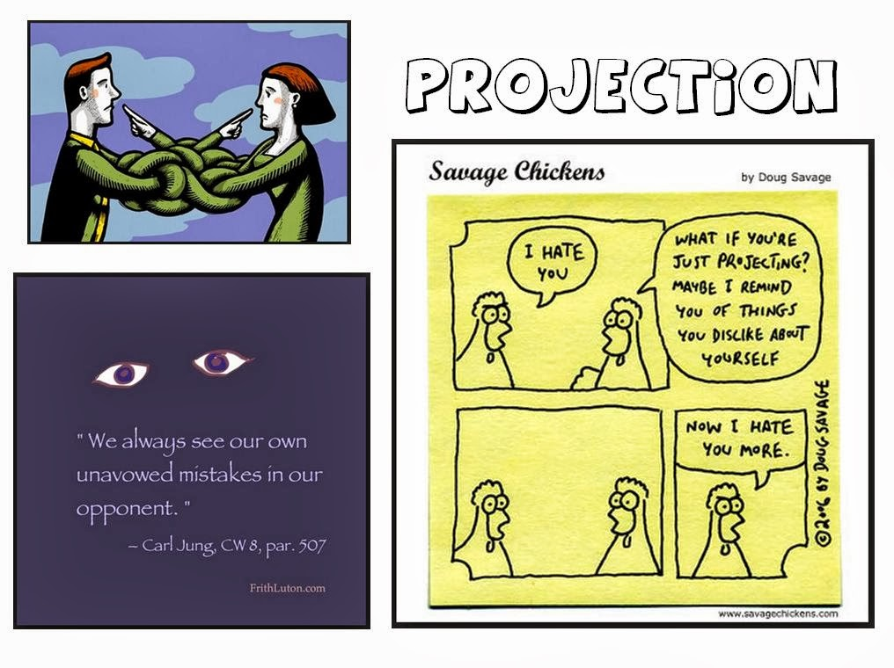

Slide 14
REACTION FORMATION
Converting unconscious wishes or impulses that are perceived to be dangerous or unacceptable into their opposites; behaviour that is completely the opposite of what one really wants or feels; taking the opposite belief because the true belief causes anxiety.
Example: A boy may really like a girl but act like hew does not and disinterested around her.
Associated disorders: Delusion, Mood Disorders, Depression, Obsessive-Compulsive Disorder, Anxiety,

Slide 15
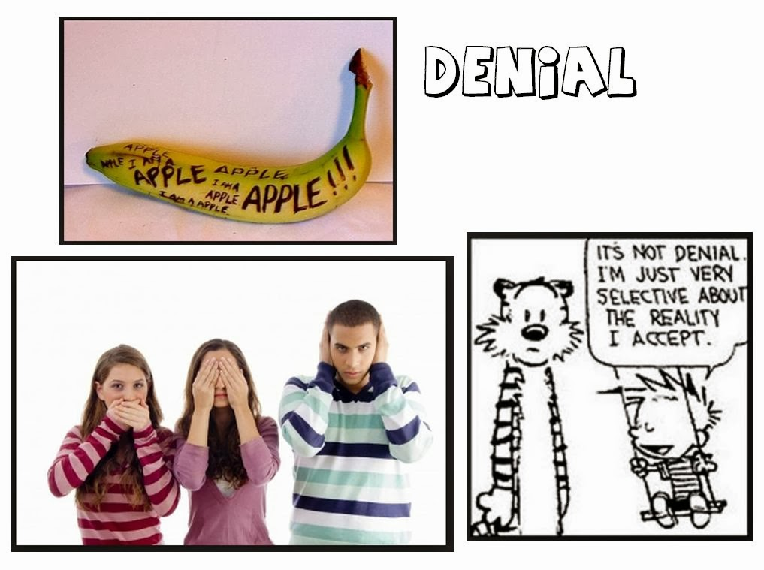
DENIAL
Refusal to Acknowledge the existence of a real situation or the feelings associated with it.
Example : Smokers may refuse to admit to themselves that smoking is bad for their health .
Associated disorders: Substance abuse

Slide 16
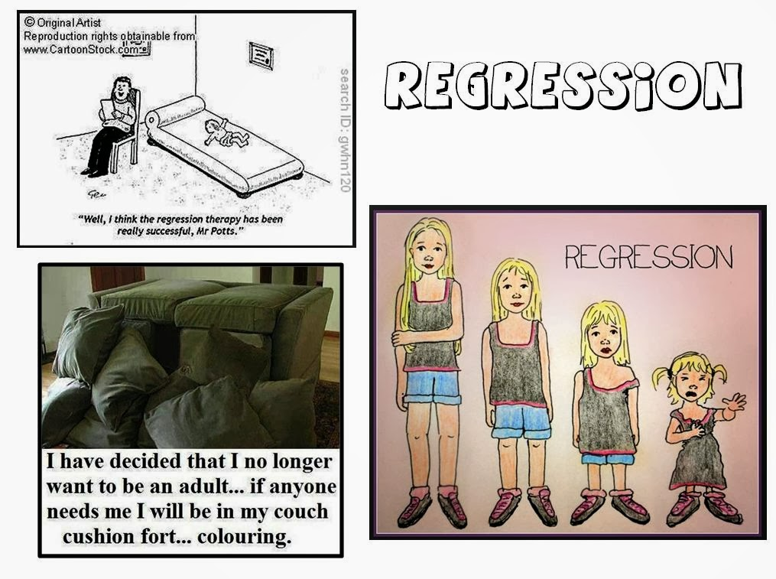
REGRESSION
Temporary reversion of the ego to an earlier stage of development rather than handling unacceptable impulses in a more adult way, for example, using whining as a method of communicating despite already having acquired the ability to speak with an appropriate level of maturity.
Associated disorders: Substance Abuse, Schizophrenia, Generalized Anxiety & Panic Disorder, OCD,

Slide 17
REPRESSION
The process of attempting to repel desires towards pleasurable instincts, caused by a threat of suffering if the desire is satisfied; the desire is moved to the unconscious in the attempt to prevent it from entering consciousness ; seemingly unexplainable naivety, memory lapse or lack of awareness of one's own situation and condition; the emotion is conscious, but the idea behind it is absent.
EXAMPLE: An accident victim can remember nothing about the accident.
Associated disorders: Somatoform Disorders, Body Dysmorphic Disorders, Guilt

Slide 18
RATIONALIZATION
Convincing oneself and others that no wrong has been done by person and that all is or was all right through faulty and false reasoning.
An indicator of this defense mechanism can be seen socially as the formulation of convenient excuses..
Example: I didn’t pass the exam because it was way more difficult than previous years.

Slide 19
Undoing
A person tries to 'undo' an unhealthy, destructive or otherwise threatening thought by acting out the reverse of the unacceptable. Involves symbolically nullifying an unacceptable or guilt provoking thought, idea, or feeling by confession or atonement.
EXAMPLE: A daughter shout at her father as there is no petrol in the car and is getting late for office, brings a favorite film for her father to watch. This is an example of undoing her behavior of shouting and then bringing a film.
Associated disorders: OCD

Slide 20

Thank you so Much
Question are welcome

