Slide 1
PSYCHODYNAMIC APPROACH OF THERAPY
Sayantani Mukherjee
Clinical Psychologist at Emotion of Life

Slide 2

GOALS OF THIS TRIANING- What are your expectations?

Slide 3
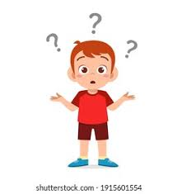
After this workshop
You will not be able to practice Psychoanalysis.
This is an overview how Psychoanalysis and Psychodynamic therapy works.

Slide 4

BUT WHAT WILL BE HELPFUL?
Most of the Psychoanalytic and Psychodynamic Therapy approaches lies in the theoretical construct.
You can try to make your Therapeutic approach in a bit Psychodynamic way
You will get to know about the techniques and how it works
You will get an insight in a psychodynamic approach how to approach a client.

Slide 5
LETS GO BACK TO HISTORY OF PSYCHOLOGY A LITTLE…

Slide 6
CAN I APPLY PSYCHOANALYSIS AND PSYCHODYNAMIC THERAPY TO EVERY CLIENT?
No.
It is not very applicable to Psychotic disorders
Mostly applicable to Personality disorders, Anxiety and Depression spectrum and sometimes in Addiction disorders too.
Not applicable to Developmental disorders and persons with intellectual disabilities.

Slide 7
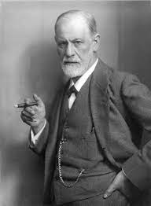
SIGMUND FREUD : FOUNDER OF PSYCHOANALYSIS
PSYCHOANALYTIC SCHOOL

Slide 8
Topographical Concept
Conscious Mind- The mind which we are aware of. It contains all of the thoughts, memories, feelings, and wishes of which we are aware at any given moment.
Preconscious/Subconscious Mind- The mind which remains submerged but we can easily bring the materials into consciousness.
Unconscious Mind – It is a reservoir of feelings, thoughts, instincts, urges, and memories that are outside of our conscious awareness and which we are unaware of. The unconscious contains contents that are unacceptable or unpleasant materials.

Slide 9
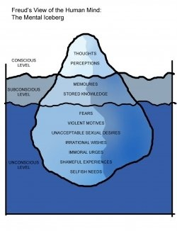

Slide 10
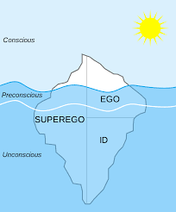
STRUCTURAL CONCEPT –
ID
Ego
Super Ego

Slide 11

ID – It is derived from the word – ‘It’ and is guided by pleasure principle. It consists of psychological and biological instincts, a part of which is partly inherited. It is also a reservoir of psychic energy, desires, instincts which are mostly unacceptable in objective reality. It only deals with pleasurable subjective experience.

Slide 12

EGO- It is guided by ‘reality principle’. It is guided by the objective reality and realistic thinking.

Slide 13
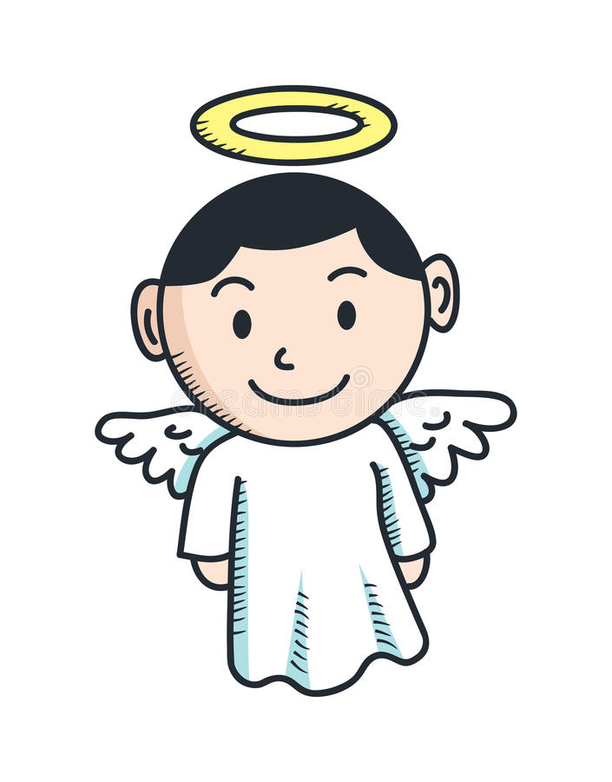
SUPER EGO- It is guided by ‘Moral principle’. It comprises of values, ethics mostly derived from parenting and authority figures.

Slide 14
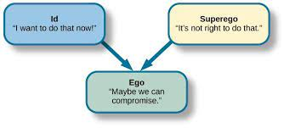

Slide 15
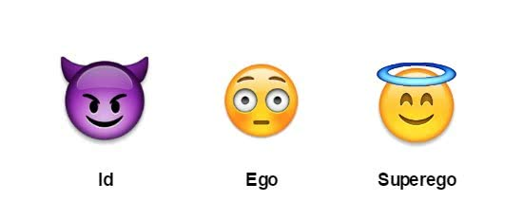

Slide 16
FRAME AN EXAMPLE
EACH OF THE PARTICIPANT

Slide 17
PSYCHOSEXUAL STAGES OF PERSONALITY DEVELOPMENT
Oral stage (age -0-2 years)
Anal stage (age 2-4 years)
Phallic stage (age – 4-6 years)
Latency stage (6- adolescence)
Genital stage (Adolescence)

Slide 18
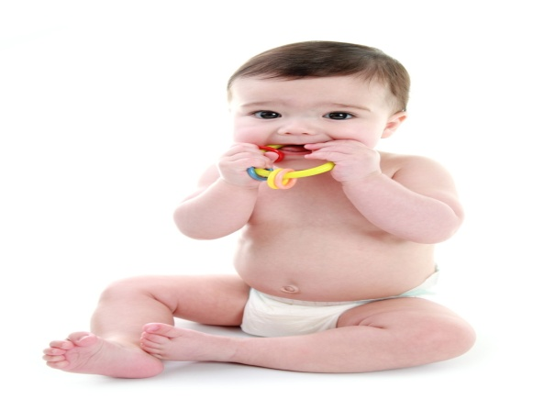
ORAL STAGE
Sexual pleasure located in the oral areas
Pleasure derived from eating, sucking, splitting out, swallowing, biting, chewing.
Two phases – Oral Incorporative and Oral sadistic
Oral receptive – sucking, eating
Oral Sadistic – biting, chewing
Some basic probable examples of oral personalities –
A. Gullible person – oral incorporative- swallow anything he is told.
B. Sarcastic and Argumentative person – Oral sadistic.

Slide 19

ANAL STAGE
Sexual pleasure on anal region
Lower end of intestinal tract, anal sphincters, expulsion and retention of feces.
Toilet training starts and with it starts the first external regulation of instinctual gratification.
Probable personalities examples –
A. Anal retentive personality- Obstinate, stingy, miser etc.
B. Anal Expulsive Personality – messy, disorganized, destructive, temper tantrums, etc.

Slide 20
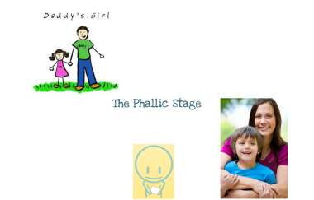
PHALLIC STAGE
Sexual and aggressive feelings along with the functioning of the genital organs comes into focus
Oedipus Complex – Unconscious sexual attraction of the boy towards mother figure and ambivalence towards father figure.
Electra Complex (Carl Jung) - Unconscious sexual attraction of the girl towards father figure and ambivalence towards mother figure.
Penis Envy
Castration anxiety
Bisexuality

Slide 21
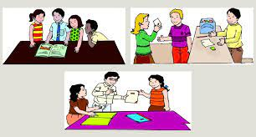
LATENCY STAGE

Slide 22

GENITAL STAGE

Slide 23
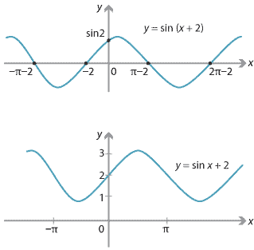
WHAT IS A FIXATION AT ANY PARTICULAR STAGE?

Slide 24
Fixation means the person in spite of passing that stage still have some unresolved issues and conflicts in that stage.
Fixation also means – Over satisfaction or under satisfaction of that particular stage.
One can have fixations in multiple stages.

Slide 25
LETS DO AN EXERCISE
A girl, 28 years old, came up with the symptoms of panic attacks, sleeplessness and anxiety symptoms. She reported she has some heart problems and is getting a nightmare of her father raping her.
In which stage do you think she might have fixation?

Slide 26
HOME WORK
Do it and we will discuss

Slide 27
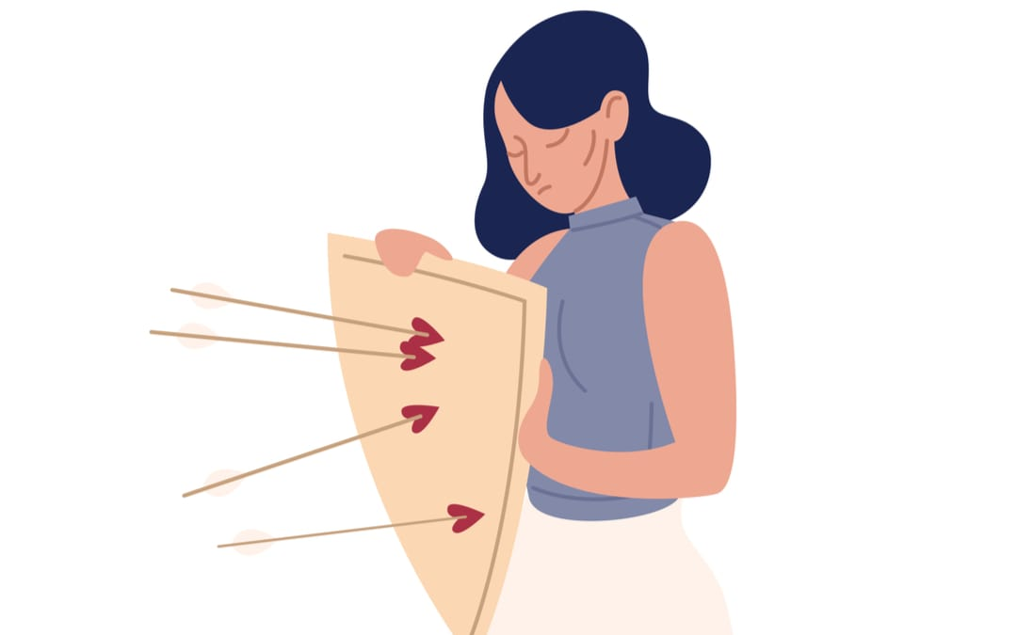
DEFENSE MECHANISMS

Slide 28
DEFENSE MECHANISMS
AS WE ARE HUMAN BEINGS WHO LIVE IN A SOCIETY
FOR MAINTAINING OUR PERSONALITY INTEGRITY
SAFEGUARD FROM INTERNAL AND EXTERNAL CONFLICTS

Slide 29
HOW IT IS DIFFERENT FROM COPING SKILLS?
Coping Skills are conscious methods dealing with challenges.
Defense Mechanisms are unconscious.

Slide 30
Defense mechanism is an complex interaction between these four factors –
A. One’s constitutional temperament
B. The nature of the stresses that one suffered in early childhood
C. The modelled defenses
D. The experienced consequences of using particular defenses

Slide 31
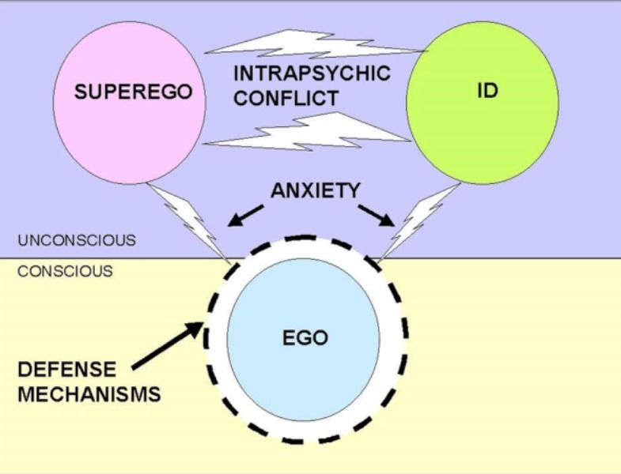

Slide 32
PRIMITIVE DEFENSE MECHANISMS
Happens at that phase where there is less involvement between the boundary of self and the outer world.
These are lower order or immature or primary or primitive defenses.
Global undifferentiated in a person’s total sensorium, fusing cognitive, affective and behavioral dimensions.
A lack of attainment of the reality principle and lack of appreciation of the separateness and constancy of those outside the self. (more magical types)

Slide 33
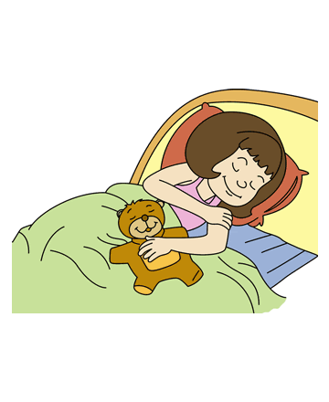
WITHDRAWAL – The tendency to escape from or avoid situations that may be experienced as emotionally or psychologically challenging.

Slide 34
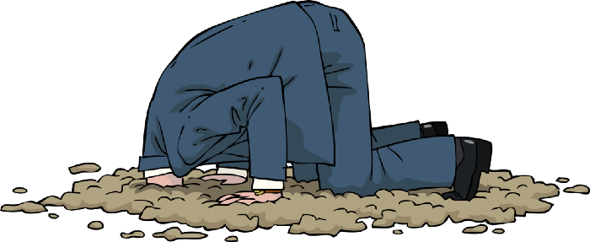
DENIAL – ‘If I don’t acknowledge, it is not happening’. This was proposed by Anna Freud which involves a refusal to accept reality, thus blocking external events from awareness.

Slide 35

OMNIPOTENT CONTROL- An infantile state of grandiosity, where the fantasy is that one is in control of all they come in contact with – happens during Primary Narcissism stage.
A healthy amount of this omnipotence should remain in us all and contributes to feelings of efficacy and competence in life.
If the individual makes too frequent a use of this defense it will stop her from being able to establish realistic causal relationships that would orient her to reach her goals.

Slide 36

SPLITTING OF EGO - The person relegates experiences and/or people into all-good and all-bad categories with no room for ambiguity.
Infants are thought to perceive mother as all good when they are gratified and perceive her as a bad mother when they are frustrated.
For people with borderline personality disorder (BPD), 'splitting' is a commonly used.

Slide 37
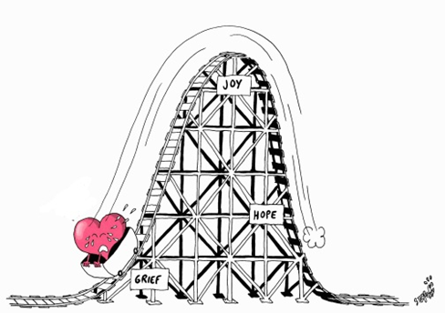
IDEALIZATION- It is a psychological or mental process of attributing overly positive qualities to another person or thing.
Devaluation on the other hand is just the opposite of Idealization.

Slide 38
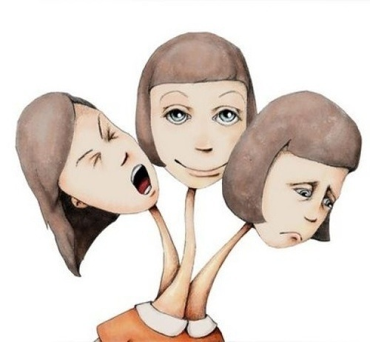
DISSOCIATION- It is a way of disconnecting oneself from present experience, sometimes by creating another representation of oneself, in order to continue existing in moments that are too painful or stimulating.
For example, a woman finds herself engaging in bulimic eating behaviors in a subconscious attempt to escape feelings of shame and self-loathing.

Slide 39
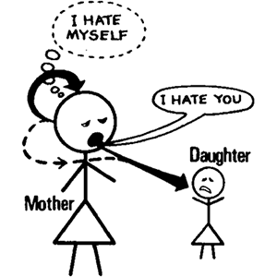
PROJECTION – Projection is a psychological defense mechanism proposed by Anna Freud in which an individual attributes unwanted thoughts, feelings and motives onto another person.
For example, you might hate someone, but your superego tells you that such hatred is unacceptable. You can 'solve' the problem by believing that they hate you.
Common in Paranoid Schizophrenia patients.

Slide 40

INTROJECTION AND IDENTIFICATION as being very similar and on a continuum; introjection usually leads to identification.
Introjection occurs when a person internalizes the ideas or voices of other people-often external authorities.
On the other hand, Identiﬁcation is an ego defense or mental mechanism through which an individual, in varying degree, makes himself or herself like someone else; he identiﬁes with another person. This result sin the unconscious taking over of various elements of another.
For example is a child is being bullied at school. The bullied child may unconsciously begin acting like the bully to avoid being further picked on. At this point, it’s just introjection. If the child then began to identify with the bully, acting like them in all respects, thinking “I’m just like him-we rule the school!”, dressing like the bully, etc. then identification has occurred.

Slide 41
SECONDARY DEFENSES
The more secondary a defense is, the more it will belong to later periods of development and the more it will preserve reality checking.
The following are the types of Secondary Defenses:-
Repression
Regression
Isolation
Undoing
Intellectualization
Rationalization

Slide 42
Displacement
Reaction Formation
Sublimation
Humor Defense
Internalization

Slide 43
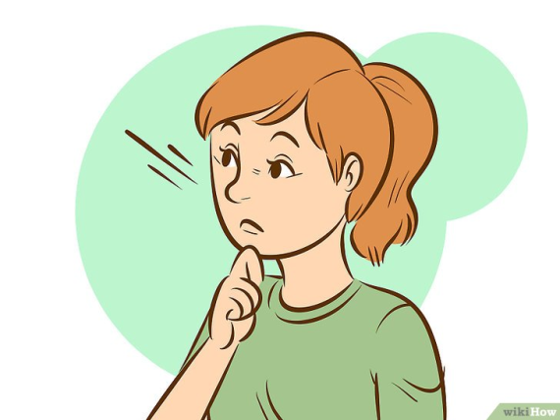
REPRESSION - An unconscious defense mechanism employed by the ego to keep disturbing or threatening thoughts from becoming conscious.
For example, in the oedipus complex, aggressive thoughts about the same sex parents are repressed and pushed down into the unconscious.

Slide 44

REGRESSION - As proposed by Anna Freud where the ego reverts to an earlier stage of development usually in response to stressful situations.
Thoughts that are often repressed are those that would result in feelings of guilt from the superego.
For example, a child may begin to suck their thumb again or wet the bed when they need to spend some time in the hospital.

Slide 45

ISOLATION - The defense mechanism of isolation can lead a person to separate ideas or feelings from the rest of their thoughts. In distinguishing an emotion or impulse from others in this way, a person attempts to protect the ego from anxieties caused by a specific situation.
For example, a person might have the thought that his father will die, yet he experiences no emotions along with the thought.
It is mainly seen using by OCD as well as in Somatoform disorder patients.

Slide 46
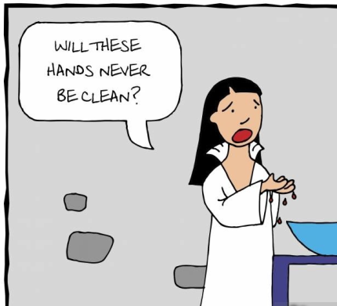
UNDOING - The defense mechanism by which individuals avoid conscious awareness of disturbing impulses by thinking or acting in a way intended to revert (“make un-happen”) those impulses, even if only at a symbolic level.
For example, Lady Macbeth compulsively washes her hands after committing murder.
This defense is mainly used by OCD patients.

Slide 47
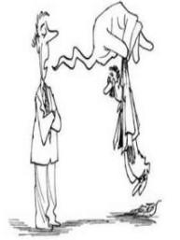
INTELLECTUALIZATION - A defense mechanism, which according to Freud involves engrossing oneself so deeply in the reasoning aspect of a situation that you completely disregard the emotional aspect that is involved.
The person is consciously aware of the situation but simply become “emotionally away”(unconsciously keeping their feelings at bay).
For example, a patient learns he has cancer. He begins to learn everything he can about the illness to avoid distress and remain distant from the reality of the situation.

Slide 48

RATIONALIZATION- It is unconscious justification of unrealistic thoughts and consequent actions.
For the story, ‘sour grapes' derives from one of the fables attributed to Aesop, The Fox and the Grapes.
Mainly seen in patients of Anxiety, OCD, Somatoform disorder and Schizophrenia (to establish magical thinking).

Slide 49
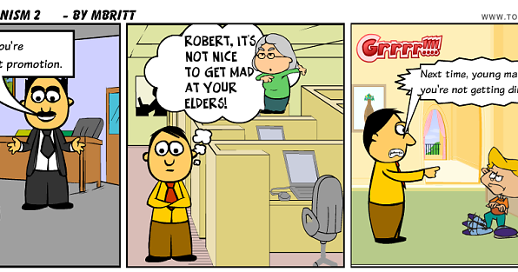
DISPLACEMENT – It involves taking out our frustrations, feelings, and impulses from a threatening people or objects that are less threatening one.
Mainly used by Phobic patients and in Somatoform Disorder.
For example, one expresses the anger which was for his boss on his child (less threatening) after coming back home.

Slide 50
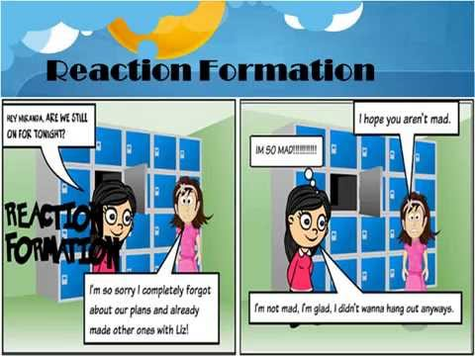
REACTION FORMATION - This one is based heavily on conflicting elements. Basically, people tend to act the opposite way that the unconscious instructs them to behave.
An example of reaction formation would be treating someone you strongly dislike in an excessively friendly manner in order to hide your true feelings.

Slide 51
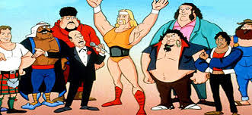
SUBLIMATION - A type of higher order and mature defense mechanism where socially unacceptable impulses or idealizations are unconsciously transformed into socially acceptable actions or behavior, possibly resulting in a long-term conversion of the initial impulse.
For example, an individual who has a lot of suppressed anger grows up to be a professional wrestler where it’s socially acceptable to fight.

Slide 52

HUMOR - A “mature” defense mechanism - a primarily adaptive technique to help us to cope with tense or stressful situations. Looking for a funny aspect in an environment in which we lack control can help us to endure it, and can even be an altruistic act in helping others to better cope as well.
For example, a person's treatment for cancer makes him lose his hair so he makes jokes about being bald.

Slide 53

INTERNALIZATION – It occurs when objects are 'installed' into the ego, such that they are both integral to sense of self and also experienced as separate and concrete internal objects.
For example, the right or wrong concepts of parents are internalized by children.

Slide 54
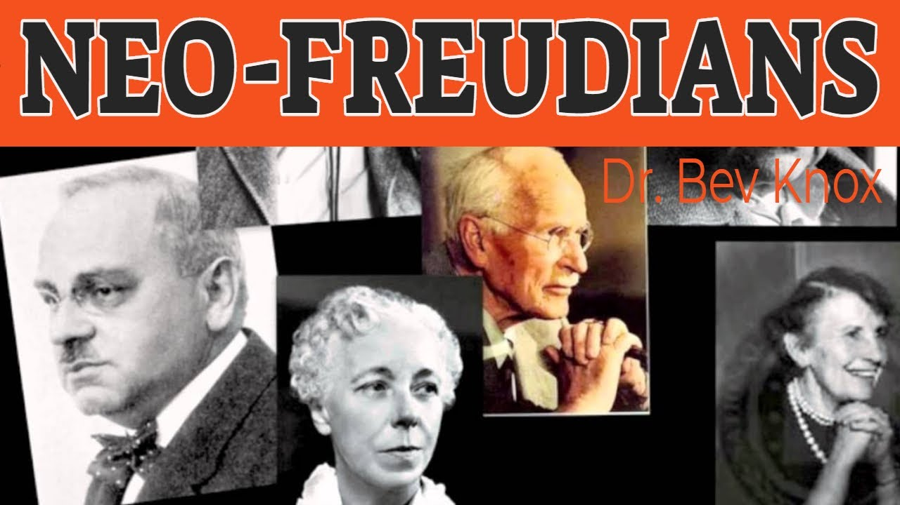
NEO FREUDIANS

Slide 55
CARL JUNG
Carl Jung was an early supporter of Freud because of their shared interest in the unconscious.
Collective Unconscious
Archetypes
Anima and Animus

Slide 56
KAREN HORNEY
Feminist Psychology
Psychoanalytic theorist Karen Horney developed one of the best-known theories of neurosis. She believed that neurosis resulted from basic anxiety caused by interpersonal relationships. Horney's theory proposed that strategies used to cope with anxiety can be overused, causing them to take on the appearance of needs.

Slide 57
ADLER
Adlerian theory is a holistic approach to psychology that emphasizes the importance of overcoming feelings of inferiority and gaining a sense of belonging in order to achieve success and happiness.

Slide 58
ACTIVITY
Identify the probable Defense Mechanism that may be present here-
I am a 32 year old women. I am married for the past 2 years. My husband stays outside and I stay here separately for my work. For the past few months I am suffering from depression. I don’t feel like doing anything. I want to stay in a dark room and do not want to talk to anyone. My mother-in-law once asked me what is wrong with me. I did not report her anything. But I sometimes think my husband stays so far. He is having an affair as he is not getting sex. I have a male friend who give me a shoulder to cry here and hear all my rants. But I am a bit suspicious about my husband.

Slide 59
HOME WORK
Identify the Defense Mechanisms

Slide 60

DREAMS – A ROYAL ROAD TO UNCONSCIOUS

Slide 61
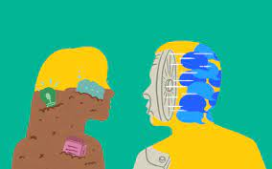
Dream analysis
There are two types on content-
A. Manifest content
B. Latent Content
P.s. – Remember one things dreams are not interpreated unless we get proper free associations with the dreams.

Slide 62

THE STIMULI AND SOURCES OF DREAMS
EXTERNAL SENSORY STIMULI
INTERNAL SESNORY EXCITATIONS
INTERNAL ORGANIC SOMATIC STIMULI
PSYCHICAL SOURCES OF STIMULATION
SYMBOLS

Slide 63
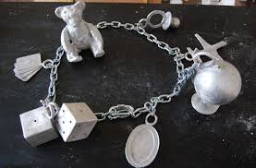
THE DREAM WORK
WORK OF CONDENSATION
WORK OF DISPLACEMENT

Slide 64
SOME COMMON DREAMS
1. Loosing things
2. Dreams attacked by animals
3. Unable to find way back home
If you are comfortable you can share some of your dreams. Obviously it cannot be interpreted without free associations and for maintaining your confidentiality one may not wish to share also.

Slide 65

METHODS OF PSYCHOANALYSIS AND PSYCHODYNAMIC THERAPY

Slide 66
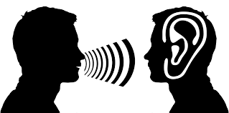
LISTENING- LISTEN/REFLECT/INTERVENE
LISTEN- 1. ACTIVE
2. PASSIVE
3. EMPATHETIC
REFLECTIVE LISTENING

Slide 67

What is Reflective listening?
Checking out process
Speaker feels heard
Some insight and in depth exploration of thought can be done too.

Slide 68
LETS DO A ROLE PLAY
A client with Anxiety features have arrived at a clinic.

Slide 69

FREE ASSOCIATION
This kind of verbal wandering is what we call free association. Free association is the patient’s effort to say whatever comes to mind without editing. It’s a very different way of communicating than most people use in social situations. For example, in a non-therapy setting you might choose not to tell your friend that you hate her dress, or you might hide the details of your wedding plans from a colleague who is in the middle of a divorce. We all edit all the time – consciously and unconsciously – in order to protect ourselves and the people with whom we communicate. If you try to talk or think without editing, you’ll find that it’s nearly impossible. So when we ask our patients to free associate we are asking them to do something that’s quite difficult. Nevertheless, we instruct them to do just that because it’s the best way we have to move toward the unconscious and to understand how their thoughts and feelings are linked.

Slide 70
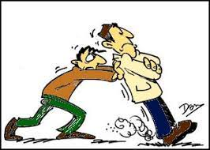
RESISTANCE
Opposition- Conscious, preconscious and unconscious
Any kind of forces which oppose the patient’s free association, patient’s attempts to remember and to gain and assimilate insight, which operate against the patient’s reasonable ego and his wish to change (Freud, 1900)

Slide 71
HOW IT APPEARS CLINICALLY?
Patient is silent
Patient does not ‘feel like talking’
Affects indicating resistance
The posture of the patient
Fixation in time

Slide 72
Trivia or external events
Avoidance of topics
Rigidities
Language of avoidance
Lateness, missing hours, forgetting to pay

Slide 73
Absence of dreams
Patient is bored
The patient has a secret
Acting out
Frequent cheerful hours

Slide 74
The patient does not change
Silent resistances

Slide 75
HOW TO INTERVENE?
Confrontation
Clarification
Interpretation

Slide 76
LETS DO AN ACTIVITY
Point out the probable resistances –
“Lalita after many conflicts and mental turmoil, finally convinced herself to go for psychotherapy. She arrived a little late for her first session but was very vocal about her problems. She talked about her marital disputes, her own emotional conflicts with her husband etc. On the second session she forgot to pay her session fee. She became very embarrassed after this incident and apologized to her therapist countless number of times. After that inicident her body language became very stiff while doing sessions and most of the times she got bored while speaking about her problems.

Slide 77
HOME WORK
A case on resistance

Slide 78
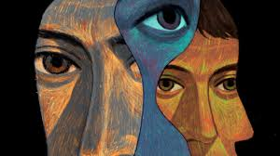
TRANSFERENCE
Transference is the sum of the feelings that a patient has about the therapist. Some of those feelings are about the patient’s here-and-now experience of the therapist, while others relate to feelings the person had for people in the past that are now displaced onto the therapist.

Slide 79
WHY DO WE CARE ABOUT TRANSFERENCE?
In psychodynamic psychotherapy, transference feelings are a way to learn about the important relationships in a patient’s life. If patients react to us in certain ways, we can bet that they react that way in other relationships as well. Making these reactions conscious and linking them to early relationships frees people up to make new choices about how to relate to others. In addition, transference reactions serve as gateways to exploring memories:

Slide 80
Example - After a session in which Mr. A began to talk about quitting his high-paying job to try his hand at writing fiction, he missed two sessions. When the therapist asked about this, Mr. A said he assumed that the therapist would try to talk him out of this idea. As they discussed this, it became clear that Mr. A made this assumption because his parents were very dismissive of artistic pursuits, and had convinced him to take a business job rather than trying to make a life as a writer.
Here, Mr. A makes an assumption about the therapist that stems from his feelings about his parents. Helping Mr. A to see that this assumption is displaced onto the therapist enables Mr. A to understand more about his expectations of people in his current life

Slide 81
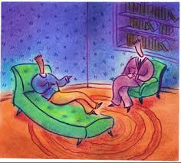
TYPES OF TRANSFERENCE
Related to affect
Related to past relationship
Displaced transference
Restitution transference

Slide 82
HOW TO INTERVENE
LISTENING AND WAIT FOR THE TIME TO INTERVENE.

Slide 83
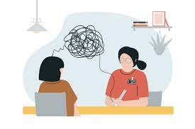
COUNTERTRANSFERENCE
When two people sit in a room and talk to each other week after week, they both have feelings about each other. In the same way that patients have feelings about their therapists, which we call transference, therapists have feelings about their patients, which we call countertransference. Countertransference is the sum of the feelings therapists have about their patients (both conscious and unconscious)

Slide 84
WHY DO WE CARE ABOUT COUNTERTRANSFERENCE?
Understanding our countertransference is important for many reasons:
Acknowledging and understanding our feelings about patients decreases the chances that we will act on those feelings: It is inevitable that in the course of working with patients we will have a range of feelings toward them, including anger, irritation, affection, and boredom. The more aware we are of these feelings and of the potential reasons for them, the less likely we are to unconsciously act on them.
Consider these two situations: Therapist #1 fights against acknowledging his boredom with his patient and begins to consistently fall asleep in sessions. Therapist #2 acknowledges his boredom with his patient. He discusses this with a supervisor and realizes that it is related to a resistance preventing the patient from engaging with him.
The therapist becomes more attentive in sessions as he reflects on the patient’s conflict.

Slide 85
Countertransference helps us to diagnose, assess, and treat our patients: Having very strong positive or negative feelings about patients helps us to recognize the predominance of splitting-based defenses. Understanding our feelings about patients during sessions helps us to recognize many aspects of our patients’ functioning, including defenses and their ways of relating to other people.
• Countertransference helps guide our interventions in a moment-to-moment way by helping us recognize what is important in the session.

Slide 86
Countertransference helps us learn more about ourselves as we work with different patients. Some examples are:
Do you always become hopeless when patients reveal that they have an eating disorder? Do you tend to feel depressed when you talk to patients who have substance abuse problems? Do you dread seeing patients who are taking medications? Acknowledging your reactions to patients will help you understand yourself as a therapist and make career decisions that will enable you to do the work you most enjoy.

Slide 87

INTERPRETATION
TIME
NOT ALWAYS THE EXACT ONE
BE CAREFUL ABOUT YOUR LANGUAGE
BE CONNECTED WITH THE CLIENT TO KNOW IF HE/SHE IS READY FOR THE INTERPRETATION.

Slide 88
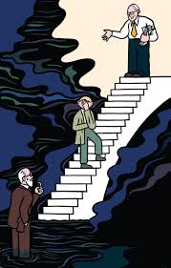
WORKING THROUGH
It is the most important psychic and emotional process and work, that is required for therapeutic process to effect meaningful internal change.
A capacity finally achieved within the individual to balance emotions, to accept the unconscious desires and self to a certain extent, capacity to self analyse and development of self soothing capacities.

Slide 89
HOW IN ANALYSIS WE REALIZE?
The person’s capacity to deal with challenges
How far she/he can experience her/his emotions and deal with it
Automatically involve in some coping skills
Even after breaking down he/she been able to sum himself/herself up
Nature of dream changes
Resistances lower down.
Reasonable ego develops.
Emergence of new emotions and thoughts
Not using too many immature defenses.

Slide 90
SO TO SUM UP
1. Listening
2. Free association
3. Dream Analysis
2. Empathy
3. Dealing with Resistances
4. Dealing with Transference
5. Dealing with Countertransference
6. Working through
7. Terminal phase

Slide 91
CONCLUSION
ALWAYS REMEMBER IF YOU HAVE DEVELOPED A PSYCHODYNAMIC VIEWPOINT THROUGH THIS WORKSHOP EVEN IF YOU CANNOT PRACTICE PSYCHOANALYSIS BUT YOU CAN TRY TO PERCEIVE AND APPROACH YOUR CASE THROUGH PSYCHODYNAMIC PERSPECTIVE

Slide 92
Thank you

