Slide 1
BRIEF INTERVENTIONS FOR SUBSTANCE USE
PRESENTER: Dr. Karthik Prasanna
CHAIRPERSON: Dr. Priyanka

Slide 2
Brief Intervention for Substance Use
Based on ‘The Alcohol, Smoking and Substance Involvement Screening Test (ASSIST)’ WHO manual for use in primary care
The ASSIST manual explains the theoretical basis and evidence for the effectiveness of brief interventions and assists primary health care workers in conducting a simple brief intervention for clients whose substance use is putting them at risk
Brief intervention is tailored to the specific circumstances of primary care and is designed to improve the health of populations and client groups

Slide 3
Aimed at primary health care workers
It may also be useful for others who work with high-risk clients or clients who are more likely to engage in drug use such as
hospital physicians and nurses
midwives and obstetricians
social workers
prison workers
community correction workers

Slide 4
The Alcohol, Smoking and Substance Involvement Screening Test (ASSIST) was developed mainly for drug use but can be used for other substances including alcohol and tobacco as well, particularly in high prevalence settings
It is considered as an instrument of choice when the goal is to address a range of different psychoactive substances

Slide 5
The brief intervention technique is focused predominantly on modifying behaviour of drug users
around the substance used most frequently or
the one causing the most problems for the client
(as identified by the client or by the highest ASSIST score)
The ASSIST-linked brief intervention is a short intervention lasting 3 to 15 minutes given to clients who have been administered the ASSIST by a health worker

Slide 6
ASSIST
The ASSIST (version 3.1) is an 8 item questionnaire designed to be administered by a health worker to a client using paper and pencil, and takes about 5-10 minutes to administer.
The ASSIST was designed to be culturally neutral and usable across a variety of cultures to screen for use of the following substances:
tobacco
alcohol
Cannabis
Cocaine
amphetamine-type stimulants (ATS)

Slide 7
Sedatives
Hallucinogens
Inhalants
opioids and other drugs

Slide 8
ASSIST
Determines a risk score for each substance
Lower
Moderate
High
The risk scores are recorded on the ASSIST feedback report card which is used to give personalised feedback to clients by presenting them with the scores that they have obtained, and the associated health problems related to their level of risk

Slide 9
The ASSIST obtains information from clients about
lifetime use of substances
use of substances and associated problems over the last 3 months

Slide 10
In brief the ASSIST comprises the following questions:
Question 1 (Q1) asks about which substances have ever been used in the client’s lifetime
Question 2 (Q2) asks about the frequency of substance use in the past three months, which gives an indication of the substances which are most relevant to current health status
Question 3 (Q3) asks about the frequency of experiencing a strong desire or urge to use each substance in the last three months.

Slide 11
Question 4 (Q4) asks about the frequency of health, social, legal or financial problems related to substance use in the last three months
Question 5 (Q5) asks about the frequency with which use of each substance has interfered with role responsibilities in the past three months
Question 6 (Q6) asks if anyone else has ever expressed concern about the client’s use of each substance and how recently that occurred
Question 7 (Q7) asks whether the client has ever tried to cut down or stop use of a substance, and failed in that attempt, and how recently that occurred

Slide 12
Question 8 (Q8) asks whether the client has ever injected any substance and how recently that occurred.

Slide 21
ADMINISTERING THE TEST

Slide 22
How to calculate a specific substance involvement score
For each substance (labelled ‘a’ to ‘j’) add up the scores received for questions 2 through 7 inclusive
Do not include the results from either Q1 or Q8 in this score
For example, a score for cannabis would be calculated as: Q2c + Q3c + Q4c + Q5c + Q6c + Q7c
For tobacco, Q5 is not coded, and is calculated as: Q2a + Q3a + Q4a + Q6a + Q7a

Slide 25
Rationale for brief intervention
Tobacco, alcohol and illicit drugs are among the top 20 risk factors for ill-health identified by the World Health Organisation
Tobacco is responsible for 8.7% of all deaths and for 3.7% of the DALYs
Alcohol is responsible for 3.8%of deaths and 4.5% of DALYs
Illicit drugs are responsible for 0.4% of deaths and 0.9% of DALYs
Hazardous and harmful alcohol use and other substance use also are risk factors for a wide variety of social, financial, legal and relationship problems for individuals and their families.

Slide 26
There is substantial evidence of the benefits of screening and brief intervention for alcohol problems in primary health care settings
Senft et al. (1997) showed a reduction in frequency of alcohol consumption at 6 and 12 months in hazardous drinkers who had received a 15 minutes brief intervention and self-help materials, in a primary care setting
The WHO Brief Intervention Study Group found that five minutes of simple advice was as effective as 20 minutes of counselling
Brief interventions have been shown to be a cost-effective way of reducing alcohol consumption and associated problems

Slide 27
Research suggests that brief interventions may also be effective in primary care settings for substance use other than alcohol, and evidence to date suggests that brief interventions can work for cannabis, benzodiazepines, amphetamines, opiates and cocaine
A randomized controlled trial investigating the effectiveness of a brief intervention linked to ASSIST scores for moderate risk cannabis, cocaine, amphetamine-type stimulant or opioid use was recently conducted in the framework of the WHO ASSIST project
Participants were recruited from primary health care settings and scored within the moderate risk range for at least one of these substances

Slide 28
The study was conducted between 2003 and 2007 in Australia, Brazil, India and the United States of America
The brief intervention, which focussed on the highest scoring illicit substance, lasted between 3 and 15 minutes and was based on the FRAMES model and Motivational Interviewing
Results
participants receiving a brief intervention for illicit substances demonstrated significant reduction in ASSIST scores after 3 months compared with control participants

Slide 29
Model of behaviour change

Slide 30
The model of behaviour change was developed by Prochaska and DiClemente
The aim of the ASSIST-linked brief intervention is to support people to move through one or more stages of change commencing with movement from precontemplation to contemplation to preparation (also called determination) to action and maintenance
Movement from the stage of precontemplation to contemplation may not result in a tangible decrease in substance use, how-ever it is a positive step that may result in clients moving on to the action stage at some time in the future

Slide 31
There is no set amount of time that a person will spend in each stage (may be minutes to months to years), and people also cycle back and forth between stages
Some clients may move directly from precontemplation to action following an ASSIST-linked brief intervention

Slide 32
The ASSIST-linked brief intervention is aimed predominantly at clients who are currently engaged in the least amount of change – that is
pre-contemplators and
some contemplators
The principles can also be built and expanded on for contemplators and preparers who want to change but lack the confidence and knowledge, and for clients who are in the action stage
The aim of the intervention is to help the client understand that their substance use is putting them at risk which may serve as a motivation for them to reduce or cease their substance use

Slide 33
The ASSIST-linked brief intervention is based on the FRAMES techniques and Motivational Interviewing
Brief interventions should be personalized and offered in a supportive, non judgmental manner
The ASSIST-linked brief intervention follows 10 suggested main steps
(or the first 5 steps for a shorter three minutes intervention)

Slide 34
STEPS IN BRIEF INTERVENTION
Asking clients if they are interested in seeing their questionnaire scores.
Providing personalised feedback to clients about their scores using the ASSIST feedback report card
Giving advice about how to reduce risk associated with substance use
Allowing clients to take ultimate responsibility for their choices
Asking clients how concerned they are by their scores
Weighing up the good things about using the substance against the;
Less good things about using the substance
Summarize and reflect on clients’ statements about their substance use with emphasis on the ‘less good things’
Asking clients how concerned they are by the ‘less good things’
Giving clients take-home materials to bolster the brief intervention

Slide 35
Asking clients if they are interested in seeing their questionnaire scores
The ASSIST feedback report card is completed at the end of the ASSIST interview and is used to provide personalised feedback to the client about their level of substance related risk
A good way to start the brief intervention is to ask the client:
“Are you interested in seeing how you scored on the questionnaire you just completed?”
This question is the health worker’s entrance into delivering a brief intervention

Slide 36
Phrasing the question in the correct way gives the client a choice about what happens next and immediately reduces any resistance
A positive response from the client gives the health worker permission to provide personally relevant feedback and information to the client about their scores and associated risk, and how the client can best reduce risk
It is worth noting that most clients are interested in seeing and understanding their scores

Slide 37
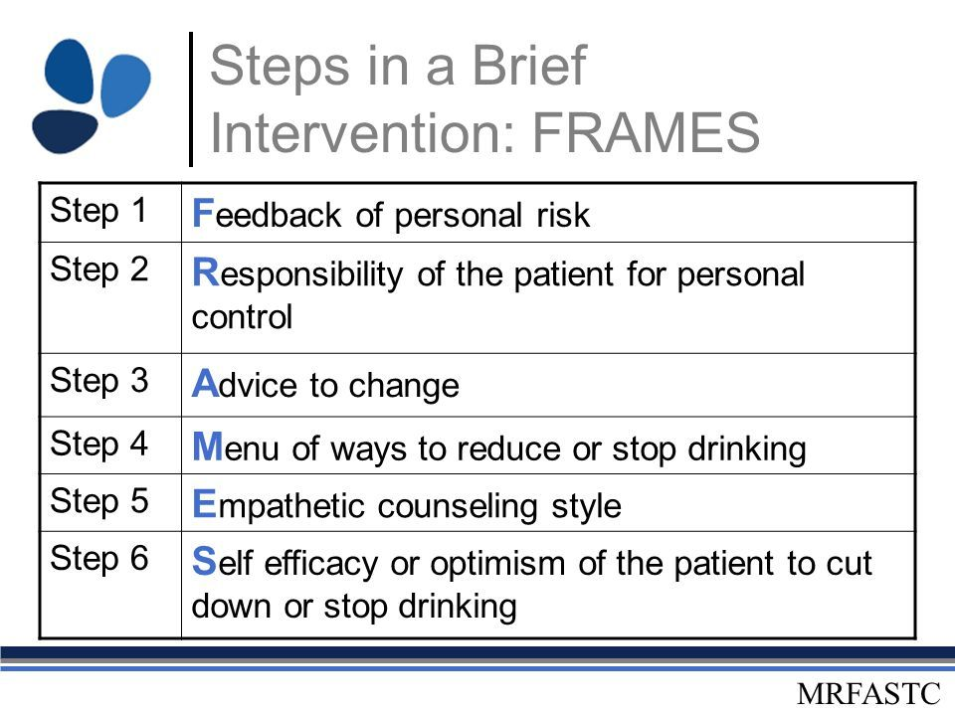
Components of brief interventions that work – FRAMES

Slide 38
Feedback
Personally relevant feedback (as opposed to general feedback)
Information about the individual’s substance use obtained from an assessment or screening (ASSIST scores)
Level of risk associated with those scores
Information about personal risks associated with a client’s current drug use patterns that have been reported during the screening
Combining all these with general information about substance related risks and harms also comprises powerful feedback

Slide 39
In short, feedback is
Provision of personally relevant information which is pertinent to the client
Delivered by the health care worker in an objective way
Can be delivered by reading directly from the ASSIST feedback report card

Slide 40
Responsibility
A key principle of intervention with substance users is to
Acknowledge and accept that they alone are responsible for their own behaviour and
Will make choices about their substance use and about the course of the brief intervention given by the health worker

Slide 41
Communicating with clients in terms such as,
“Are you interested in seeing how you scored on this questionnaire?”
“What you do with this information I’m giving you is up to you” and
“How concerned are you by your score?”
enables the client to retain personal control over their behaviour and its consequences, and the direction of the intervention. This sense of control has been found to be an important element in motivation for change and in decreasing resistance

Slide 42
Using language with clients such as, “I think you should… ”, or “I’m concerned about your (substance) use” is likely to create resistance in clients and causes them to maintain and defend their current substance use patterns

Slide 43
Advice
Provide clear objective advice regarding how to reduce the harms associated with continued use
Should be delivered in a non-judgmental manner
Make clients aware that their current pattern of substance use could lead to health or other problems or make existing problems worse
Providing clear advice that cutting down or stopping substance use will reduce their risk of future problems will increase their awareness of their personal risk and provide reasons to consider changing their behaviour

Slide 44
Advice can be summed up by delivering a simple statement such as, “The best way you can reduce your risk of (e.g. depression, anxiety, etc.) is to cut down or stop using”
The language used to deliver this message is an important feature and comments such as, “I think you should stop using (substance)” or “I’m concerned about your use of (substance)” does not comprise clear, objective advice

Slide 45
Components of brief interventions that work – Motivational Interviewing
Brief intervention is based on the motivational interviewing principles developed by Miller and further elaborated by Miller and Rollnick
MOTIVATIONAL INTERVIEWING
Client centred style of interaction
Directs people to explore and resolve their ambivalence about their substance use (the ‘good things’ versus the ‘less good things’) and
Facilitates movement through the stages of change
Especially useful when working with clients in the precontemplation and contemplation stages

Slide 46
PRINCIPLES OF MOTIVATIONAL INTERVIEWING
Based on the understanding that effective treatment assists a natural process of change
Motivation for change occurs in the context of a relationship between the client and the health care worker, even though the time spent together may be brief

Slide 47
Create discrepancy and ambivalence using open-ended questions
Clients are more likely to be motivated to change their substance use behaviour when they see a difference or discrepancy between their current substance use and related problems and the way they would like their life to be
Motivational interviewing aims to
Create a discrepancy
Then amplify the discrepancy
between current behaviour and broader goals and values from the client’s point of view

Slide 48
Client should identify their own goals and values and express their own reasons for change
Ask Open-ended Questions
Open-ended questions:
Direct clients to express their own reasons for change
Get clients to start thinking and talking about their substance use
Reinforce the notion that the client is responsible for the direction of the intervention and of their substance use choices

Slide 49
Empathy
An important principle of motivational interviewing is the expression of empathy by the health care worker to the client
Empathy comprises of
Acceptance
Non-judgmental approach
Trying to understand the client’s point of view
Avoiding the use of labels such as alcoholic or drug addict

Slide 50
The empathy of the health worker is an important contributor to how well the client responds to the intervention
Avoid
confrontation and
Blaming/ criticism
Skilful reflective listening
Clarifies and amplifies the person’s own experience and meaning
It is a fundamental part of expressing empathy

Slide 51
Reflective listening
A reflective listening response is a statement guessing at what the client means
Reflect back the underlying meanings and feelings the client has expressed as well as the words they have used
Using reflective listening is like being a mirror for the person so that they can hear the health worker say what they have communicated
Reflective listening shows the client that the health worker understands what has been said or it can be used to clarify what the client means

Slide 52
Roll with resistance
key principles:
Accept that ambivalence and resistance to change is normal
Invite the client to consider new information and perspectives on their substance use
When the client expresses resistance:
Health worker should reframe it or reflect it rather than oppose it
Avoid arguing in favour of change as this puts the client in the position of arguing against it
Within the context of an ASSIST-linked brief intervention the opportunities for the expression of resistance by clients are few

Slide 53
Summarising
Way of gathering together what has already been said and preparing the client to move on
Health worker can then choose, to some degree, what to include in the summary and can use it to redirect the client to consider further the less good things about their substance use
Summarising adds to the power of reflective listening particularly in relation to concerns and change talk

Slide 54
First, clients hear themselves say it, then they hear the therapist reflect it, and then they hear it again in the summary
Summarizing is used to highlight the client’s ambivalence about their substance use and to steer the client towards a greater recognition of their problems and concerns

Slide 55
Asking clients how concerned they are by ‘less good things’
This is another open-ended question similar to the one asked in Step 5 regarding concern about the ASSIST score
The question could be phrased like:
“Do the less good things concern you? How?”
While it is similar to a previous question, it serves to strengthen change-thought in the client and provides a platform for health workers to take the brief intervention further if time is available

Slide 56
Giving clients take-home materials to bolster the brief intervention
In brief, there are 3 to 4 items that should be given to clients upon the completion of the brief intervention session.
These are:
ASSIST feedback report card
General information pamphlets on the substance(s) being used by the client (obtained from the relevant agency)
Self-help strategies for cutting down or stopping substance use: a guide 30 booklet
Risks of injecting card (if relevant)

Slide 57
The written information can strengthen and consolidate the effects of the brief intervention, if they are read by the client
They also can serve as a secondary outreach if read by friends and family of the client, who also may be using substances

Slide 58
Points to remember for the health care worker administering the ASSIST-linked brief intervention
Brief Intervention should be objective
Act a conduit for the delivery of information pertinent to that client
Be empathetic and non-judgemental
Respect the client’s choices regarding the decisions they make about their drug use; and the choices they make during the course of the brief intervention

Slide 59
Show the client that they are listening and not dismissive of the client’s responses
Do not argue with the client
Use respectful language toward the client and treats the client as an equal
Use open-ended questions to direct conversation in the direction of self-discovery for the client and ultimately towards change

Slide 60
High risk and injecting clients
Clients who have been injecting drugs regularly over the last three months
Clients whose ASSIST scores are in the ‘high’ risk range (‘27 or higher’) for any substance
require more than just the brief intervention
However, the brief intervention including the take-home materials still should be given to these clients as a means of motivating them to seek further treatment

Slide 61
A brief intervention for these clients will take at least 15 minutes given the seriousness of the problem
If the client has tried unsuccessfully to cut down or stop their substance use in the past, discuss these past attempts
High risk clients need further Assessment and preferably referral for further treatment

Slide 62
Injecting Clients
Discuss about increased risk of
Dependence
overdose
psychosis
local and systemic infections
abscesses and ulcers
Collapsed veins
communicable diseases such as hepatitis B and C and HIV/AIDS

Slide 63
Harm minimisation strategies
Clients who choose to continue to inject should be informed of appropriate harm minimisation strategies
Not sharing injecting equipment
Hygiene around injecting
Avoiding the use of other substances at the same time – especially alcohol and sedatives
Letting a friend know when you are going to use in case of overdose
Learning first aid and resuscitation techniques
Having a small amount to start with to check the purity of the substance being used

Slide 64
Clients should also be informed of
where they can access clean needles (or how to clean existing needles if unavailable)
how to safely dispose of their used needles

Slide 65
Longer interventions for Addressing multiple substance use
A scenario in which health workers may wish to spend longer with their clients is to address multiple substance use
Polydrug use, particularly that of tobacco, alcohol, cannabis, amphetamine-type stimulants, cocaine, opioids is fairly common among clients
Suggested Variations
Feedback should be given on all substances scoring in the moderate or high risk range

Slide 66
Focus of the intervention should be directed toward the substance(s) that are creating the most problems for the client or is of most concern to the client
Take home materials for all the substances should be provided

Slide 67
References
The Alcohol, Smoking and Substance Involvement Screening Test (ASSIST): manual for use in primary care / prepared by R. Humeniuk… [et al]
The ASSIST-linked brief intervention for hazardous and harmful substance use: manual for use in primary care / prepared by R. Humeniuk… [et al]
WHO Brief Intervention Study Group (1996). A randomised cross-national clinical trial of brief interventions with heavy drinkers. American Journal of Public Health, 86 (7):948-955

Slide 68
THANK YOU

