Slide 1
RELAXATION TRAINING, PROGRESSIVE MUSCLE RELAXATION AND VISUALIZATION
Sayantani Mukherjee
Clinical Psychologist in Emotion of Life

Slide 2

Why Anxiety affects our physiology if we are apprehensive in our mind?

Slide 3

Let us understand how body plays its role during Anxiety

Slide 4
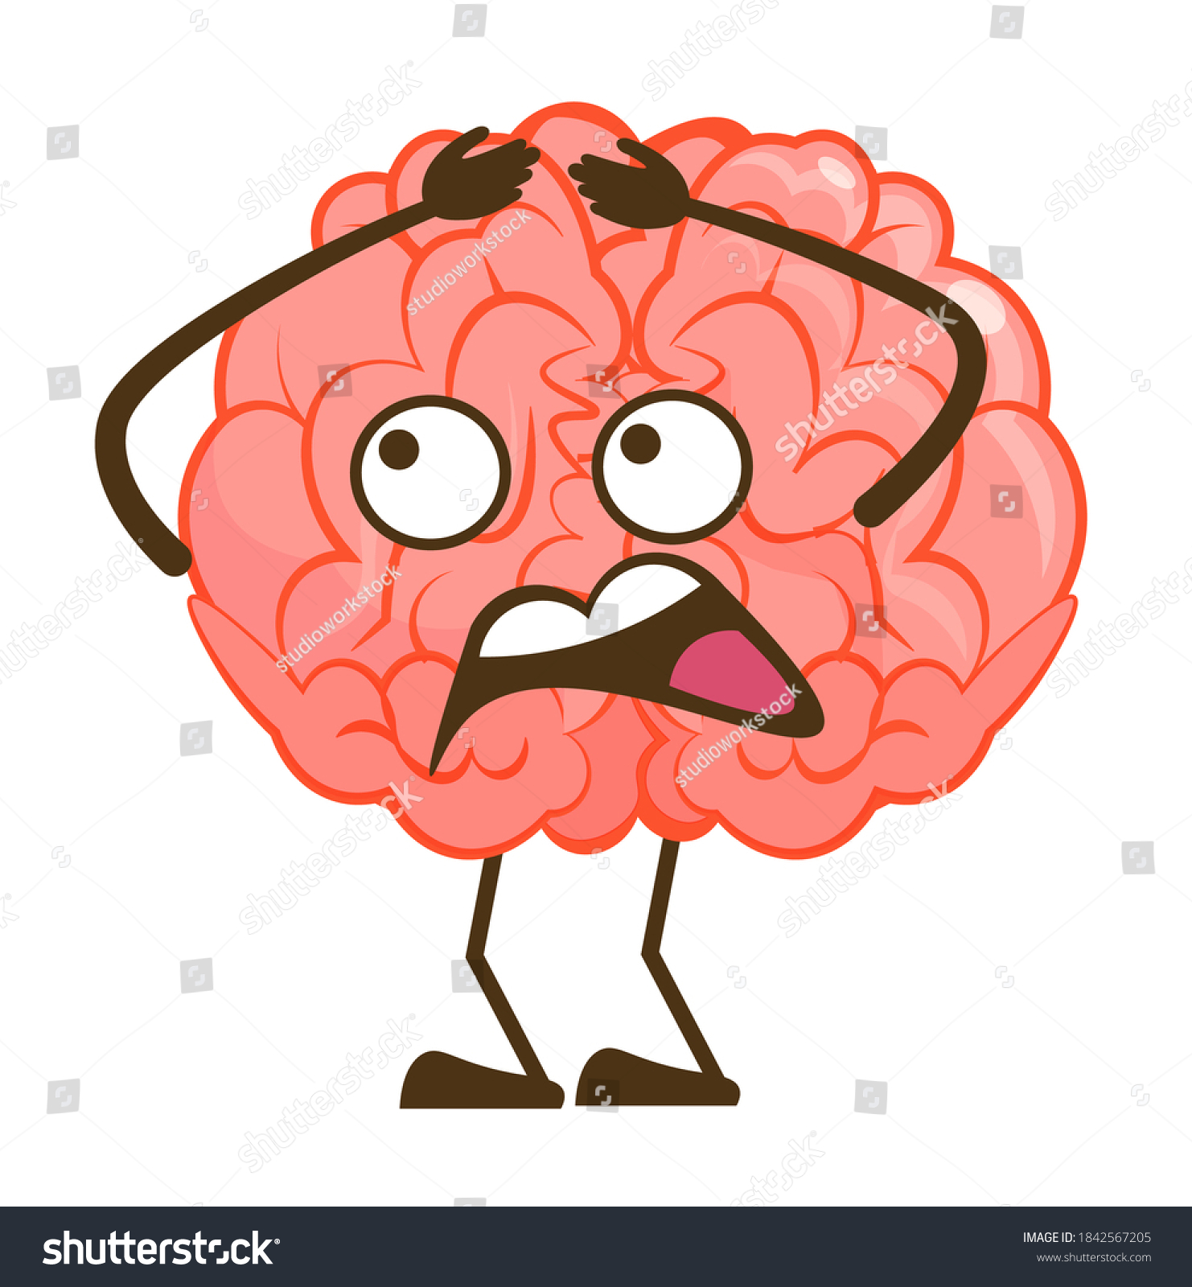
BRAIN ONLY UNDERSTANDS DANGER- How, why, worth it or not, who cares?

Slide 5
AUTONOMIC NERVOUS SYSTEM
SYMPATHETIC
PARASYMPATHETIC

Slide 6
The autonomic nervous system has two components, the sympathetic nervous system and the parasympathetic nervous system.
The sympathetic nervous system functions like a gas pedal in a car. It triggers the fight-or-flight response, providing the body with a burst of energy so that it can respond to perceived dangers.
The parasympathetic nervous system acts like a brake. It promotes the "rest and digest" response that calms the body down after the danger has passed.

Slide 7
PHYSIOLOGY OF STRESS RESPONSE
When someone experiences a stressful event, the amygdala, an area of the brain that contributes to emotional processing, sends a distress signal to the hypothalamus. This area of the brain functions like a command center, communicating with the rest of the body through the nervous system so that the person has the energy to fight or flight.
The hypothalamus communicates with the rest of the body through the autonomic nervous system, which controls involuntary body functions such as breathing, blood pressure, heartbeat, and the dilation or constriction of key blood vessels and small airways in the lungs called bronchioles.

Slide 8
After the amygdala sends a distress signal, the hypothalamus activates the sympathetic nervous system by sending signals through the autonomic nerves to the adrenal glands.
-These glands respond by pumping the hormone epinephrine (also known as adrenaline) into the bloodstream. As epinephrine circulates through the body, it brings on a number of physiological changes.
-The person undergoing these changes also starts to breathe more rapidly. This way, the lungs can take in as much oxygen as possible with each breath. Extra oxygen is sent to the brain, increasing alertness.

Slide 9
HPA AXIS
(Hypothalamus-Pituitary- Adrenal axis)
The HPA axis relies on a series of hormonal signals to keep the sympathetic nervous system — the "gas pedal" — pressed down.
-If the brain continues to perceive something as dangerous, the hypothalamus releases corticotropin-releasing hormone (CRH), which travels to the pituitary gland, triggering the release of adrenocorticotropic hormone (ACTH). This hormone travels to the adrenal glands, prompting them to release cortisol.
-The body thus stays revved up and on high alert. When the threat passes, cortisol levels fall. The parasympathetic nervous system — the "brake" — then dampens the stress response.

Slide 10
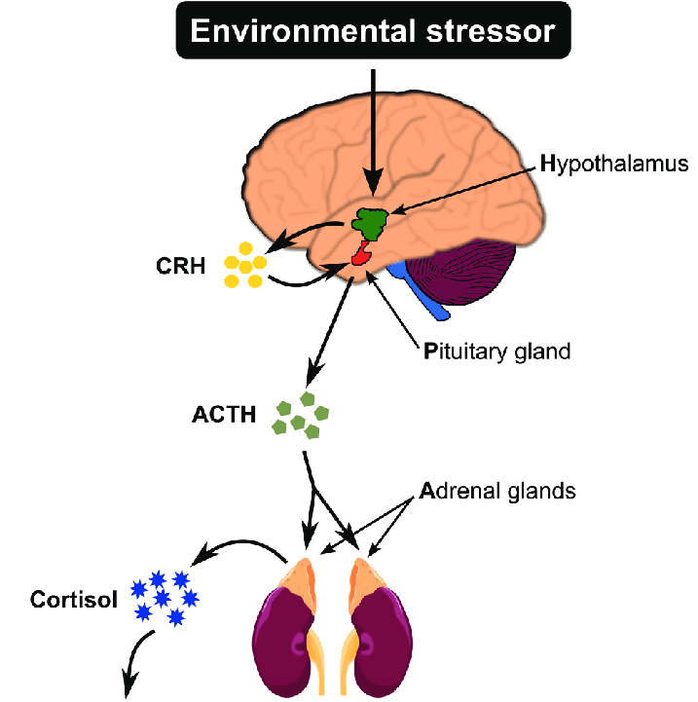

Slide 11
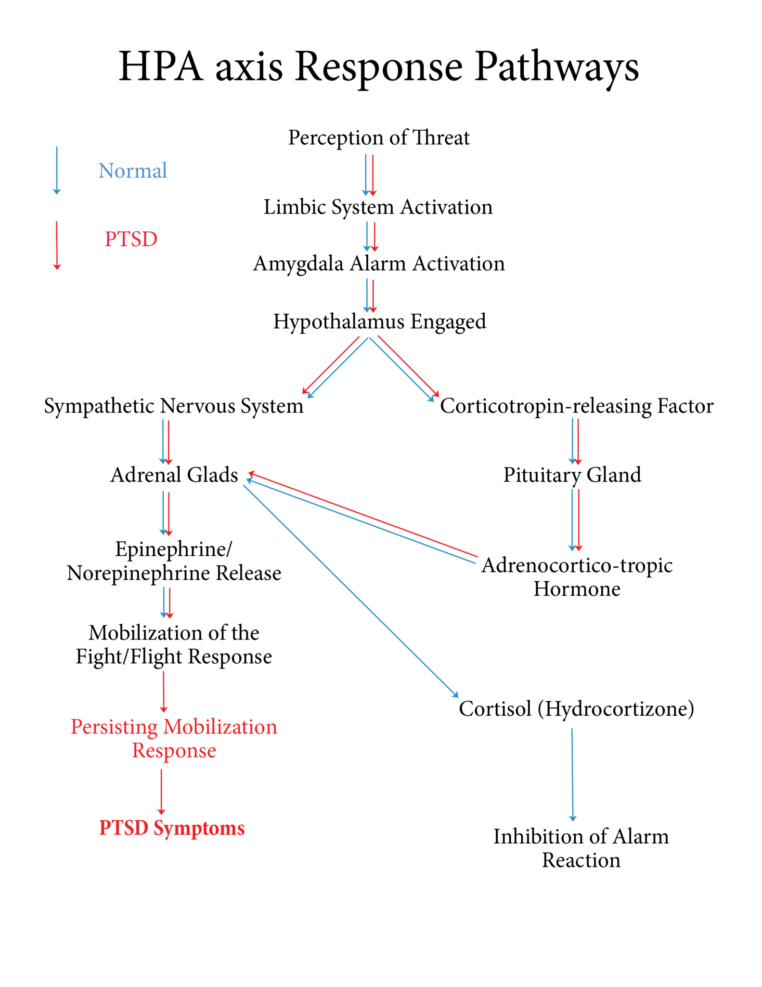

Slide 12

In CBT these are mostly the behavioral techniques used to reduce Anxiety

Slide 13
RELAXATION TECHNIQUES

Slide 14
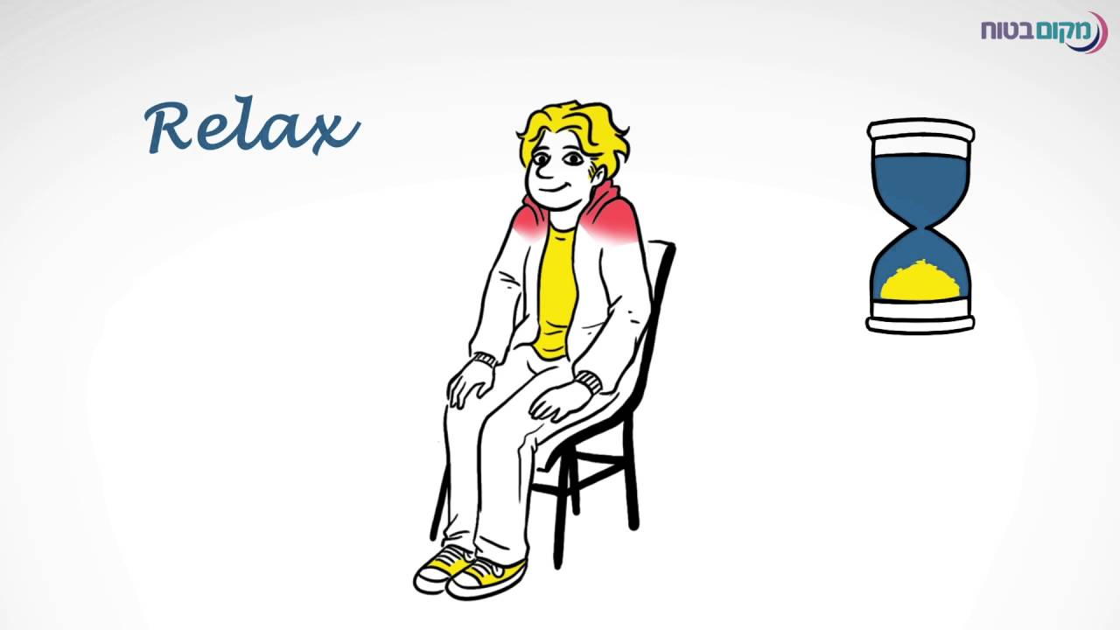
JACOBSON PROGRESSIVE MUSCLE RELAXATION
A popular technique is progressive relaxation, in which the individual is taught what it feels like to relax by comparing relaxation with muscle tension.
It was developed by Dr. Edmund Jacobson in the 1930’s. He discovered that a muscle could be relaxed by first tensing it for a few seconds and then releasing it. Tensing and releasing various muscle groups throughout the body produces a state of relaxation.
It is termed progressive because it proceeds through all major muscle groups, relaxing them one at a time, and eventually leads to total muscle relaxation.

Slide 15
PROCEDURE
Sit or lie down in a comfortable position
Lights are minimal
Wear loose clothes
Close the eyes

Slide 16
INSTRUCTION
Lets begin by tensing the muscles of the right hand by clinching your fist. Tense these muscles now. Hold it... feel the tension... feel the tightness... Let go off all the tension. Let your hand come to a comfortable position… Relax, relax, relax.”
Both hands and arms.
All facial muscles.
Chest, shoulders, upper-back, stomach.
Buttocks in both upper legs.
Both lower legs and feet

Slide 17
After termination of the procedure, the therapist should interview the client about the induction. The therapist might ask the client to indicate on a 10 point scale how he or she feels with 10 being as anxious as the client has ever felt, and 1 indicating a feeling of complete relaxation.
HOME TASK:
The therapist should then instruct the client to practise the relaxation skills once, or preferably twice a day.

Slide 18

CAUTION
Always ask your Therapist before starting the exercise.
The exercise will be avoided in certain situations like –
1. Any history of muscle spasms, back problems, injuries due to any accidents
2. Suicidal Thoughts

Slide 19
Other techniques
Deep Breathing
Body Scanning
Biofeedback etc.

Slide 20

VISUALISATION AND GUIDED IMAGERY
Imagination is always a very powerful tool.
Imagining themes and trying to experience it through our sense organs eventually calms down our body and mind.
These are mental exercises and evokes specific emotions in a client.

Slide 21
GUIDED IMAGERY
LETS DO A SAFE PLACE EXERCISE - ACTIVITY

Slide 22
CONCLUSION
Always remember… Constant anxiety is one of the defining features of modern life and the source of many common health problems. Our bodies are relatively sedentary, while our minds are forced to respond to the rapid pace of a society that never stops. The result is high levels of stress and reduced ability to cope with it. So, increased physical exercise can help, as can simple, common sense steps like taking relaxation breaks and vacations. Most relaxation techniques are enjoyable, and many healthy individuals practice them without having particular health problems.

