Slide 1
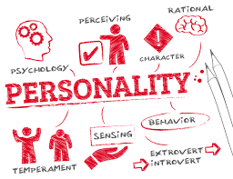
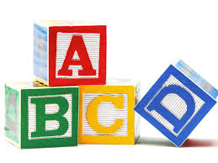
By Annjala Moni Mathews
IInd M.Sc Psychology

Slide 2

Personality is the dynamic organization within the individual of those psychophysical systems that determine his characteristics behavior and thought" (Allport, 1961, p. 28).
“The characteristics or blend of characteristics that make a person unique” (Weinberg & Gould, 1999).

Slide 3
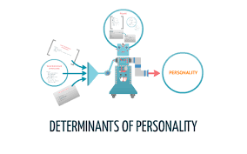

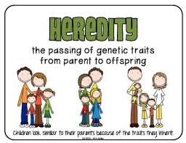





Slide 4
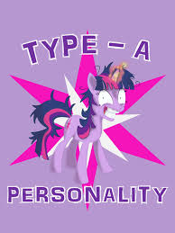
Type A personality likes to be in charge and be in control of their environment and their lives.
They’re usually very goal-oriented and practical in their solutions.
They prefer to work all alone by themselves and does not like any restrictions.

Slide 5
STRENGTHS OF TYPE A
Embraces change
Fast-paced
Entrepreneurial
Direct management style
Ambitious
Works well independently
Dominant
Good administrative skills
Highly competitive
MOTIVATION FOR TYPE A
Money
Opportunity
Freedom/independence
Favorable risk-reward ratio
Challenges
Urgency
Success
Leadership
WEAKNESS OF TYPE A
Stubborn
Workaholic
Impatient
Abrupt
Tough
Easily angered

Slide 6

President/CEO
General contractor
Salesperson or sales manager
Business owner
Politician
Entrepreneur
Police/military officer
Manager
Executive

Slide 7
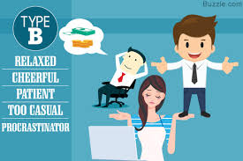
Those with type B personality are very outgoing, energetic, and fast-paced individual who likes to be around people and enjoys being the center of attention.
Their driving force is approval from other’s for which they work hard to make other’s accept them.

Slide 8
Strengths of Type B
Enthusiasm
Fun-loving
Persuasiveness
Easily liked by most people
Friendliness
Charismatic
People-oriented
People-oriented
Weakness of Type B
Too self-involved
May try to do too much at once
Impatient
Sometimes unrealistic
Trouble being alone
Motivation for Type B
Public recognition
Awards, plaques, certificates
Having picture taken with celebrities
Acceptance

Slide 9

Public relations
Salesperson
Entertainment
Personnel interviewer
Politician

Slide 10
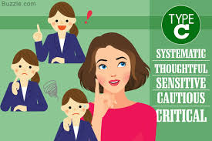
A person with Type C personality are very detail-oriented individual who likes to be involved in things that are controlled and stable.
Their main interest will be for accuracy, rationality and logic.

Slide 11
Strengths of Type C
Accuracy
Creative
Dependable
Imaginative
Independent
Detailed
Organized
Intelligent
Analytical
Critical thinker
Weakness of Type C
Worry about progress
Critical behavior
Likes to do things their own way
Motivation of Type C
Control
Opportunities to be independent and analytical
Challenges
Problem-solving

Slide 12

Engineer
Technical support
Research scientist
Game designer
Data analyst
Pilot
Inventor

Slide 13
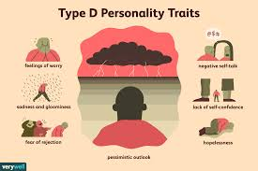
It is usually seen that type D personality usually seen to take a slower, easier pace towards the work that they are assigned of and even about their life.
They get a security in the work that they are repeting and doesn’t like if the rules changes since they don’t want to change.

Slide 14
Strength of Type D
Caring
Sincere
Compassionate
Stable
Fair and equitable
Calm
Reliable
Consistent
Weakness
Not speaking up
Easily used by others
Uncomfortable with constant change
Resistant to change
Motivation
Stability
Benefits
Security
Low risk
Routine
Team/group opportunities
Calm work atmosphere

Slide 15

Secure team position
Administrator
Financial services
HR manager
Social worker
Family doctor/nurse
Mechanic
Teacher

Slide 16
Gordon Allport (1897 – 1967) was a well-respected and influential American scholar in the psychology field. According to Allport, the personality traits are influenced by our childhood experiences, our current environment, and the interaction between them. He put forward three trait which are as follows:
Secondary traits-They’re only seen in certain situations or under specific circumstances.
For example, a person whose cardinal trait is assertiveness may show signs of submission when the police stops them for speeding. This is just a situational trait that may or may not show up during other interpersonal encounters.
Cardinal traits-
Some historical figures with strong cardinal traits are Abraham Lincoln for his honesty, Marques de Sade for his sadism, and Joan of Arc for her heroic self-service. People with such personalities are known for these traits and their names are often associated with these qualities. Allport suggested that cardinal traits are rare and tend to develop over the years.
Central traits-
Central traits are the general characteristics that form the basic foundations of personality. It seen that each person has between 5 and 10 central traits. They’re present to varying degrees in each person. These include common traits such as intelligence, shyness, and honesty.

Slide 17
Eysenck believed personality is largely governed by biology, and he viewed people as having two specific personality dimensions: extroversion vs. introversion and neuroticism vs. stability. Later collaborating with his wife and fellow personality theorist Sybil Eysenck, he added a third dimension to this model: psychoticism vs. socialization.
In the neuroticism/stability dimension, people high on neuroticism tend to be anxious; they tend to have an overactive sympathetic nervous system and even with low stress, their bodies and emotional state tend to go into a flight-or-fight reaction. In contrast, people high on stability tend to need more stimulation to activate their flight-or-fight reaction and are therefore considered more emotionally stable.
In the psychoticism/socialization dimension, people who are high on psychoticism tend to be independent thinkers, cold, nonconformist, impulsive, antisocial, and hostile. People who are high on socialization tend to have high impulse control—they are more altruistic, empathetic, cooperative, and conventional.
According to their theory, people high on the trait of extroversion are sociable and outgoing and readily connect with others, whereas people high on the trait of introversion have a higher need to be alone, engage in solitary behaviors, and limit their interactions with others.

Slide 18
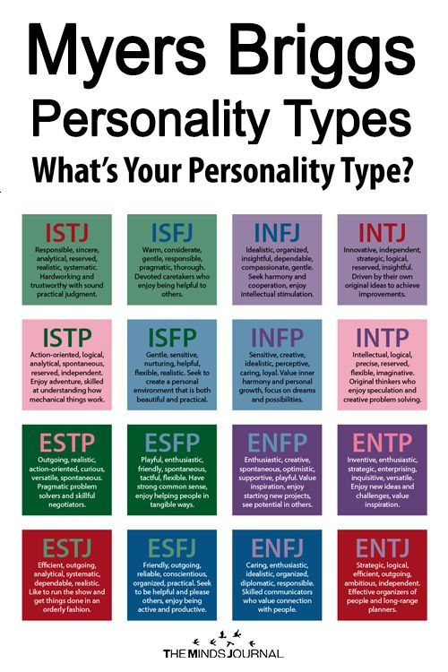

Slide 19
Jung’s 8 Personality Types
Jung formulated eight personality types, which are the basis for the Briggs Myers’ 16 personality. The eight types are:
Extraverted Thinking
Introverted Thinking
Extraverted Feeling
Introverted Feeling
Extraverted Sensation
Introverted Sensation
Extraverted Intuition
Introverted Intuition

Slide 20
Hippocrates theorized that personality traits and human behaviors are based on four separate temperaments associated with four fluids (“humors”) of the body: choleric temperament (yellow bile from the liver), melancholic temperament (black bile from the kidneys), sanguine temperament (red blood from the heart), and phlegmatic temperament (white phlegm from the lungs).
Years later, the influential Greek physician and philosopher Galen built on Hippocrates’s theory, suggesting that both diseases and personality differences could be explained by imbalances in the humors and that each person exhibits one of the four temperaments.
For example, the choleric person is passionate, ambitious, and bold; the melancholic person is reserved, anxious, and unhappy; the sanguine person is joyful, eager, and optimistic; and the phlegmatic person is calm, reliable, and thoughtful.

Slide 21
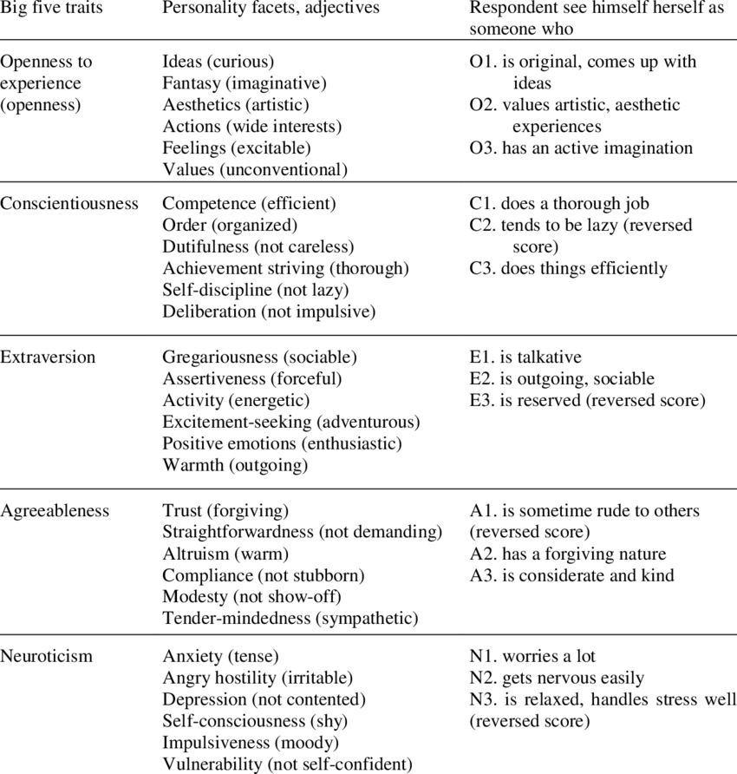

Slide 22


