Slide 1
The Butterfly Project
Community One Initiative
Temple Beth Shalom Foundation

Slide 2
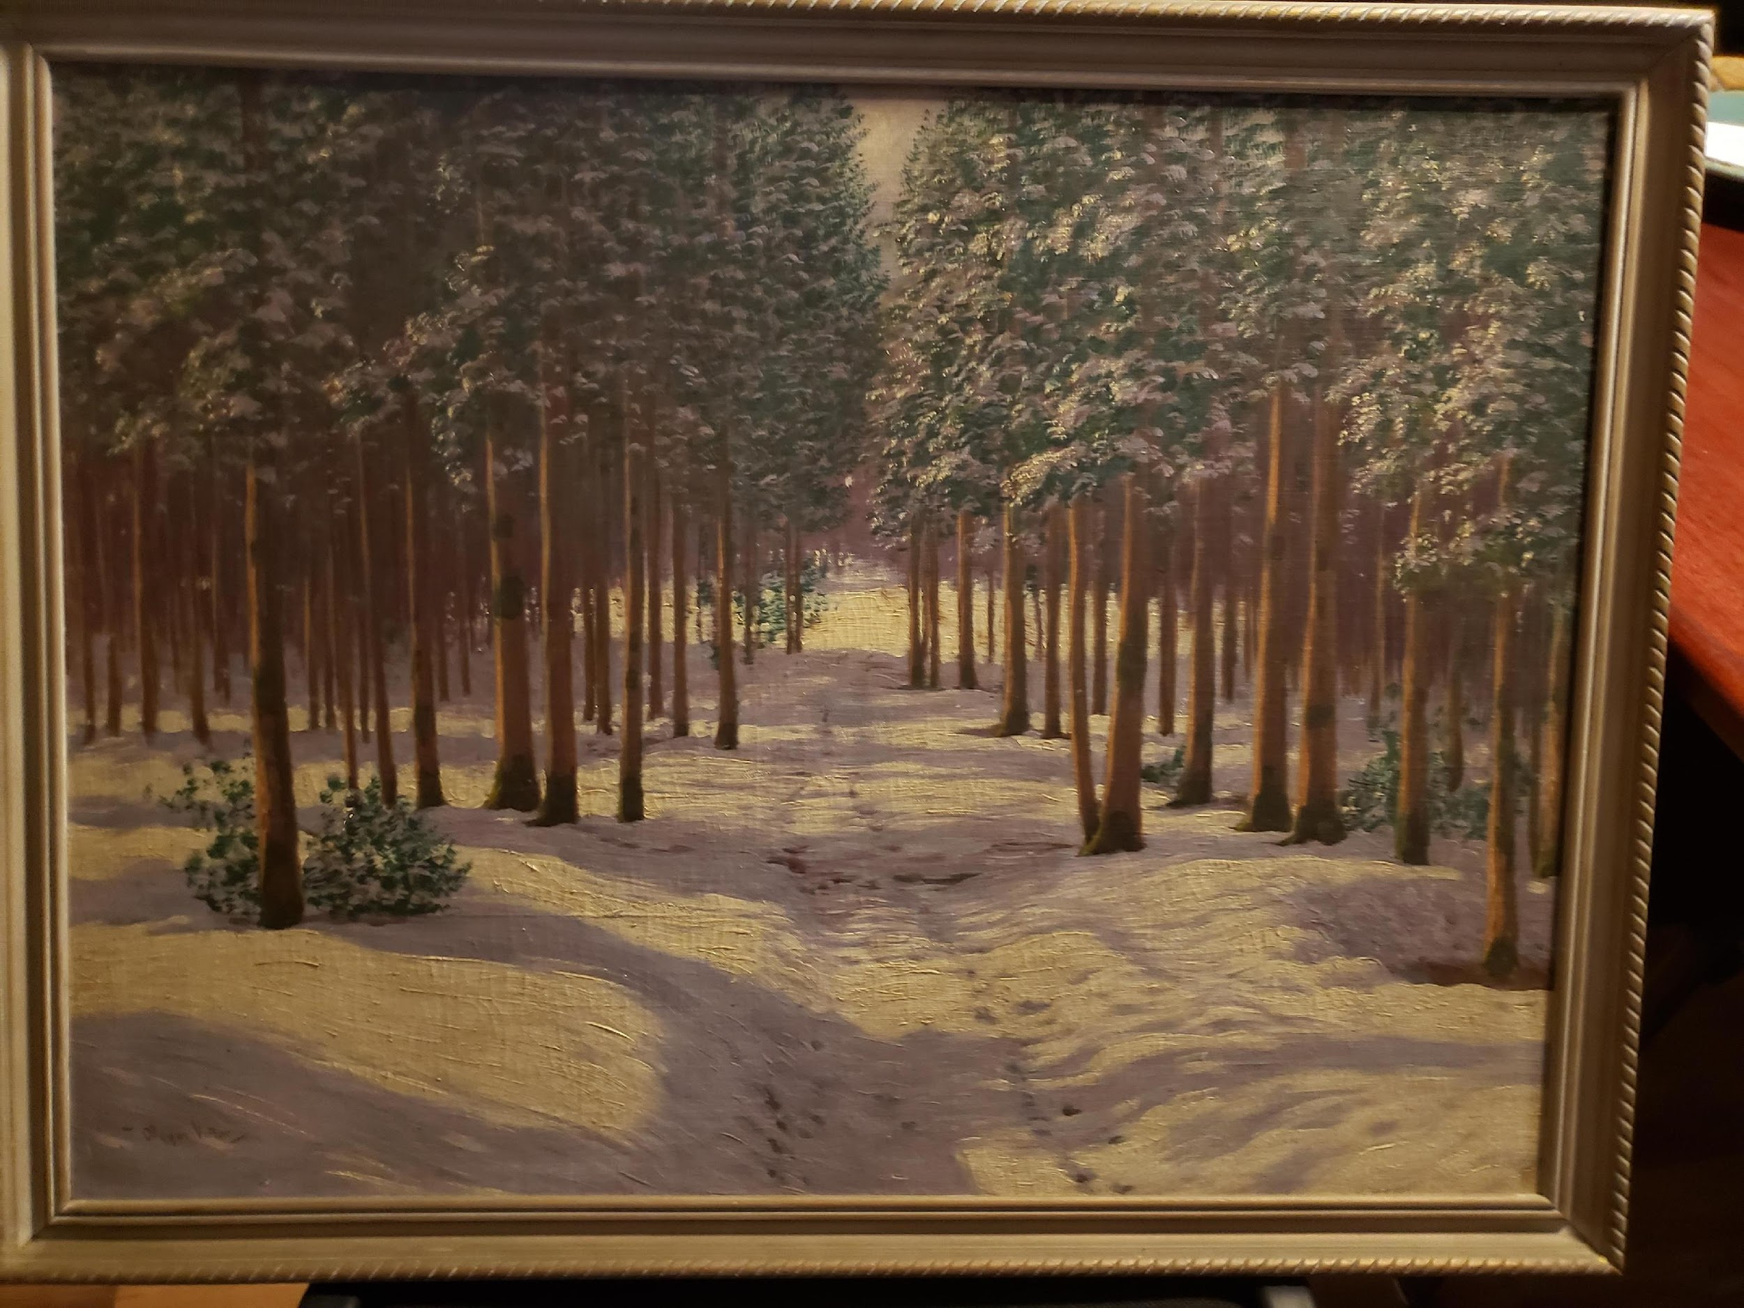

Slide 3
The Butterfly by Pavel Friedman Terezin April 1942
The last, the very last, So richly, brightly, dazzlingly yellow. Perhaps if the sun’s tears would sing against a white stone…
Such, such a yellow Is carried lightly ‘way up high. It went away I’m sure because it wished to kiss the world goodbye.
For seven weeks I’ve lived in here, penned up inside this ghetto But I have found my people here. The dandelions call to me and the white chestnut candles in the court. Only I never saw another butterfly.
That butterfly was the last one. Butterflies don’t live in here, In the ghetto.

Slide 4
Holocaust
Shoah
World War II 1939 to 1945
Nazi Germany
Adolph Hitler
Concentration Camps
6 Million
Anti-Semitism
Genocide
Yellow Stars
Scapegoat
Upstander

Slide 5
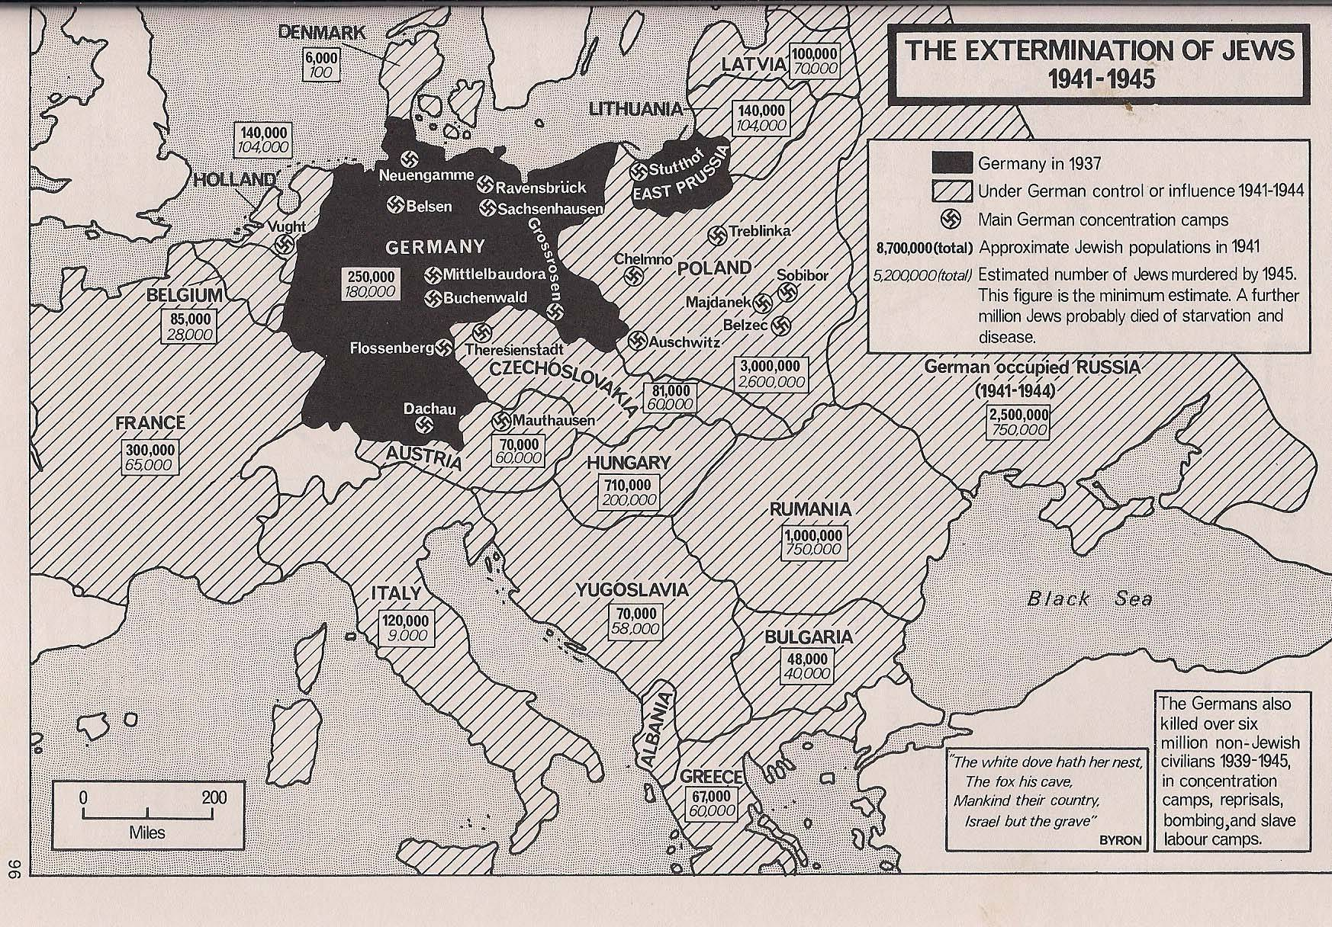
1/3 of the world Jewish population

Slide 6
Who is left Handed?

Slide 7
What does it mean to make a group a scapegoat?
How can we tell that we are focusing on a particular characteristic to demonize or attack?
What happens when scapegoating isn’t stopped?

Slide 8
Martin Neimoller
When the Nazis came for the communists, I remained silent; I was not a communist. When they locked up the social democrats, I remained silent; I was not a social democrat. When they came for the trade unionists, I did not speak out; I was not a trade unionist. When they came for the Jews, I remained silent; I wasn't a Jew. When they came for me, there was no one left to speak out.
Martin Niemöller (1892–1984) was a prominent Lutheran pastor in Germany. In the 1920s and early 1930s, he sympathized with many Nazi ideas and supported radically right-wing political movements. But after Adolf Hitler came to power in 1933, Niemöller became an outspoken critic of Hitler’s interference in the Protestant Church. He spent the last eight years of Nazi rule, from 1937 to 1945, in Nazi prisons and concentration camps. Niemöller is perhaps best remembered for his postwar statement,
https://encyclopedia.ushmm.org/content/en/article/martin-niemoeller-first-they-came-for-the-socialists

Slide 9
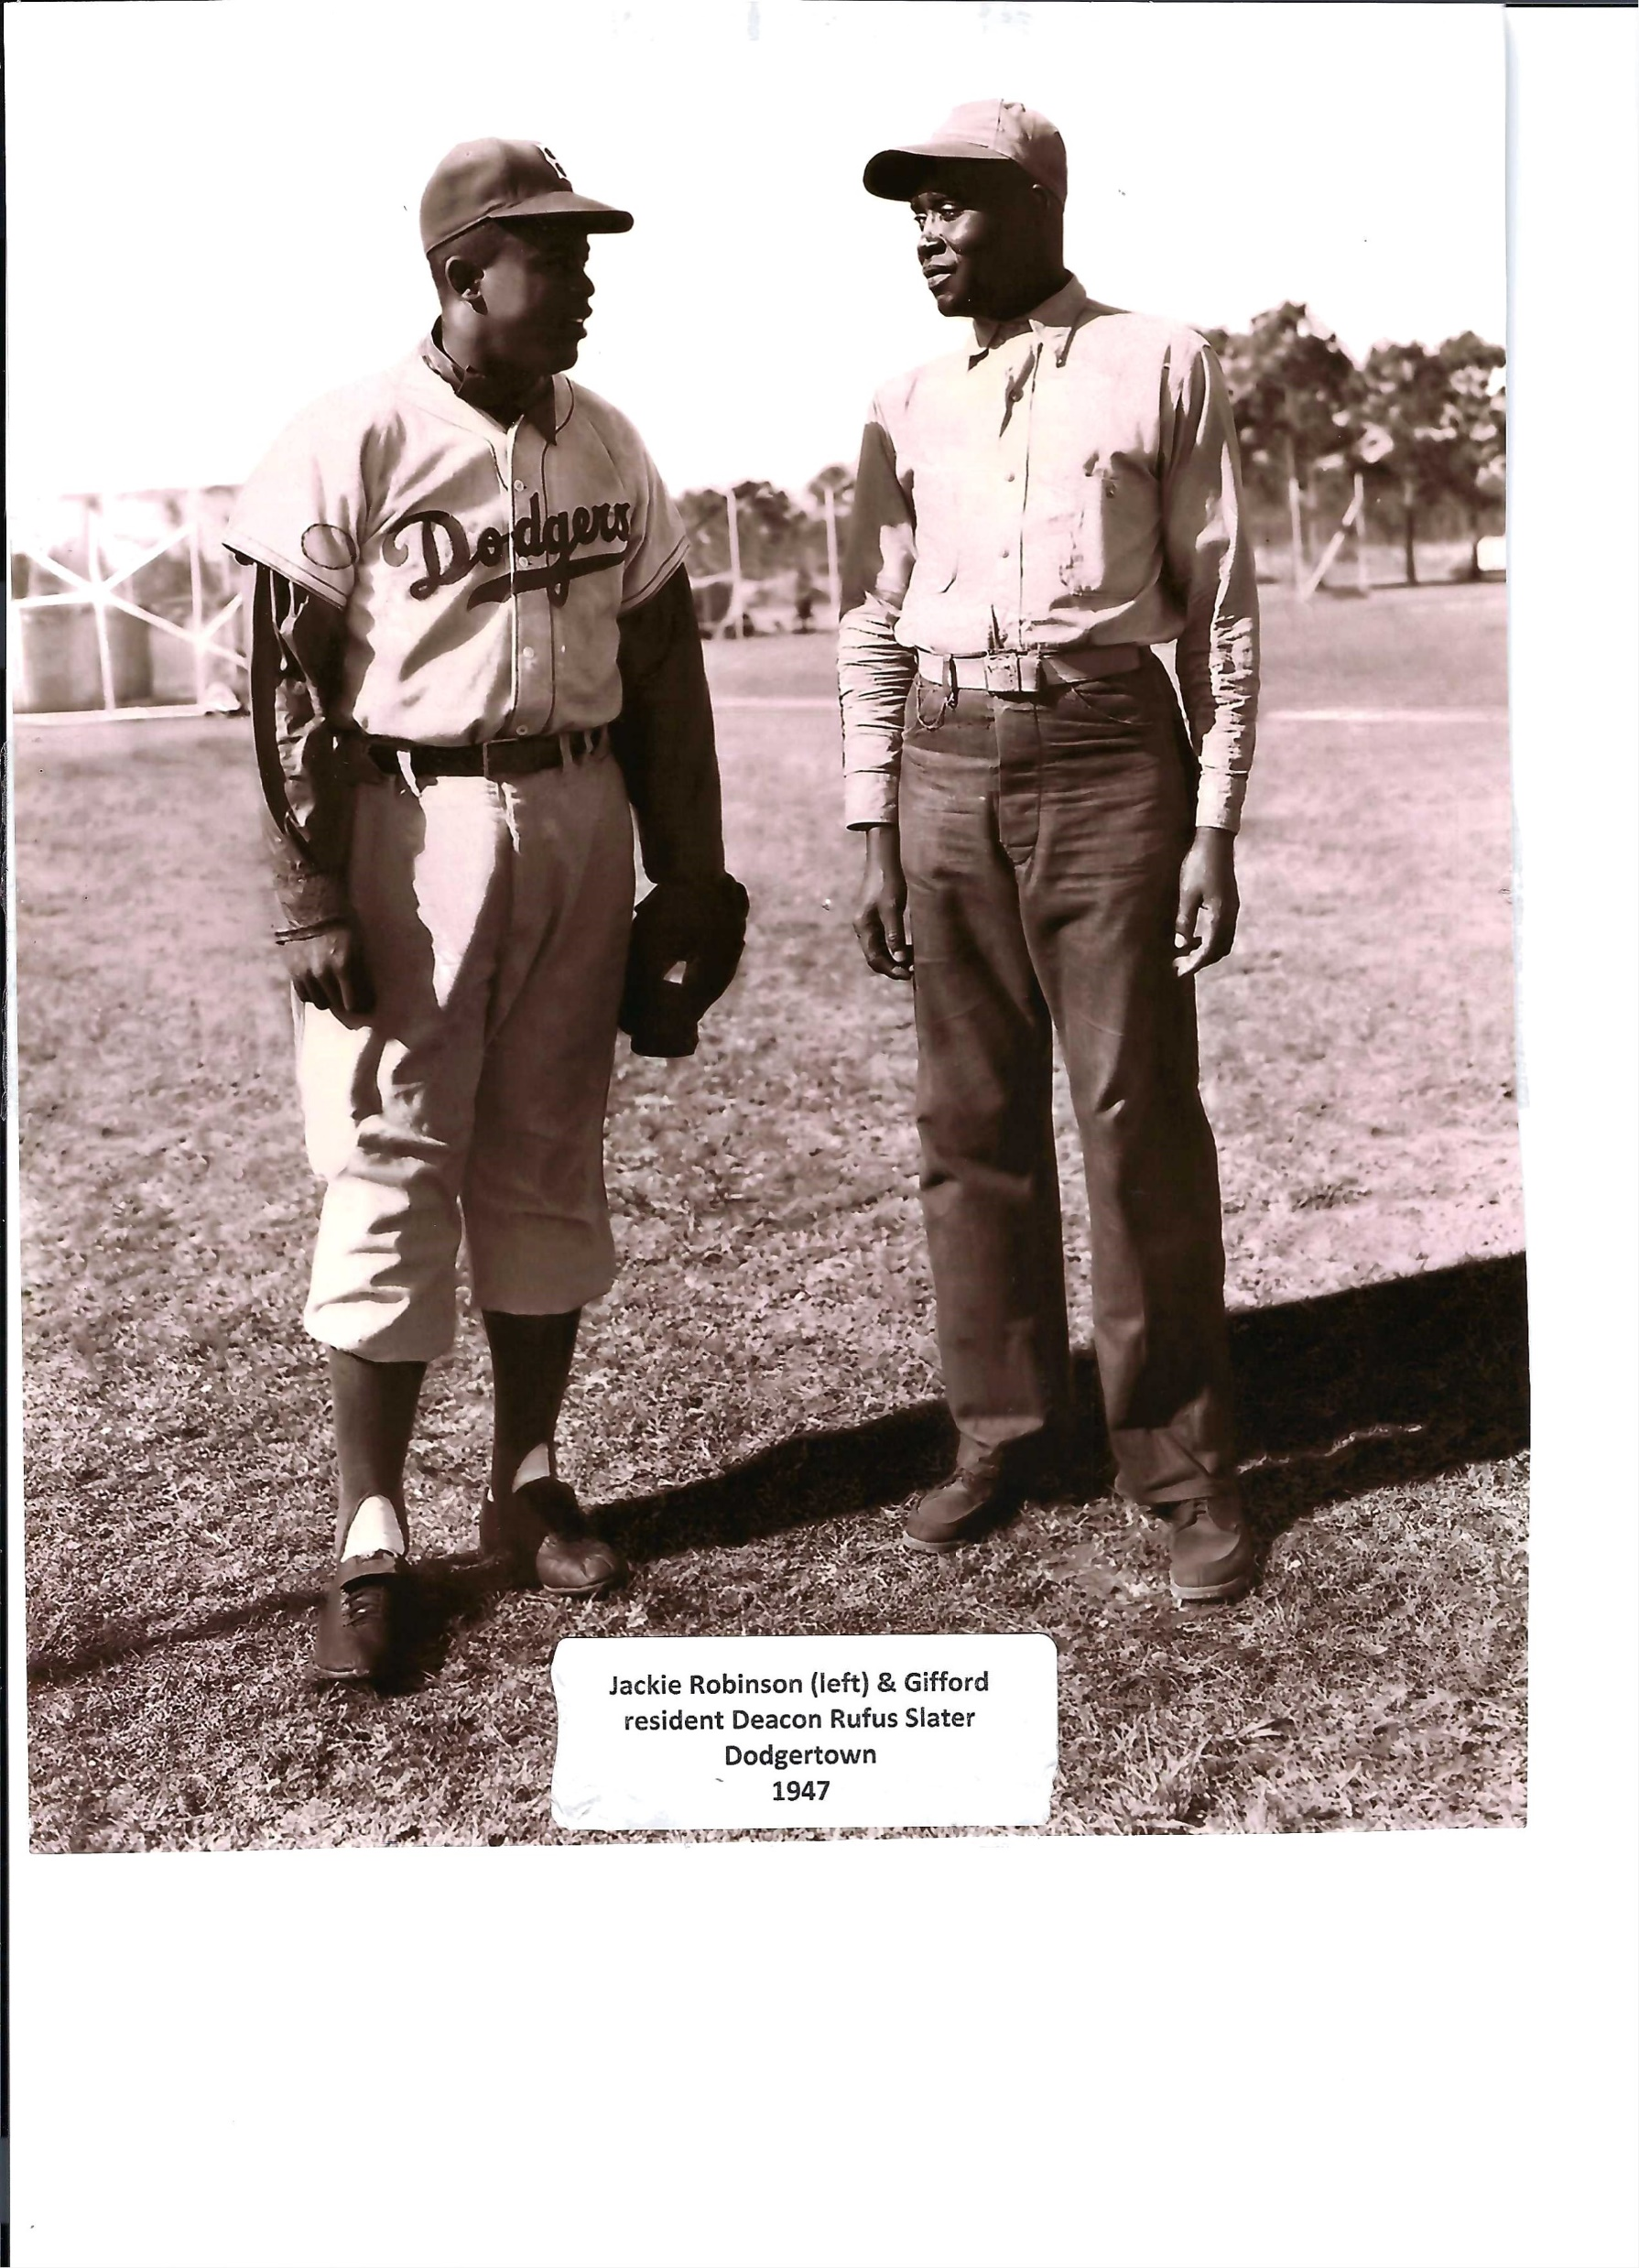

Slide 10
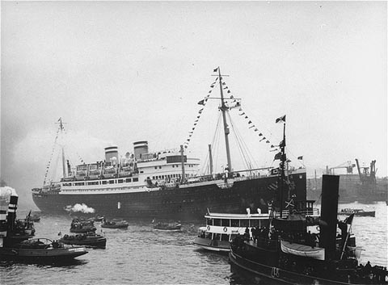
Being an Upstander!
Being a bystander!

Slide 11
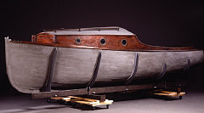
Denmark

Slide 12
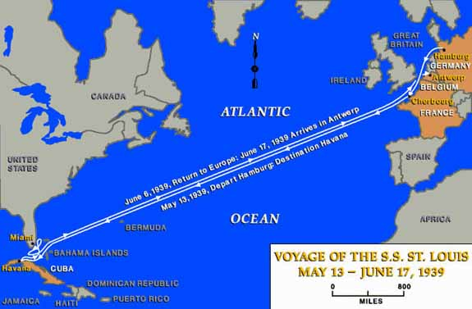

Slide 13
It’s more than just ART!
It’s an act of Kavod and Zachor. Honoring and remembering.
Pledging to be an upstander yourself and inspiring and empowering others . When they see your butterfly display to learn the story and put these values into action.

Slide 14
The Butterfly by Pavel Friedman Terezin April 1942
The last, the very last, So richly, brightly, dazzlingly yellow. Perhaps if the sun’s tears would sing against a white stone…
Such, such a yellow Is carried lightly ‘way up high. It went away I’m sure because it wished to kiss the world goodbye.
For seven weeks I’ve lived in here, penned up inside this ghetto But I have found my people here. The dandelions call to me and the white chestnut candles in the court. Only I never saw another butterfly.
That butterfly was the last one. Butterflies don’t live in here, In the ghetto.

Slide 15
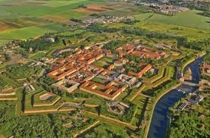
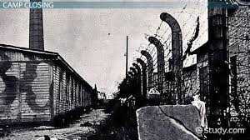

Slide 16
“In spite of everything I still believe that people are really good at heart. I simply can’t build up my hopes on a foundation consisting of confusion, misery, and death. I see the world gradually being turned into a wilderness, I hear the ever approaching thunder, which will destroy us too, I can feel the sufferings of millions and yet, if I look up into the heavens, I think that it will all come right, that this cruelty too will end, and that peace and tranquility will return again.” ― Anne Frank, The Diary of a Young Girl https://www.goodreads.com/author/quotes/3720.Anne_Frank

Slide 17
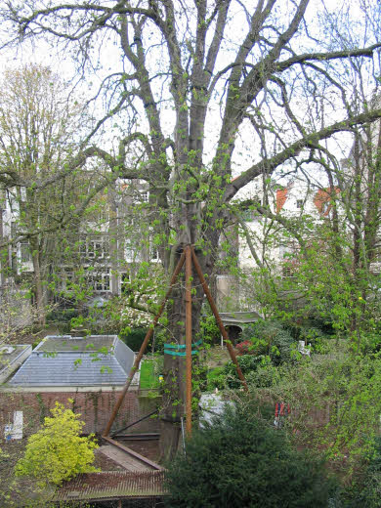
Anne Frank wrote about the tree in her diary three times.
23 February 1944
The two of us looked out at the blue sky, the bare chestnut tree glistening with dew, the seagulls and other birds glinting with silver as they swooped through the air, and we were so moved and entranced that we couldn’t speak.
18 April 1944
April is glorious, not too hot and not too cold, with occasional light showers. Our chestnut tree is in leaf, and here and there you can already see a few small blossoms.
13 May 1944
Our chestnut tree is in full bloom. It’s covered with leaves and is even more beautiful than last year.

Slide 18
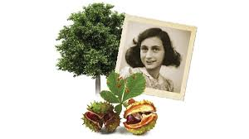
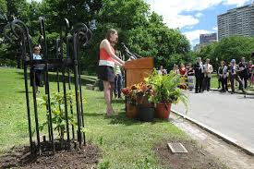

Slide 19
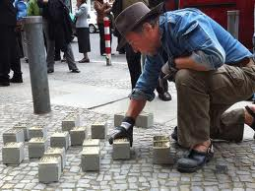
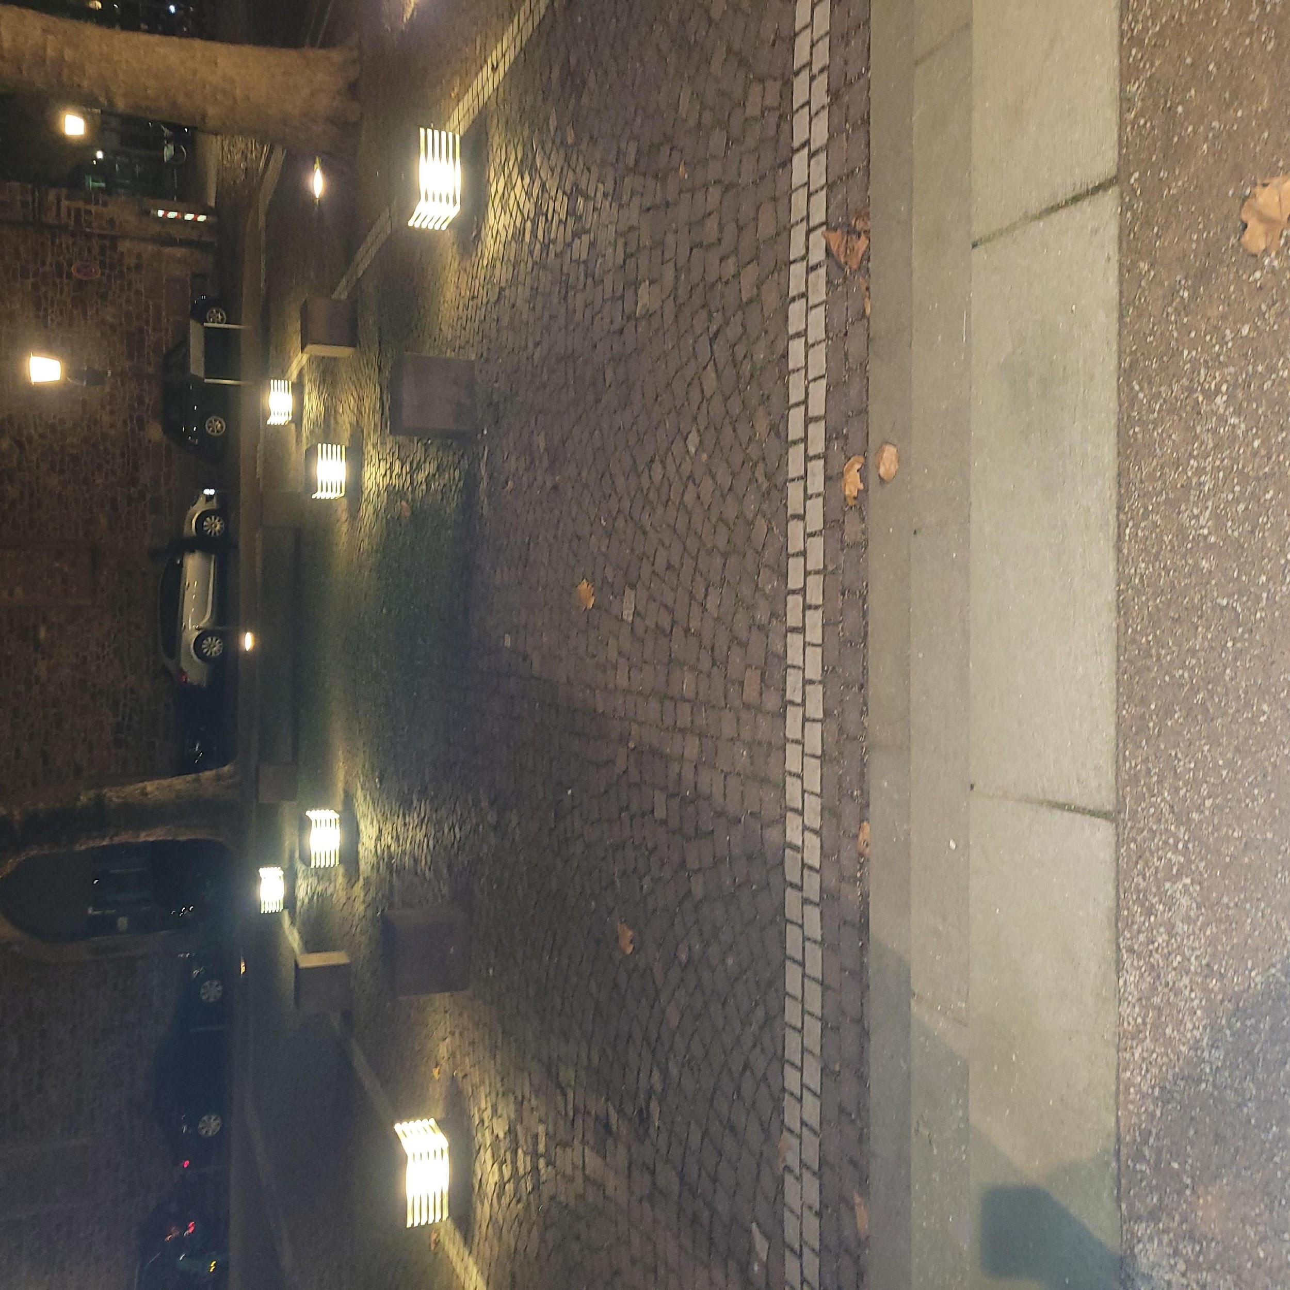
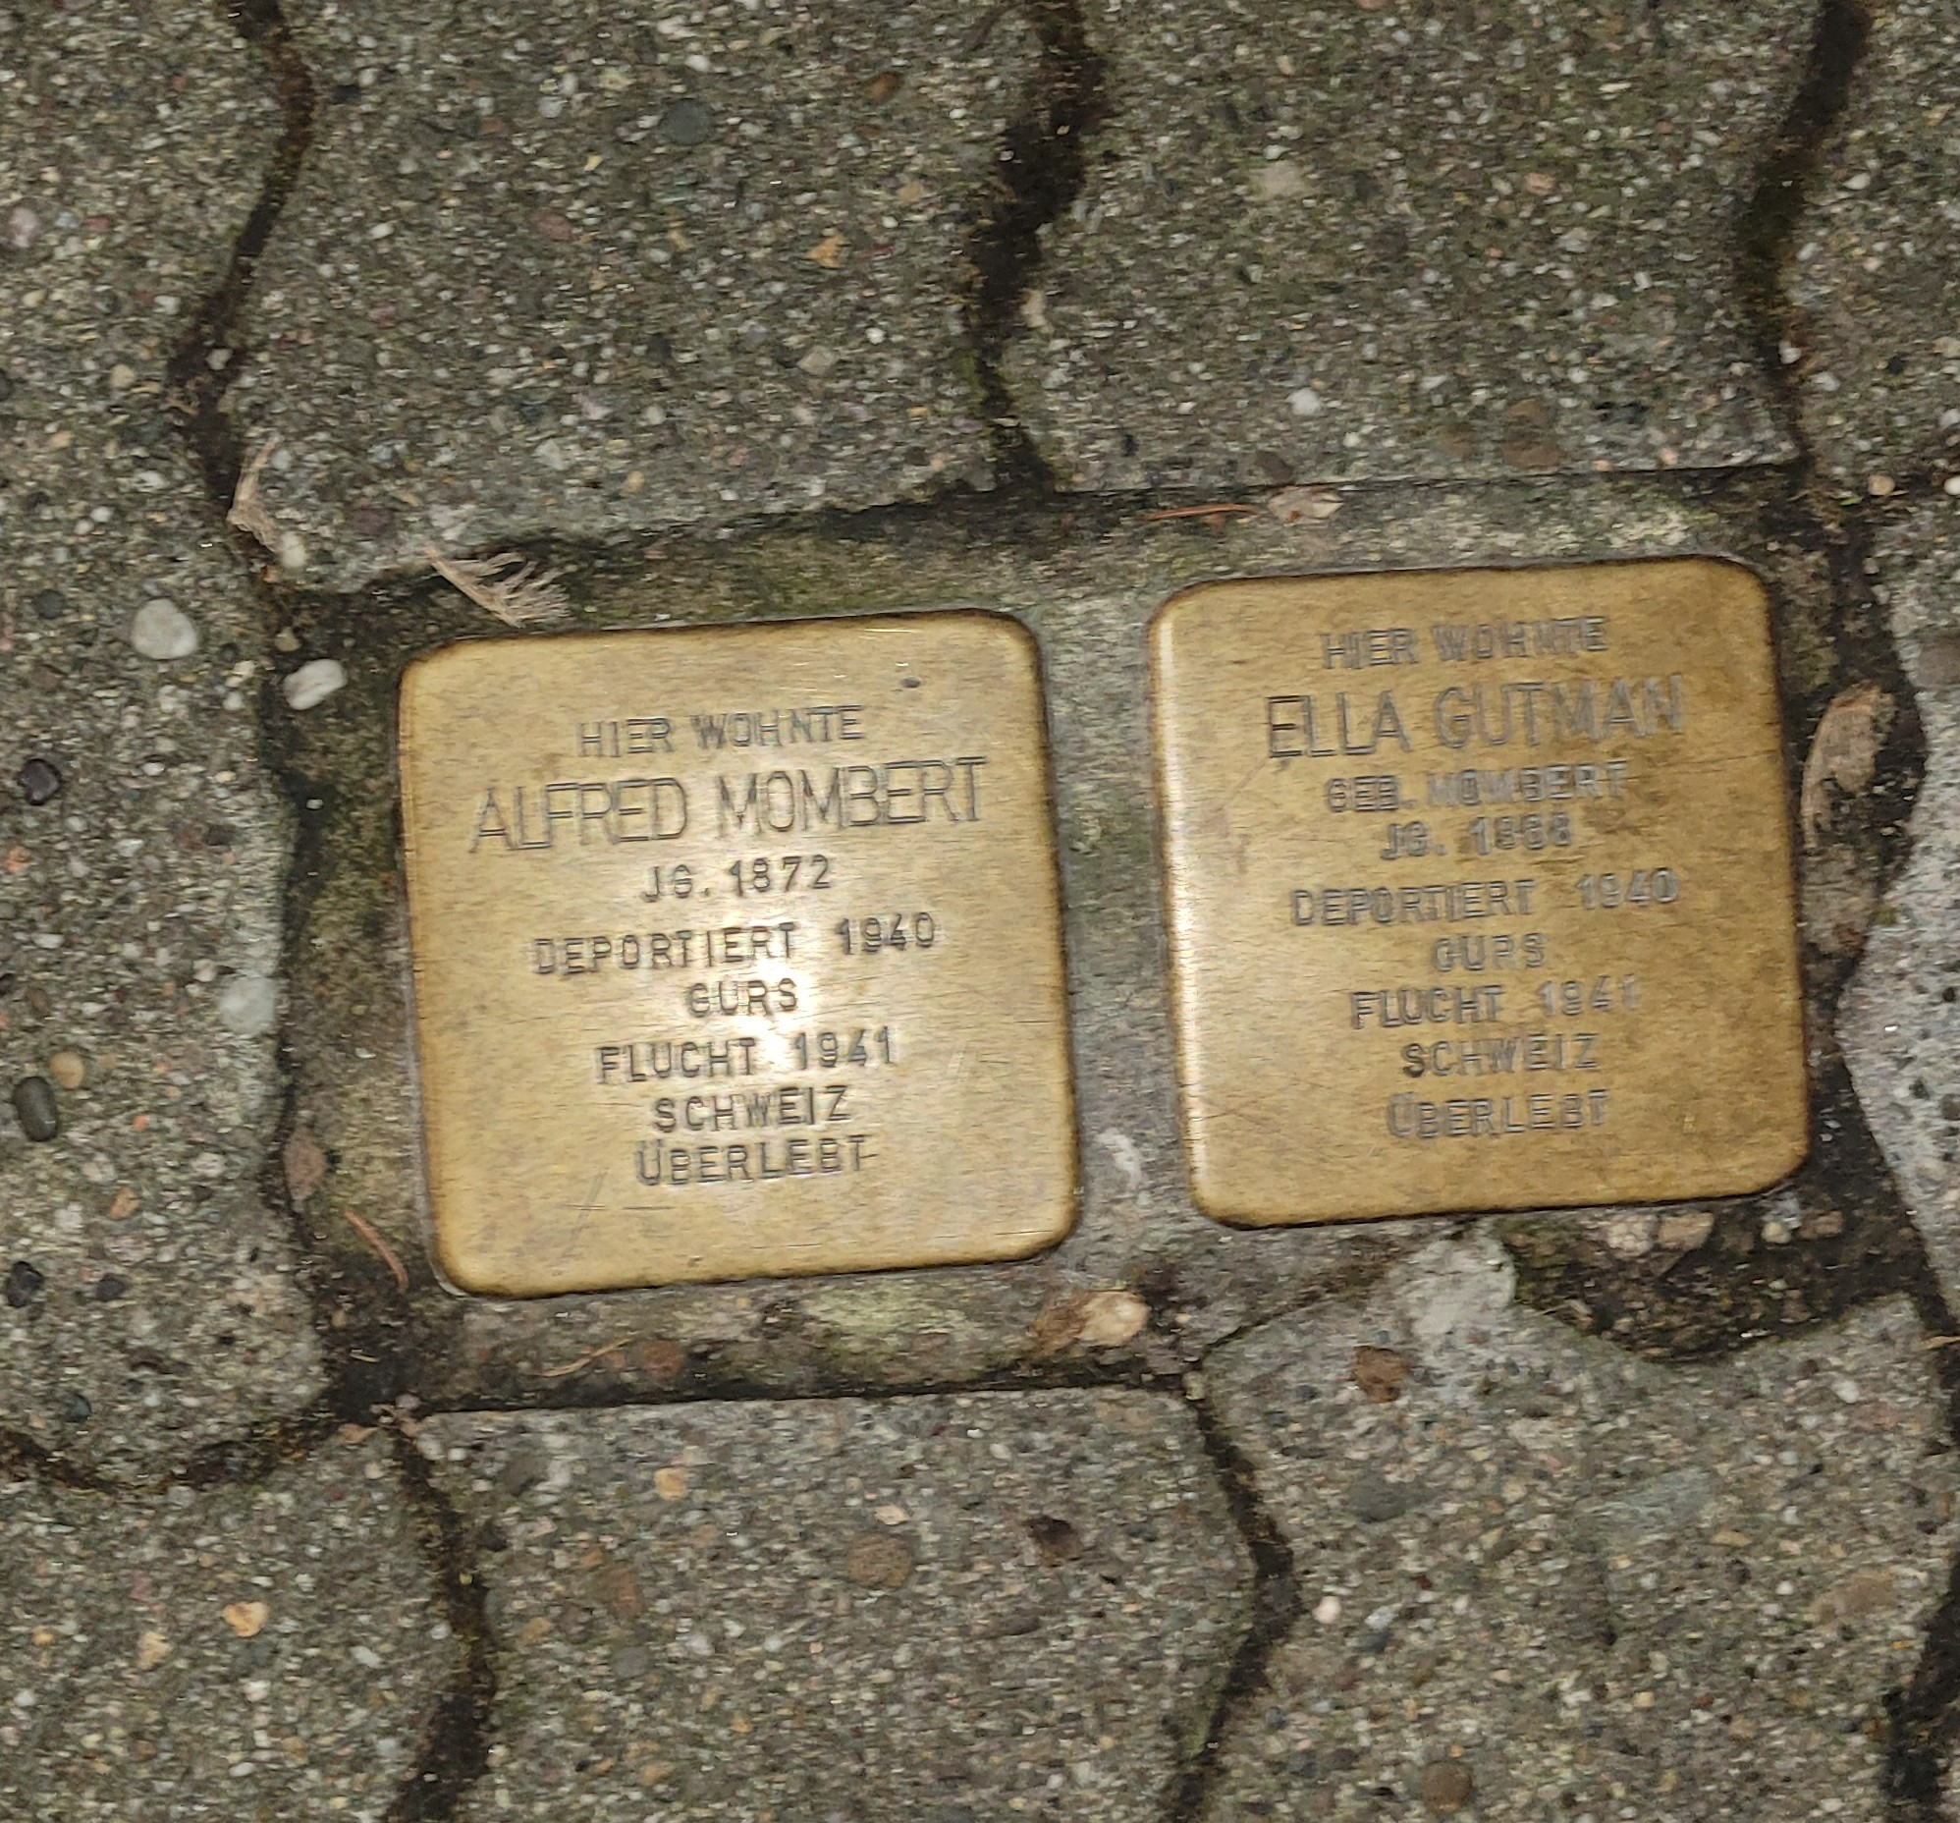
Stumble Stones and other acts of memory into action

Slide 20
