Slide 1
The Butterfly Project
Remembrance and Hope
Brought to you by:

Slide 2
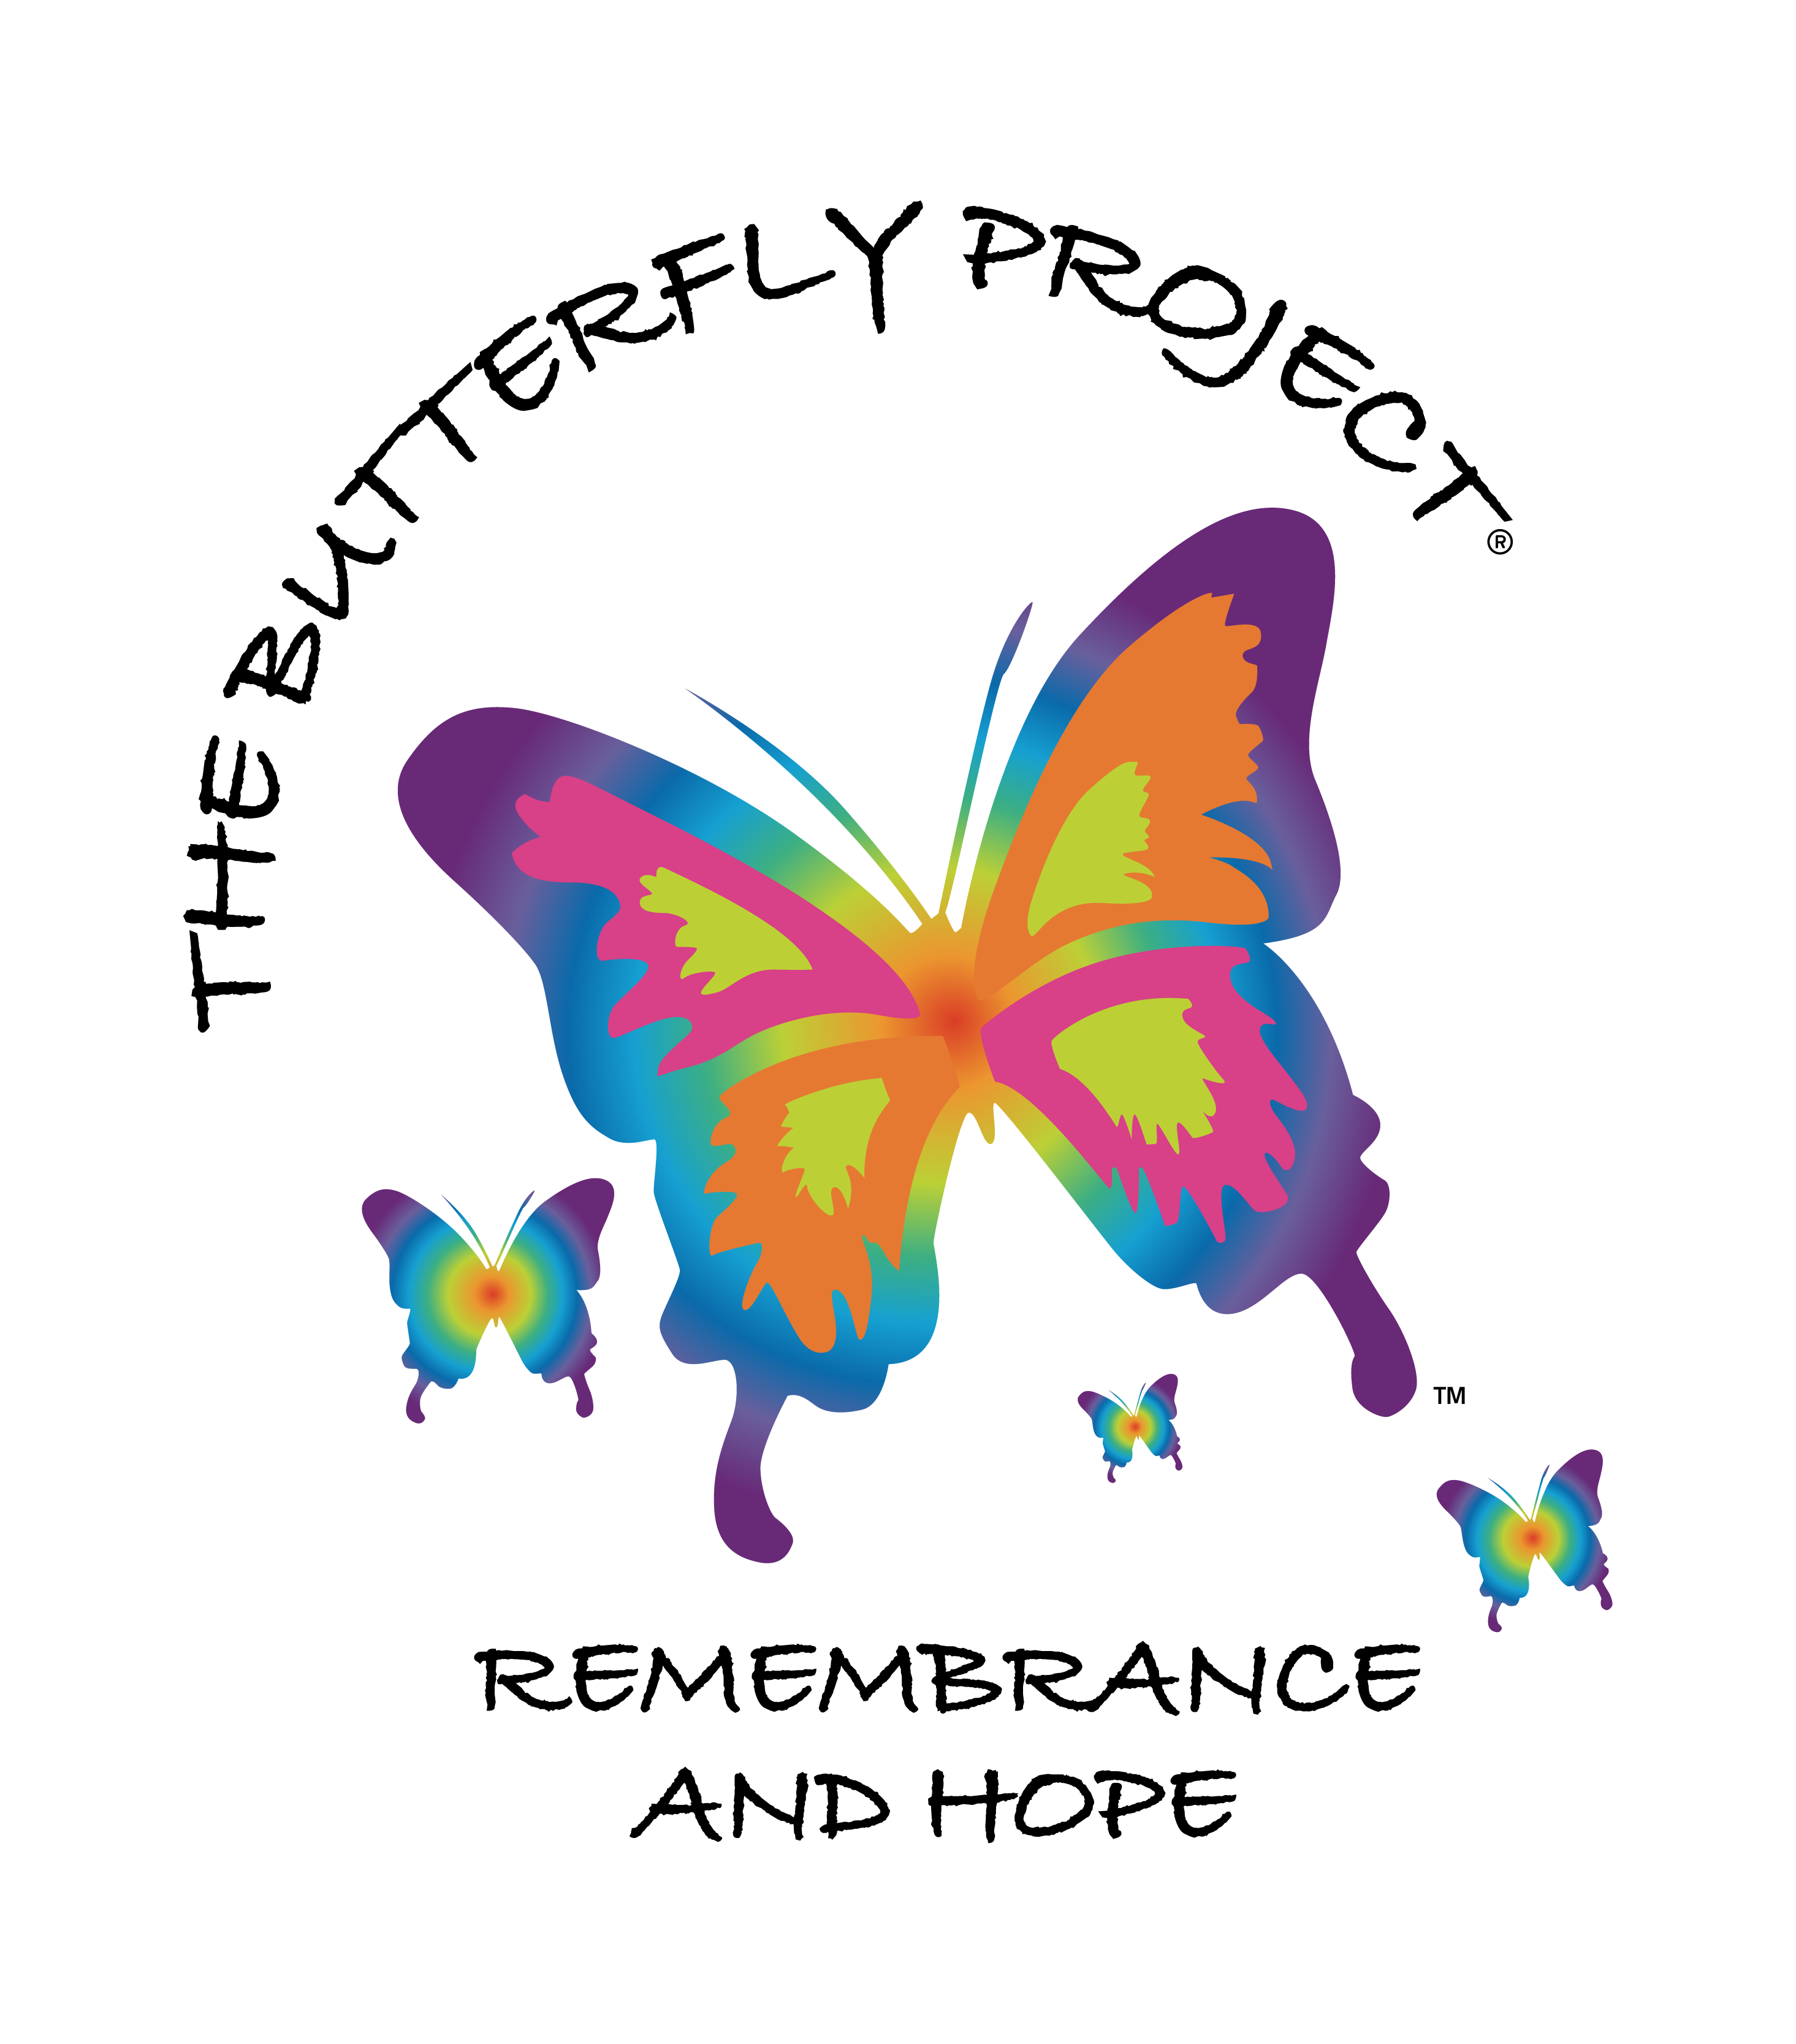
Understanding and Significance

Slide 3
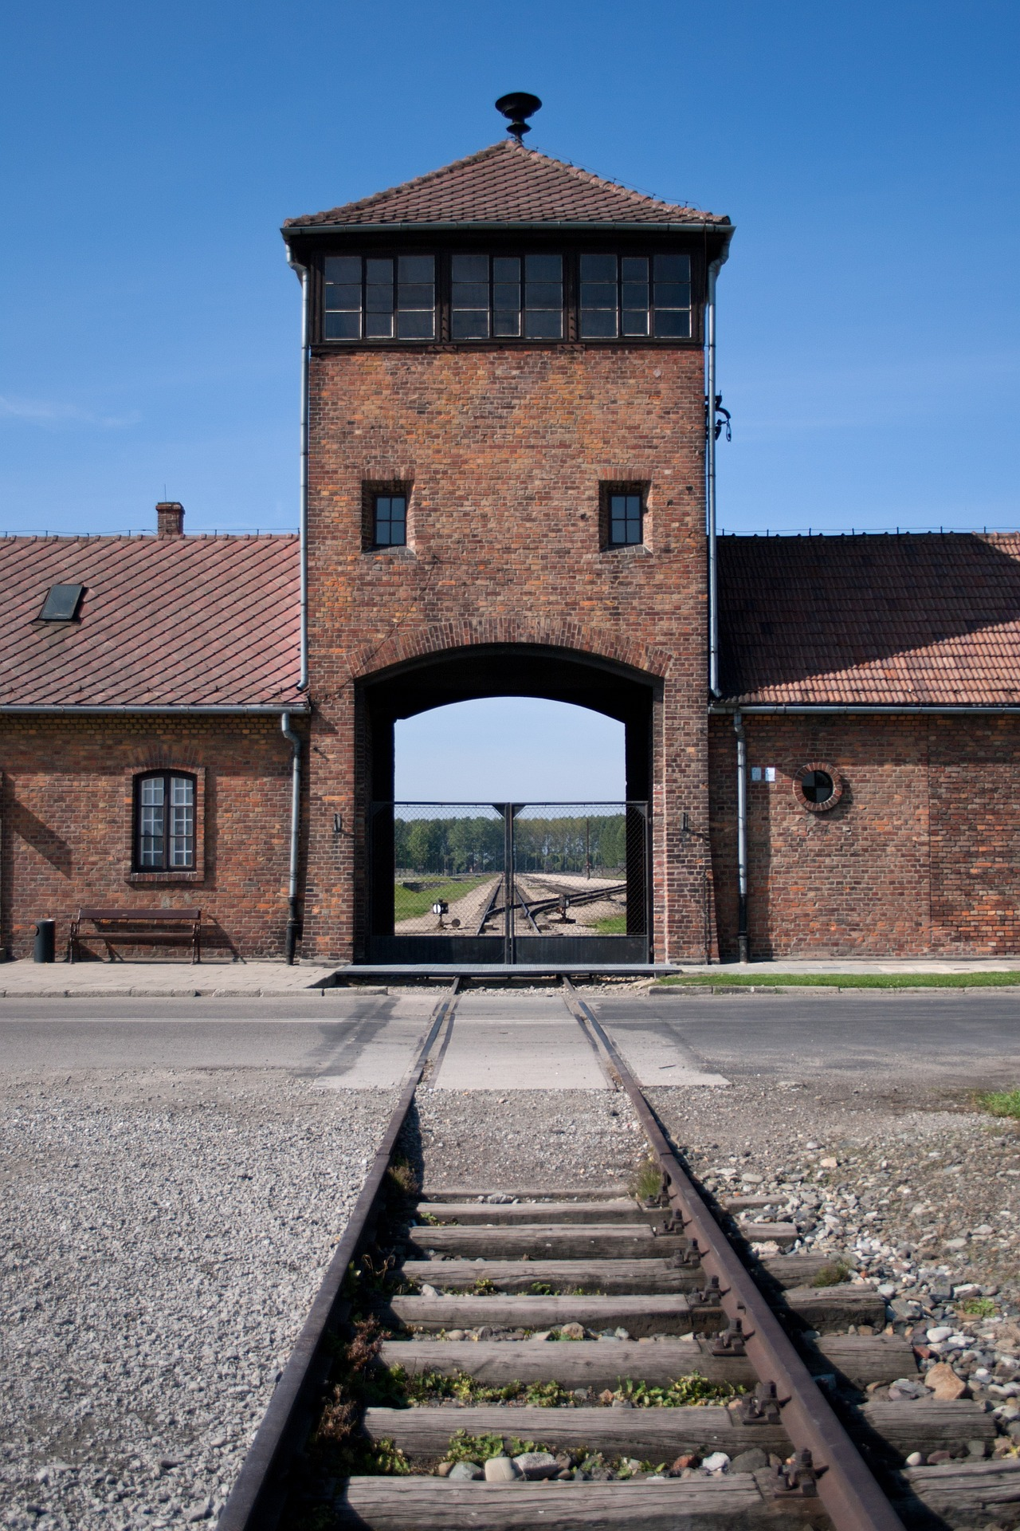
Children
Suffering, fear, and loss. Many children were separated from their families, forced into ghettos and labor camps, and subjected to brutal conditions including starvation, disease, violence, and even medical experiments.
1942, the “Final Solution”. Eliminate the Jews from Europe through mass murder. Children were among the primary targets of this operation. Murdered in concentration and extermination camps such as Auschwitz and Terezin.
Roma or Sinti, disabled and LGBTQIA+, targeted and subjected to inhumane activities and treatment.
In Terezin, out of the 15,000 children that went through there, only 100 survived. We have a little over 15,000 students in this district…
Orphaned, left with no homes or families, faced with the daunting task of rebuilding their lives. Many chose to speak about what they had endured later in life and now we have the privilege of listening to their testimonies as a way to remember and ensure we never forget.

Slide 4
“The Butterfly Project is a call to action through education, the arts and memorial making. We teach social justice through lessons of the Holocaust, educating participants about the dangers of hatred and bigotry to cultivate empathy and social responsibility. By painting ceramic butterflies, which are displayed as symbols of resilience and hope, participants remember the 1.5 million children killed during the Holocaust. In this work, The Butterfly Project honors our commitment to the Survivors to Never Forget.”
- The Butterfly Project Mission

Slide 5
NOT The Last Butterfly Trailer

Slide 6
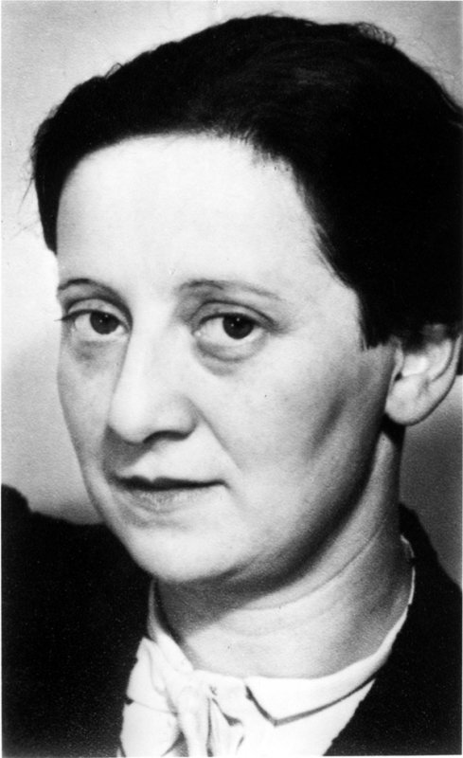
Friedl (Frederika) Dicker-Brandeis
Born in 1898 in Vienna.
She studied under the famous artists Franz Cizek and Johannes Itten and became a skilled painter, graphic artist, and designer.
1942, sent to the Terezin concentration camp.
In Terezin, she began teaching art to children in secret.
1944, sent to Auschwitz, where she was murdered.
After her death, over 4,500 pieces of student’s work was found. Most of them are now in the Jewish Museum in Prague. Her legacy lives on, and the art created by her and her students at Terezin is a powerful testimony to the strength of the human spirit in the face of adversity.

Slide 7
Pavel Friedmann
The Butterfly Project was inspired by the poem “The Last Butterfly” written by Pavel Friedmann.
Born January 7th, 1921 in Prague.
1942, deported to Terezin, a camp-ghetto for Czech Jews.
Wrote poems to process his situation.
Murdered in Auschwitz.
After the war, poems by Pavel Friedmann were discovered.

Slide 8
The Last Butterfly by Pavel Friedmann
The last, the very last,
So richly, brightly, dazzlingly yellow.
Perhaps if the sun’s tears would sing against a white stone…
Such, Such a yellow is carried lightly way up high.
It went away I’m sure because it wished to kiss the world goodbye.
For seven weeks I’ve lived here, penned up inside this ghetto
But I have found my people here.
The dandelions call to me
And the white chestnut candles in the court.
Only I never saw another butterfly.
That butterfly was the last one.
Butterflies don’t live here, in the ghetto.

Slide 9
Impact

Slide 10
Impact
Broward Video

Slide 11
Objectives
Students will understand the significance of The Butterfly Project.
1
Students will create a tangible symbol of their respect for history.
2
Students will understand the importance of tolerance and diversity.
3
1
2
3

Slide 12
Materials
Community One Initiative + Indian River Clay
will provide supplies and the firing of pieces if needed
ceramic butterflies or clay molds Paints brushes lesson plan biography cards
Visit www.communityoneinitiative.com or email coi.ircfl@gmail.com
for resources

Slide 13
Lesson Plan and Resources
Rabbi/Presenter or slideshow presentation
Lesson plan guide
www.communityoneinititave.com
Or
Coi.ircfl@gmail.com

Slide 14
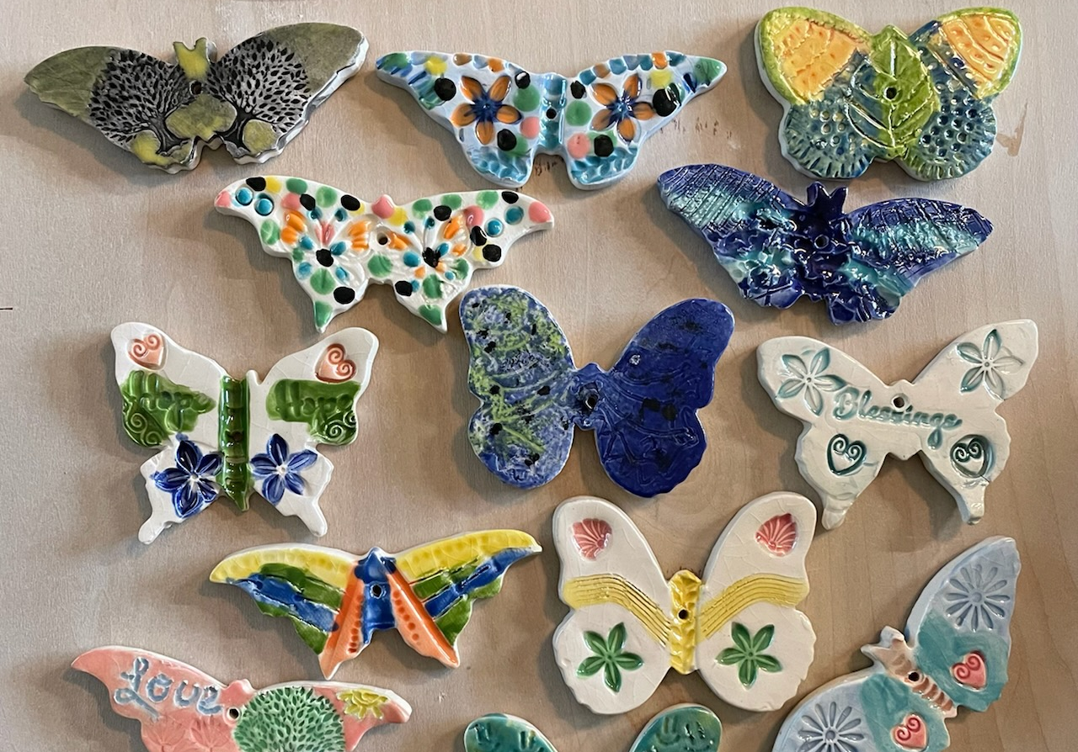
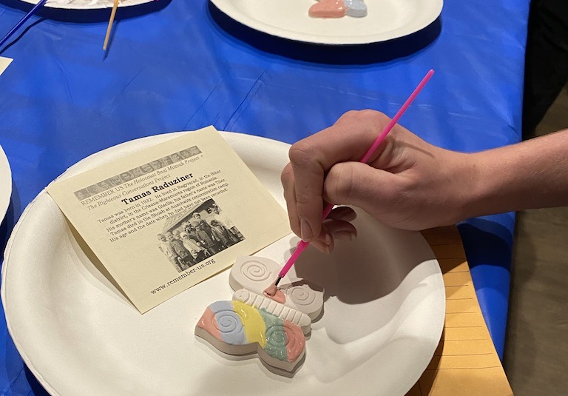
Creating Butterflies
In order for the butterflies to count towards the total 1.5 million goal they must be made of clay.
Create the butterflies and paint them in memory of the 1.5 million child lives lost.
Each butterfly is dedicated to a child with an accompanying biography card.

Slide 15
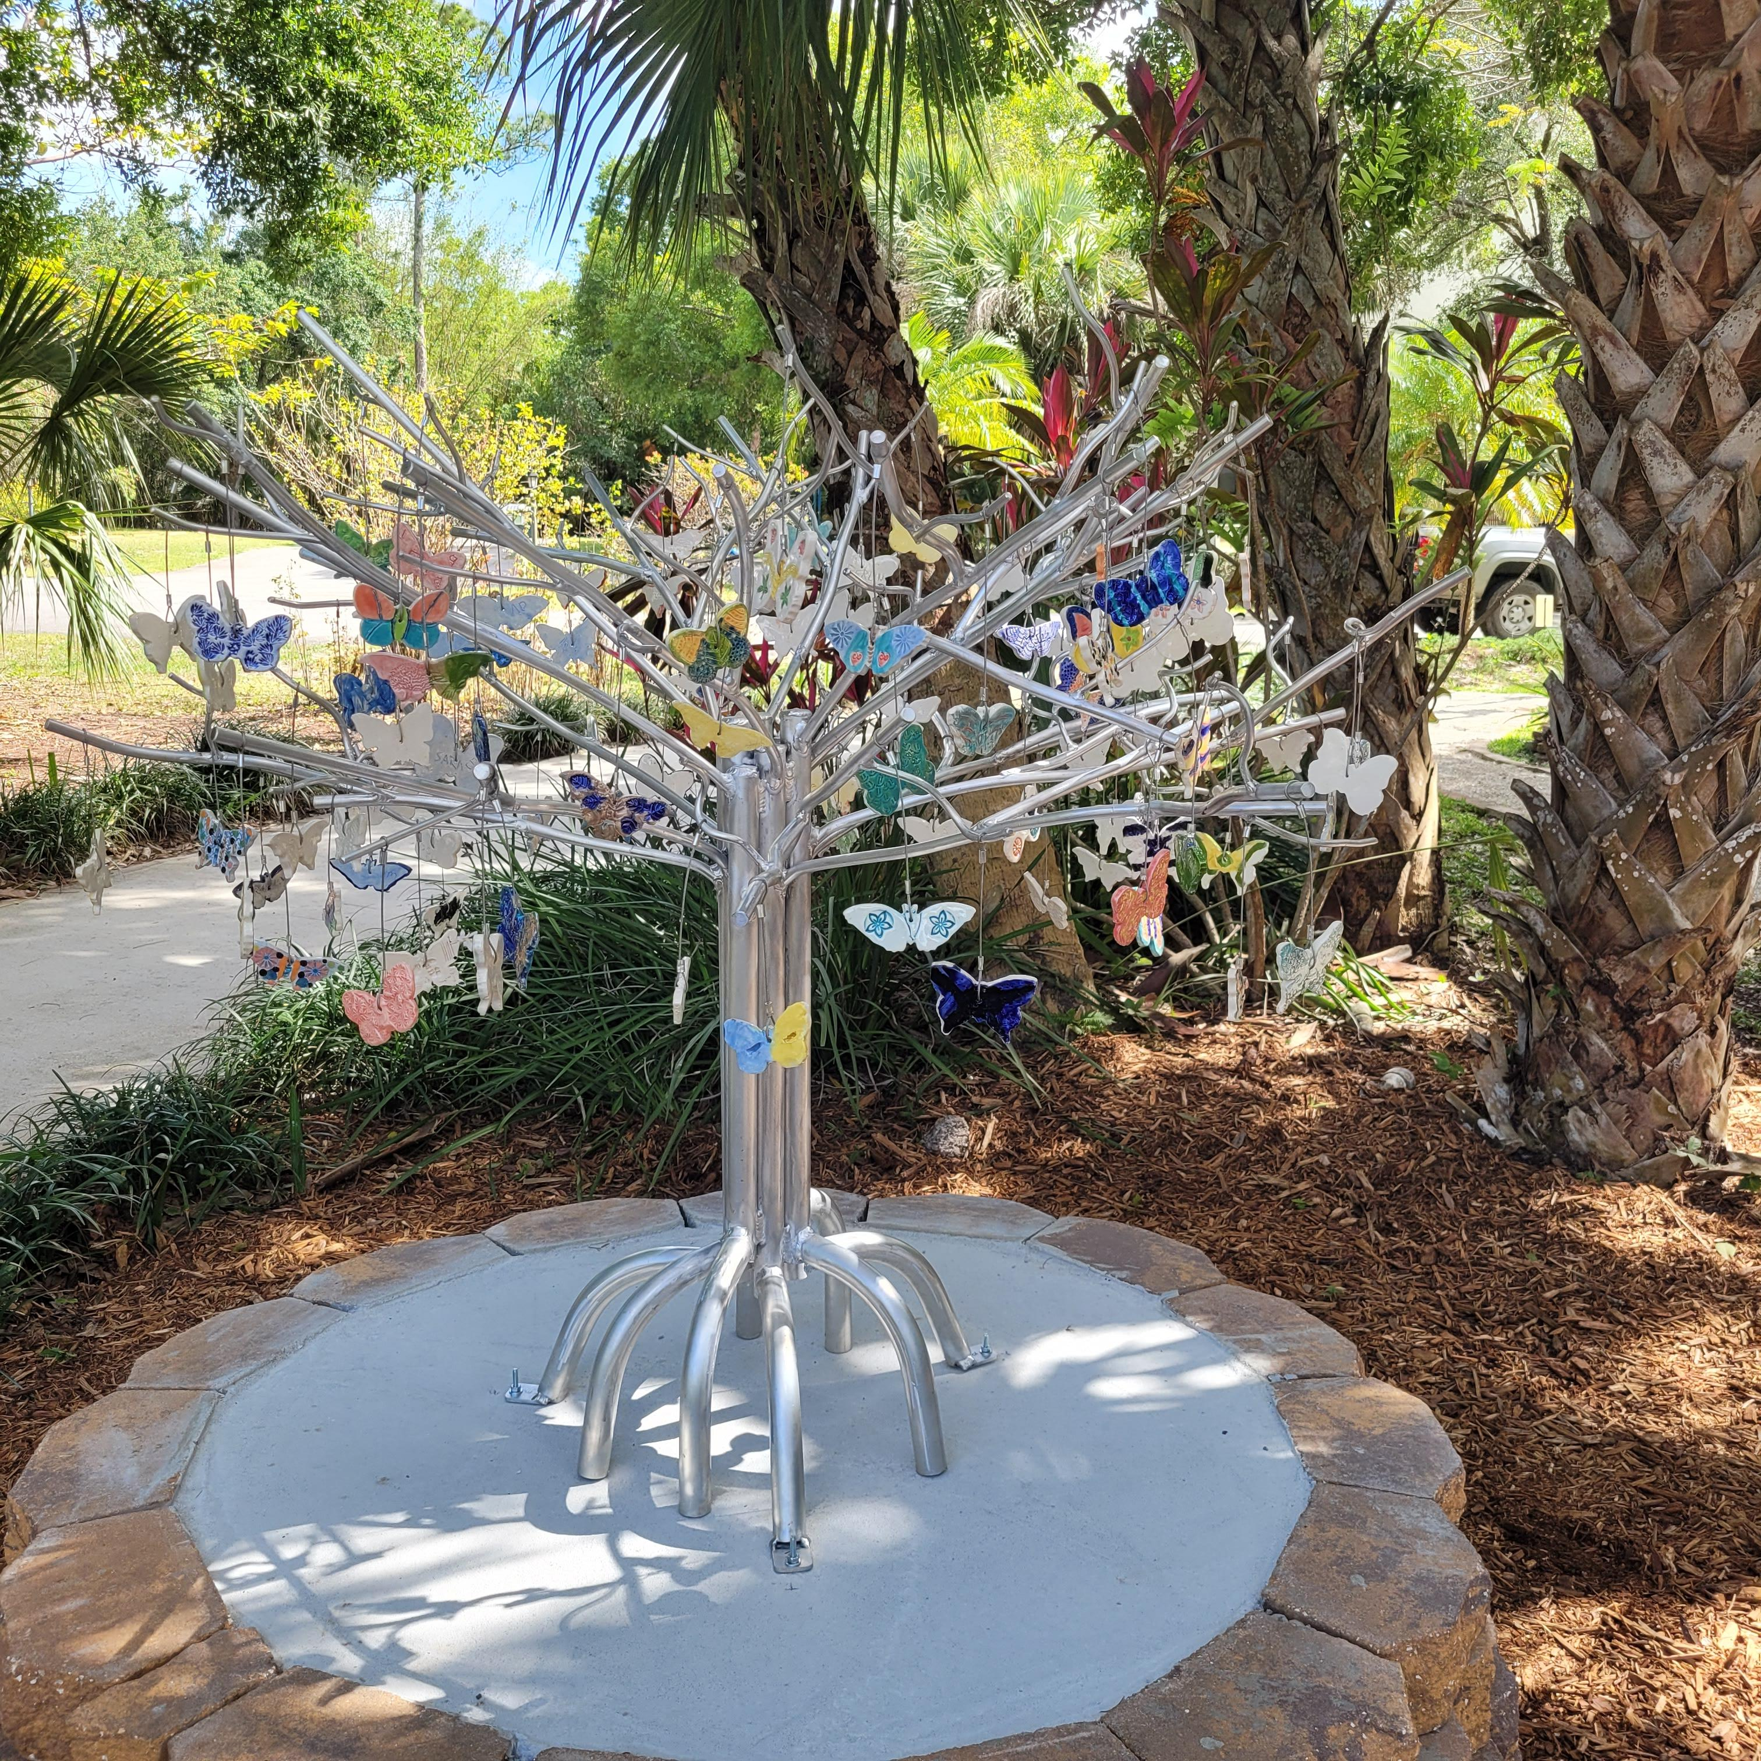
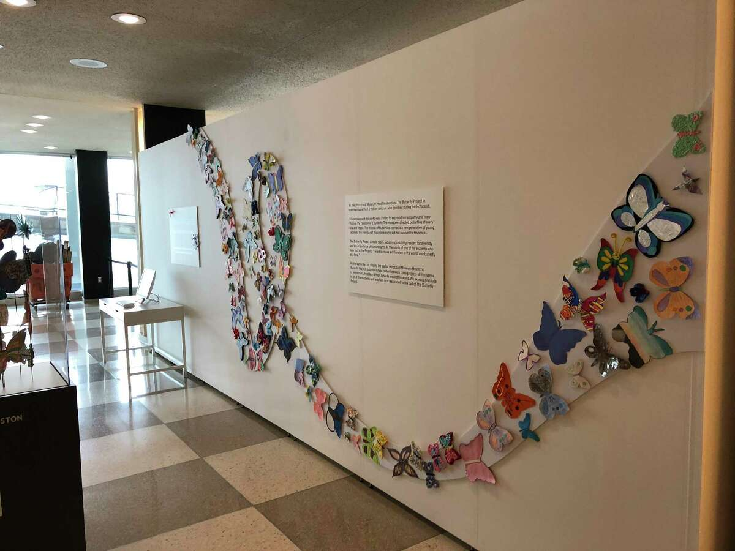
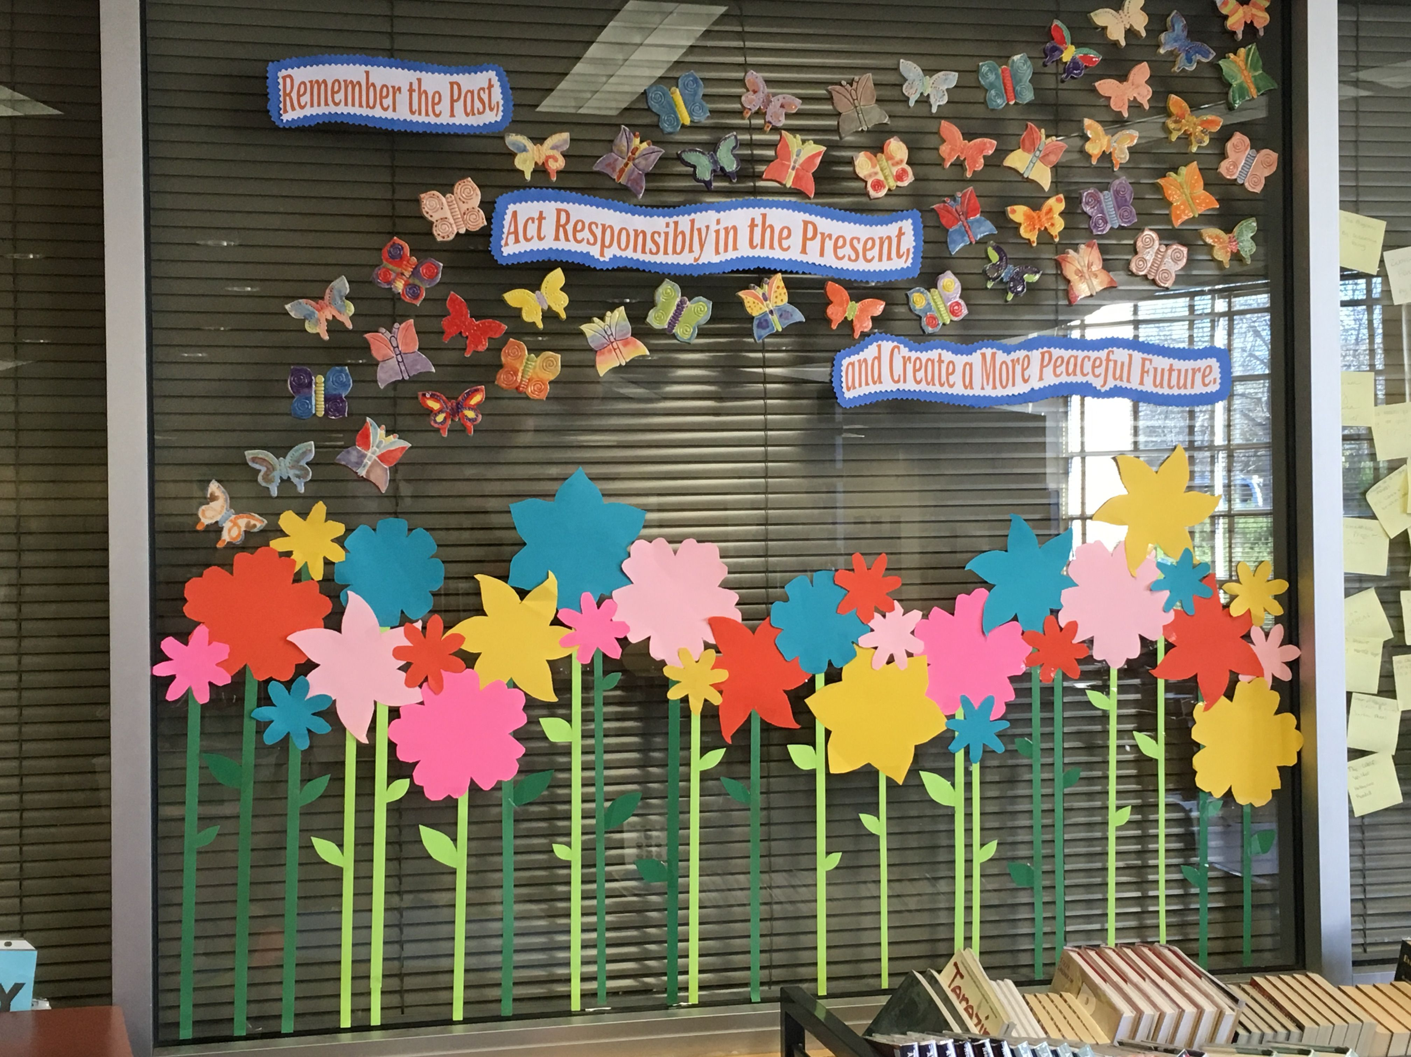
Butterfly Memorial
Once the butterflies are complete, it’s time to display them.

Slide 16
Have you done The Butterfly Project?
How did it go?
Do you have any questions?

Slide 17
Over 315,000 Butterflies
How many more from SDIRC?

