Slide 1

BLACK TIE basics
THE BASICS OF TABLE MANNERS
1- Invitations & RSVPs
2- Proper Attire
3- Greetings & Polite Conversation
4- Beginning the Meal- when to sit, proper posture, fingers or forks
5- Proper Napkin Use
6- the Buffet
7- Utensils & Place Settings
8- Passing the Dish
9- Different Foods
10- Ending the Meal
11- OOPS! Common Mistakes (and how to handle them)

Slide 2
Brunch, Lunch, Buffet, or Dinner here are the TOP 3 RULES to Remember-
When considering a new hire, business relationship, or prospective in-law, the most reported "deal breakers" at the table are loud table guests, open mouth chewing and cell phone use!!!
1- don't draw attention to yourself (the rule of onomatopoeia- avoid clang, clink, slurp, burp, smack, yell, scrape, etc.)
2- Gum is not your friend! chewing with your mouth open and talking with food in your mouth will be a sure way to NOT impress your dinner mates- this applies to food AND Gum!
3- silent and hidden! let all your friends and family know you will be off-line and out of reach for the next hour or two. If it's an emergency, politely excuse yourself and step outside out of earshot of other dinners. DO NOT rest your cell phone on the table.
BTT TIP: until you are comfortable with the basics of polite dining, don’t order food that is messy or eaten with the hands (e.g., spaghetti or hamburgers).

Slide 3
1- Invitations & RSVPs
the invitation can be via email, phone call or paper- (refer to sample invitations you might receive and sample responses).
It is IMPERATIVE (very important) that you respond to let them know if you will be able to attend.
RSVP is French for “please respond” (literally respondez s'il vous plait- or respond if you please) this is not a suggestion. The head count is vital to the event, and you need to respond.
The invitation should also list the style of dress expected for the event so make sure to read ALL of the invitation carefully. If you can't find it, ask a friend or call the restaurant. It is also appropriate to ask the host. (see diagram 1)
TIP: Layering is a good way to be prepared, you can add a tie when you arrive, shed a jacket, add or remove a fancy necklace or pair of shoes.
NOTE: if this is an interview, make every effort to attend.
Refinement - if "regrets only" is listed then it is assumed you will attend, and you need only respond if you can not.

Slide 4
Sample Invitations
Client Appreciation Lunch Invitation
Subject: You're Invited to Our Client Appreciation Lunch - [Date]
Dear [Recipient's Name],
We truly value your partnership, and to show our gratitude, we would like to invite you to a Client Appreciation Lunch on [date] at [location]. This is an opportunity for us to express our thanks and discuss how we can continue to support each other's growth.
During the lunch, we will have a presentation where we will share our latest achievements and future plans. We will also have a Q&A session where you can ask us any questions or provide feedback on our services.
Join us for a delicious lunch and let's celebrate our partnership and success together.
New Employee Welcome Lunch Invitation
Subject: Welcome [New Employee's Name] at Our Team Lunch - [Date]
Hello Team,
We have a new team member joining us! Let's welcome [New Employee's Name] with a friendly team lunch on [date] at [location]. This event will help us get to know each other and make [New Employee's Name] feel at home in our organization. Please join us!
During the lunch, we will have a team building activity where we will introduce ourselves and share our hobbies and interests. We will also have a presentation where [New Employee's Name] will introduce themselves and share their background and experience.
Let's make [New Employee's Name] feel welcome and part of the team from day one. See you at the lunch!
Traditional Dinner invitation at home
The Thomas Family
Cordially invites you to join them for
Dinner and Drinks
Thursday November 22nd, 5 o’clock
Thomas Home
123 Oak Lane
Dallas, Texas
RSVP: email@email.com
555.444.2233
Formal Business Lunch Invitation (Interview)
Subject: Join Us for an Exclusive Business Luncheon - [Date]
Dear [Recipient's Name],
We are pleased to invite you to an exclusive business luncheon on [date] at [location]. This event will provide an opportunity for you to meet the leader of our company and for our company to get to know you as we forge a new partnership in a relaxed setting. We would be honored if you could join us and share your background and experience.
We look forward to seeing you there and having a productive and enjoyable time together.
NOTE: if no attire is listed go by the time of day, 5 in the evening is considered cocktail hour so a business casual attire or informal would be appropriate. After 6 is more formal, before noon is more casual. It is also appropriate to ask someone who might be attending or call the host/hostess to ask.

Slide 5
Sample RSVP Responses
Acceptance 1:
Hi (Recipient's name),
I have received your invite to (event details) and can confirm that I would like to attend.
I've provisionally added the date to my calendar and will wait to hear from you with further details.
You can contact me here if you choose to reschedule the event for another date.
Kindest regards,
(Your full name)
Acceptance 3: (traditional):
Mr./Miss, Mrs., Ms. (recipient’s name)
Thank you for the kind invitation. I look forward to joining you and (boss’s name, interviewer, etc.) for lunch on (date/time). I have heard wonderful reviews of (restaurant name) and I’m excited to try it.
Sincerely,
(your full name)
Acceptance 2:
Hi (Recipient's name),
I'm delighted to receive your invite to (event name) on the (date).
I can confirm that I can/can't attend.
(if applicable) I have read through the invite and provided answers below to your questions:
Answers to all questions
I look forward to seeing you at (even name). Please let me know if anything changes.
Kind regards,
(Your full name)
Acceptance 4: (best for an at home dinner or event)
Mr./Miss, Mrs., Ms. (recipient’s name)
Thank you for the kind invitation. I look forward to joining you and your family for (event) on (date).
Warm regards,
(your name)
Decline invitation (not recommended if an interview):
Hi (Recipient's name),
Thank you for your invite to (insert details). Unfortunately, I am unable to attend due to a prior engagement. I look forward to meeting with you soon.
(You can add information here about why you can't attend, such as the alternative engagement you are attending.)
I wish you all the best and hope the event is a huge success.
Kindest regards,
(Your name)

Slide 6
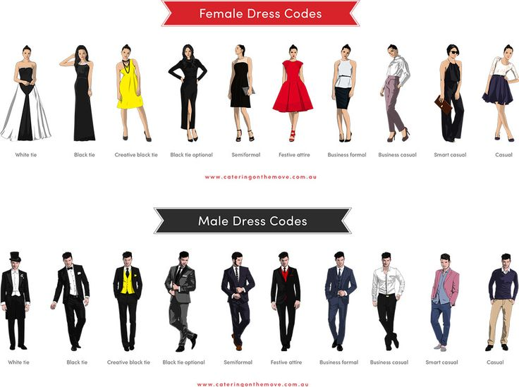
2- Proper Attire
DIAGRAM 1
Save blue jeans for a BBQ- dress appropriately for the meal (i.e., review the dress term chart! don't wear a tux to brunch or shorts outside of a picnic; “jeans” doesn't mean casual.)
check the invitation for the expected dress for the event; if you can't find it, ask a friend or call the restaurant. (See 1- Before the Meal, Sample Invitations)
When in doubt, opt for attire somewhere between business casual and business.
NOTE:
Semiformal is often called “cocktail attire”.
Informal is rarely used in modern times, but if you see it, it is a step down from Semiformal or “cocktail attire”.
If no attire is listed, go by the time of day, 5 in the evening is considered cocktail hour so a business casual attire or informal would be appropriate. It is also appropriate to ask someone who might be attending or call the host/hostess to ask.
TIP: Layering is a good way to be prepared, you can add a tie when you arrive, shed a jacket, add or remove a fancy necklace or pair of shoes.
.

Slide 7
3- Greetings & Polite Conversation
Greet your host as quickly as possible upon arrival
If there is a receiving line, DON’T Skip it (see the etiquette details under the Receiving Line tab.)
A warm smile will help you greet everyone in the room, even those who you have not yet met.
If standing, shake hands with your table mates before everyone is seated. If everyone is already seated or positioned at their seat, shake hands with your immediate table mates (to the left and right) and say a simple greeting to others, “good evening,” “hi, how are you, I’m (your name)” will be enough.
Make conversation- NOT talking to the people around you also breaks rule #1! learn a few ice breaker topics to get you and your dinner mates into light, polite conversation.
Stay away from hot button issues like politics and religion.
Some helpful examples of topics to break the ice:
"have you been to this restaurant before?“
"have you been with the company long?“
"was your day busy?“
"do you have fun weekend plans?“
"this is a beautiful home/restaurant“
Refinement- stay positive and know something interesting about the company or family with whom you are dining.

Slide 8
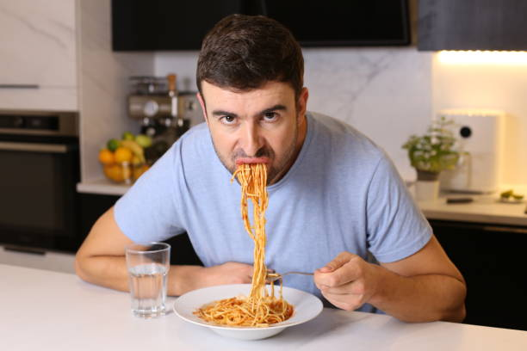
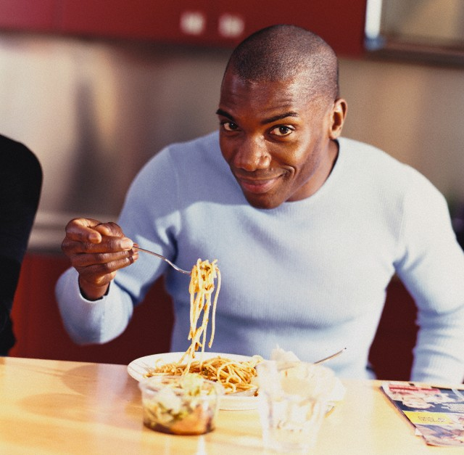
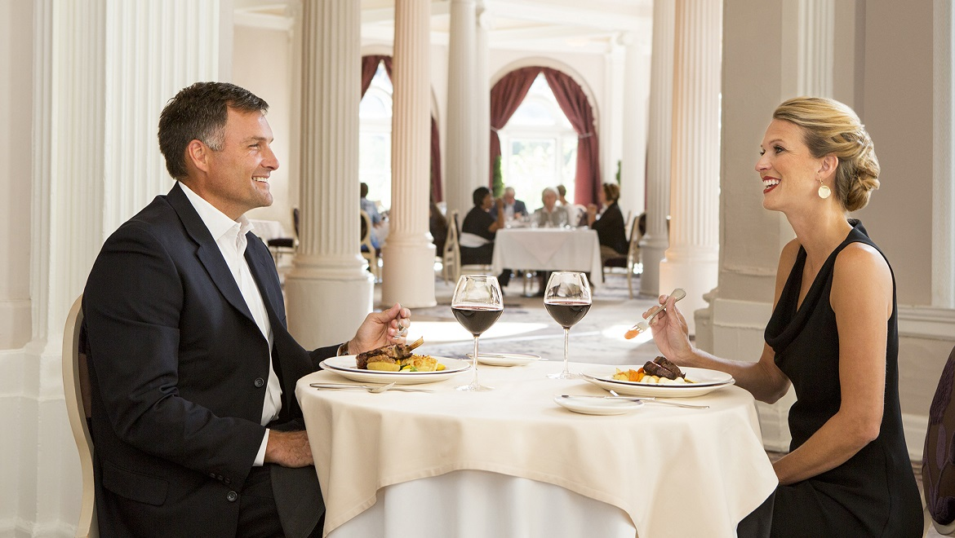
4- Beginning the Meal- when to sit, proper posture, fingers or forks
don't eat with your knife in your hand
Don’t talk with your utensils in your hands
remain standing until host sits at table. If it's a large event and you're not seated with the host, wait until invited to take your seat by the speaker or SR most person at the table. (TIP: Read the room, if most of the room is still standing, DON'T SIT!) If you're at a restaurant and are already seated when they arrive, stand briefly for a greeting. (if you don't have a place card or know which seat is yours, remain standing until you can ask which is the best place for you to sit. You don't want to accidentally take the spot of the host or guest of honor.)
Greeting examples: "nice to meet you“, "thank you for the invitation, I've been looking forward to this”
elbows don't belong on the table; this includes leaning with the forearm!
Don’t hunch over your food! Bring the food gently to your mouth, NOT your mouth to your food.
all 4 on the floor - don't tilt back in your chair
proper posture, don't bend over your plate, lean slightly toward your spoon/fork so as not to drop food.
it's not a race, don't slurp or shovel food into your mouth or guzzle your drink, take your time and enjoy the food and the company. A meal is an event
don't use your fingers- a few items like bread are eaten with hands, but if when in doubt use your fork (spoons are only used for soft or liquid items) (R-use your spoon to retrieve your tea bag, not your fingers)
NOTE: remember there is NO profanity, smoking or vaping, licking fingers, burping, blowing nose, leaning over table, reaching across the table, or talking too loudly at the table.
TIP: Switching is savoring!- don't eat with your knife in your hand, Fork in left, knife in right; cut- lay knife on edge/rim of dinner plate (blades in) and put fork in right hand. Cut only ONE BITE AT a TIME (exception- if the item is too large to eat with one cut, like pancakes). If you are left-handed, this process is reversed. (see 7- Utensils & Place Settings)

Slide 9
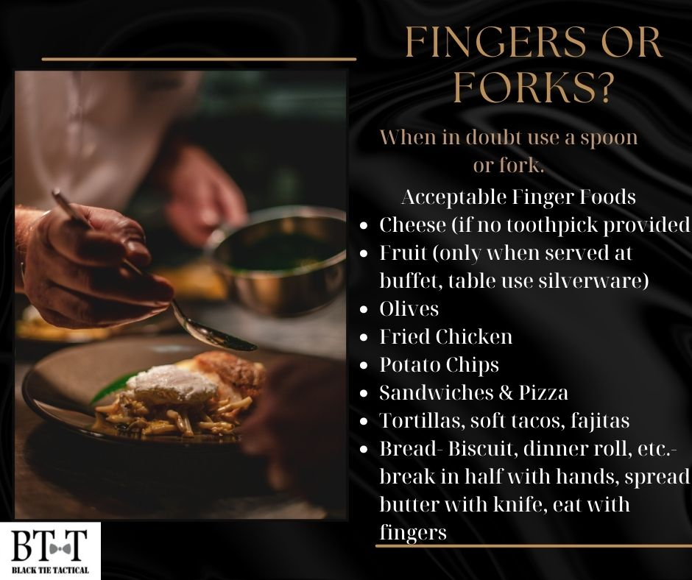
When in doubt, use a fork!!!

Slide 10
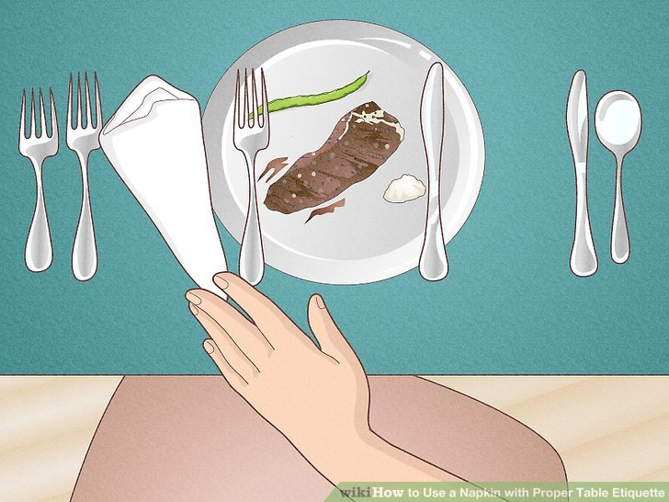
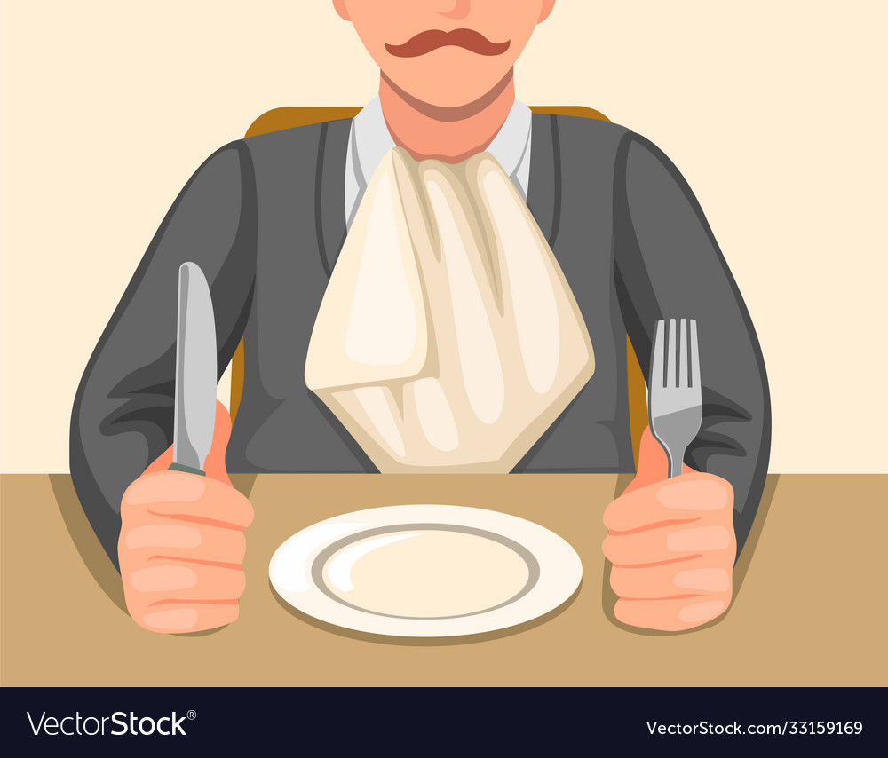
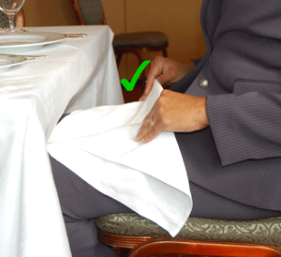
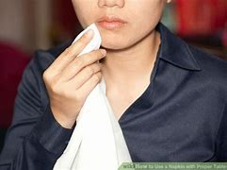
5- Proper Napkin Use
DIAGRAM 2
Loosely Left- if you need to get up or you are finished with the meal, your napkin is laid loosely to the left of your plate; don't wad or crumple. (see Diagram 2)
Your napkin rests on your upper thigh or across your lap if in a skirt. (see Diagram 4)
Don't tuck your napkin into your shirt or leave it on the table while you're eating. (see Diagram 3)
Don’t use your napkin for anything other than dabbing your mouth.
NOTE: remembering HOW to use your napkin is important, but remembering to USE your napkin is more important.
TIP: blowing your nose should NEVER be done at the table- it’s just gross!
DIAGRAM 3
DIAGRAM 4
Refinement- dab the napkins lightly across your lips or corners of your mouth, don't smear it across your mouth.
DIAGRAM 5

Slide 11
6- the Buffet
Always take a clean plate at the buffet, no matter how many times you visit the buffet line.
don't eat while in the buffet line or standing near the buffet.
if you touch it with your hands or utensils DON'T put it back, put it on your plate, you don't have to eat it. this applies to buffet AND table items. (see 8- Passing the Dish)
Don’t take a to-go plate at the buffet- this isn't your store.
NOTE: At a buffet, wait until your closest table mates have returned from the buffet line to begin eating, at a seated dinner, wait until everyone is served to begin eating.
Refinement-
at a buffet dinner, don't go back for 2nds until invited to do so or everyone else has been through. NEVER go back for 3rds unless invited to do so by the host.
If you need to step away from the table before the meal begins, whether buffet or seated, politely excuse yourself and allow others to begin eating without you- “please excuse me, I need to step away, but don’t wait on me to eat.”

Slide 12
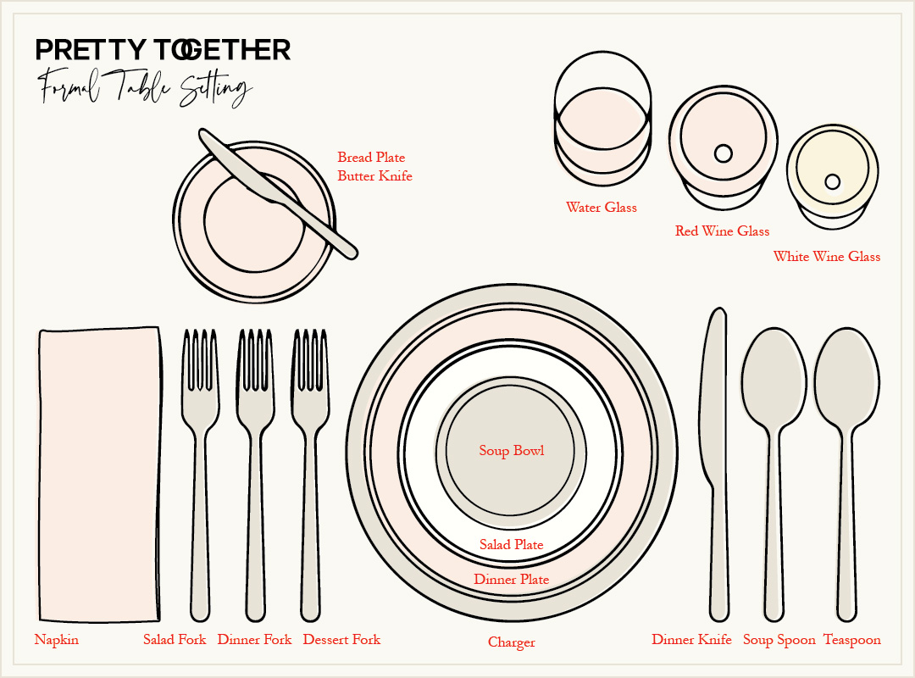
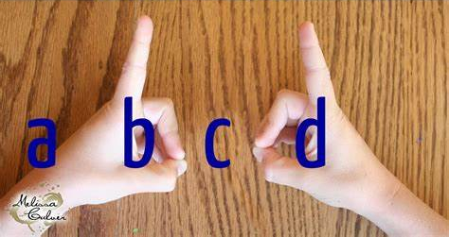
7- Utensils & Place Settings
DIAGRAM 6
B W
keep your utensils quiet- don't clang when stirring drinks, cutting food, or eating.
All dirty utensils lay on your dishes: dinner knives and forks rest on the side or rim your dinner plate. coffee, dessert utensils, as well as butter knife, rest on your bread plate. It is ok to use your dinner plate if no bread plate is available. (See diagram 15)
BMW (Bread Meal Water) -know which is your water glass, bread plate and dinner plate. (see Diagram 6)
OR try BeD- make a "b" with your left hand and a "d" with your right hand, your Bread is on your left, your Drink is on your right. (see Diagrams 7 and 7A)
Use your utensils from the outside in- utensils are set based on the sequence of the meal being served; the spoon and/or fork at the TOP of the plate is for dessert and coffee only (occasionally you will see a tiny 3-tined fork, this is for shrimp or other shelled seafood).
TIP: Knowing which fork and spoon is used for which part of the meal is a big help at a nice dinner, but NOT eating with your fingers is even more important.
Bread
Meal
Water
M
DIAGRAM 7
BeD
Bread
and
Drink
DIAGRAM 7A

Slide 13
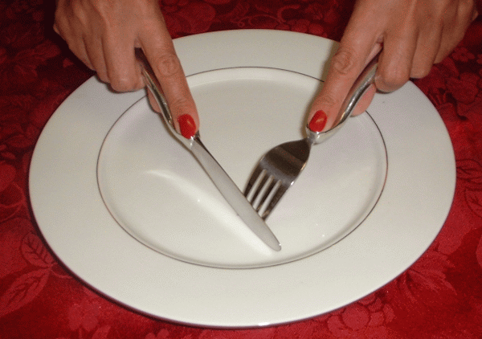
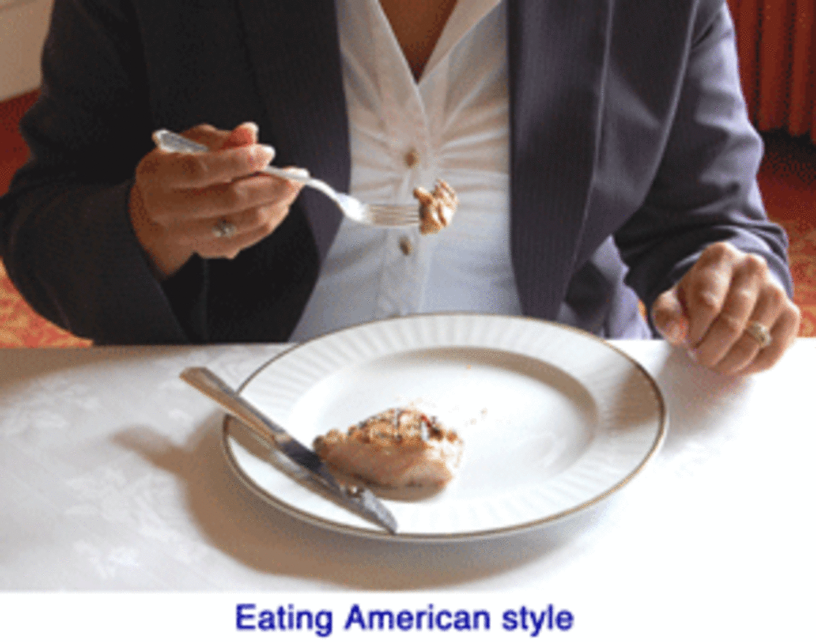
Switching is Savoring!
Don't eat with your knife in your hands.
Place your fork in your non-dominate hand and your knife in your dominate hand to cut (this is the left hand if you are left-handed, and right if you are right-handed). (see Diagram 8)
Switch! Place your fork in your dominate hand and your lay knife on edge/rim of dinner plate (blades in- see diagram 9)
Cut only ONE BITE AT a TIME (exception- if the item is too large to eat with one cut, like pancakes).
(see diagrams 8 & 9)
One bite at a time!
DIAGRAM 8
Knife in dominate hand, fork in non-dominate hand for cutting.
DIAGRAM 9
Switch! Fork in dominate hand, knife in non-dominate hand for eating.

Slide 14
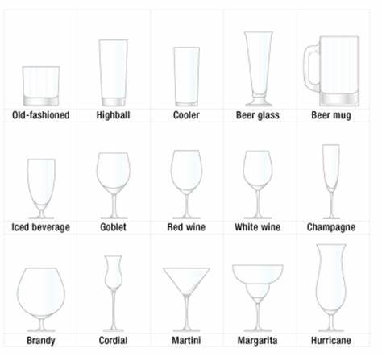
Different types of glasses
Refrain from:
licking your plate
licking your utensils clean between courses. (as a general rule, there is NOTHING at the table that requires licking. You won't be served ice cream in a cone!)
scraping teeth on utensils. Instead, place your lips around your food to cleanly take the fork or spoon into your mouth.
using the serving spoon/fork or knife on your plate. Serving utensils remain in the dish with which they are served.
resting dirty utensils on the table! Use a bread plate or dinner plate.
putting your knife in your mouth!
Crunching or chewing the ice in your glass. It is extremely loud and breaks rule #1.
Refinement-
when stirring tea or coffee, hold the spoon so it doesn't touch the bottom or sides, stir a few times and remove WITHOUT clanging it on the side of your cup or glass.
utensils are rested gently on the plate, don't let them clatter.
Don't scrape utensils on bowls, cups, or plates- this breaks rule #1.
See diagram of different utensils and glasses
DIAGRAM 10

Slide 15
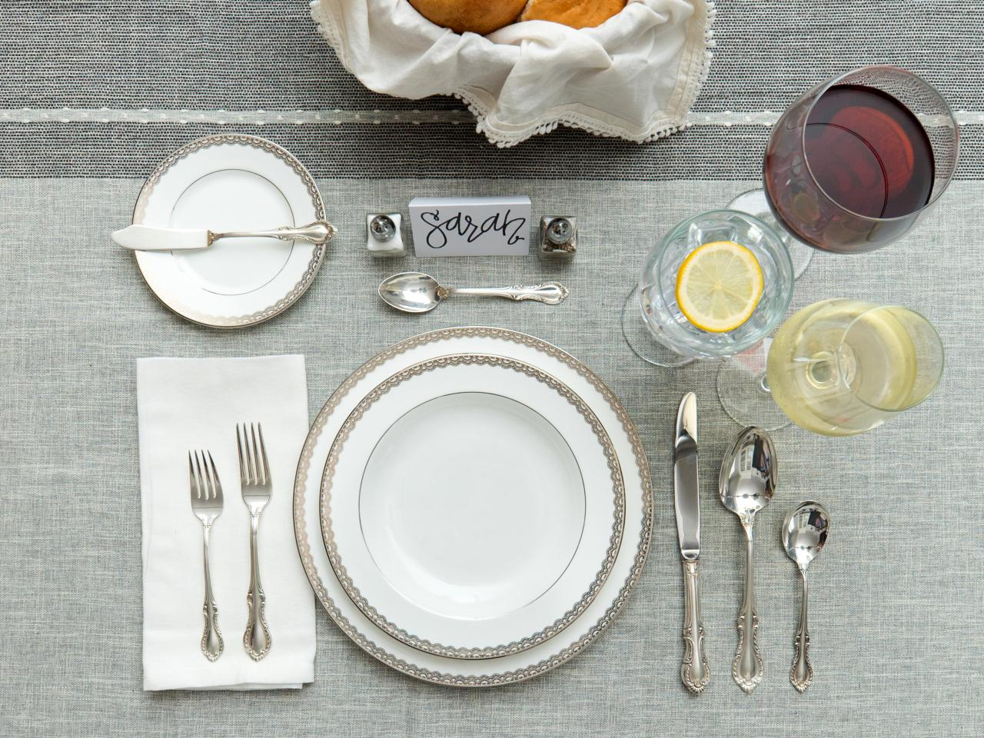
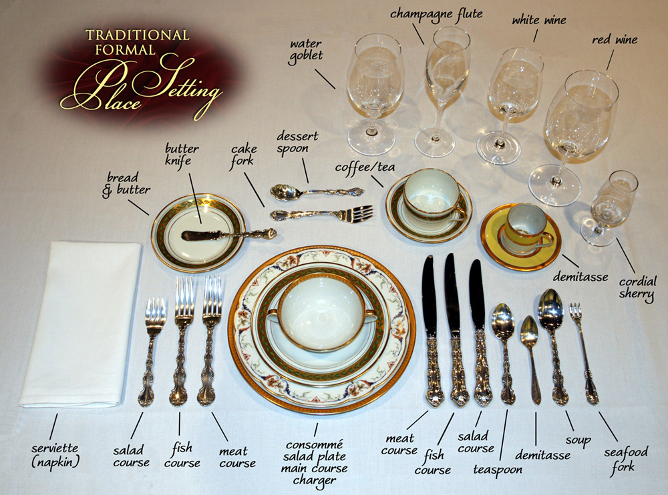
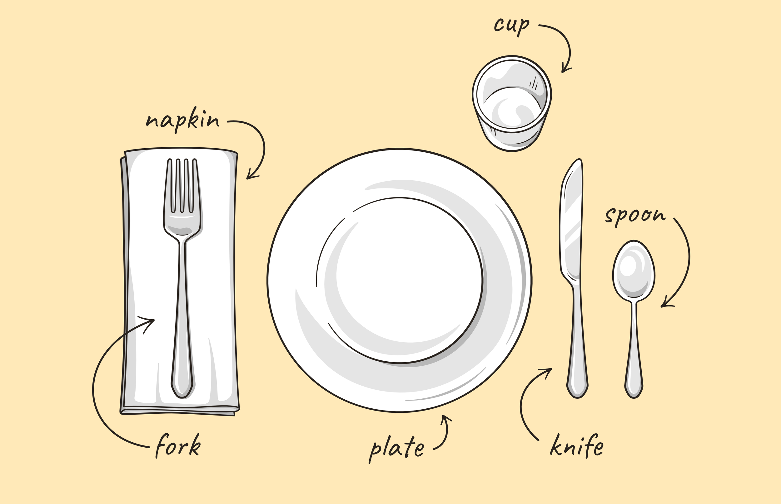
Utensils & Place Settings
DIAGRAM 12
Most Common
NOTE: the demitasse cup is traditionally used to serve espresso or Turkish coffee.
Most Formal
Casual
DIAGRAM 13
DIAGRAM 11

Slide 16
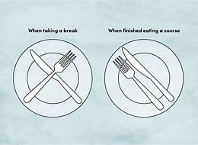
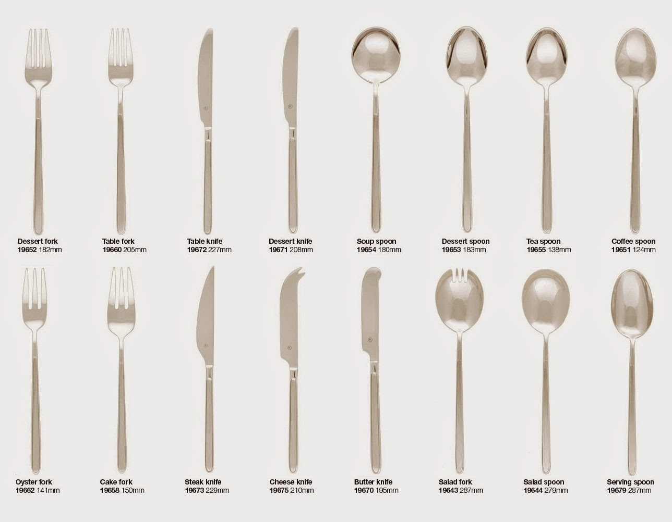
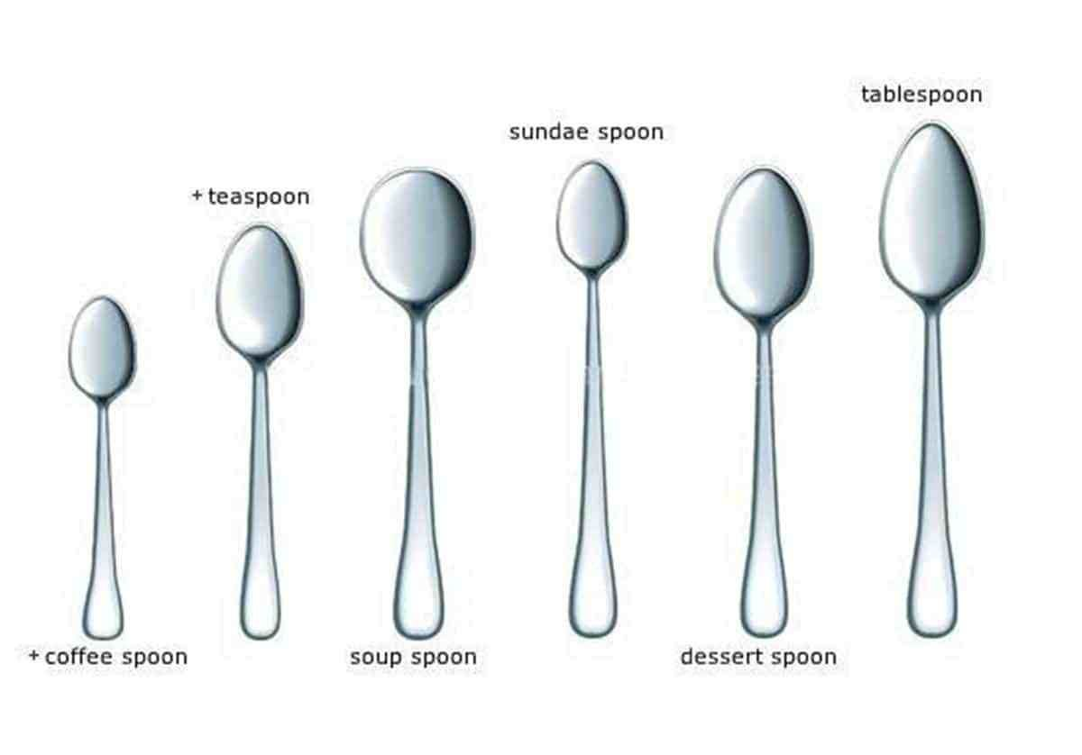
Proper placement of utensils during and after the meal
DIAGRAM 15
Different Types of Utensils
DIAGRAM 14
DIAGRAM 16

Slide 17
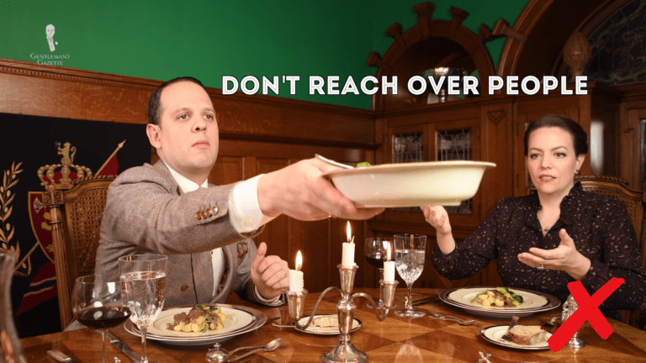
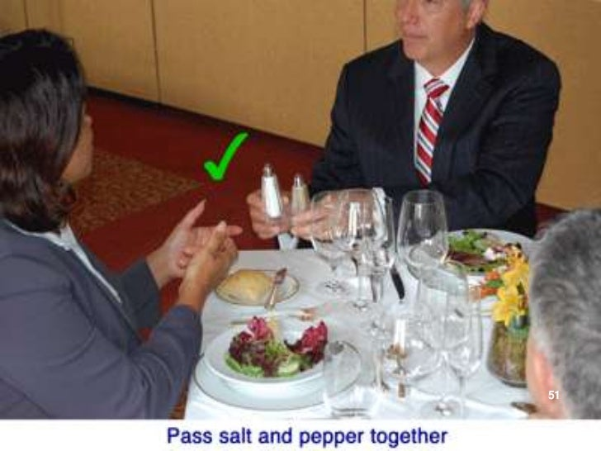
8- Passing the Dish
ask for items to be passed don't reach across the table, a simple “please pass the tea” will work nicely.
When serving your plate, items will be passed to the right (Counterclockwise) and circle the table until each item has been passed to everyone at the table.
Bread, tea, water and other items should be passed to the right at the beginning of the meal.
Once every item has been passed once, asking for an item is passed by whomever is closest to the item. (e.g., if the bread is close to you on the left, ask the person closest to you to pass the bread.)
Take a small portion to ensure everyone has a chance to serve themselves. You can ask for the dish to be passed back if you would like 2nds. NEVER ask for 3rds unless offered by the host.
NOTE: the guest of honor sits to the right of the host, therefore all items are passed to the right allowing the guest of honor to serve themselves first.
At a seated dinner, wait until everyone is served to begin eating. At a buffet, wait until your closest table mates have returned from the buffet line to begin eating.
Refinement:
a “no thank you” bite is helpful when you are at someone’s home, and they have worked hard on the meal. Unless you are allergic to the item, take a small spoonful to politely try. If you don’t like it, you haven’t wasted the item.
If you need to step away from the table before the meal begins, whether buffet or seated, politely excuse yourself and allow others to begin eating without you- “please excuse me, I need to step away, but don’t wait on me to eat.”
If a dish is asked to be passed, pass it along to the person who requested it. DO NOT serve yourself from it. If you would like to ask for it back, you may.
Paired condiments are always passed together no matter if only one is requested- Salt and pepper, oil and vinegar, cream and sugar.

Slide 18
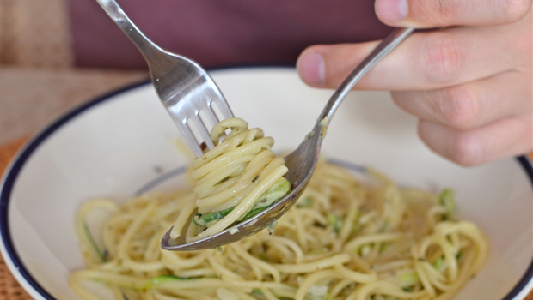
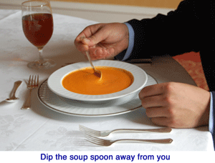
9- Different Foods
keep your food under control, don't chase it around your plate, use your knife as a "pusher" if you can't easily take it upon your fork
dip away drip away- for all liquids (cereal, soup, stew, chili) dip the spoon away from you, lightly touch your spoon to the back of the bowl to get the last drips (this is also true for messy things like pancakes with syrup, salad with dressing, etc.), when the bowl is almost empty, tip the bowl slightly away from you and get the last spoonful, let the rest go (don't drink from ANY bowl)!
the art of the Twirl- eat spaghetti like a pro- if you are given a large spoon, you will use it to twirl spaghetti or other long flat noodles. take the noodle on your fork, rest it lightly against the "bowl" of the spoon and twirl a few times wrapping the noodle securely around your fork before eating. If there is a messy sauce, practice the "drip away" method as mentioned with soup. If no "twirling" spoon is offered, cut noodles into bite size portion before eating.
Small bites! No matter what you're eating, remember not to pile up your fork or spoon. If you imagine 3-4 gummy bears on your spoon or fork you will know the limit you should put on each bite.
Don’t crumble crackers! even if provided, never crumble crackers or other items into salad or soup. Your hands, clothes and place setting will be a mess and break rule #1. (to properly use crackers, place them on the salad or in soup and use your fork or spoon to break it into bite size or leave them off.)
learn to cut a cherry tomato, also called a grape tomato,- you will thank me later! If you can't cut it, leave it- don’t chase it around the plate or bowl with your fork and don’t pop a full cherry/grape tomato into your mouth, this breaks rule #1!
Refinement- eating liquid items can be tricky, there are ways to tackle each item from cereal to chili. For soups that are just broth like tomato soup, sip the broth from the side of the spoon, for soups like chicken noodle, sip the broth from the side before placing spoon in your mouth to eat the noodle. For everything else take small portions into your spoon and place your mouth on the entire spoon without slurping.

Slide 19
10- Ending the Meal
DIAGRAM 16A
as with the greeting, at the end of the meal, stand, push in your chair, and say “good-bye” and “thank you” to your dinner mates. Make a special effort to thank the host or their second in charge (manager, spouse, chief of staff, etc.)
Examples: "thank you for inviting me, I enjoyed the evening“, "Thank you for a wonderful meal, I look forward to seeing you again“, "thank you for including me in this wonderful event“.
don't work past 5- when you're finished, your utensils go together about the 4 or 5 o'clock position.
set yourself apart- learn the art of a TY note, email is good, hand-written is better. (See sample Thank You Notes)
Loosely Left! When you are finished with the meal (as when you need to get up) your napkin is laid loosely to the left of your plate don't wad or crumple
NOTE: don’t take a to-go plate at the buffet- this isn't your store.
Refinement-
the proper placement for your utensils when you are finished with your meal is 4:20 when thinking of your plate as a clock. Remembering to put them together in this approximate position is more important than remembering the exact position. (see diagram 16A)
Never cross your utensils when you are finished, it’s a sign you didn’t enjoy your meal.

Slide 20
Suggestions for Thank you notes- email is good, but hand-written will make you stand out.
Post Interview Lunch/Dinner
Dear (host’s name)
Thank you for a wonderful dinner. I enjoyed talking with you and getting to meet many new people. The food was wonderful; I particularly enjoyed (name of dish).
I look forward to working with you and am available if you have any further questions.
Kind regards,
(your full name)
Note: a Thank you note should be sent within a week of the event (3 days is best).
Hosted dinner at the home
Dear (host’s name),
Thank you for a wonderful dinner on (date). I enjoyed the great company and the (specific dish). I was thrilled to meet (enter name) and hear about their (adventures/career, etc).
Thank you for including me in the evening.
Kindly,
(Your name)

Slide 21
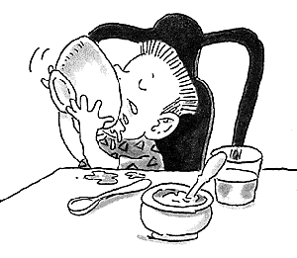
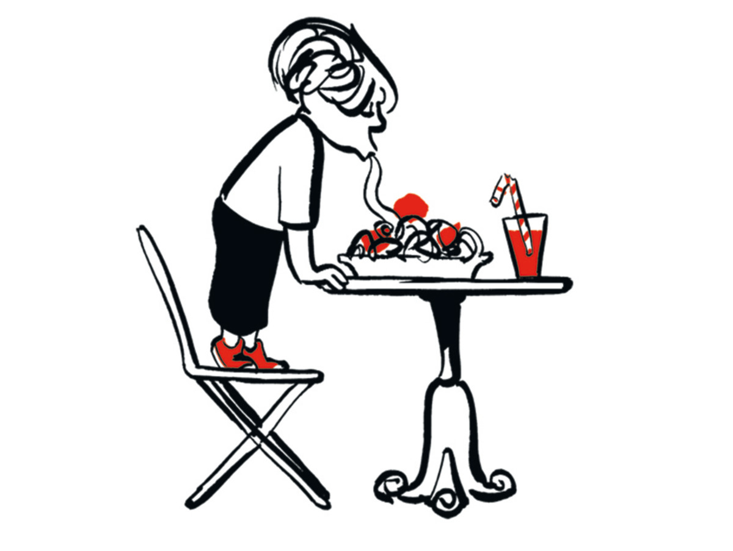
11- OOPS! Common Mistakes
AVOID:
breaking rules 1, 2, or 3 (see slide 2, TOP 3 RULES)
Profanity (4- Beginning the Meal)
smoking or vaping (4- Beginning the Meal)
licking fingers (4- Beginning the Meal)
Burping (4- Beginning the Meal)
Crunching or chewing ice (7- Utensils & Place Settings)
blowing nose (4- Beginning the Meal)
Resting elbows on the table (4- Beginning the Meal)
leaning over table (4- Beginning the Meal)
reaching across the table (4- Beginning the Meal)
talking too loudly (4- Beginning the Meal)
drinking from a soup/cereal bowl (9- Different Foods)
licking the plate (7- Utensils & Place Settings)
licking your utensils clean between courses. (7- Utensils & Place Settings)
scraping teeth on utensils (7- Utensils & Place Settings)
using the serving spoon/fork or knife on your plate (7- Utensils & Place Settings)
resting dirty utensils on the table (7- Utensils & Place Settings)
putting your knife in your mouth! (7- Utensils & Place Settings)
taking a to-go plate at the buffet (6- the Buffet and 10- Ending the Meal)
crumbling crackers (9- Different Foods)

Slide 22
Mistakes: everyone makes mistakes, it's ok. Here are the best practices if you make a mistake.
Remember rule #1- don't call attention to the mistake you made, even if you dropped your drink or dish. Simply apologize and let someone from the restaurant staff know. If at someone's home, politely offer to help clean it up. Wait patiently for the opportunity to ask for a new fork, glass, plate. This is true if you're standing with hors d'oeuvres (appetizers) or seated at a dinner. If no mess was made as with a dropped fork, ask for a new one as discreetly as possible. Do not retrieve the fork without drawing attention, instead, point it out to the staff when you ask for a clean one.
How to Handle Common Mistakes?
You spilled your coffee on the table and ruined your meal and that of the person to your right.
*Quietly apologize and ask the restaurant staff to bring a new meal for each of you if it’s a seated meal. If at a buffet, apologize and quietly ask the staff to remove the plates or remove them yourself and ask if you can refresh their plate 1st before you refresh yours.
You dropped your full plate leaving the buffet.
* If it is easy enough (no gravy etc.) quietly put the items back on your plate and ask the staff to remove it for you or set it on the tray/table used for dirty plates. If it is messy (like spaghetti) ask the staff if there is someone to clean it. Return to the back of the line to refresh your plate.
Your cell phone rings at the table.
* Apologize to your table mates and quietly turn it off. “Excuse me, I’m sorry I forgot to silence my phone” is a polite way to move on and not draw attention. If it is an emergency, excuse yourself and leave the area where others are dining. (“Excuse me, this is my child’s school I need to take this” is a polite way to get up from the table and not draw attention. Return as soon as possible.) Note: Remember Loosely Left for your napkin.
You're asked a question when you have food in your mouth.
* A small head nod will let them know you have heard them, but you are chewing and don’t want to talk with your mouth full. Once your food is chewed you may properly answer their question.
NOTE: if you ask someone a question who is chewing, it is polite to say something like, “excuse me, I didn’t mean to catch you with your mouth full.”

Slide 23
You're seated next to someone you don't like. (don't move name tags, you've been placed there for a reason).
*Make the best of the meal and find small things to talk about (e.g., work, weather, sports, travel). You don’t have to be their best friend and it’s only for the duration of the meal. After the meal, if there is an appropriate time, you can excuse yourself to stand with others.
NOTE: don’t sit with others, it will appear rude.
You used the wrong water glass.
*If you forget the BMW or BeD method (see 7 Utensils and place settings), simply apologize and hand the table mate to your left the clean glass you were supposed to use. Don’t make a big deal about it, “I’m sorry, I’ve grabbed the wrong glass” will do it.
You put the serving fork/spoon butter knife on your plate.
*This utensil is larger and usually a different shape than your utensils. Don’t put it back and don’t draw too much attention to yourself; apologize and ask the staff for a clean spoon. “Excuse me, I’m not paying attention, and I’ve kept the serving fork from the turkey. Would it be possible to get a clean one.”
You’re over or under dressed for the event.
*Don’t draw attention to it, own it. Just be the best possible you that you can be and everyone there may not notice or at least remember. NOTE: if you are overdressed and able to remove a tie, necklace or other item it’s ok to do so if you have somewhere inconspicuous to put it.
You arrived late.
*If you’re not 10 minutes early you are late. But in the case the unavoidable happens, be honest and make your excuses to the group or host upon arrival with as little disruption as possible. “I’m sorry I’m late, there was a wreck on Main Street”, “Please excuse my tardiness, my daughter’s practice ran late.”
You need to excuse yourself to the restroom.
*This is an easy thing and happens to everyone from time to time. Quietly excuse yourself to your table mates and find a restroom. “excuse me, I will be right back” or “excuse me do you know where the restroom is?” is all you need to say!
Do NOT inform the whole table, Do NOT tell people of your needs like “I have to pee” or some other ridiculous saying; it’s tacky and no one cares!
Remember your napkin is set Loosely Left; wash your hands and return as quickly as possible.

Slide 24
You used your dessert fork for your salad.
*The dessert fork and spoon are set ABOVE the plate to keep this from happening, but if you forget, quietly move your salad fork to the place where the desert fork was. Don’t tell anyone or draw attention. Remember, using the correct utensil is good, but not drawing attention is BETTER!!!
One of your table mates is vaping or smoking at the table.
*While you don’t want to call attention, you are faced with someone creating a bigger commotion than you will if you ask them to leave or stop. If worded correctly you may be able to avoid conflict. “I believe I saw a smoking/vaping space outside the restaurant, I’m sure you would be more comfortable there”, “Your smoke is a lot for the table, would you mind taking that outside.”
Even if the smoke doesn’t offend you, the behavior is unacceptable at the table and should politely be pointed out. The offender may get offended, but your tablemates will thank you for it.
You find a bone or other item in your food.
*don’t say anything or draw attention. If it is a small bone or pit as with chicken, fish, or cherries simply expel it onto your fork and place it on the side of your plate (using a paper napkin for this is acceptable by drawing the napkin to your mouth and discreetly removing the item. NEVER use a cloth napkin for this). If you unfortunately find a hair or bug in your food, quietly lay your utensils in the finished position on your plate (between 4 and 5 see 10-Ending the Meal) and ask the staff to bring you a fresh plate and utensils. If it is a buffet, place your utensils at the finished position and revisit the buffet. If at someone’s home and you find yourself in the awkward position of needing to inform your host. Do so quietly, “excuse me, may I refresh my plate and utensils? I’ve found a hair in my potatoes.”
You are served something to which you are allergic.
*This is tricky for anyone with a serious allergy. If it is a buffet, it is ok to ask the staff if any of the items don’t contain that to which you are allergic. If it is a restaurant, make sure to ask the wait staff before ordering the item as discreetly as possible “excuse me I’m allergic to onion, can this item be made without onion or can you recommend something that can?”
At someone’s home, it becomes a little awkward. If your host has prepared a meal and you find you can safely eat a few of the items, focus on those items you can eat. If your host asks, be honest and tell them, “I’m sorry, I am allergic to that.” If you find every item in the dinner prepared contains something to which you are allergic, simply speak to your host, “this dinner smells wonderful, unfortunately I am allergic to this.” Let the host find a solution. If there is no solution offered, use the "no ty bite“ rule (see 8- Passing the Dish) to help yourself to a small amount of the items presented because an empty plate draws attention and breaks rule #1.

