Slide 1
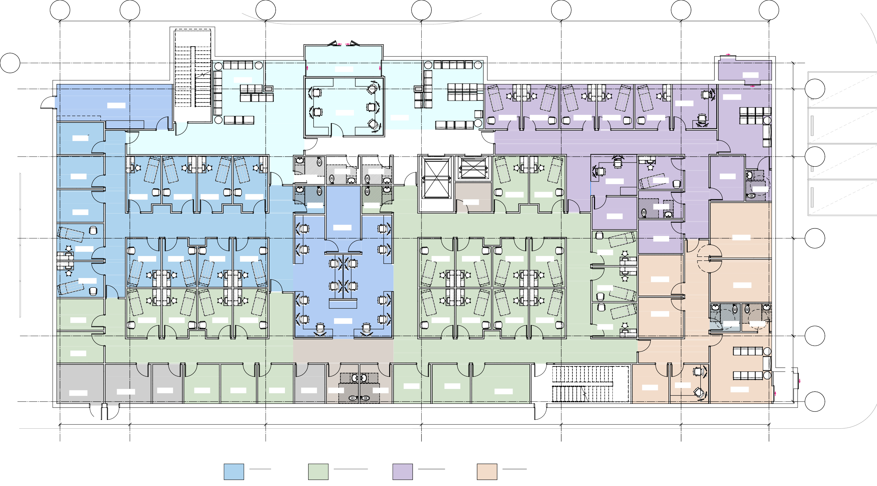

a5
17'-6"
a6
34'-0"
a7
39'-0"
a16
35'-0"
a8
30'-0"
a9
22'-0"
a10
a17
PEDS WAITING
355.90 SF
KIOSK
VESTIBULE
146.23 SF
KIOSK
VESTIBULE
66.53 SF
6'-6"
STAFF BREAK AND ENTRANCE
RECEPTION
WAITING
257.73 SF
10 SEATS
a11
STAFF ENTRY
299.61 SF
20-SEATS
REGISTRATION
281.77 SF
MAIN WAIT
424.85 SF
25-SEATS
EXAM 5
100.34 SF
EXAM 4
100.34 SF
EXAM 3
100.34 SF
EXAM 2
100.34 SF
EXAM 1
100.34 SF
123.81 SF
LOCKERS
KITCHENETTE
17'-0"
OFFICE 3
94.03 SF
MAIN LOBBY
URGENT CARE
PUBLIC TLT
52.00 SF
PUBLIC TLT
59.15 SF
PUBLIC TLT
52.21 SF
a12
OFFICE 2
95.14 SF
WORK STATION
119.83 SF
EXAM 6
93.49 SF
OFFICE 1
95.77 SF
PAT TLT
50.32 SF
EXAM 4
113.96 SF
EXAM 3
112.83 SF
EXAM 2
114.28 SF
EXAM 1
114.77 SF
PAT TLT
52.00 SF
PAT TLT
52.00 SF
STORAGE
65.83 SF
EXAM 1
118.79 SF
EXAM 2
118.79 SF
PAT TLT
77.15 SF
20'-6"
OFFICE 1
95.14 SF
PEDIATRICS
MED ROOM
143.43 SF
FAMILY MEDICINE
MEDS
91.08 SF
EXAM 10
107.33 SF
OFFICE 2
94.16 SF
GROUP ROOM 1
212.24 SF
a13
EXAM 11
 | EXAM 8 | EXAM 7 | EXAM 6 | EXAM 5 | EXAM 3 | EXAM 4 | EXAM 5 | EXAM 6 | 96.43 SF
 | 103.10 SF | 98.69 SF | 98.69 SF | 103.10 SF | 107.01 SF | 102.60 SF | 102.60 SF | 107.01 SF
EXAM 9 104.88 SF |  |  |  |  |  |  |  |  | EXAM 12 96.43 SF | OFFICE 1 114.79 SF | GROUP ROOM 2 164.09 SF
BEHAVIORAL
24'-6"
OFFICE 7
92.05 SF
NOURISHMENT
OFFICE 2
112.00 SF
103.81 SF
EXAM 17
99.22 SF
EXAM 16
99.22 SF
EXAM 15
103.81 SF
EXAM 14
SHARED CARE TEAM
658.86 SF
107.75 SF
EXAM 7
103.37 SF
EXAM 8
103.37 SF
EXAM 9
107.75 SF
EXAM 10
EXAM 13
96.57 SF
STF TLT PUBLIC TLT
51.70 SF 51.70 SF
OFFICE 6
92.05 SF
a14
RECEPTION
94.42 SF
10 SEATS
16'-6"
ELECTRICAL
115.31 SF
MECHANICAL | JAN | OFFICE 5 | OFFICE 4 | OFFICE 3 | IT | STAFF TLT | STAFF TLT | OFFICE 2 91.20 SF | OFFICE 1 92.84 SF | PROCEDURE ROOM
112.37 SF | 72.85 SF | 86.76 SF | 86.76 SF | 86.76 SF | 73.82 SF | 78.44 SF | 78.44 SF |  |  | 142.44 SF
OFFICE 3
89.21 SF
WAITING
272.02 SF
VESTIBULE
40.82 SF
a15
17'-6"
34'-0"
39'-0"
35'-0"
30'-0"
22'-0"
 | PEDIATRICS |  | FAMILY MEDICINE |  | URGENT CARE |  | BEHAVIORAL
 | EXAM ROOMS: | 10 | EXAM ROOMS: | 17 | EXAM ROOMS: | 6 | GROUP ROOMS: | 2
 | OFFICE: | 3 | OFFICE: | 7 | OFFICE: | 2 | OFFICE: | 3
LEVEL 1 FLOOR PLAN |  |  | PROCEDURE: | 1
1/8" = 1'-0"
1
08/29/2025

Slide 2

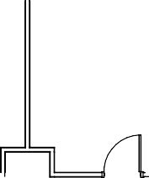






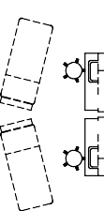

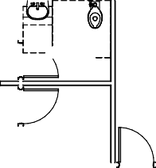



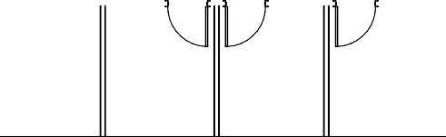










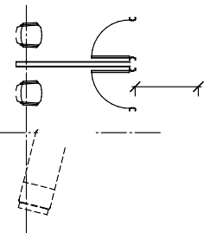



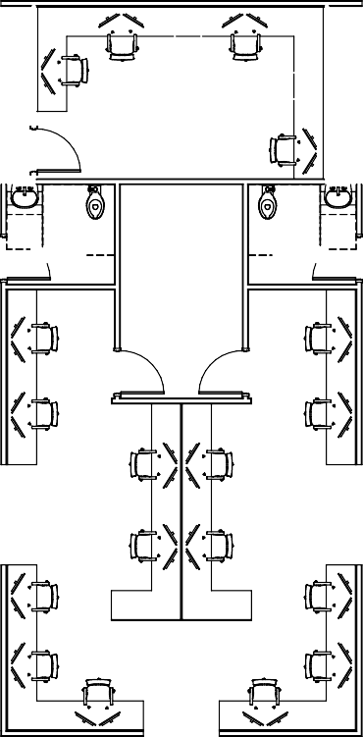

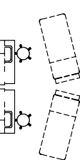


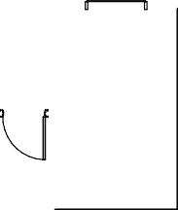

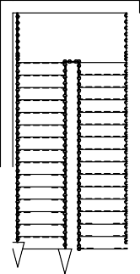

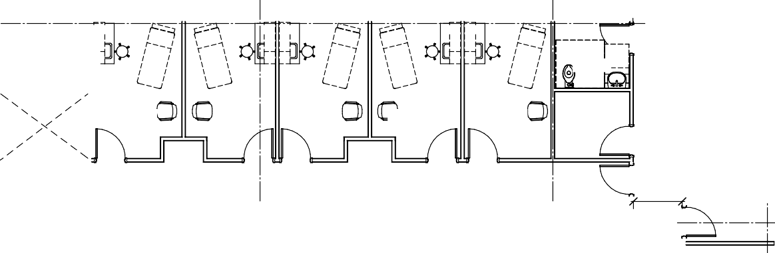






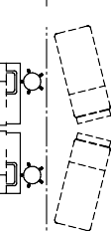
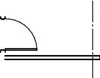



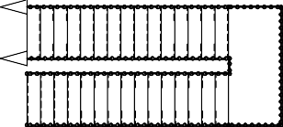

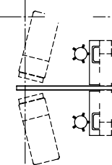

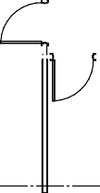



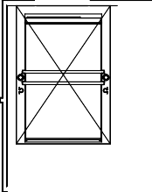

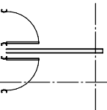

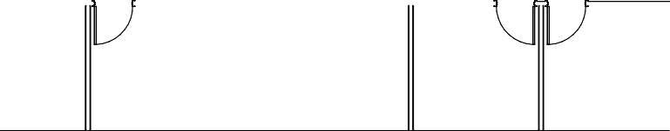
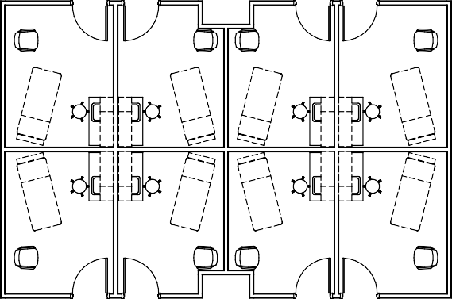
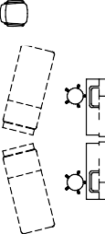




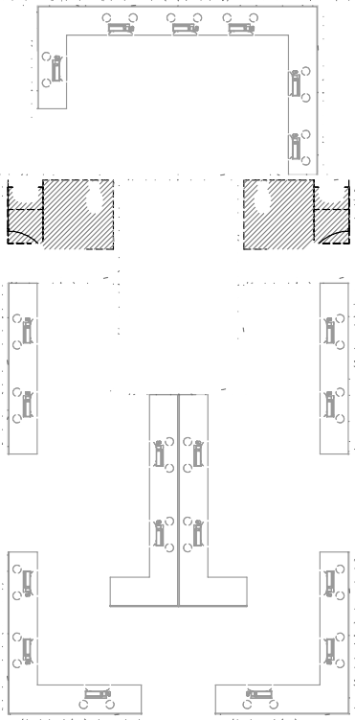
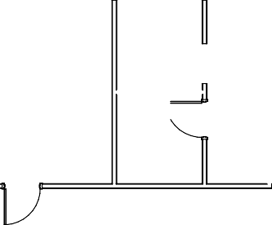
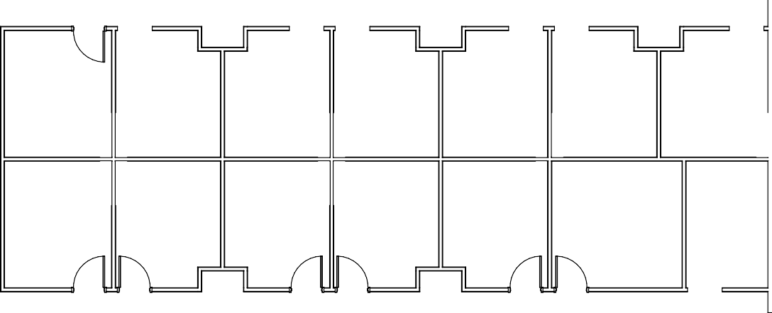


Slide 3
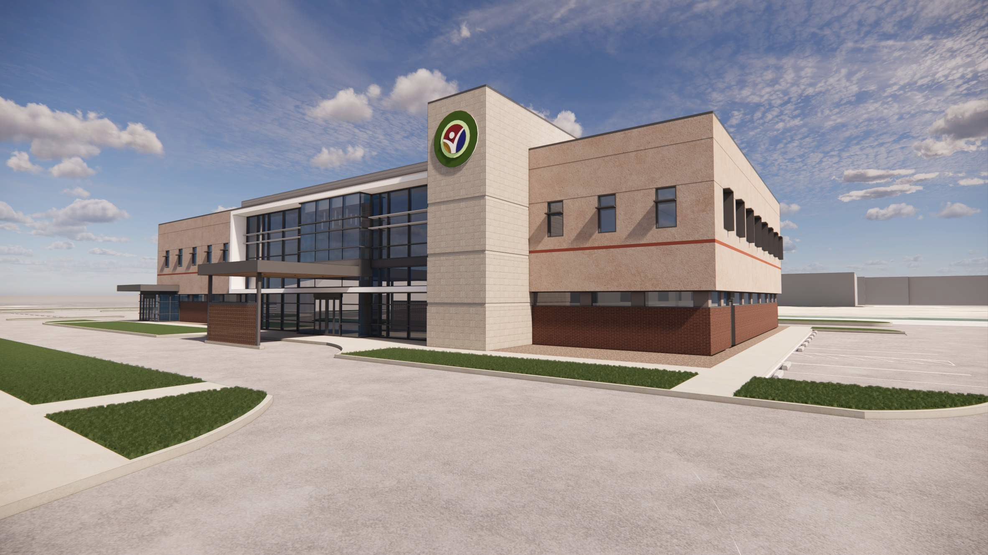


Slide 4
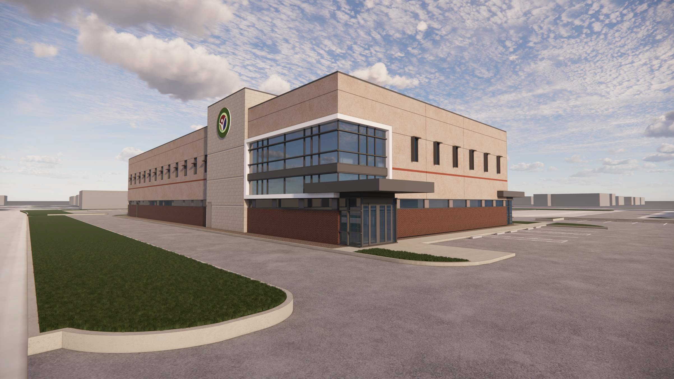


Slide 5
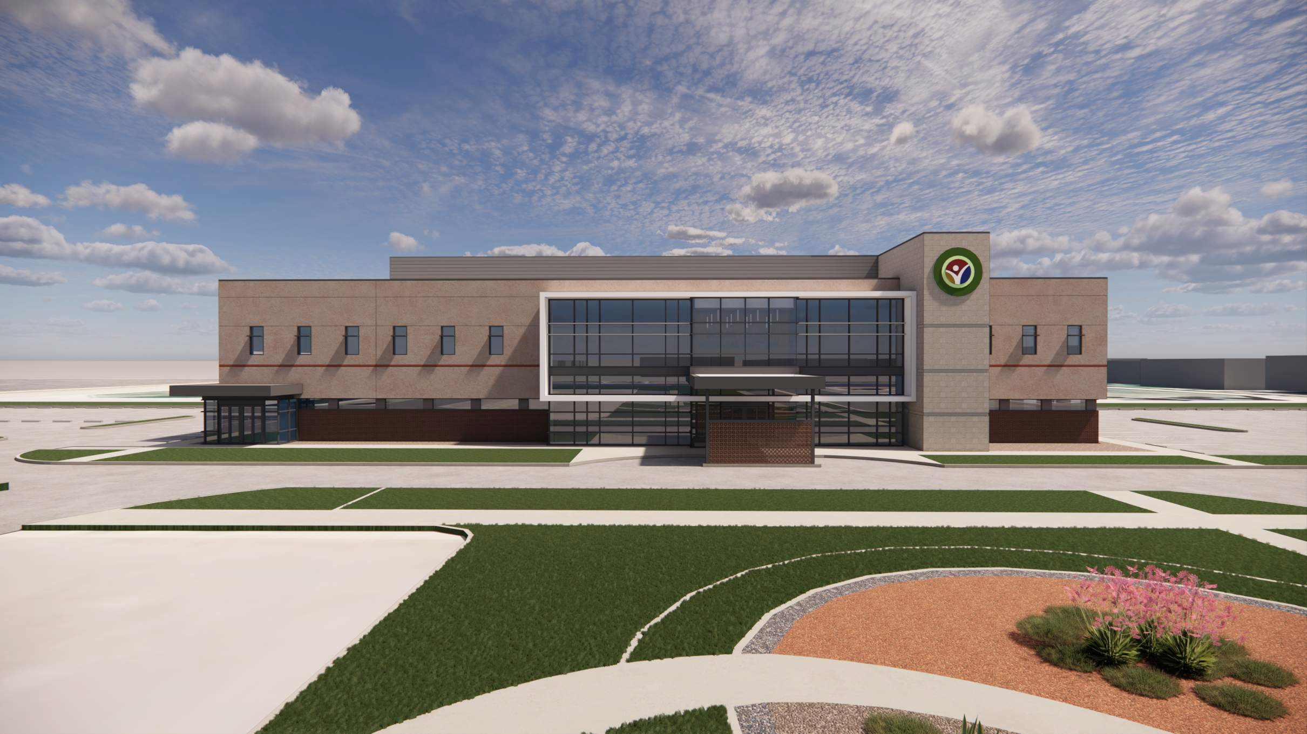

Slide 6
