Slide 1
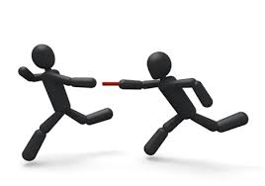

This is only the beginning.
STEP ONE
“A journey of a thousand miles begins with a single step”- Lao Tzu

Slide 2
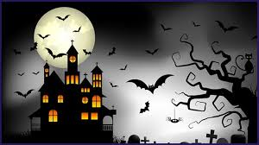

Slide 3
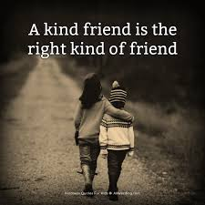

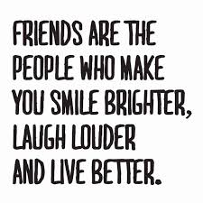
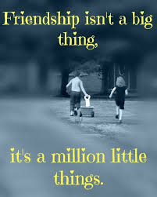

Slide 4

Regardless of the impression others have of you – YOUR-self impression and the impressions we leave count the most!

Slide 5
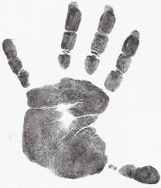

Mindfulness Meditation
Notes:
Remember your FIVE FINGER BREATHING TECHNIQUE and use it whenever you’re feeling anxious and need to calm yourself down. It can be used anywhere and it your friends don’t know how to do it, well you do so. Show them how to do it.
EACH ONE TEACH ONE

Slide 6
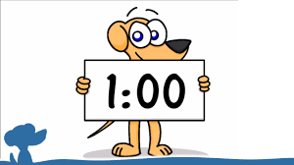
1 Minute Challenge
Notes:
Remember this game?
Play it at home with your family members and see who gets closest to the minute.

Slide 7


“Teach the heart and the mind will follow”

