Slide 1
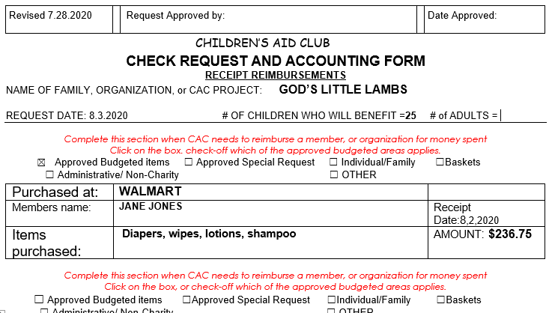
CREATING A CHECK REQUEST > FOR A MEMBER REIMBURSMENT
SLIDE 1 OF 2 SLIDES – TOP OF PAGE
1.Enter the Family name if Individual Family, OR Name of Organization, OR Name of Project.
2. Enter the date you are Requesting approval next to the REQUEST DATE and the # 0f CHILDREN & ADULTS that will benefit from this funding.
3. Select the appropriate funding category and click on the box.
4. Begin filling in the information requested within this area.

Slide 2
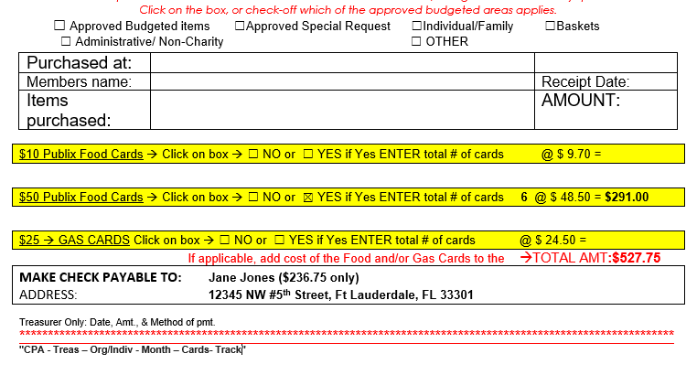
CREATING A CHECK REQUEST > FOR MEMBER REIMBURSMENT SLIDE 2 0f 2
5.In the event Food Cards are
part of the Check Request click on the Yes or No box. If Yes then enter the # of cards in the blank space review the example shown. Then using the cost times the number of cards place the total cost for the cards in the space provided. Be sure to then add the amount from slide 1, if applicable. In this example the amount from slide 1= $236.75 + cost for cards $291.00 = Total Amount $527.75
Finally, member enters their name and address in the Check Payable area in the space provided. . It is best to note the amount to be reimbursed in the Make Check Payable area.
SPECIAL NOTE:
Reimbursements to a member should not include the total that is listed for Food and/or Gas Cards.
X
X
6
6. Once the member completes the form with all the required information it is to be sent with the related receipt(s), and/or invoice(s) to the Organization Chair for approval with a copy to the Welfare Chair. The Chair approving the Request will send it off to the Treasurer for reimbursement.

Slide 3
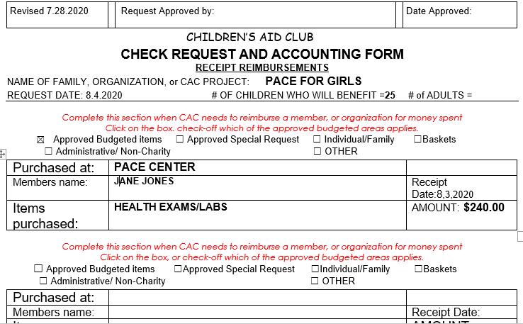
CREATING A CHECK REQUEST > FOR ORGANIZATION REIMBURSMENT
1.Enter the Name of Family if Individual Family, OR Name of Organization, OR Name of Project
2. Enter the date you are Requesting approval next to the REQUEST DATE and the # 0f CHILDREN & ADULTS that will benefit from this funding.
.
SLIDE 1 OF 2 SLIDES – TOP OF PAGE
3. Select the appropriate funding category and click in the box.
4. Begin filling in the information requested within this area.

Slide 4
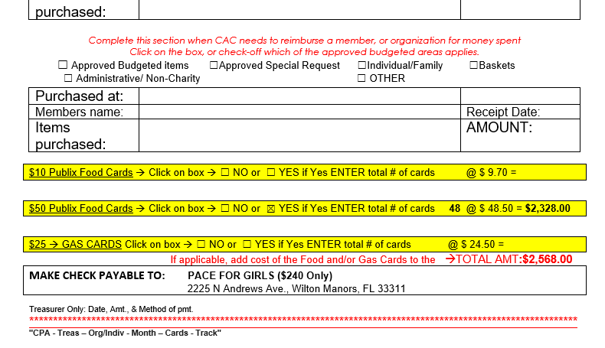
CREATING A CHECK REQUEST > FOR AN ORGANIZATION REIMBURSMENT SLIDE 2 0f 2 - BOTTOM OF PAGE
5.In the event Food Cards are
part of the Check Request click on the Yes or No box. If Yes then enter the # of cards in the blank space review the example shown. Then using the cost times the number of cards place the total cost for the cards in the space provided. Be sure to then add the amount from slide 1, if applicable. In this example the amount from slide 1 is $240.00 + cost for cards $2,328.00 = Total Amount $2,568.00
Finally, member enters the name of the Organization and their address in the Check Payable area in the space provided. It is best to note the amount to be reimbursed in the Make Check Payable area.
SPECIAL NOTE:
Reimbursements to an organization should not include the total that is listed for Food and/or Gas Cards.
6. . Once the member completes the form with all the required information it is to be sent with the related receipt(s), and/or invoice(s) to the Organization Chair for approval with a copy to the Welfare Chair. The Chair approving the Request will send it off to the Treasurer for reimbursement.

